Slide 1
Year 4

Slide 2
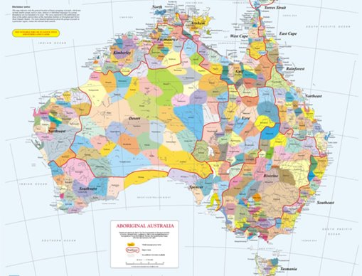
Acknowledgement
[Name of school/class] acknowledges Country, Custodians and Community of the lands on which we are on today [insert name of land/ peoples].
We also pay our respects to Elders and to Stolen Generations survivors, of the Dreaming and of the here and now.
We recognise the ongoing nature of trauma experiences for First Nations peoples and commit each day to survivor-led intergenerational healing.
Notes:
Update this slide with the name of your school/ class and the name of the land/s on which you're presenting the lesson on.
You may choose to make the wording of this acknowledgement more specific to your land/school/experiences. The acknowledgement isn't a script that we have to follow, you may even introduce the unit by working with students to write an acknowledgement for your class.
Image credit: https://ipaustralia.libguides.com/c.php?g=451400&p=3082380

Slide 3
Aboriginal and Torres Strait Islander students and teachers should be aware that these resources may contain the names, images, and voices of deceased persons.
Notes:
Important to remind students to speak up if they are feeling discomfort, and any safety and wellbeing measures your school has in place.

Slide 4
Care and safety
These lessons might include some content that is confronting or overwhelming
We all need to understand a full history of Australia, including the experiences of Stolen Generations survivors, their families and communities, and the impacts of past government policies that are still being felt today
It is important to speak to me or another adult if at any point you feel distressed – we are all here to learn together and keep each other safe.
Notes:
Important to remind students to speak up if they are feeling discomfort, and any safety and wellbeing measures your school has in place.
This is also a good place to ask the cultural safety questions from the educator's guide so you can co-construct a culturally safe space with your students.

Slide 5
Healing together
Why is learning about the Stolen Generations important?
  to change the way we look at our collective history.
  to support reconciliation and an honest understanding of our past – not just one perspective.
  to become aware of past government policies that still affect many Aboriginal and Torres Strait Islander peoples and families today.
Notes:
Give students a chance to suggest why they think the learning is important before clicking through to the reasons.

Slide 6
Overview: this week’s activities
ACTIVITY 1: LITERATURE INTRODUCTION AND RESPONSE TO ILLUSTRATION (40–60 MINUTES)
Teacher leads students in a guided reading session. Students respond to questions about the text and closely analyse an illustration.
ACTIVITY 2: TIMELINE ACTIVITY (40–60 MINUTES)
Students complete a timeline of significant dates in Aboriginal and Torres Strait Islander history and compare to their own personal timeline.
ACTIVITY 3: LISTENING TO STORIES (40–60 MINUTES)
Students work in groups to listen and respond to personal stories told by members of the Stolen Generations.
ACTIVITY 4: SHARING LEARNING AND PERSUASIVE LETTER WRITING (30–40 MINUTES)
Students reflect on and share their learning by writing a letter to a family member, friend or member of the school community to urge them to watch the stories of members of the Stolen Generations.
Notes:
OPTIONAL SLIDE
Update week to timeframe for these teaching activities in consideration of class schedule and activity time.

Slide 7
Cultural Safety
How does a safe classroom look to you?
How does it feel?
How can we be culturally safe?
Notes:
You may have already established this as a class, if so, use this time to reiterate the class rules.
Begin a discussion about cultural safety with the class. Ask them to answer the questions in a 'think/pair/share' activity, or address them as a group.
Use the final question to lead in to the next slide.

Slide 8
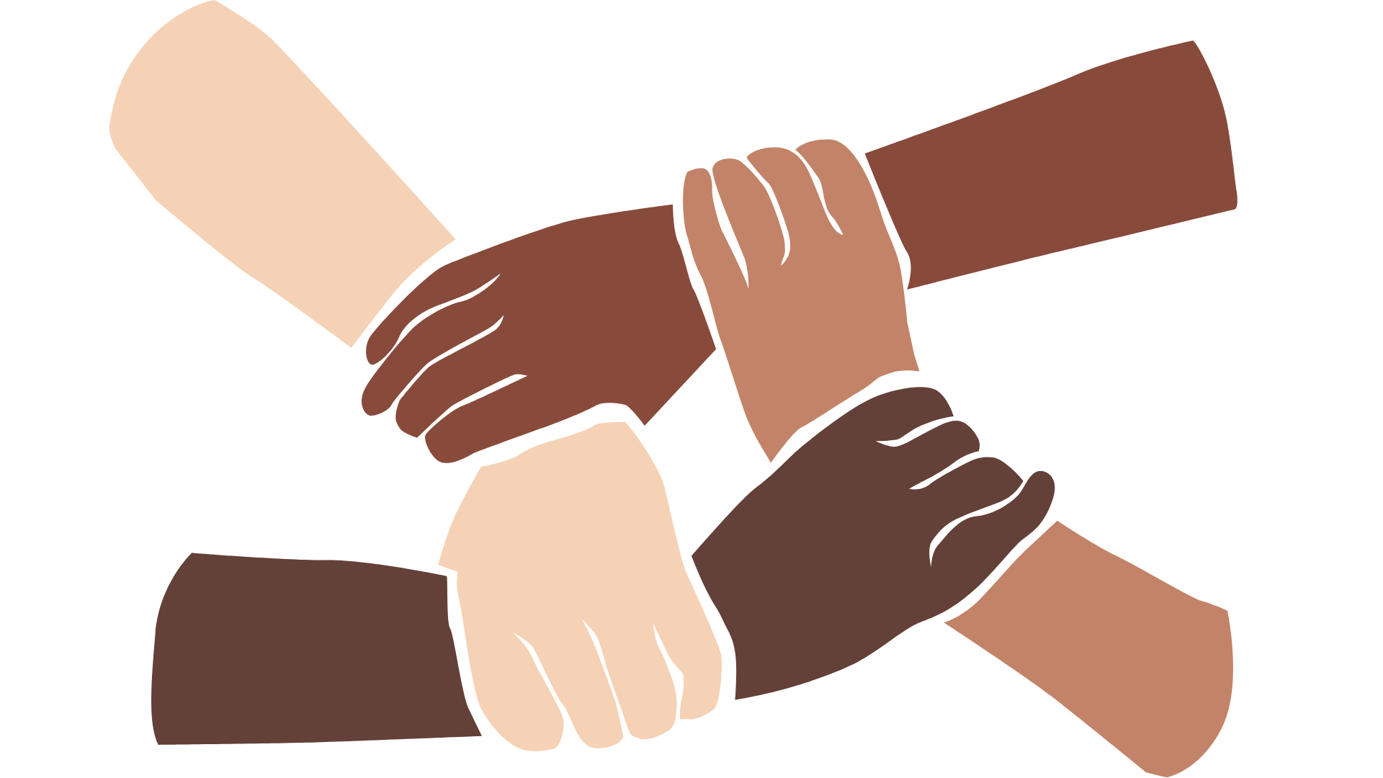
Cultural Safety
Open mindedness
Respect
Honest communication
Being mindful of privilege
Notes:
A culturally safe classroom environment relies on open-mindedness, respect and honest communication.
Make any changes needed for this discussion to be age-appropriate for your class
Image credit: Sketchify from Canva

Slide 9

Terminology
Sorry
Country
Aboriginal
Reconciliation
Colonisation
Culture
Torres Strait Islander
Notes:
Optional: Use to guide the creation of a word wall

Slide 10
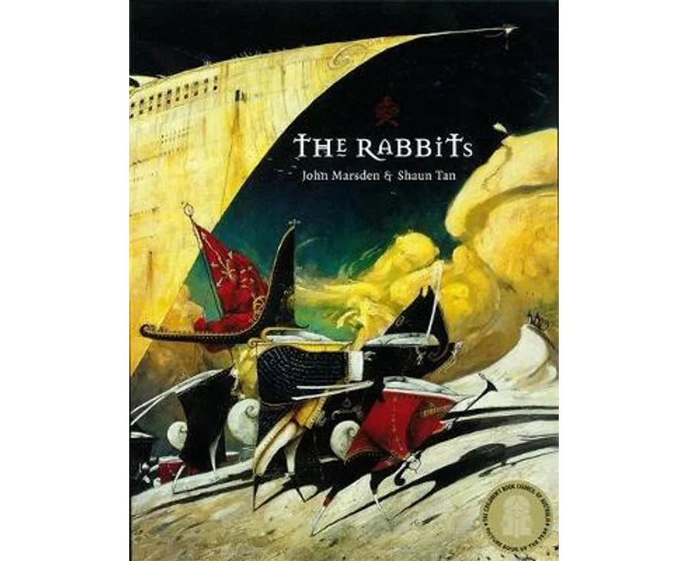

Activity 1:
Literature Introduction and response to illustration
Notes:
In this lesson, students will be led in a guided reading session. Students respond to questions about the text and closely analyse an illustration.
Resources:
Book for this session: The Rabbits by John Marsden and Shaun Tan.
Perspectives table (Appendix 1) displayed on board, printed on A3 paper or drawn on butchers’ paper.
Pens/sharpies.
Responding to Illustration worksheet (Worksheet 1).
Colour print out or projection of the page ‘And stole our children’ from The Rabbits.

Slide 11
Aboriginal and Torres Strait Islander Culture and history:
What do you know?
Notes:
Encourage students to share what they know about the Aboriginal and Torres Strait Islander culture and history.
Use this opportunity to explain appropriate terminology we will be using during this unit.
If students bring up the Stolen Generations, this is a good time to move on to the next slide.

Slide 12
The Stolen Generations:
What do you know?
Notes:
Encourage students to share what they know about the Stolen Generations. Use the next slide to explain what happened in more detail.

Slide 13
The Stolen Generations
For about one hundred years, thousands of First Nations children were systematically taken from their families, communities and culture, many never to be returned. These children are known as Stolen Generations survivors.
Notes:
More information:
This happened from the mid-1800s to the 1970s. In the 1860s, Victoria became the first state to pass laws authorising the removal of First Nations children from their families.
Similar policies were later adopted by other states and territories – and by the federal government when it was established in the 1900s.
For about a century, thousands of children were taken from their families, communities and culture, many never to be returned.
These children are known as Stolen Generations survivors, or Stolen Children. They were taken by the police, from their homes, and on their way to or from school, and placed in more than 480 institutions, adopted or fostered by non-Indigenous people and often subjected to abuse. The children were denied all access to their culture, they were not allowed to speak their language and they were punished if they did.
There are currently more than 33,000 Stolen Generations survivors in Australia. More than one third of all First Nations peoples are their descendants. In Western Australia, more than half of the population have Stolen Generation links.

Slide 14
Read book: The Rabbits by John Marsden and Shaun Tan
Notes:
Read The Rabbits by John Marsden and Shaun Tan.
Explain the book as an allegory for the arrival of Europeans in Australia and their impact on Aboriginal and Torres Strait Islander people and the environment.
Facilitate a class discussion. You might ask:
What did you like about the story?
What did you learn from the story?
Are there any words in the story that are new to you?
Use a sentence to describe how the book made you feel.
How does the book use illustration to help us feel something? Is there a particular illustration that made you feel something?
Do you recognise any parts of the book as a part of Australian history?

Slide 15
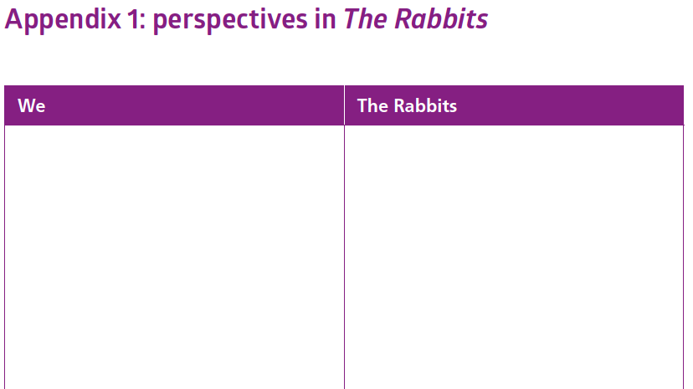
Perspective Activity
Notes:
Check for student understanding of relevant terms: perspective, colonisation, European, Aboriginal and Torres Strait Islander. Add these to the word wall. (Refer back to terminology slide)
Introduce the task. Show students an enlarged version of the Perspectives worksheet (Appendix 1).
Ask students for one word suggestions of the perspective of both the ‘Rabbits’ and the ‘We’. To prompt discussion you could turn to specific pages of the book and ask:
How would the 'We' feel in this part of the story?
How would the Rabbits feel in this part of the story?

Slide 16
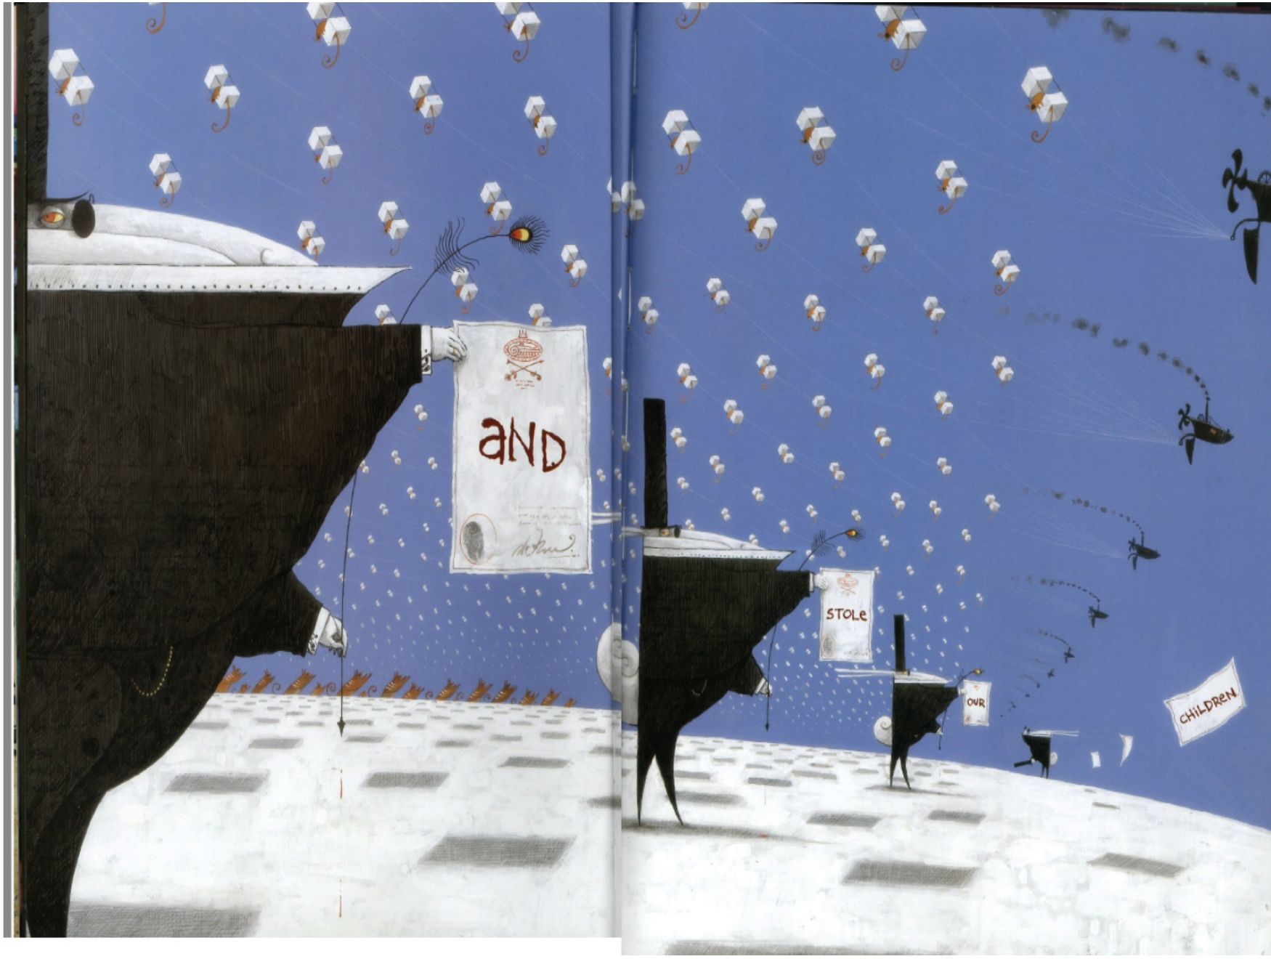
Responding to illustrations
Worksheet 1
Colour
Composition (where things are in the illustration)
Focus
Symbolism
Notes:
Turn to the page in the book that says ‘And stole our children.’ If possible, project a large colour version of this page.
Hand out Response to Illustration worksheet (Worksheet 1).
Model how to identify the features above.
Explain to students that this worksheet is asking for their own personal responses and viewpoints.
Students complete this worksheet individually.
Image source: https://st-marys.hackney.sch.uk/wp-content/uploads/2021/01/The-Rabbits-story-PDF.pdf

Slide 17
Conclusion:
Share your thoughts and feelings
Notes:
Once worksheet is completed, facilitate a class discussion to share thoughts and feelings.

Slide 18

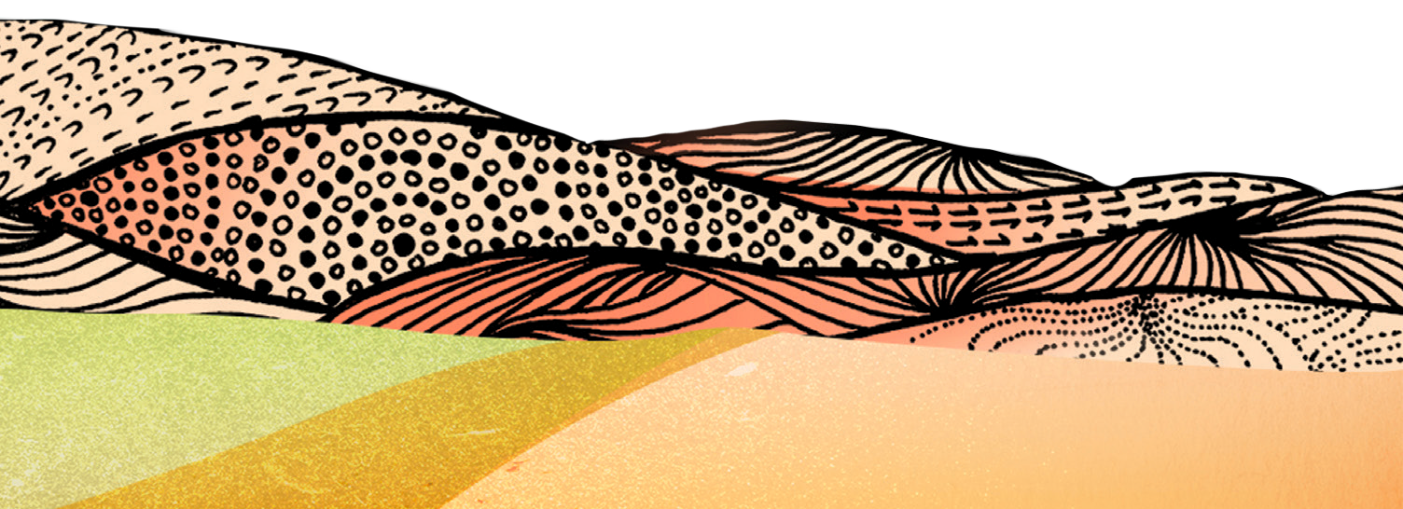

Activity 2:
Timeline Activity
Notes:
Students complete a timeline of significant dates in Aboriginal and Torres Strait Islander history and compare to their own personal timeline.
Resources
Suggested book for this session: Sorry Day by Coral Vass and Dubb Leffler.
The Story of The Healing Foundation video.
Other suggested videos for this session (both of these videos contain significant dates and would also work for the timeline activity. If you are unable to play videos, there are also full transcripts of these segments on the website).
BTN Apology 10th Anniversary.
BTN Stolen Generations.
Timeline worksheet (Worksheet 2).
Whole class timeline. You might wish to project a digital copy of Worksheet 2 to complete as a class, or you could draw a large version of the timeline on butchers’ paper and stick it to the board for this activity.

Slide 19

Read book: Sorry Day by Coral Vass and Dub Leffler
Notes:
Read Sorry Day by Coral Vass and Dub Leffler or another book from your classroom library
Facilitate a class discussion. You might ask:
What did you like about the story?
What did you learn from the story?
Are there any words in the story that are new to you?
Use a sentence to describe how the book made you feel.
How does the book use illustration to help us feel something? Is there a particular illustration that made you feel something?
Do you recognise any parts of the book as a part of Australian history?

Slide 20
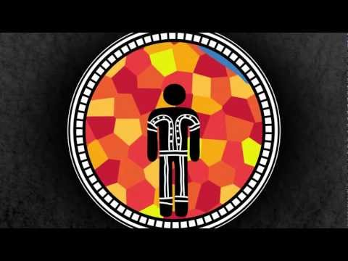
Video response: The Story of the Healing Foundation
Notes:
Link: https://www.youtube.com/watch?v=zDN7R6qRpUg
Introduce students to the activity:
We are going to watch a video about some of the history of the Stolen Generations. You may have seen this video before, but when you watch it this time you need to listen for the significant dates mentioned. We are going to use these dates to start shaping a timeline of Aboriginal and Torres Strait Islander history.
Play the video.

Slide 21
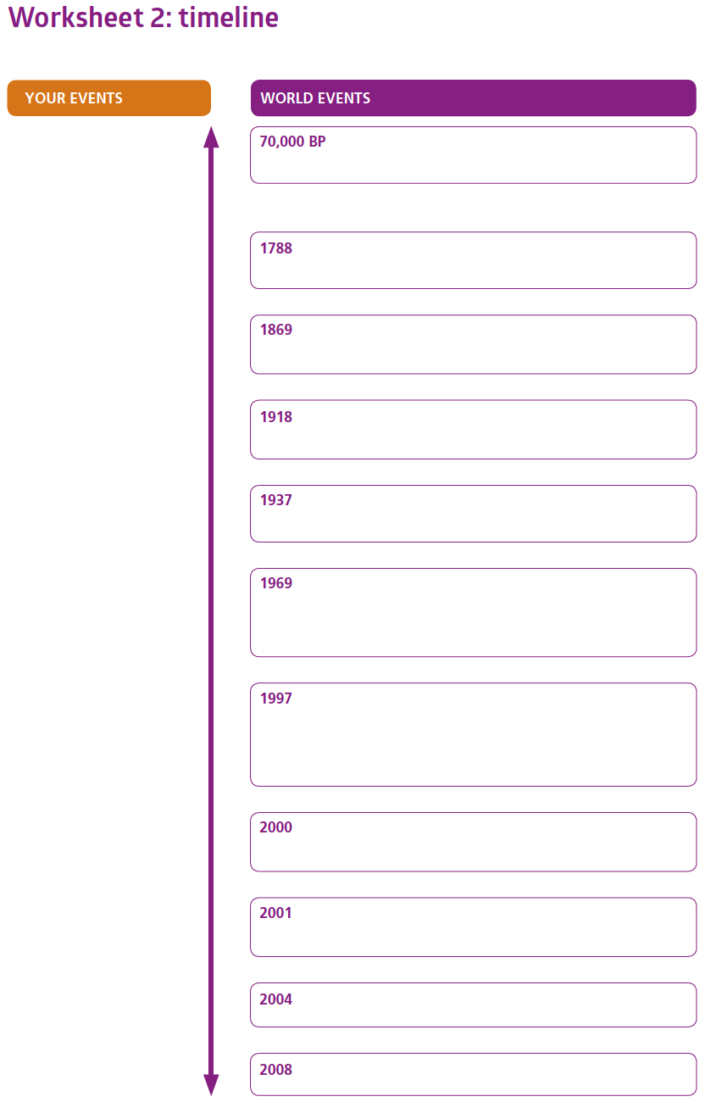
Creation of Timeline
Notes:
Draw a large version of the timeline on the board.
Hand out the Timeline worksheet (Worksheet 2).
Ask students what significant dates they heard during the video. They should be able to name these dates and some may be able to tell you the event (note: some dates are part of a stylistic choice of the animation rather than pertinent to the timeline):
70 000 BP (Before Present) Aboriginal people and culture present in Australia
1788 Arrival of first Europeans
2008 National Apology to the Stolen Generations.
As students tell you the dates they have seen, explain and fill in the event on the timeline. Students should copy these events to their own timeline as well.
Use the Answers Sheet (Worksheet 2b) to read out significant events in random order. Do not give students the associated dates. Using their own judgment and information they already have on the timeline, students work as a class to match the event to the year. Students may be surprised by how recent some of the events are.
OR
print copies of the timeline, blocking out the years, and cut it into each entry so students can build timelines themselves
ANSWERS ON NEXT SLIDE

Slide 22
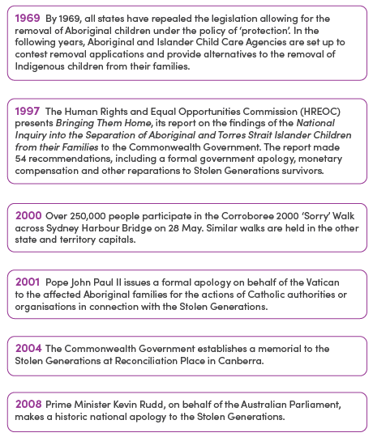
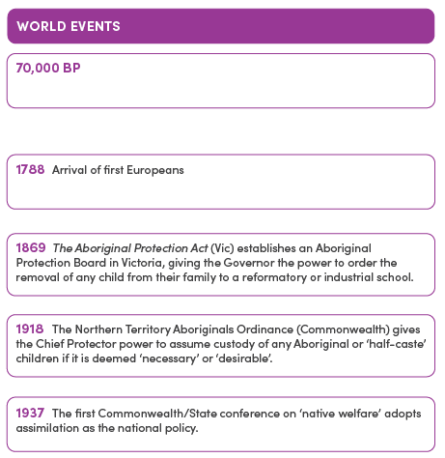
Creation of Timeline: Answers
Notes:
Use this as a guide for students to mark their own timelines.

Slide 23
Personal Timeline
Some events you could add to your timeline:
the year you were born
the year you started started school
the year your brothers and sisters were born
the year your parents, guardians or grandparents were born.
Notes:
To contextualise the dates, ask students to fill out the ‘Your Timeline’ side:
Some of these events happened a long time ago but some are quite recent. To get a better idea of that, on the ‘Your Timeline’ side, you are going to record some significant events related to you and your family. Estimate where your birth year would be on the timeline and add it in. Check the other side of the timeline and see what was happening around the year you were born.
You could also ask students to add in:
the year they started school
the year their siblings were born
the year their parents or grandparents were born.
This activity could also become homework as students could work with a parent or carer to add significant events.
Once timelines are completed, the class can discuss some significant personal events and add them to the class timeline (e.g. you will end up with nearly all students having the same birth year and so this can be easily added).

Slide 24
Conclusion:
Share your learning
Notes:
Facilitate a discussion about what students have learned so far about the Stolen Generations.
To prompt discussion ask students:
Have you been surprised by anything you have learnt so far?
Why do you think it is important for us to learn about this?
What are some other ways we could learn about the Stolen Generations?

Slide 25
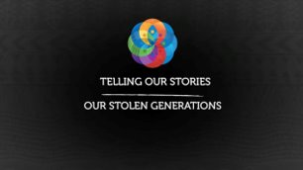
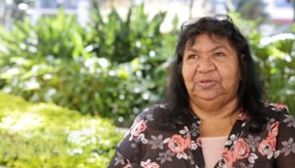
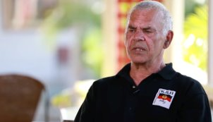
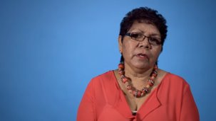
Activity 3:
Listening to Stories
Notes:
Students work in groups to listen and respond to personal stories told by members of the Stolen Generations.
Resources:
Suggested book: Tell Me Why by Robyn Templeton and Sarah Jackson.
Listening to Stories worksheet (Worksheet 3).
Three stations with iPads or computers with internet access and headphones (optional):
Station 1: Florence Onus.
Station 2: Fay Clayton-Mosely.
Station 3: Michael Welsh (please note: language warning).

Slide 26
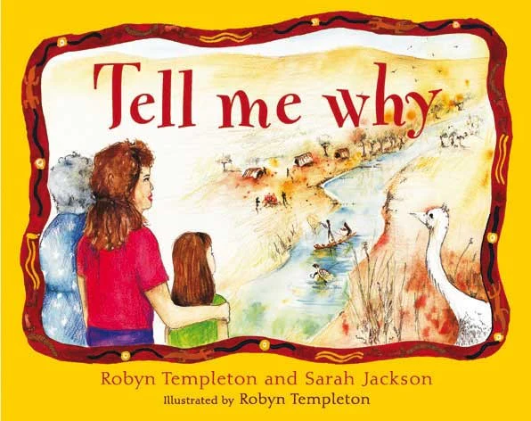
Read book: Tell Me Why by Robyn Templeton and Sarah Jackson
Notes:
Read Tell me Why by Robyn Templeton and Sarah Jackson or another book from your classroom library
Facilitate a class discussion. You might ask:
What did you like about the story?
What did you learn from the story?
Are there any words in the story that are new to you?
Use a sentence to describe how the book made you feel.
How does the book use illustration to help us feel something? Is there a particular illustration that made you feel something?
Do you recognise any parts of the book as a part of Australian history?

Slide 27
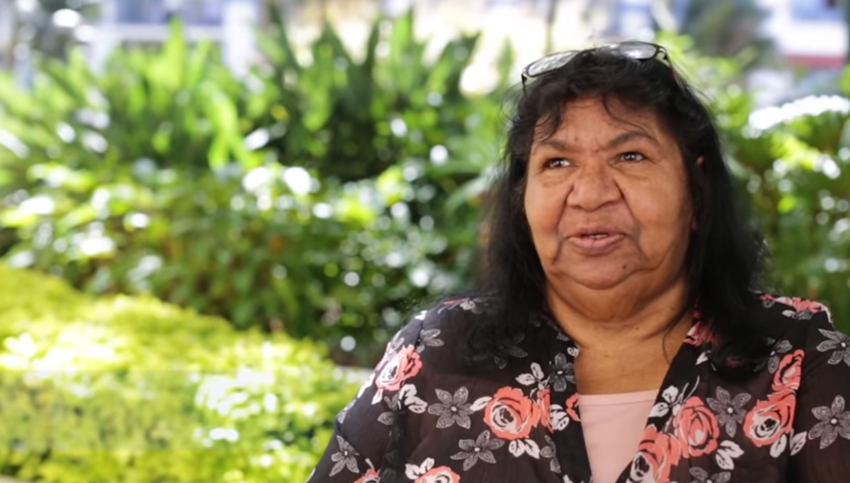
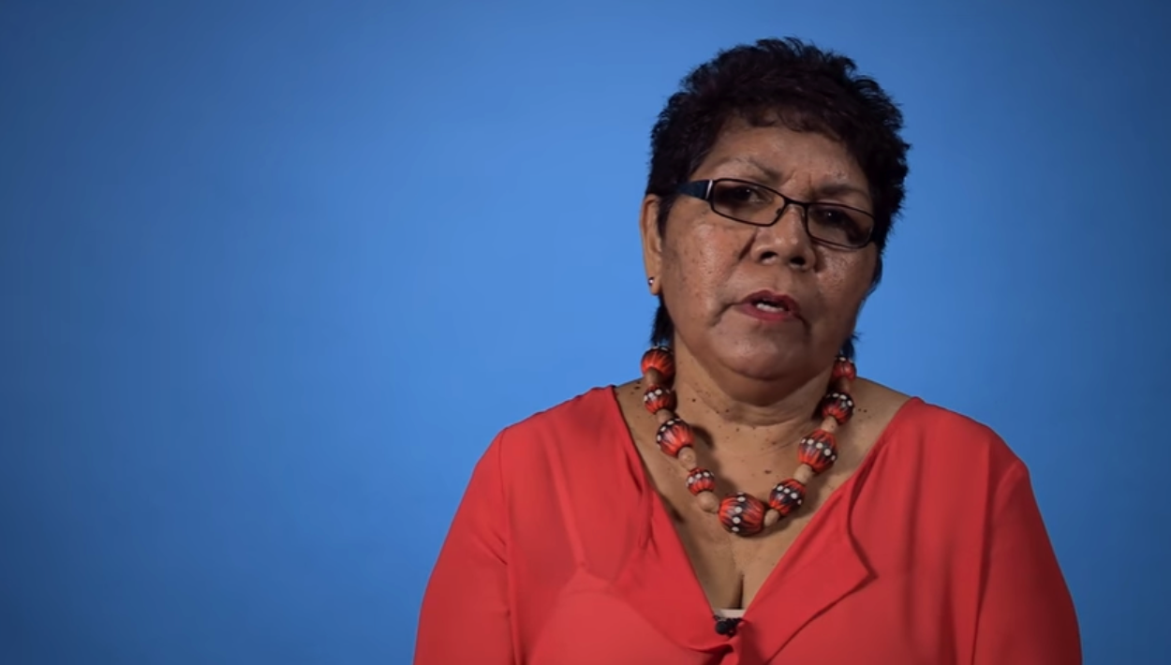
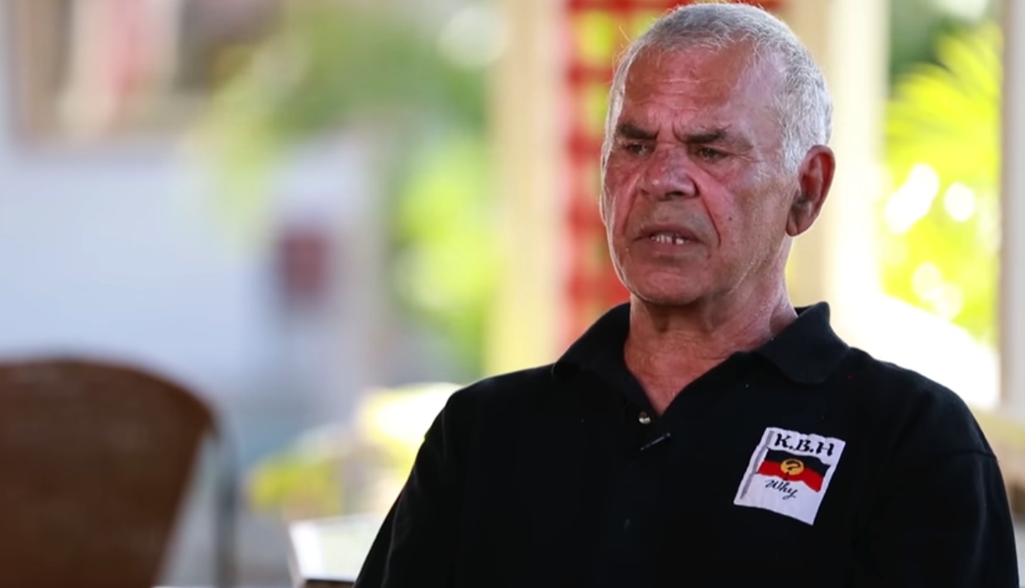
Listening and Responding to stories
Notes:
Contextualise this activity by recapping the last activity.
In the last activity, we discussed how recent some of the events of the Stolen Generations really are. Many members of the Stolen Generations are still alive today and still feel the impact of their removal. Today we are going to listen to the stories of three members of the Stolen Generations. These stories are sometimes difficult to hear, and it is ok to feel sad or angry when you listen. As you listen, also consider this question: Why is it important to hear the stories of Stolen Generations members?
Show students worksheet 3 and explain the questions in more detail.
Break students into three groups and assign each group to one station. Ask groups to appoint a speaker who will share information with the rest of the class.
In groups, students listen to the story, discuss and then each student will fill out their worksheet individually. Each group will only listen to one story, no rotation.
AFTER students have completed the worksheet, bring the class back together for a viewing of each video. At the end of each video, the speaker from that group presents the group’s response to the story.

Slide 28
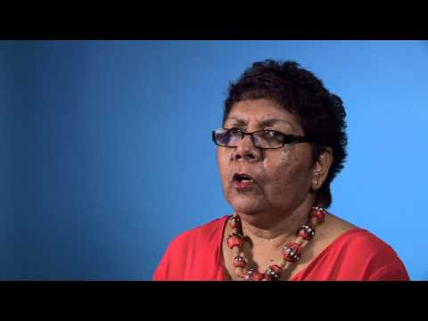
Listening and responding to stories: Florence Onus
Notes:
Link: https://www.youtube.com/watch?v=CzExWBCuuyg
Bring the class back together for a viewing of each video. At the end of each video, the speaker from that group presents the group’s response to the story.
Questions on worksheet:
What were some major events in the Elder's history?
How does the Elder describe there experience of being removed from their family?
Were other people impacted by their removal? Who?
How is the Elder healing themselves?
What does the Elder think needs to happen in the future to help members of the Stolen Generations and Aboriginal and Torres Strait Islander people?

Slide 29
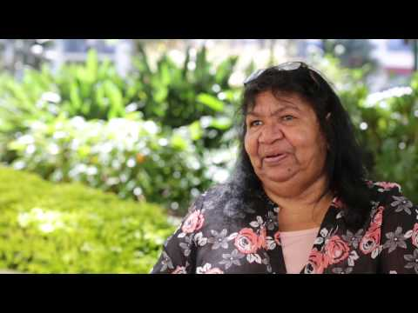
Listening and responding to stories: Faye Clayton
Notes:
Link: https://www.youtube.com/watch?v=kDs0oTYZqeE
Bring the class back together for a viewing of each video. At the end of each video, the speaker from that group presents the group’s response to the story.
Questions on worksheet:
What were some major events in the Elder's history?
How does the Elder describe there experience of being removed from their family?
Were other people impacted by their removal? Who?
How is the Elder healing themselves?
What does the Elder think needs to happen in the future to help members of the Stolen Generations and Aboriginal and Torres Strait Islander people?

Slide 30
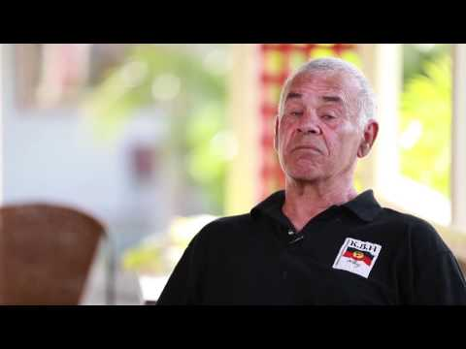
Listening and responding to stories: Michael Welsh
Notes:
Link: https://www.youtube.com/watch?v=TxtJGyZhq0k
Bring the class back together for a viewing of each video. At the end of each video, the speaker from that group presents the group’s response to the story.
Questions on worksheet:
What were some major events in the Elder's history?
How does the Elder describe there experience of being removed from their family?
Were other people impacted by their removal? Who?
How is the Elder healing themselves?
What does the Elder think needs to happen in the future to help members of the Stolen Generations and Aboriginal and Torres Strait Islander people?

Slide 31
Conclusion:
Discuss similarities in the stories
Notes:
Hold a class discussion about the similarities in the stories
To prompt discussion you might ask:
How did these stories relate to the books we have been reading?
Was there a common idea or message in these stories?
What important message did you take from these stories?
How did watching the stories make you feel?
How old do you think these speakers are? What does this tell you about the history of the Stolen Generations?
Why do you think it is important to hear these stories?
Students need to keep these sheets somewhere safe to use in the next activity.
Add extra words to your classroom word wall.

Slide 32
Activity 4:
Sharing learning and persuasive letter writing
Notes:
Students reflect on and share their learning by writing a letter to a family member, friend or member of the school community to urge them to watch the stories of members of the Stolen Generations.
Resources
Completed Listening to Stories worksheets for reference (Worksheet 3).
Completed timeline for reference.
Lesson plan for teaching persuasive letter writing, if you require it.
Planning your Letter worksheet (Worksheet 4).

Slide 33
Persuasive Text
Write a persuasive letter using:
The worksheet from activity three
The Planning Your Letter template
Features of a persuasive letter
Repetition
Rhetorical questions
Emotive language
Notes:
Introduce students to the task. They are going to reflect on what they have been learning by writing a persuasive letter to a family member, friend or someone in the school community telling them why they think it is important they watch videos of the stories of Stolen Generations members.
Remind students of the conventions of a persuasive letter: repetition, rhetorical questions, emotive language. Model persuasive letter writing if your class requires it.
Guide students to use the worksheet to plan a draft of their letter before completing a good copy.

Slide 34
Conclusion:
Share your letter
Notes:
Students share their letter with a partner or with the class.
To legitimise the activity, students should deliver the letter to the intended recipient.

Slide 35
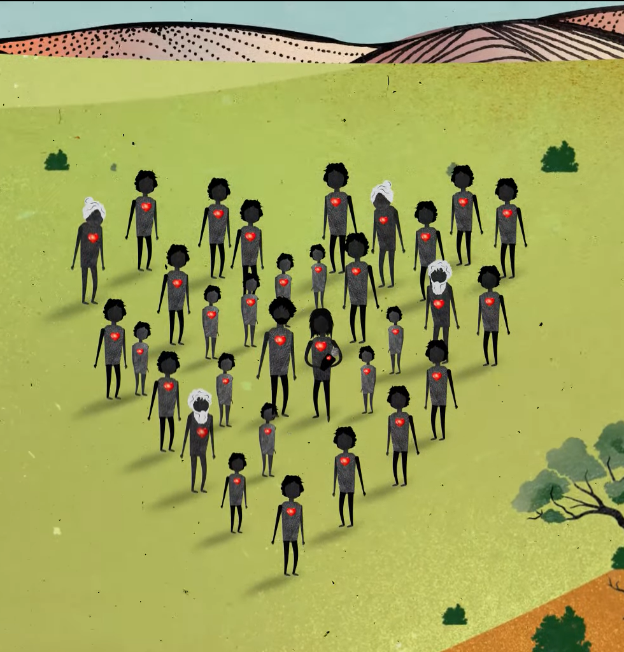
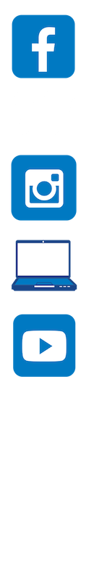
Contact The Healing Foundation
@HealingFoundation
@healingourway
@healingourway
www.healingfoundation.org.au
Healing Foundation
Notes:
Consider:
Sharing your outcomes and experience with The Healing Foundation at resources@healingfoundation.org.au
Sharing the resource and how you used it amongst your networks.
Sharing your students’ learning journey and tag The Healing Foundation on Instagram @healingourway and on Facebook as ‘Healing Foundation’.

