Slide 1
Year 12

Slide 2
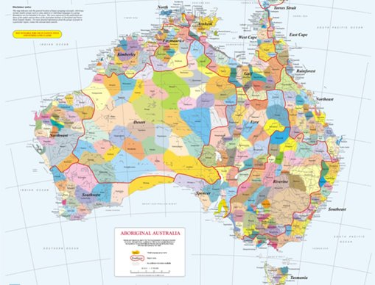
Acknowledgement
[Name of school/class] acknowledges Country, Custodians and Community of the lands on which we are on today [insert name of land/ peoples].
We also pay our respects to Elders and to Stolen Generations survivors, of the Dreaming and of the here and now.
We recognise the ongoing nature of trauma experiences for First Nations peoples and commit each day to survivor-led intergenerational healing.
Notes:
Update this slide with the name of your school/ class and the name of the land/s on which you're presenting the lesson on.
You may choose to make the wording of this acknowledgement more specific to your land/school/experiences. The acknowledgement isn't a script that we have to follow, you may even introduce the unit by working with students to write an acknowledgement for your class.
Image credit: https://ipaustralia.libguides.com/c.php?g=451400&p=3082380

Slide 3
Aboriginal and Torres Strait Islander students and teachers should be aware that these resources may contain the names, images, and voices of deceased persons.
Notes:
Important to remind students to speak up if they are feeling discomfort, and any safety and wellbeing measures your school has in place.

Slide 4
Care and safety
These lessons might include some content that is confronting or overwhelming
We all need to understand a full history of Australia, including the experiences of Stolen Generations survivors, their families and communities, and the impacts of past government policies that are still being felt today
It is important to speak to me or another adult if at any point you feel distressed – we are all here to learn together and keep each other safe.
Notes:
Important to remind students to speak up if they are feeling discomfort, and any safety and wellbeing measures your school has in place.
This is also a good place to ask the cultural safety questions from the educator's guide so you can co-construct a culturally safe space with your students.

Slide 5
Healing together
Why is learning about the Stolen Generations important?
  to change the way we look at our collective history.
  to support reconciliation and an honest understanding of our past – not just one perspective.
  to become aware of past government policies that still affect many Aboriginal and Torres Strait Islander peoples and families today.
Notes:
Give students a chance to suggest why they think the learning is important before clicking through to the reasons.

Slide 6
Cultural Safety
How does a safe classroom look to you?
How does it feel?
How can we be culturally safe?
Notes:
You may have already established this as a class, if so, use this time to reiterate the class rules.
Begin a discussion about cultural safety with the class. Ask them to answer the questions in a 'think/pair/share' activity, or address them as a group.
Use the final question to lead in to the next slide.

Slide 7
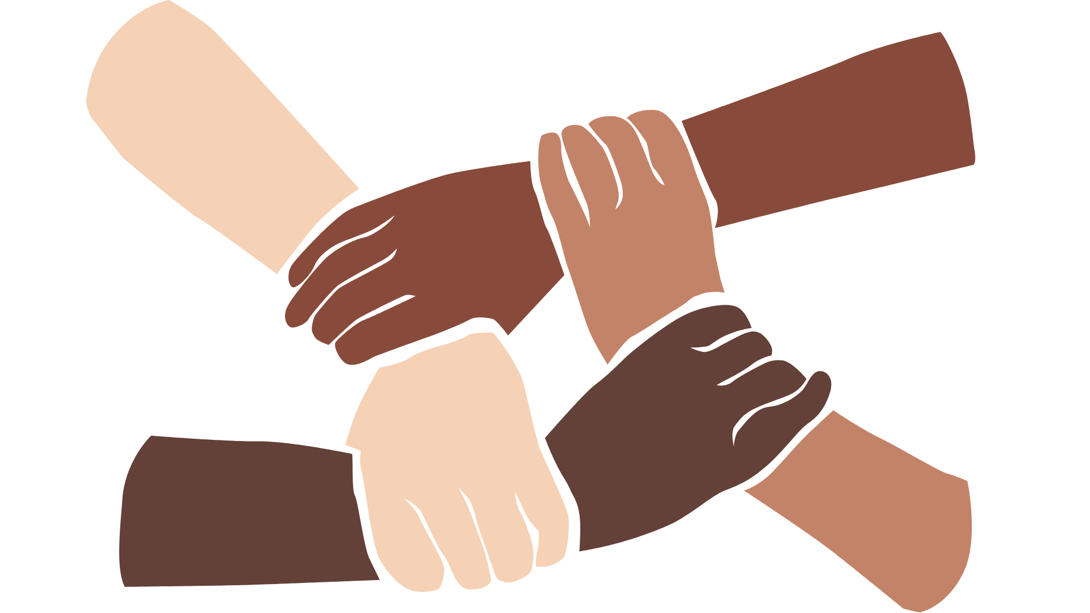
Cultural Safety
Open mindedness
Respect
Honest communication
Being mindful of privilege
Notes:
A culturally safe classroom environment relies on open-mindedness, respect and honest communication.
Make any changes needed for this discussion to be age-appropriate for your class
Image credit: Sketchify from Canva

Slide 8
Overview: this week’s activities
ACTIVITY 1: CONTINUING CULTURE
Students will research, and reflect on Aboriginal and Torres Strait Islander cultures, learning about the impact of Government policies and how First Nations resilience is keeping culture alive.
ACTIVITY 2: VOICE
In this activity, students will get to analyse if there is equity in whose voices are heard. How can they help to voice this information?
ACTIVITY 3: THE POWER OF STORY
Students will have the opportunity to read, discuss and reflect on the powerful written testimonials, and testimonials from the Bringing them Home report. They will be asked to make connections to other learning and justify their ideas and thinking by using evidence in their research.
ACTIVITY 4: RESILIENCE
In this activity, students should reflect on and unpack their own personal attitudes and perspectives.
Notes:
OPTIONAL SLIDE
Update week to timeframe for these teaching activities in consideration of class schedule and activity time.

Slide 9
The Stolen Generations:
What do you know?
Notes:
Encourage students to share what they know about the Stolen Generations. Use the next slide to explain what happened in more detail.

Slide 10
The Stolen Generations
For decades, thousands of First Nations children were systematically taken from their families, communities and culture, many never to be returned.
These children are known as the Stolen Generations.
Notes:
More information:
First Nations children were removed by government authorities from the mid-1800s to the 1970s. In the 1860s, Victoria became the first state to pass laws authorising the removal of First Nations children from their families.
Similar policies were later adopted by other states and territories – and by the federal government when it was established in the 1900s.
For about a century, thousands of children were taken from their families, communities and culture, many never to be returned.
These children are known as Stolen Generations survivors, or Stolen Children. They were taken by the police, from their homes, and on their way to or from school, and placed in more than 480 institutions, adopted or fostered by non-Indigenous people and often subjected to abuse. The children were denied all access to their culture, they were not allowed to speak their language and they were punished if they did.
There are currently more than 33,000 Stolen Generations survivors in Australia. More than one third of all First Nations peoples are their descendants. In Western Australia, more than half of the population have Stolen Generation links.

Slide 11
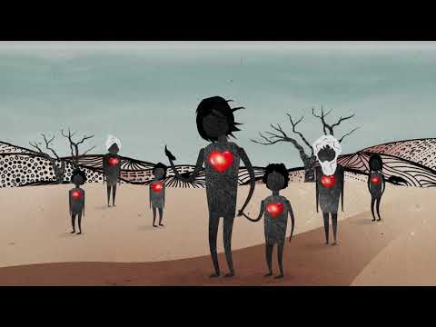
What is intergenerational trauma?
Notes:
Link to video: https://www.youtube.com/watch?v=vlqx8EYvRbQ

Slide 12
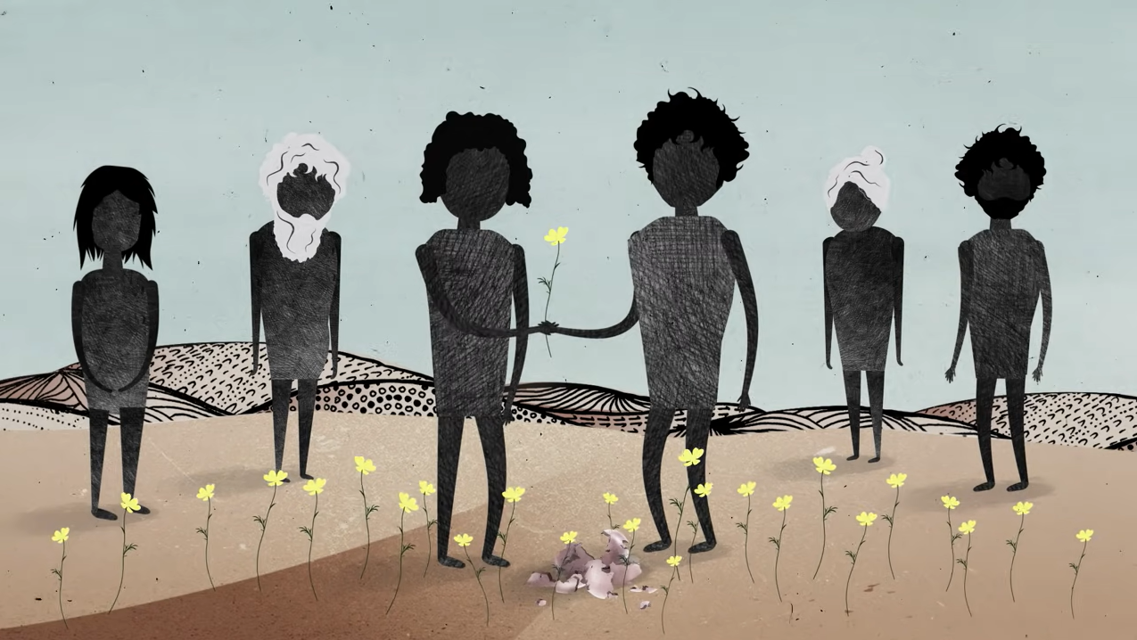
Intergenerational trauma
A report by the Australian Institute of Health and Welfare found that in comparison to other First Nations peoples, children living in households with Stolen Generations are:
2 times as likely to experience discrimination
2 times as likely to experience violence
1.5 times more likely to have been arrested
Notes:
Use this slide to discuss what intergenerational trauma means and how it impacts Stolen Generations descendants. Information from the lesson plan is provided below.
Trauma in First Nations communities is not just experienced individually but between generations and across communities. The ripple effect is felt far and wide.
If people don’t have the opportunity to heal from trauma, they may unknowingly pass it on to others through their behaviour. Their children may experience disconnection from their extended families and culture and have high levels of stress. This creates a cycle of trauma, where the impact is passed from one generation to the next. In Australia, intergenerational trauma predominantly affects the children, grandchildren and future generations of the Stolen Generations.
Report link: https://healingfoundation.org.au/aihwchildrensreport/

Slide 13
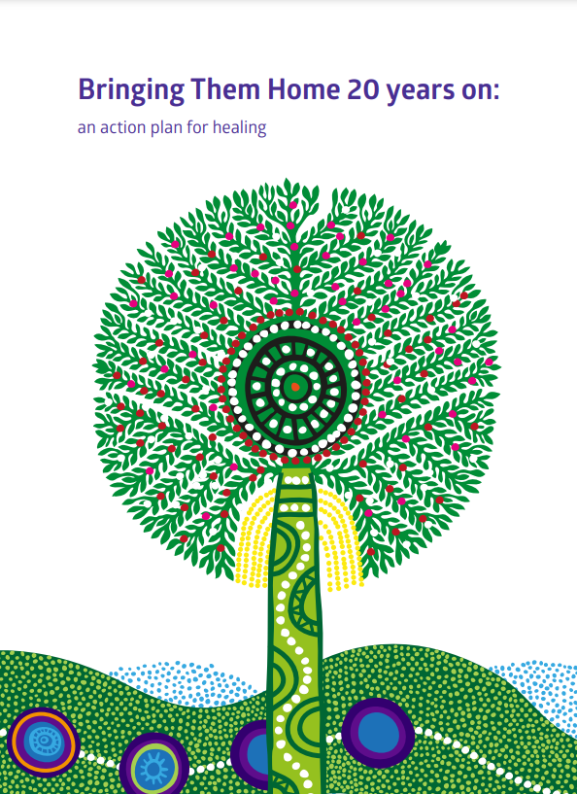
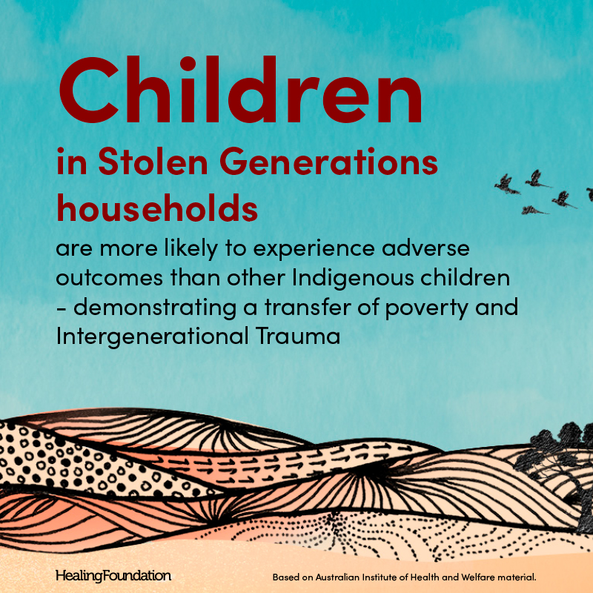
Class discussion
In groups of three explore and analyse the following documents:
AIHW Stolen Generations report
AIHW Children’s report and summary poster
Bringing Them Home 20 years on report.
What are the main points of each document?
Notes:
AIHW Stolen Generations report: https://healingfoundation.org.au/stolen-generations/stolengenerationsreport/
AIHW Children's report and summary poster: https://healingfoundation.org.au/aihwchildrensreport/
Bringing Them Home 20 years on report: https://healingfoundation.org.au/app/uploads/2017/05/Bringing-Them-Home-20-years-on-FINAL-PRINT.pdf

Slide 14
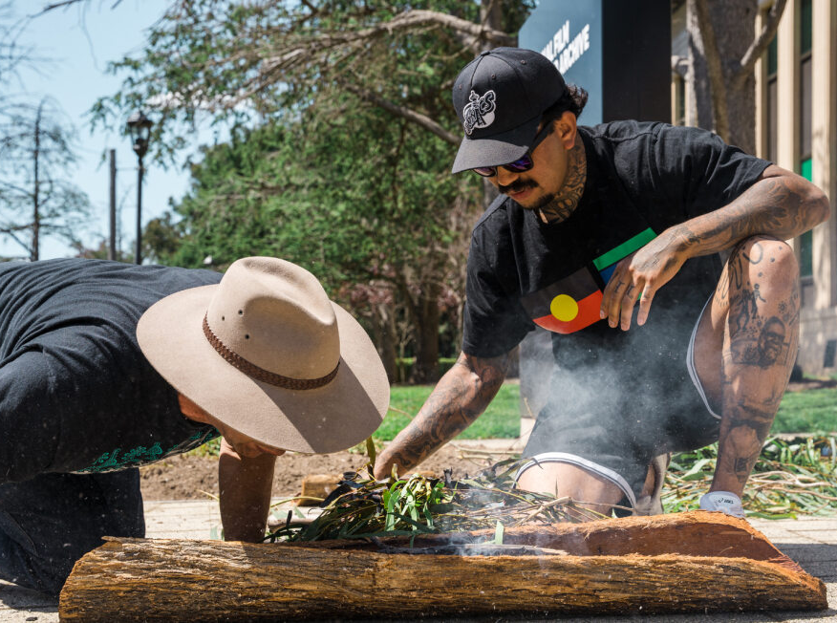
Activity 1:
Continuing Culture
Notes:
Students will research, and reflect on Aboriginal and Torres Strait Islander culture, learning about how policy has affected different areas and how First Nations resilience is keeping culture alive.
Resources
Video: First Contact, Episode 1: Elcho Island snippet.
Timeline of Trauma and Healing in Australia.
Gambay – First Languages Australia map.
How to structure student discussions with a walk and talk.

Slide 15
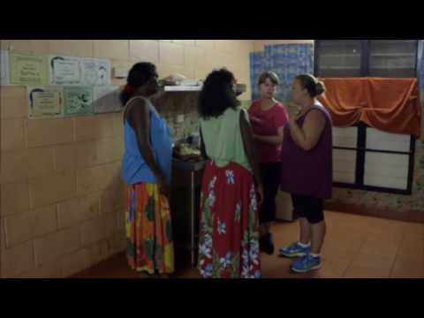
Video: First Contact Episode 1, Elcho Island
Notes:
Introduce video, let students know they will be discussing the clip with the class.
Video link: https://www.youtube.com/watch?v=9fMod5nTzck

Slide 16

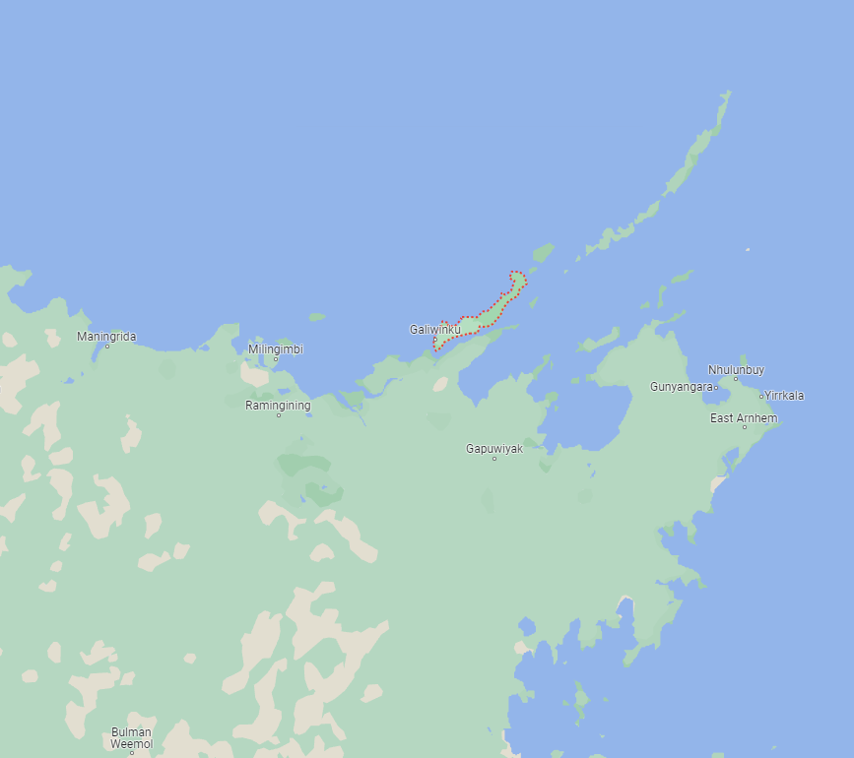
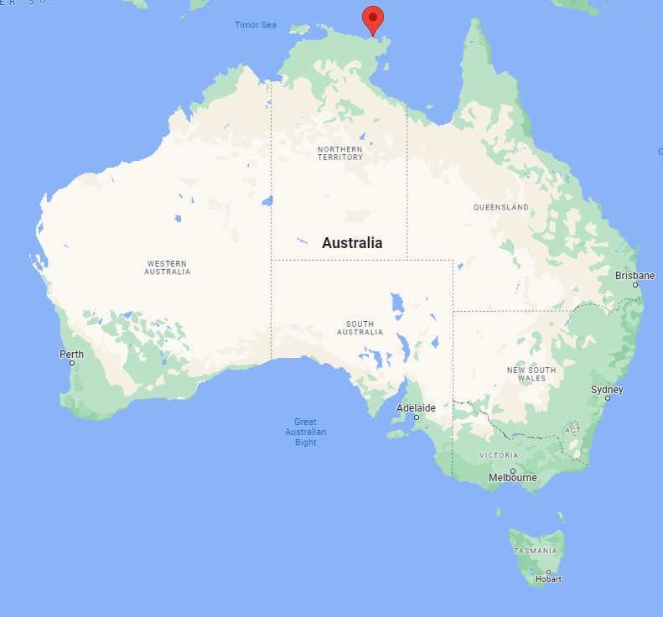
Video: First Contact Episode 2, Elcho Island
  What do you think the purpose of this show is?
  What were the main points raised in this episode?
  What lies and propaganda were used?
Notes:
Discussions may be in small groups first before a whole class discussion

Slide 17
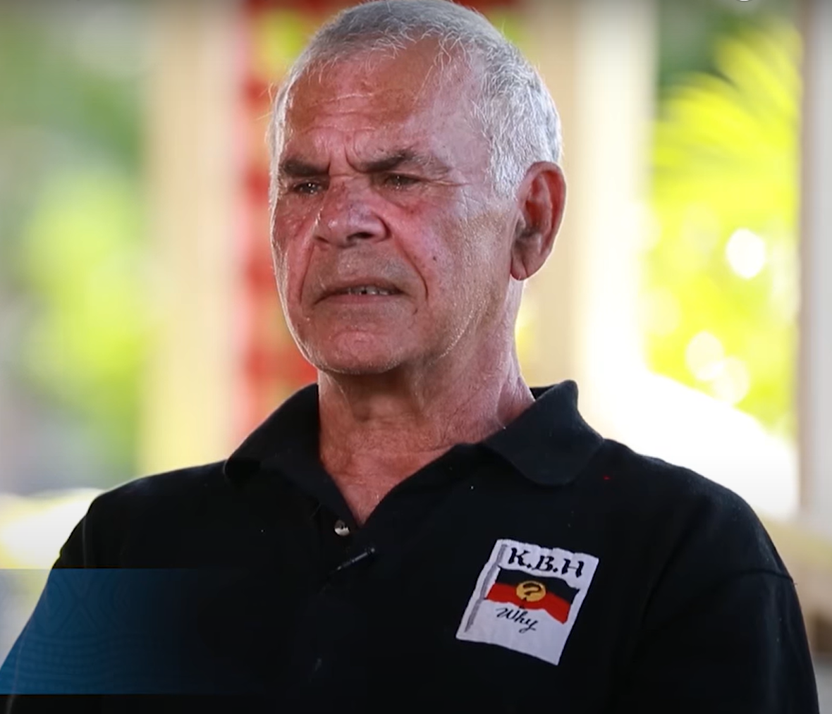
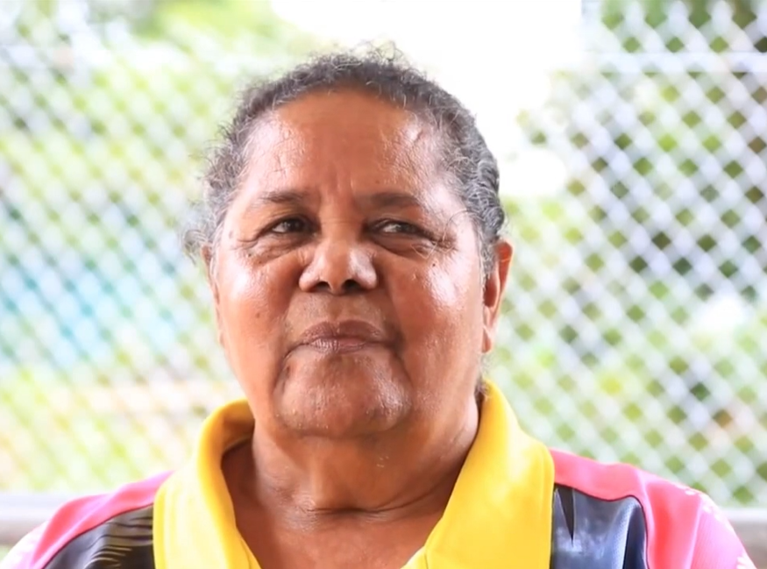
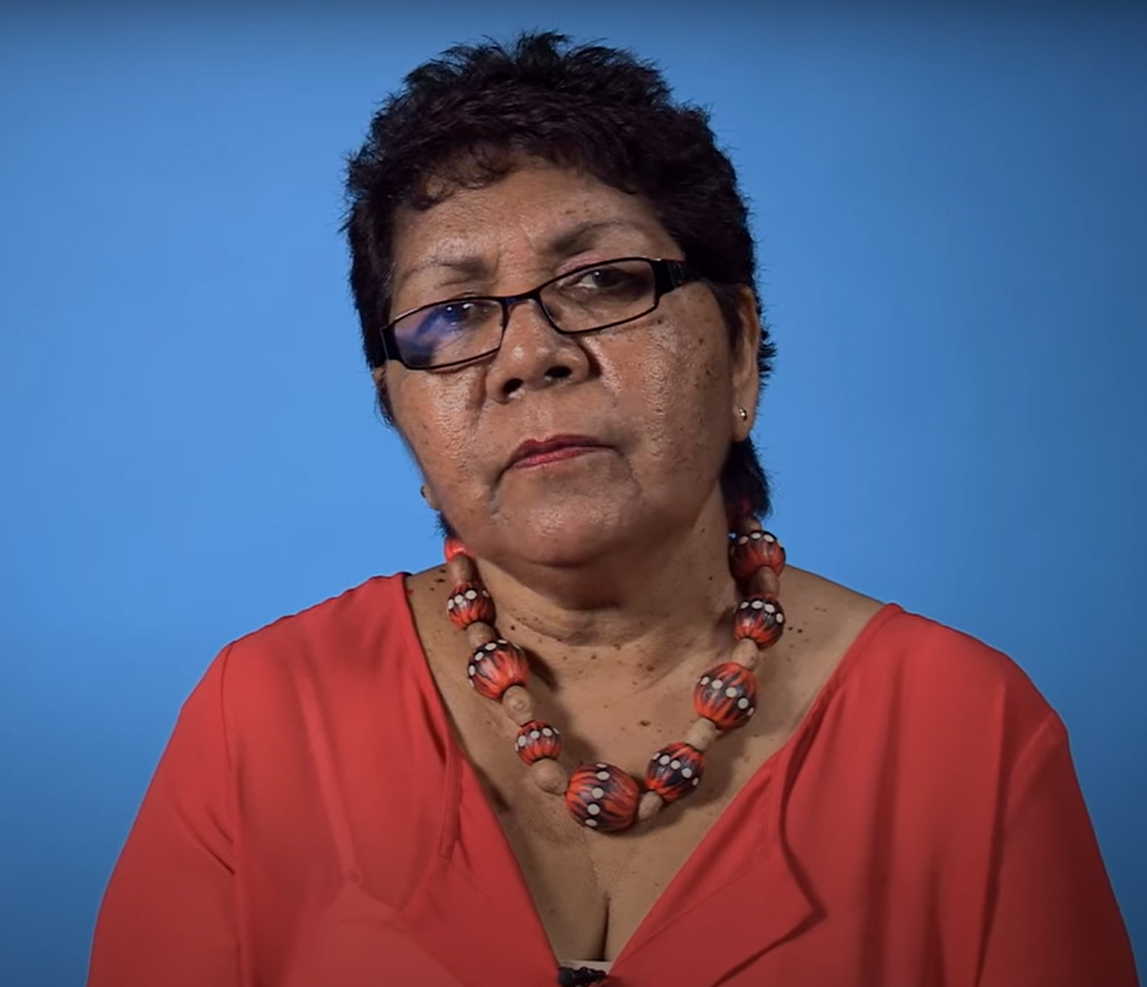
Continuing Culture
  In small groups, watch one of the following videos:
  Michael Welsh Gwen Schrieber Florence Onus
  Discuss the difference between the story you watched and the opinions shared in First Contact.
Notes:
Michael Welsh - https://www.youtube.com/watch?v=TxtJGyZhq0k
Gwen Schrieber - https://ictv.com.au/video/item/3237
Florence Onus - https://www.youtube.com/watch?v=CzExWBCuuyg
You can prompt discussions with questions such as:
How do these videos challenge the views from First Contact?

Slide 18
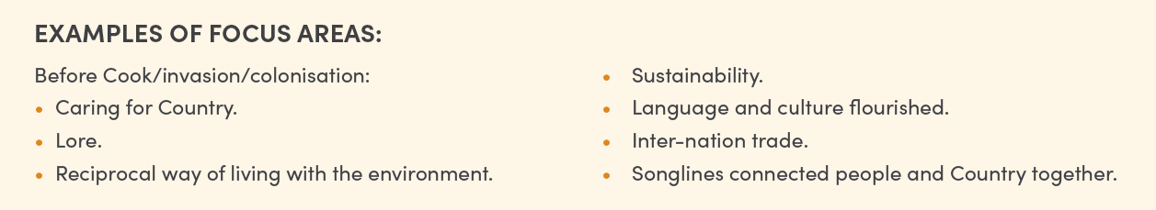
Continuing Culture
Focus on one area of Aboriginal and Torres Strait Islander culture to explore these questions:
What was this focus area like before settlement?
What is this focus area like now?
What is currently being done to heal/regain/restore this focus area? What else can be done?
  Make connections to policies that have impacted First Nations peoples.
Notes:
Use the Government policy in relation to Aboriginal people and The Policy of Assimilation, as a starting point for students to research how policy impacted the focus area.
An example is demonstrated on the next slide, looking at language as a focus area

Slide 19
Example
Focus Area: Languages
  First Nations languages flourished before settlement. There are more than 250 First Nations languages in Australia, and today less than 50 are spoken fluently. AIATSIS language map of Australia
  Many policies restricted First Nations people from speaking their languages, and the removal of children from families resulted in them being separated from their language and being raised to speak English.
  There are lots of positive things that are happening in this area. Many First Nations communities are revitalising, regaining and rebuilding their language communities. However, there is still a long way to go.
  To heal, regain and restore this focus area First Nations languages can be embedded into the school curriculum, specific to the location. This will allow for the language to be continually used and learnt.

Slide 20
Continuing Culture
To reflect on the learning you've done so far, find a new group to discuss the following questions:
What do you know about the history of Australia? What did you know and what are some of the new learnings you can take away?
How can you use this knowledge to educate other people?
What needs to happen for Australians to truly understand and acknowledge the truth of this nation
Think big! Who are some people who might be able to help? How could you request their help?
Notes:
After students have discussed these questions, you may wish to end the session with a yarning circle or a walk and talk to give students a chance to debrief about the content of the lesson.

Slide 21
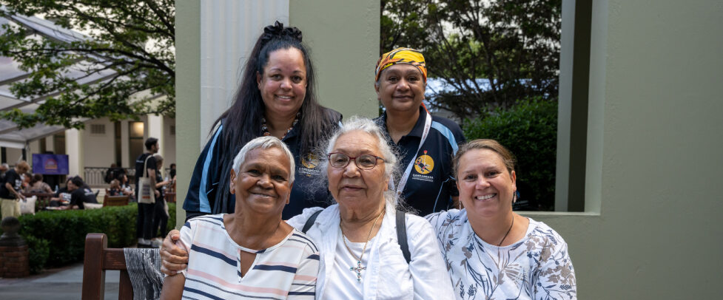
Activity 2:
Voice
Notes:
In this activity, students will get to analyse if there is equity in whose voices are heard. They will consider how they can help to voice this information.
Resources
Video: Telling Our Stories – Michael Welsh.
Documentary: K’gari.

Slide 22
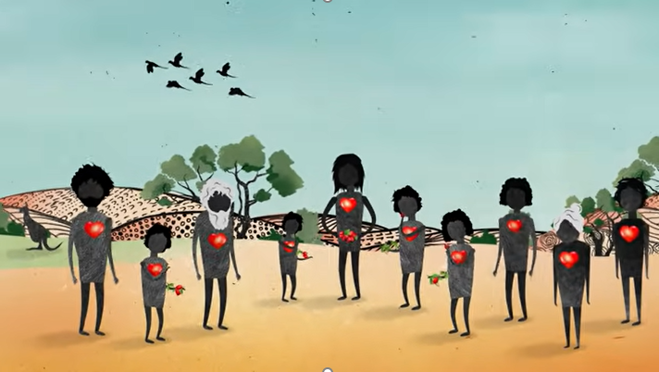
Recap
Notes:
Use images to prompt students knowledge from the previous lesson and the Stolen Generations

Slide 23
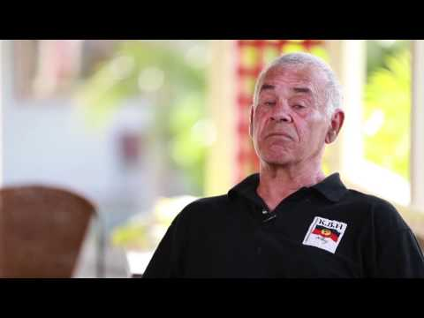
Video: Telling our Stories – Michael Welsh
Notes:
Video link: https://www.youtube.com/watch?v=TxtJGyZhq0k

Slide 24
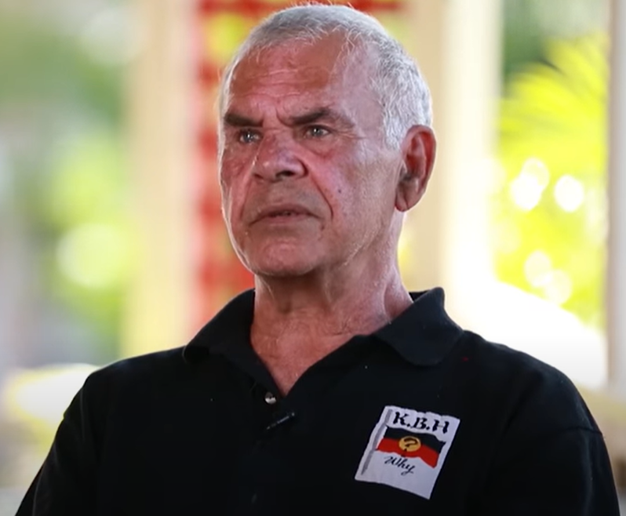

Videos
Was there any new information you have learnt from Michael’s story?
Michael talks about ‘Healing our past to heal our future’. What do you think he means by this?
On your own devices, watch the K'gari interactive documentary.
For some of us this is new information. Why?
Why do you think some aspects of Australian history are more well known than others.
Notes:
Link to K'Gari documentary: https://www.sbs.com.au/kgari/

Slide 25
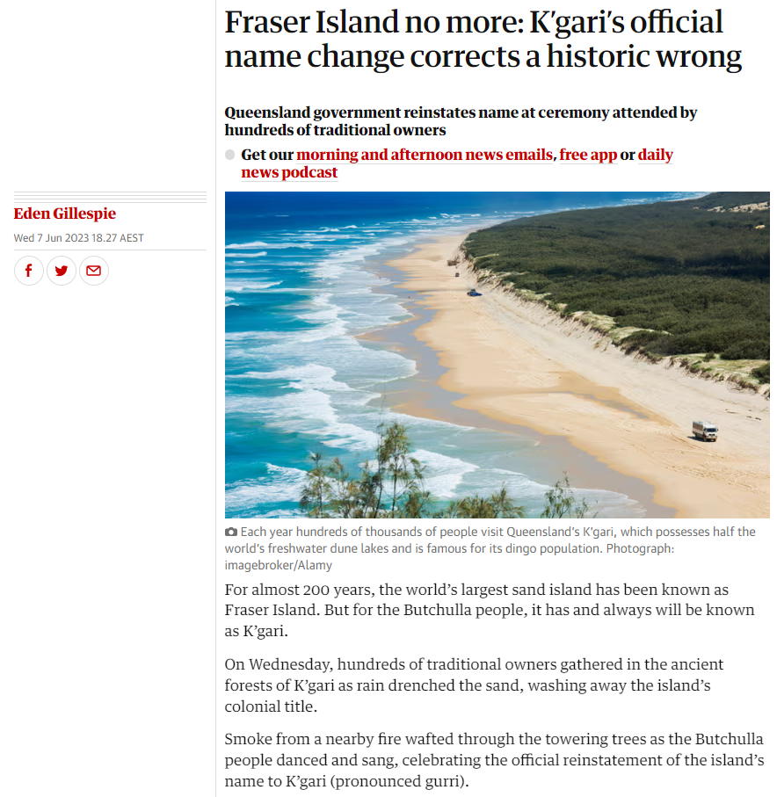
K'gari now...
Notes:
https://www.theguardian.com/australia-news/2023/jun/07/fraser-island-no-more-kgaris-official-name-change-corrects-a-historic-wrong
Before revealing article, see if students know about the K'gari official name change

Slide 26
Voice
Working individually, create a text for someone who might not know anything about the Stolen Generations. You might make:
  a small book for upper primary aged students
  a speech for an assembly during National Reconciliation Week or on Sorry Day
  a video
  an article for the local newspaper or school news
  a song
  a school mural
  Share your ideas and creations with The Healing Foundation for survivors and other students to see what you’ve learned!
Notes:
You may wish to change this activity to suit the assessment or skills of your class

Slide 27

Yarning Circle
What have you learnt so far?
What are you still wondering about?
What would you like more information about?
Are there any elements you would like to discuss further?

Slide 28
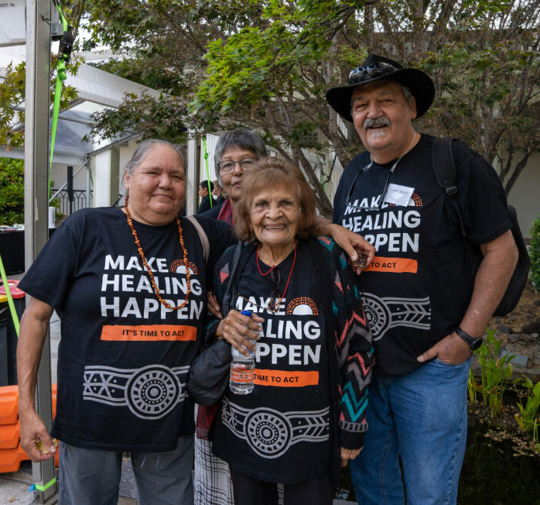

Activity 3:
The Power of Story
Notes:
Students will have the opportunity to read, discuss and reflect on the powerful written testimonials, and the number of testimonials, from the Bringing them Home report. They will be asked to make connections to other learning and justify their ideas and thinking by using evidence in their research.
Resources
Bringing them Home report extracts: written testimonies.
Timeline of Trauma and Healing in Australia.
Map of Stolen Generations Institutions.
Video: First Contact, Episode 2, Clip 3: Cootamundra Girls Home.

Slide 29
Care and safety
These lessons might include some content that is confronting or overwhelming
We all need to understand a full history of Australia, including the experiences of Stolen Generations survivors, their families and communities, and the impacts of past government policies that are still being felt today
It is important to speak to me or another adult if at any point you feel distressed – we are all here to learn together and keep each other safe.
Notes:
Remind students about the cultural safety rules you've all created as a class.

Slide 30
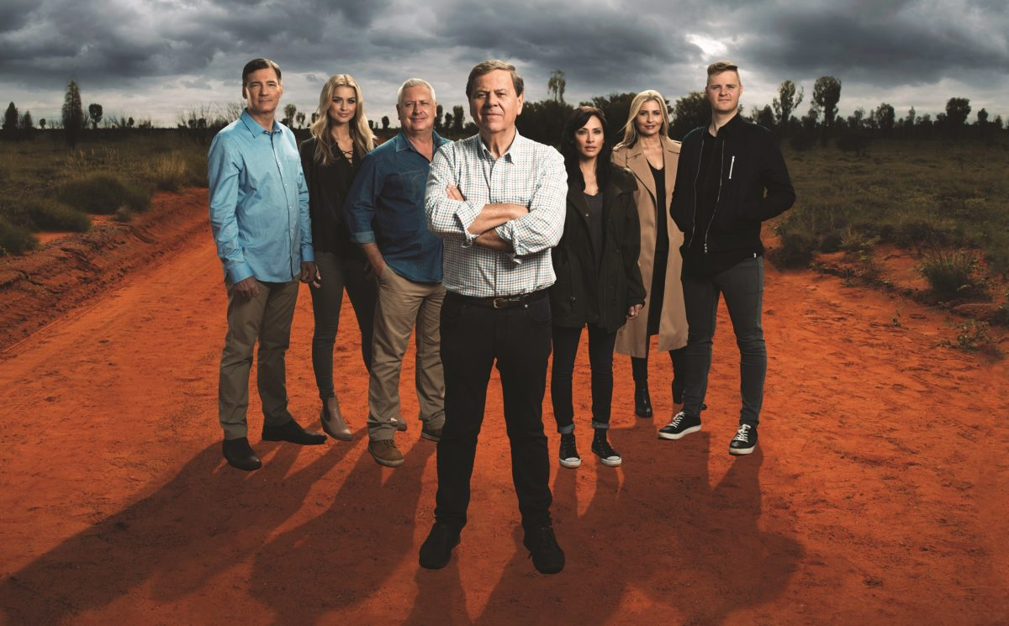
Cootamundra Girls Home
Watch video: First Contact, Episode 2, Clip 3, Cootamundra Girls Home
In small groups, discuss the video using the following questions as prompts:
  Why do you think people doubt historical events like the Stolen Generations?
  Why would hearing stories firsthand affects people's
  understanding of historical events like the Stolen
  Generations?
  What do you think the impact is on survivors who have
  to prove their story to people like those in the video?
Notes:
Video link: https://www.sbs.com.au/ondemand/watch/817350723797
Image credit: https://www.mediaweek.com.au/sbs-first-contact/

Slide 31
Testimony – Bringing Them Home report
‘So the next thing I remember was that they took us from there and we went to the hospital and I kept asking – because the children were screaming and the little brothers and sisters were just babies of course, and I couldn’t move, they were all around me, around my neck and legs, yelling and screaming.
I was all upset and I didn’t know what to do and I didn’t know where we were going. I just thought, well, they’re police, they must know what they’re doing. I suppose I’ve got to go with them, they’re taking me to see Mum. You know this is what I honestly thought. They kept us in hospital for three days and I kept asking, ‘When are we going to see Mum?’ And no-one told us at this time. And I think on the third or fourth day they piled us in the car and I said, ‘Where are we going?’ And they said, ‘We are going to see your mother’. But then we turned left to go to the airport and I got a bit panicky about where we were going ... They got hold of me, you know what I mean, and I got a little baby in my arms and they put us on the plane. And they still told us we were going to see Mum. So I thought she must be wherever they’re taking us.’
– Confidential submission 318, Tasmania: removal from Cape Barren Island, Tasmania, of eight siblings in the 1960s. The children were fostered separately.
Notes:
Provide students with some context before clicking through to text.
Introduce students to the activity today by discussing the role of testimonies in healing from the Stolen Generations. Read through the example with the class. Give students some time to reflect and discuss this example with the person next to them.

Slide 32
The Power of Story
In pairs, read statements from survivors who were stolen in the Bringing Them Home report.
As you read through these statements, reflect on the following questions:
  Why is hearing the stories from Stolen Generations survivors important to changing the narrative of Australia?
  Is it possible for the Stolen Generations to receive justice?
  How can this be achieved?
Notes:
Be mindful that some of the stories on this site include physical and sexual violence, as well as many other possibly triggering themes. Decide the best way for your students to peruse these stories, keeping in mind their histories and their safety.
Click through to the extra questions when students have spent some time reading testimonies.
Link to testimonies: https://bth.humanrights.gov.au/our-stories/written-testimonies

Slide 33
Debrief
Notes:
Discuss and analyse why this information is not common knowledge to all Australians. Give students space to discuss what they'd read and how they are feeling.

Slide 34
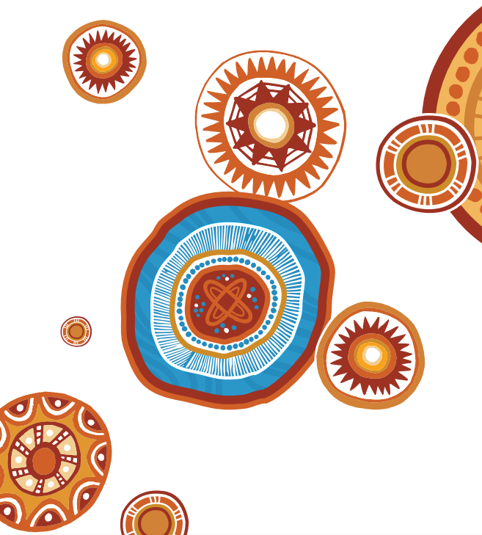
Activity 4:
Resilience
Notes:
In this activity, students have the opportunity to reflect on and unpack their own personal attitudes and perspectives.
Resources
Video: Telling Our Stories – Brian Gray.
Appendix 2: Venn diagram.
Video: Apology 11 Collective Healing.
The Theory of Change - The Healing Foundation.
Outcry after Scott Morrison says ‘there was no slavery in Australia’ amid Black Lives Matter protests – news article by Zoe Tidman.
Transforming my white identity from an agent of oppression to an agent of change through education in contemporary Australian society - Journal article by Kimberly Smith.
White Privilege: Unpacking the Invisible Knapsack – Peggy McIntosh.
Truth Telling – ABC Compass.

Slide 35
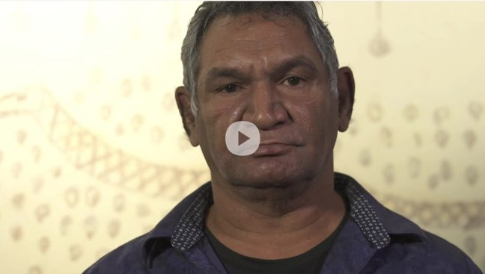
Video: Brian Gray
Notes:
VIDEO CANNOT BE EMBEDDED ON SLIDE, FOLLOW LINK: https://www.dropbox.com/s/2nwk0qiqkvqshdu/Brian%27s%20Story1st%20film.mp4?dl=0

Slide 36
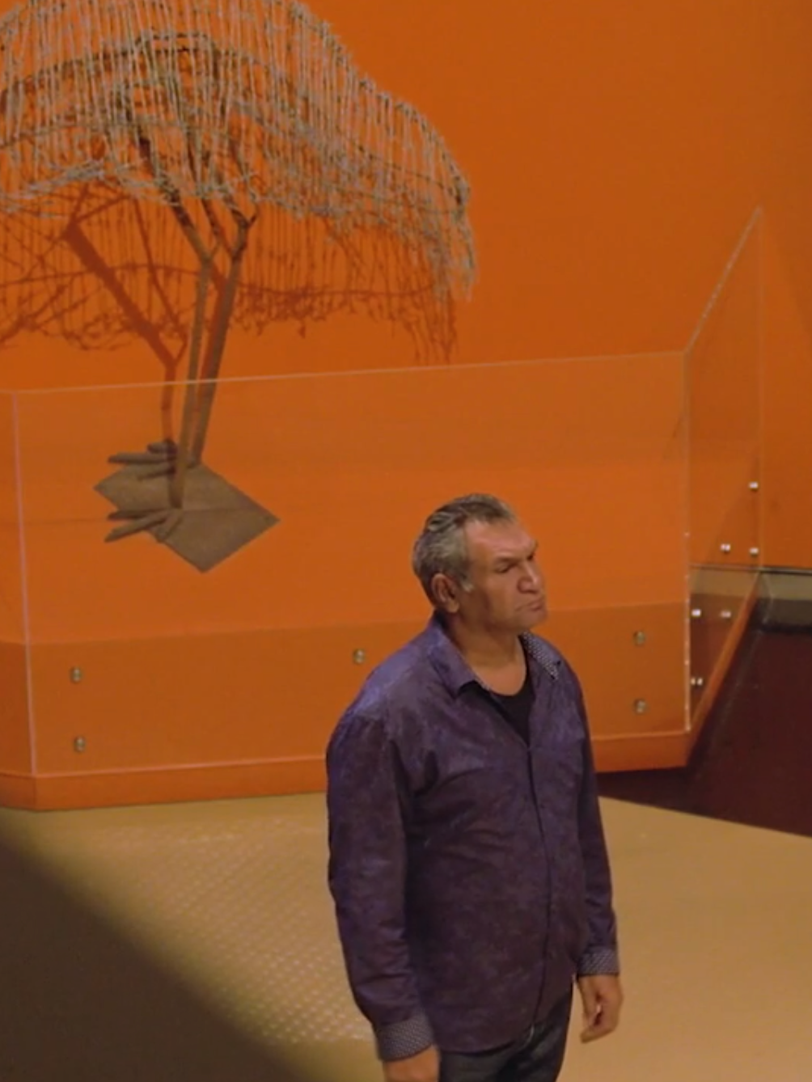
Resilience
Discuss and respond to some of the issues raised in Brian’s video.
  Key questions:
  What are the different attitudes and perspectives held by people Brian met in his life? Compare and contrast these perspectives.
  Why did people hold these perspectives?
  How have these perspectives and attitudes been perpetuated through our history?
Notes:
Image: Brian Gray

Slide 37
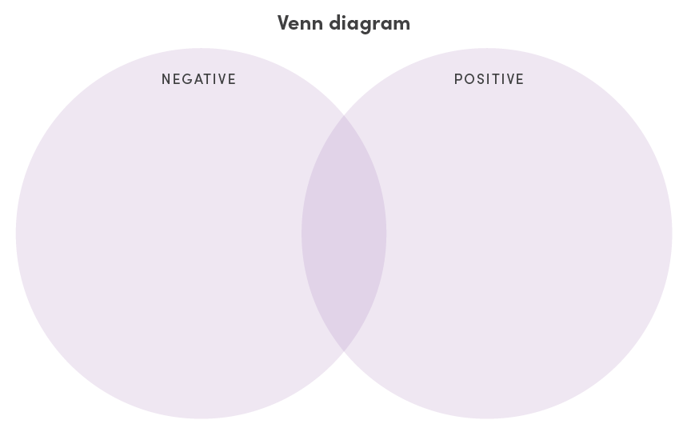
Resilience
On your Venn diagram handout, write around the outside all the events that Brian talks about in his video.
Then, place the events on either the negative impact or positive impact in Brian’s life.
In the middle section of the Venn diagram, write how Brian explains he was feeling throughout the video.

Slide 38
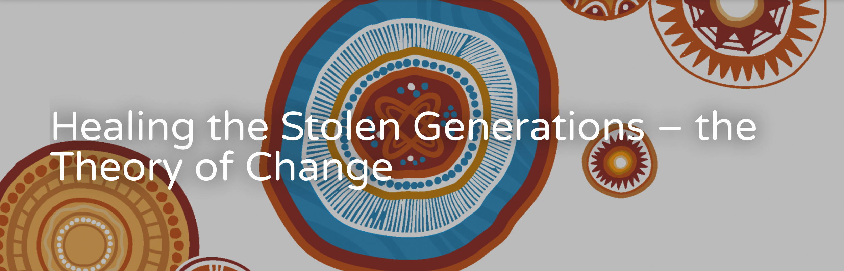
Resilience
Explore the concept of collective healing that has helped many Stolen Generations survivors with their healing journey.
Read the Theory of Change:
Synthesise your own ideas and opinions based on the facts you have found, to develop a complex argument to inform your school community about the Stolen Generations and intergenerational trauma.
Notes:
The Theory of Change: https://healingfoundation.org.au/resources/healing-the-stolen-generations-the-theory-of-change/

Slide 39
Conclusion & Debrief
  Share your work with three other people.
  This could be through conversations, writing a blog, creating an artwork, writing an article in the school newsletter, a persuasive essay or writing, or composing and performing a song or performance to be showcased to an audience.

Slide 40
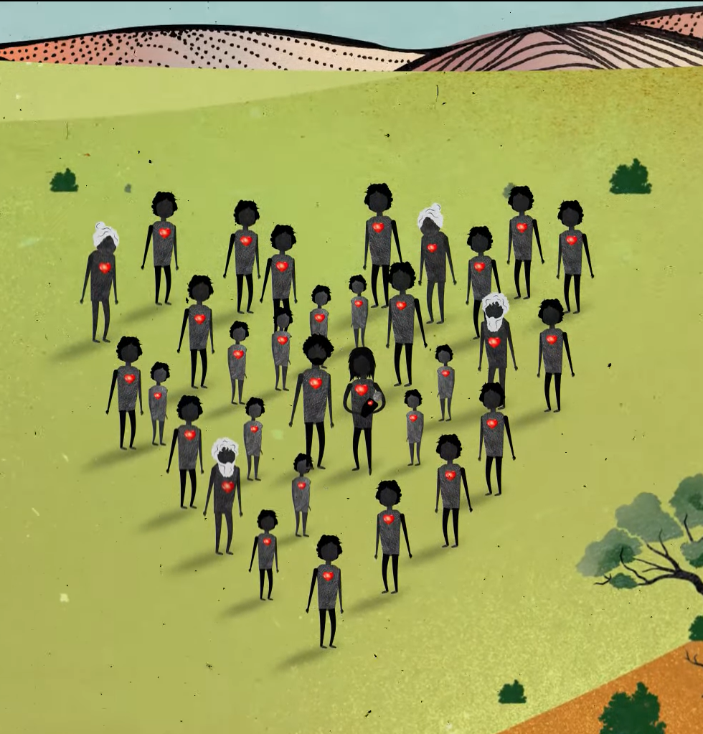
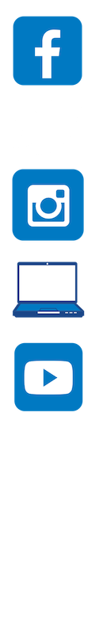
Contact The Healing Foundation
@HealingFoundation
@healingourway
@healingourway
www.healingfoundation.org.au
Healing Foundation
Notes:
Consider:
Sharing your outcomes and experience with The Healing Foundation at resources@healingfoundation.org.au
Sharing the resource and how you used it amongst your networks.
Sharing your students’ learning journey and tag The Healing Foundation on Instagram @healingourway and on Facebook as ‘Healing Foundation’.

