Slide 1
Year 8

Slide 2
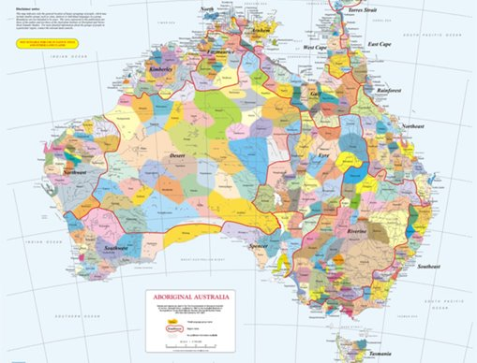
Acknowledgement
[Name of school/class] acknowledges Country, Custodians and Community of the lands on which we are on today [insert name of land/ peoples].
We also pay our respects to Elders and to Stolen Generations survivors, of the Dreaming and of the here and now.
We recognise the ongoing nature of trauma experiences for First Nations peoples and commit each day to survivor-led intergenerational healing.
Notes:
Update this slide with the name of your school/ class and the name of the land/s on which you're presenting the lesson on.
You may choose to make the wording of this acknowledgement more specific to your land/school/experiences. The acknowledgement isn't a script that we have to follow, you may even introduce the unit by working with students to write an acknowledgement for your class.
Image credit: https://ipaustralia.libguides.com/c.php?g=451400&p=3082380

Slide 3
Aboriginal and Torres Strait Islander students and teachers should be aware that these resources may contain the names, images, and voices of deceased persons.
Notes:
Important to remind students to speak up if they are feeling discomfort, and any safety and wellbeing measures your school has in place.

Slide 4
Care and safety
These lessons might include some content that is confronting or overwhelming
We all need to understand a full history of Australia, including the experiences of Stolen Generations survivors, their families and communities, and the impacts of past government policies that are still being felt today
It is important to speak to me or another adult if at any point you feel distressed – we are all here to learn together and keep each other safe.
Notes:
Important to remind students to speak up if they are feeling discomfort, and any safety and wellbeing measures your school has in place.
This is also a good place to ask the cultural safety questions from the educator's guide so you can co-construct a culturally safe space with your students.

Slide 5
Healing together
Why is learning about the Stolen Generations important?
  to change the way we look at our collective history.
  to support reconciliation and an honest understanding of our past – not just one perspective.
  to become aware of past government policies that still affect many Aboriginal and Torres Strait Islander peoples and families today.
Notes:
Give students a chance to suggest why they think the learning is important before clicking through to the reasons.

Slide 6
Cultural Safety
How does a safe classroom look to you?
How does it feel?
How can we be culturally safe?
Notes:
You may have already established this as a class, if so, use this time to reiterate the class rules.
Begin a discussion about cultural safety with the class. Ask them to answer the questions in a 'think/pair/share' activity, or address them as a group.
Use the final question to lead in to the next slide.

Slide 7

Cultural Safety
Open mindedness
Respect
Honest communication
Being mindful of privilege
Notes:
A culturally safe classroom environment relies on open-mindedness, respect and honest communication.
Make any changes needed for this discussion to be age-appropriate for your class
Image credit: Sketchify from Canva

Slide 8
Overview: this week’s activities
ACTIVITY 1: NOMINATION WRITING
In this lesson, we are going to watch a video from a Stolen Generations survivor and learn about how they use irony. We will then write a nomination for an Elder to be presented with a Reconciliation Award.
ACTIVITY 2: WRITING AND DESIGNING INFOGRAPHIC
After taking part in a yarning circle with the class, you will each create an infographic to inform the school community about the ongoing impact of the Stolen Generations
ACTIVITY 3: MULTI-MODAL PRESENTATION
We will be conducting research into the Apology to the Stolen Generations and National Sorry Day and using this research to create a presentation about why it's important to recognise these events as a school community
ACTIVITY 4: NATIONAL DAY OF MOURNING PITCH
We are going to learn about the National Day of Mourning (1938) and other peaceful protest actions. Using this knowledge, we are going to write a pitch for a current affairs TV segment about why all students should be learning about the National Day of Mourning.
Notes:
OPTIONAL SLIDE
Update week to timeframe for these teaching activities in consideration of class schedule and activity time.

Slide 9

Activity 1:
Nomination Writing
Notes:
Image credit: https://statements.qld.gov.au/statements/93514
Introduce students to activity: students will watch an interview with an Elder who is a member of the Stolen Generations and analyse the textual features of irony in the transcript. Students consolidate their knowledge of reconciliation and write a nomination for the Elder to be recognised for a Reconciliation Award.
Resources
Telling Our Stories – Fay Clayton-Moseley.
Give Nothing to Racism.
Video transcript – Aunty Fay Clayton-Moseley (Appendix 1).
Irony worksheet (Appendix 2).
Exploring the use of irony example answers (Appendix 3).

Slide 10
The Stolen Generations:
What do you know?
Notes:
Encourage students to share what they know about the Stolen Generations. Use the next slide to explain what happened in more detail.

Slide 11
The Stolen Generations
For about a century, thousands of First Nations children were systematically taken from their families, communities and culture, many never to be returned. These children are known as Stolen Generations survivors.
Notes:
More information:
First Nations children were removed by government authorities from the mid-1800s to the 1970s. In the 1860s, Victoria became the first state to pass laws authorising the removal of First Nations children from their families.
Similar policies were later adopted by other states and territories – and by the federal government when it was established in the 1900s.
For about a century, thousands of children were taken from their families, communities and culture, many never to be returned.
These children are known as Stolen Generations survivors, or Stolen Children. They were taken by the police, from their homes, and on their way to or from school, and placed in more than 480 institutions, adopted or fostered by non-Indigenous people and often subjected to abuse. The children were denied all access to their culture, they were not allowed to speak their language and they were punished if they did.
There are currently more than 33,000 Stolen Generations survivors in Australia. More than one third of all First Nations peoples are their descendants. In Western Australia, more than half of the population have Stolen Generation links.

Slide 12
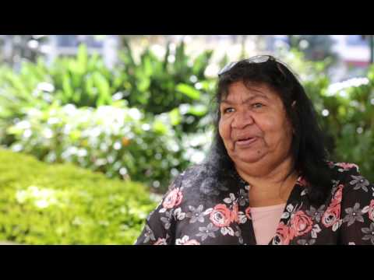
VIDEO: Telling our Stories – Our Stolen Generations
Aunty Fay Clayton-Moseley
Notes:
Video link: https://www.youtube.com/watch?v=kDs0oTYZqeE
Tell students that Aunty Fay Clayton-Moseley is a Stolen Generations survivor and she has shared her story in this video

Slide 13
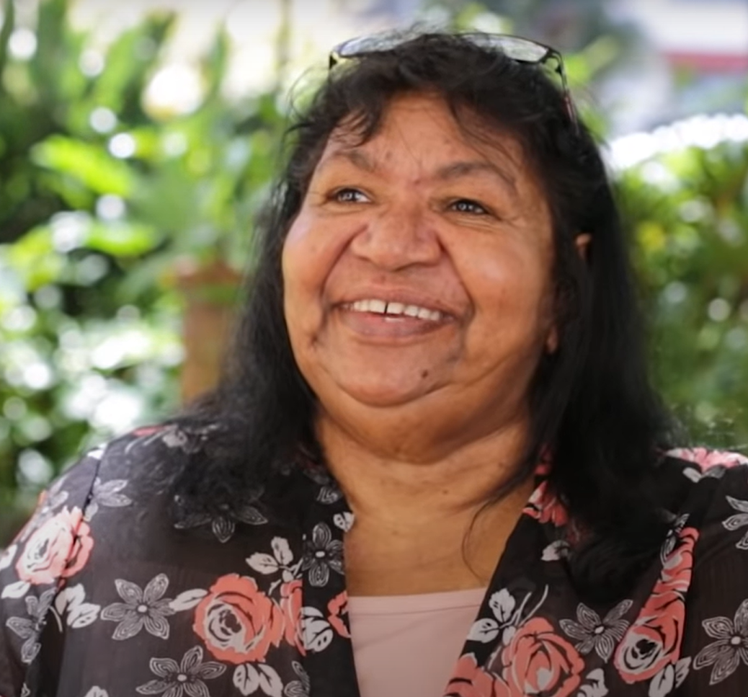
Video: Telling our Stories – Our Stolen Generations Aunty Fay Clayton-Moseley
Discuss the following:
Aunty Fay as an Aboriginal Elder
The Stolen Generations
Colonisation
Reconciliation
Notes:
Facilitate whole class discussion in response to the video and the information on the topics listed on slide.

Slide 14

VIDEO: Telling our Stories – Our Stolen Generations Faye Clayton
What are you thinking/feeling after watching that video?
Think (30 seconds to reflect on your own)
Pair (chat to the person next to you for one minute)
Share (discuss as a class)
Remember as a class we want to think about:
Aunty Faye as an Aboriginal Elder​
The Stolen Generations​
Colonisation​
Reconciliation
Notes:
Complete the think/pair portion of the activity, then bring up the reminder for what they were focusing on. Give them more time in their pairs, then come together as a group to discuss.

Slide 15
Irony
Where have you heard the word irony?
What do you think it means?
Notes:
Encourage students to think of where they've heard the term before.
As students make suggestions these can be written on the board or in a word document to slowly build the definition before providing the definition.

Slide 16
Irony...
Irony is the use of words to convey a meaning that is the opposite to what has been said. Typically for a humorous or emphatic effect.
Example:
An English teacher who doesn't like reading
When you sleep through your alarm, burn your toast and then you miss your bus and you say, "I guess it's my lucky day!"
Someone is learning to do a kick-flip and they fall over. As they get up they say, "I meant to do that."

Slide 17
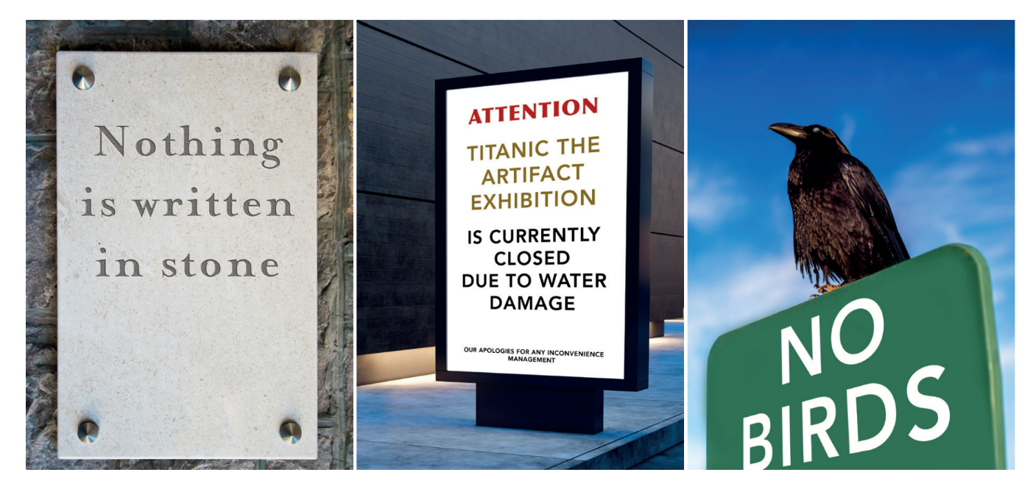
Irony Worksheet
Notes:
Refer to irony worksheet (appendix 2 of the Year 8 Stolen Generations School Resource Kit for Teachers and Students) and read through as a class.
Introduce video on next slide – Give Nothing to Racism

Slide 18

VIDEO: Give Nothing to Racism
Notes:
Video Link: https://www.youtube.com/watch?v=g9n_UPyVR5s

Slide 19
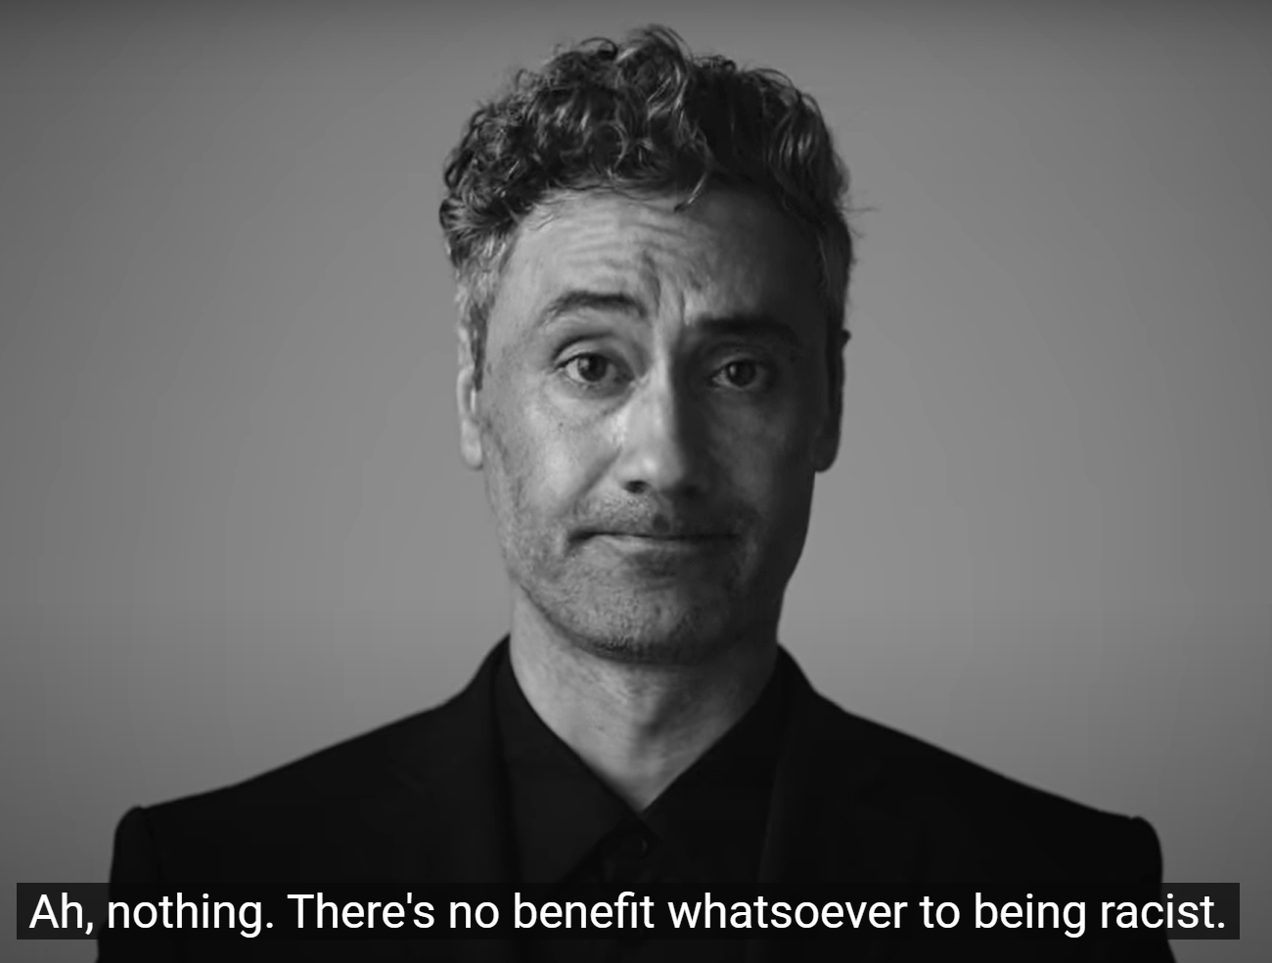
VIDEO: Give Nothing to Racism
How was irony used?
  Think/Pair/Share
How did this enhance meaning?
Notes:
Video Link: https://www.youtube.com/watch?v=g9n_UPyVR5s

Slide 20
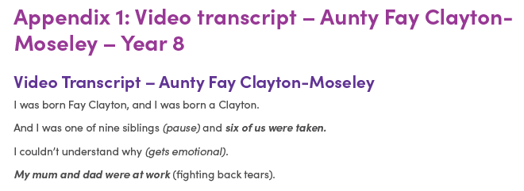
Transcript: Telling our Stories – Our Stolen Generations
Aunty Fay Clayton-Moseley
Notes:
Refer to Appendix 1 – Aunty Fay Clayton-Moseley's transcript. Read through as a class, give students a print out or a digital copy so they can make notes and mark sections that use irony.

Slide 21
Transcript: Telling our Stories – Our Stolen Generations
Aunty Fay Clayton-Moseley
Where does Aunty Fay use irony?
Why is it ironic?
How does irony enhance meaning in the text?
Notes:
Encourage students to mark the examples of irony on their own copy of the transcript

Slide 22
Nomination for Aunty Fay Clayton-Moseley
Planning:
  What are some reasons that Aunty Fay should receive a reconciliation award?
  Use the script to find evidence
Notes:
Find a local reconciliation award for students to nominate Aunty Fay Clayton-Moseley. These can be given at a state level or more locally.
Students write a nomination to recommend Aunty Faye Clayton-Moseley as a candidate for a local award (Appendix 3).

Slide 23
Conclusion
How do you think Aunty Fay might feel or react to receiving such a nomination?
Why do you think it is important to give awards to community leaders and positive role models?
Notes:
Facilitate whole class discussion.

Slide 24

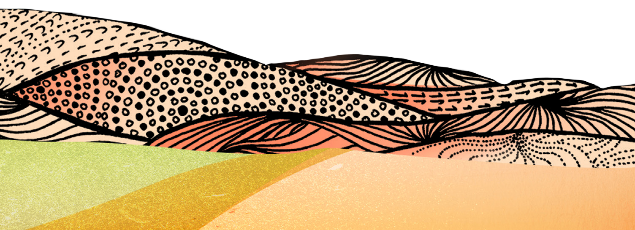

Activity 2:
Writing and designing infographic
Notes:
After taking part in a yarning circle with the class, you will each create an infographic to inform the school community about the ongoing impact of the Stolen Generations
Resources
Consequences of colonisation (Appendix 4).
Telling Our Stories – Our Stolen Generations (Fay Clayton-Moseley).

Slide 25
Yarning Circle:
What do you know about the
Stolen Generations?
Notes:
Facilitate a yarning circle:
choose a quiet place (preferably outdoors) and arrange chairs or cushions in a circle
invite students to share their knowledge and understanding of the Stolen Generations and The Healing Foundation
guide students to reflect on sharing of knowledge, understanding and perspectives.

Slide 26
Intergenerational Trauma:
What do you know?
Notes:
Encourage students to share what they know about Intergenerational Trauma. Use the next slide to explain what happened in more detail.

Slide 27
Intergenerational Trauma
If people don’t have the opportunity to heal from trauma, they may unknowingly pass it on to others through their behaviour.
In Australia, Intergenerational Trauma predominantly affects the children, grandchildren and future generations of the Stolen Generations.
Stolen Generations survivors might also pass on the impacts of institutionalisation, finding it difficult to know how to nurture their children because they were denied the opportunity to be nurtured themselves.
Notes:
More information:
Their children may experience difficulties with attachment, disconnection from their extended families and culture and high levels of stress from family and community members who are dealing with the impacts of trauma. This can create developmental issues for children, who are particularly susceptible to distress at a young age. This creates a cycle of trauma, where the impact is passed from one generation to the next.

Slide 28
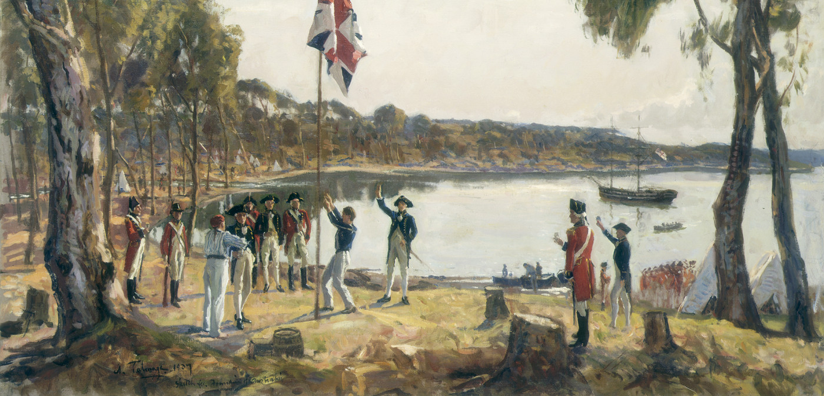
Consequences of Colonisation
Short or Long Term consequences?
Discuss where you think each consequence sits.
Notes:
Read out list of consequences of colonisation (Appendix 4) and guide students to classify examples as short-term or long-term effects. Create a table on the board where the answers to the activity can go
Image source: https://australianstogether.org.au/discover-and-learn/our-history/colonisation/

Slide 29
High rates of incarceration
Short-Term Consequences | Long-Term Consequences
Diseases such as smallpox, influenza, measles, tuberculosis
Violence, death, massacre
Loss of connection to land
Family breakdown
Loss of land
High rates of family and domestic violence
Decreased emotional and psychological wellbeing
Low income
Sexual harassment
Removal from families
Decrease in population
Low life expectancy
Low rates of education and employment
Loss of access to traditional food supplies
Decreased physical wellbeing
Suicide and self-harm
Loss of access to sacred sites
Loss of hunting and gathering skills
High rates of infant mortality
High rates of drug and alcohol abuse
Loss of language
Notes:
You may wish to use this table to click and drag the consequences into the two columns, or you can type them in

Slide 30
VIDEO: Telling our Stories – Our Stolen Generations
Aunty Fay Clayton-Moseley
Notes:
Video link: https://www.youtube.com/watch?v=kDs0oTYZqeE
Thinking back to this video from yesterday, what other consequences of colonisation can we add to the list?

Slide 31
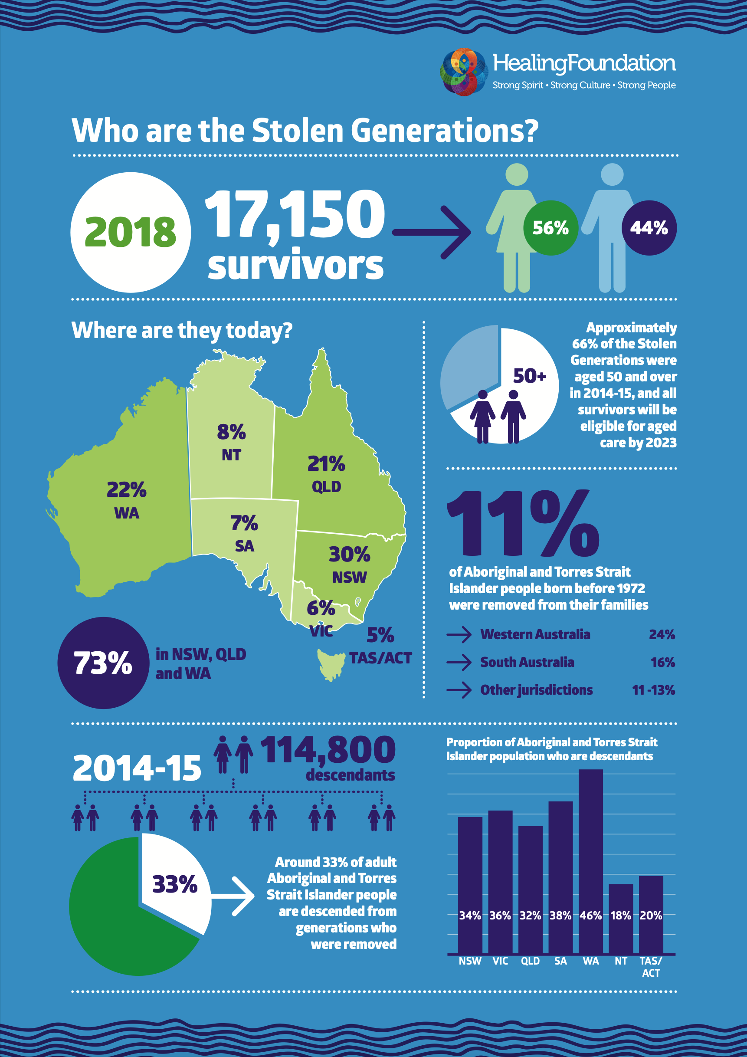
Creating a Digital Infographic
INFOGRAPHIC EXAMPLE
In Pairs:
Research Intergenerational Trauma.
Gather information on long term effects of colonisation.
Compile findings into a Digital Infographic
Notes:
In pairs, students research Intergenerational Trauma and gather information on the long-term effects of colonisation. Recommended resources:
The Healing Foundation – Intergenerational Trauma and young people
Creative Spirits
Bringing them Home report
Australians Together
Close the Gap.
Students compile their findings into a digital infographic that functions as an informative text to raise awareness of Intergenerational Trauma. Recommended platforms:
Software such as Microsoft Word, Adobe Photoshop, Adobe Illustrator
Websites such as Piktochart, Canva, Venngage, Snappa, Visme, Mind The Graph.
Link to infographics: https://healingfoundation.org.au//app/uploads/2018/08/HF_Stolen_Gererations_2Page_Infographics_Aug2018_V1.pdf

Slide 32
Conclusion
Share infographics
Notes:
Share the infographics among the class. You may also choose to publish these to the wider school community at teacher’s discretion (school library, newsletter, website etc.).

Slide 33
Activity 3:
Multi-modal presentation
Notes:
We will be conducting research into the Apology to the Stolen Generations and National Sorry Day and using this research to create a presentation about why it's important to recognise these events as a school community
Resources
• Tenth anniversary since the Apology to the Stolen Generations – Behind the News.
• The National Apology – Tenth Anniversary video.

Slide 34
Apology to Stolen Generations:
What do you know?
Notes:
Encourage students to share what they know about the Apology to the Stolen Generations. Video on next slide to detail.

Slide 35
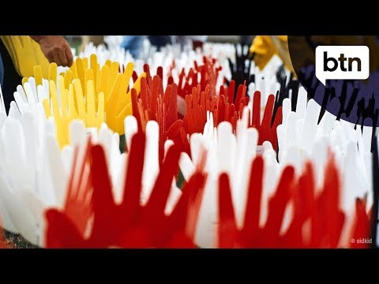
Video: Tenth Anniversary since the Apology to Stolen Generations
Notes:
Video Link: https://www.youtube.com/watch?v=CE7hCCO9jv8
Watch video

Slide 36
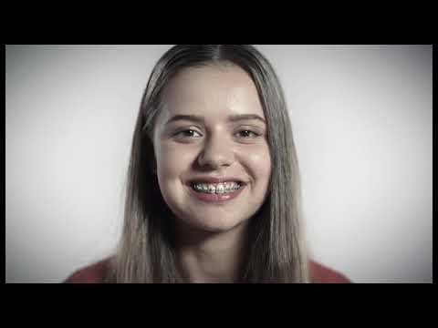
Video: The National Apology – Ten Year Anniversary
Notes:
Video Link: https://www.youtube.com/watch?v=HelxCAldlAE
Watch Video

Slide 37
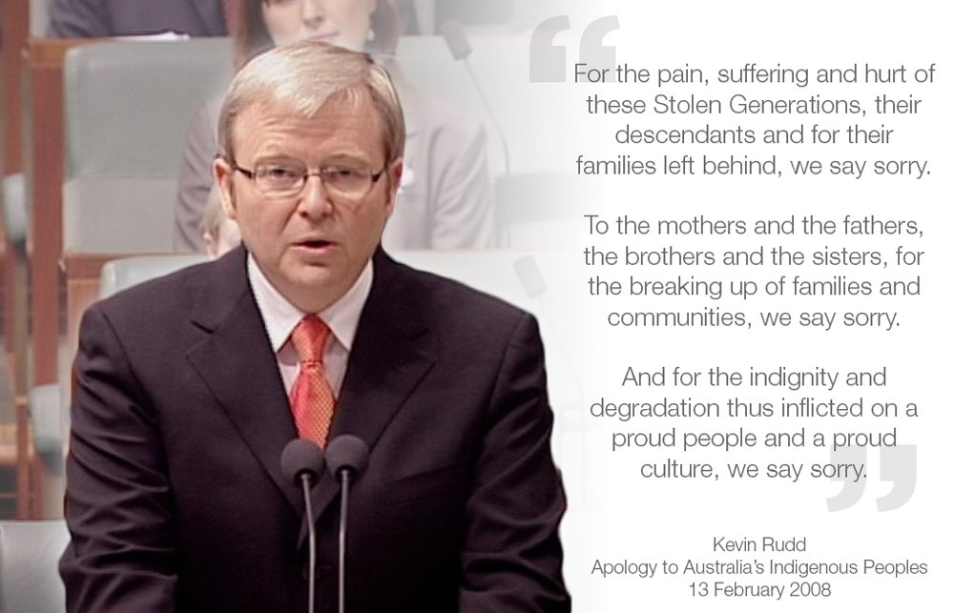
Apology to the Stolen Generations
Notes:
Facilitate whole class discussion to consider:
the importance of recognising the Apology
culturally safe ways to raise awareness about anniversary of the Apology
respectful ways to engage in dialogue about the Apology, National Sorry Day or the Stolen Generations
the form and function of informative texts, including public speaking techniques and visual aides.
Image source: https://twitter.com/MarkMcGowanMP/status/963252220639629312

Slide 38
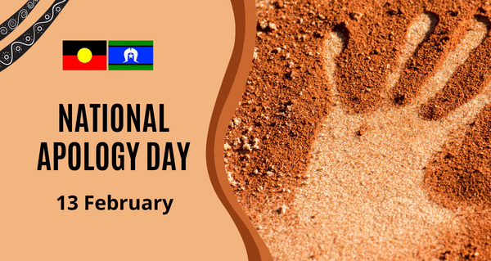
Multi-Modal Presentation: the Apology
In groups:
conduct research to enhance your knowledge and understanding about the Apology.
Compile research and present in a Multi-Modal presentation.
Notes:
Image source: https://encircle.org.au/national-apology-day/
In small groups, students conduct research to enhance their knowledge and understanding about
the Apology.
Students compile their research to create a multi-modal presentation about the importance of recognising the anniversary of the Apology and National Sorry Day every year in the school community.
Presentations must include both audio and visual aspects. Recommended multi-modal formats:
PowerPoint/slideshow/Prezi
Video
oral speech
Posters
dramatic performance.

Slide 39
Conclusion:
Presentation
Notes:
Students present their multi-modal presentations to the class and submit a hard copy script to the teacher
Presentations may be published to the wider school community at teacher’s discretion (school library, newsletter, website etc.)

Slide 40
Activity 4:
National Day of Mourning Pitch
Notes:
We are going to learn about the National Day of Mourning (1938) and other peaceful protest actions. Using this knowledge, we are going to write a pitch for a current affairs TV segment about why all students should be learning about the National Day of Mourning.
Resources
Jack Patten’s Grandson Remembers the Legacy of the 1938 National Day of Mourning.
Gandhi’s Salt March [0:00-3:15].
Montgomery Bus Boycott.
Pitch writing format worksheet (Worksheet 2).

Slide 41
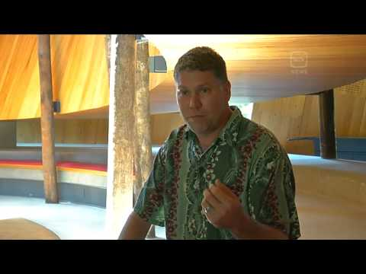
Video: Jack Patten’s Grandson Remembers the Legacy of the 1938 National Day of Mourning
Notes:
Link: https://www.youtube.com/watch?v=yj3-pMnyUOI
Play video.

Slide 42

Consider concepts
Privilege
Self-Determination
Consultation
Autonomy
Notes:
Facilitate a whole class discussion to guage understanding of the concepts on the slide

Slide 43
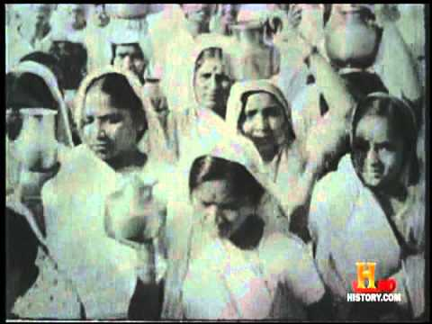
Video: Gandhi’s Salt March
Notes:
Link: https://www.youtube.com/watch?v=wj8Gf1rkJK8
Play video.

Slide 44

Video: Montgomery Bus Boycott
Notes:
Link: https://www.youtube.com/watch?v=FE6Yvy--5aw
Play video.

Slide 45
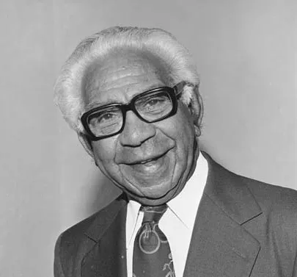
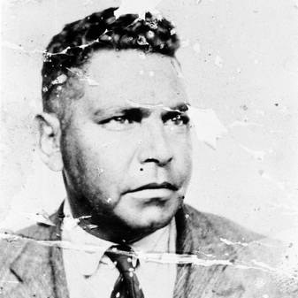
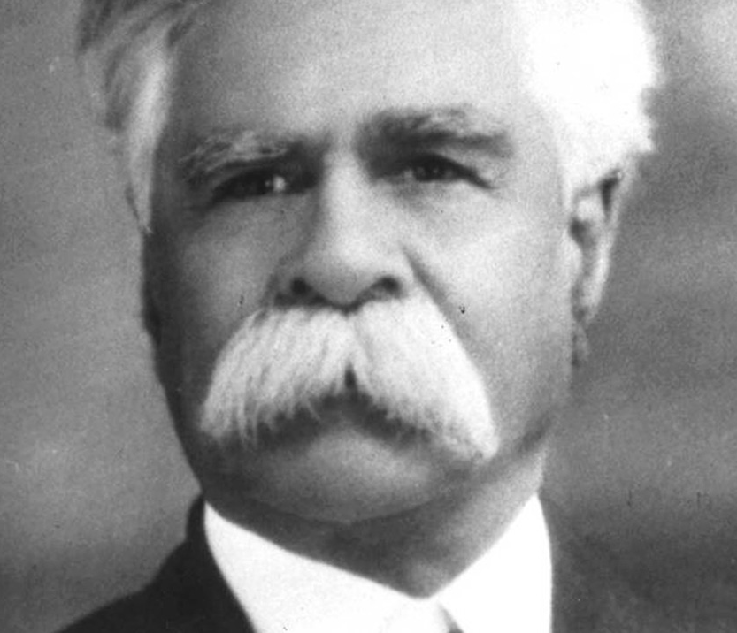
Peaceful Protests
Consider the Historical, Social, Cultural and Political significance of the videos watched.
Notes:
Facilitate whole-class discussion about the function of peaceful protests to raise awareness and call for action:
compare the historical, social, cultural and political significance of the three videos
consider that most Australians know more about Gandhi or Rosa Parks than they do about Jack Patten, Douglass Nicholls or William Cooper.
Doug Nicholls Image Source: https://kids.britannica.com/students/article/Douglas-Nicholls/628838
Jack Pattern Image Source: https://williamcooper.monash.edu/people/john-jack-patten/
William Cooper Image Source: https://insidestory.org.au/the-evolution-of-a-myth/

Slide 46

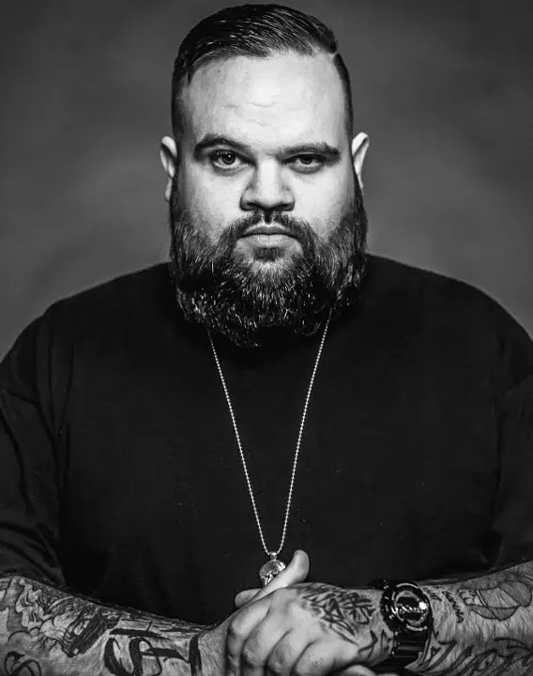
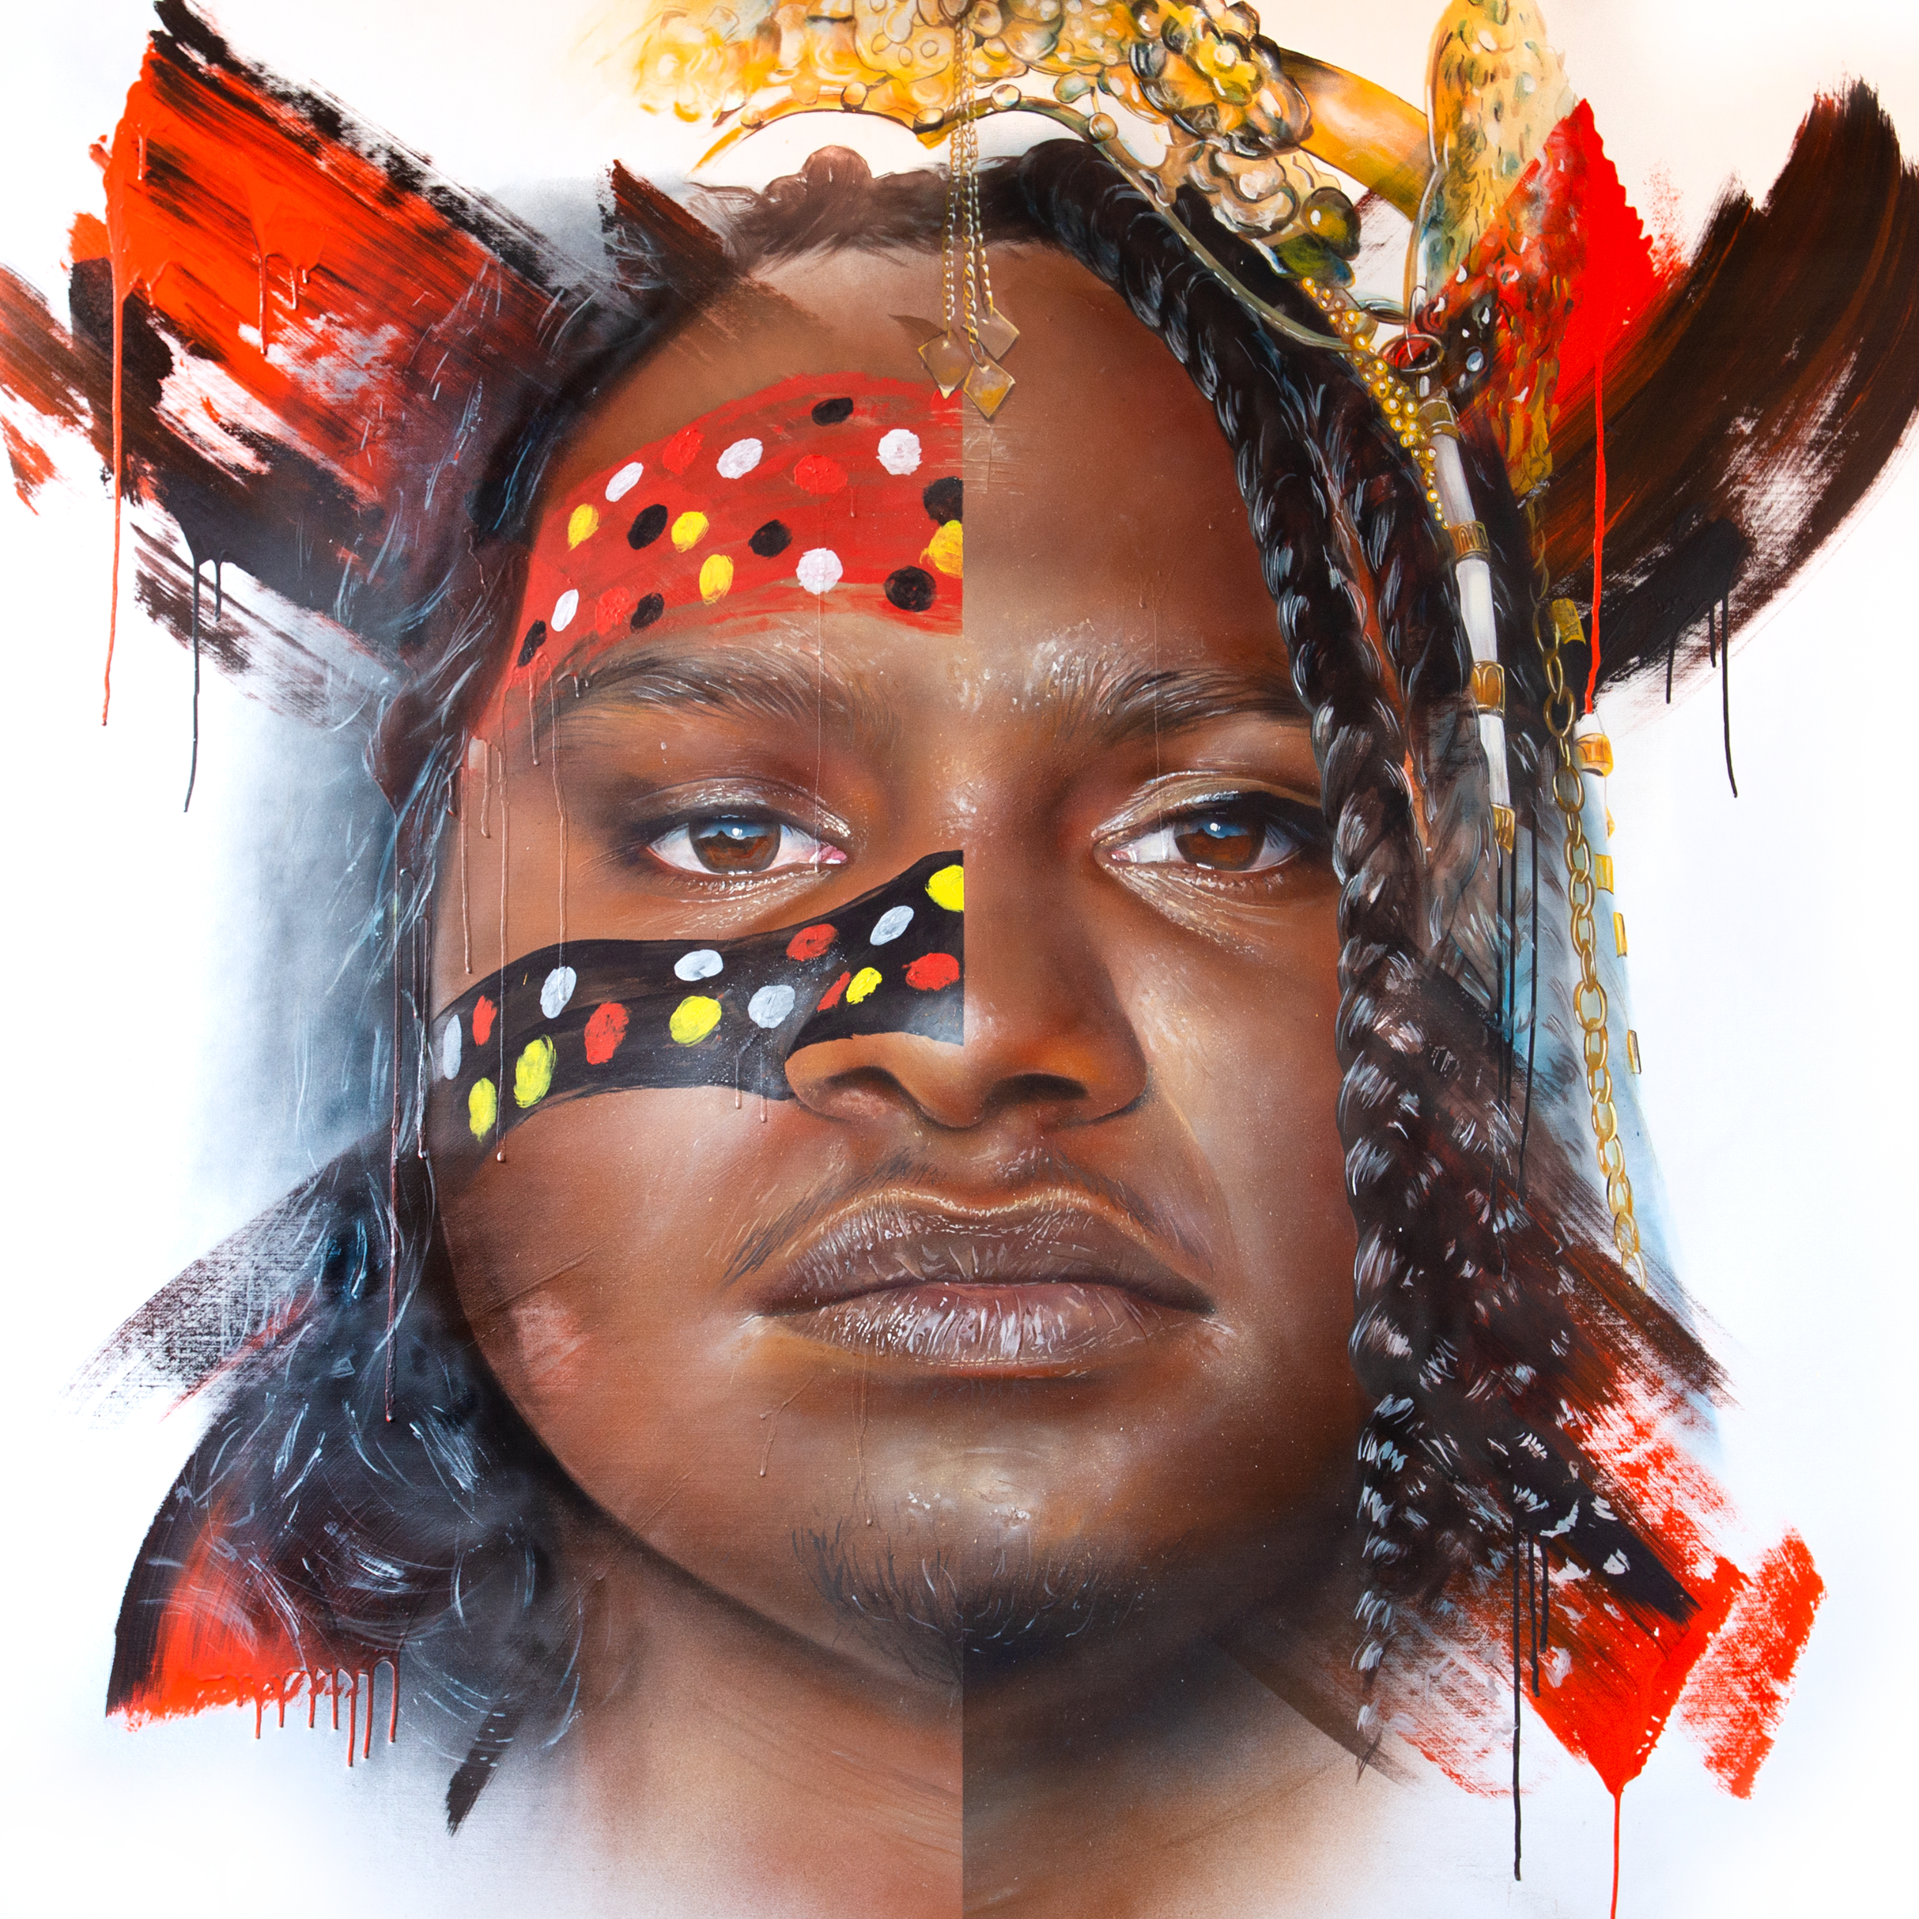
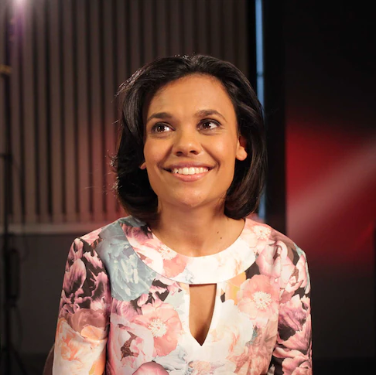
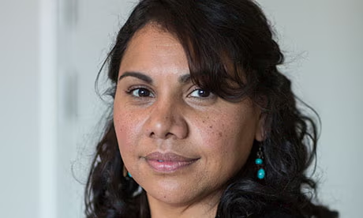
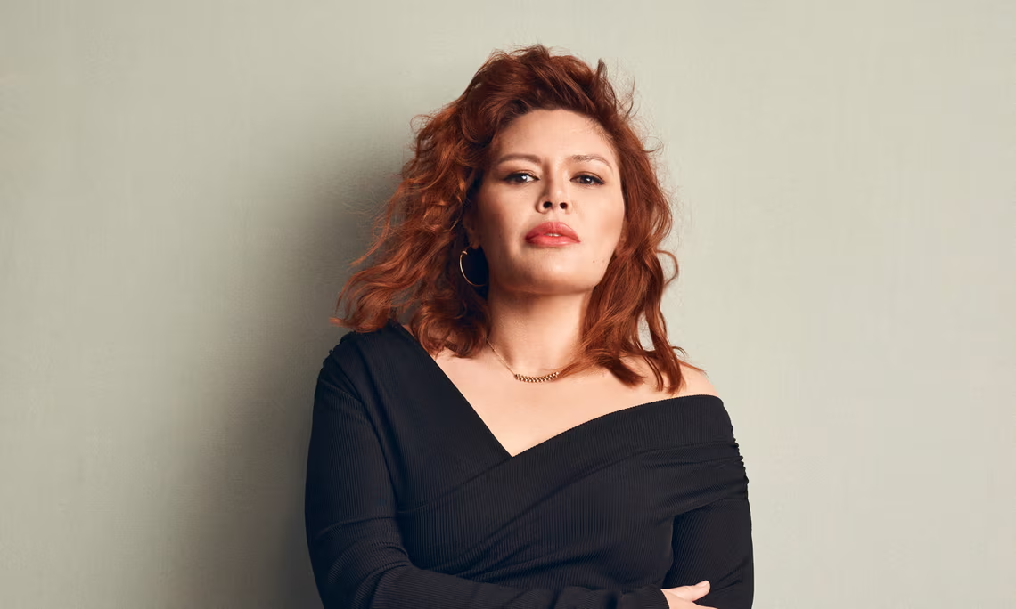
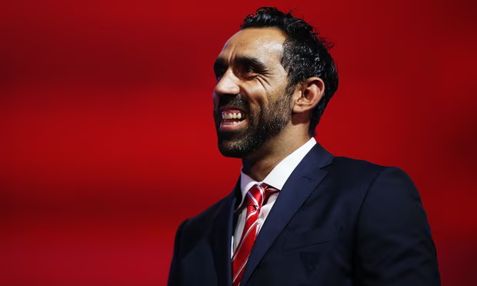

National Day of Mourning Pitch
In groups:
Write a pitch for a television segment promoting compulsory education about the 1938 Day of Mourning in all Australian Schools.
Notes:
The pitch is to be aired on a television show such as Today Tonight, The Project, The Weekly, Sunrise etc.
students to follow the pitch writing format worksheet (Appendix 6).
express that students will need to nominate Aboriginal and Torres Strait Islander people to be involved in the pitch as writers, directors, producers, artists, musicians, actors etc.
these could be local community members or well-known public figures such as:
Miranda Tapsell, Adam Goodes, Deborah Mailman, Nakkiah Lui, Jessica Mauboy, Sally Morgan, Adam Briggs, Baker Boy, Steven Oliver, Beck Cole, Rachel Perkins
Depending on time constraints, students may also create storyboards (6–8) as a visual guide to the pitch.
Students will support their pitch with relevant research. Recommended sources include:
Right to self-determination
Aboriginal self-determination and autonomy
My grandfather protested against Australia Day in 1938
The 1938 Day of Mourning.
Image credit Miranda Tapsell: https://www.abc.net.au/news/2016-07-15/actress-miranda-tapsell-on-resilience-and-diversity/7629718
Image credit Adam Goodes: https://www.theguardian.com/sport/2023/may/31/if-im-only-known-for-football-ive-failed-adam-goodes-opens-up-in-rare-interview
Image credit Jessica Mauboy: https://www.jessicamauboy.com.au/
Image credit Baker Boy: https://musicfeeds.com.au/album/review-baker-boy-has-truly-arrived-with-debut-album-gela/
Image credit Adam Briggs: https://www.theguardian.com/commentisfree/2014/nov/14/indigenous-rapper-adam-briggs-an-introvert-with-an-extroverts-career
Image credit Nakkiah Lui: https://www.theguardian.com/lifeandstyle/2023/jun/26/its-pretty-much-a-second-child-nakkiah-lui-on-family-finger-limes-and-her-new-food-podcast
Image credit Deborah Mailman: https://www.theguardian.com/world/2013/oct/31/redfern-now-receptive-audience-indigenous-sydney
Image credit Steven Oliver: https://www.abc.net.au/qanda/steven-oliver-2022/101707356

Slide 47
Conclusion:
Present pitch
Notes:
In groups, students present their pitch to class.
Teacher may award commendations such as ‘most creative’, ‘most successful’ and ‘people’s choice’ places to the most outstanding pitches.
Pitches may be published to the wider school community at teacher’s discretion (school library, newsletter, website etc.)

Slide 48
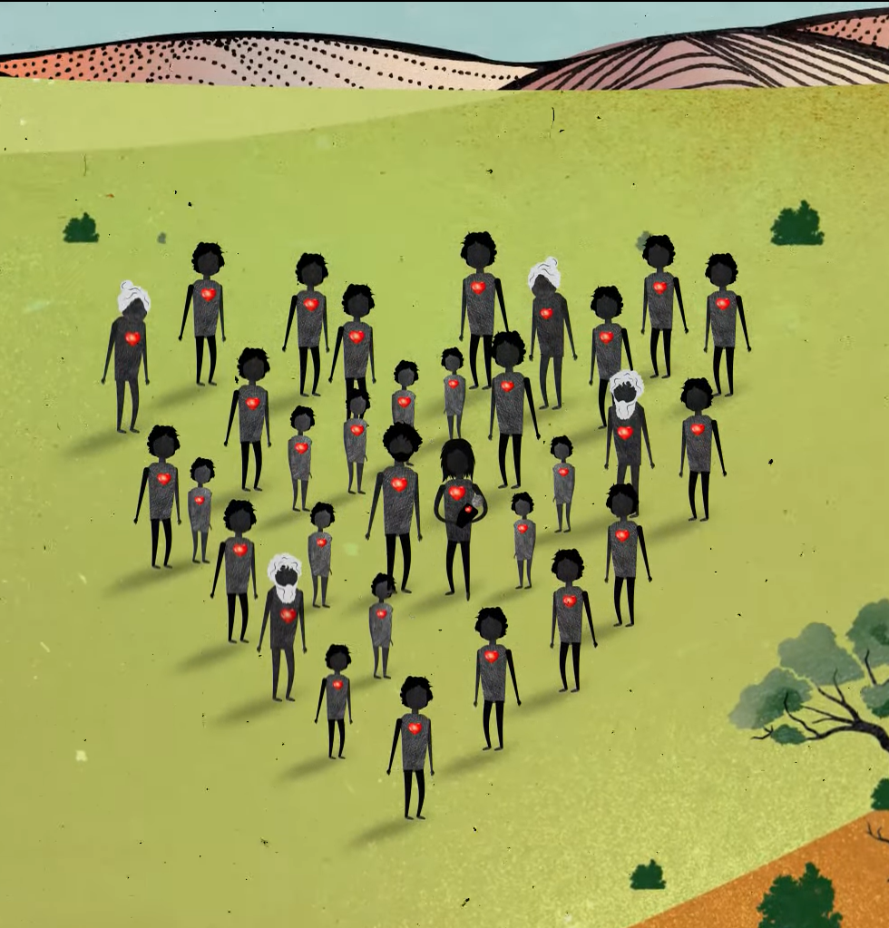

Contact The Healing Foundation
@HealingFoundation
@healingourway
@healingourway
www.healingfoundation.org.au
Healing Foundation
Notes:
Consider:
Sharing your outcomes and experience with The Healing Foundation at resources@healingfoundation.org.au
Sharing the resource and how you used it amongst your networks.
Sharing your students’ learning journey and tag The Healing Foundation on Instagram @healingourway and on Facebook as ‘Healing Foundation’.

