Slide 1
Year 10

Slide 2
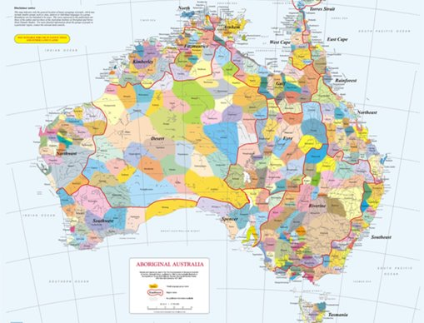
Acknowledgement
[Name of school/class] acknowledges Country, Custodians and Community of the lands on which we are on today [insert name of land/ peoples].
We also pay our respects to Elders and to Stolen Generations survivors, of the Dreaming and of the here and now.
We recognise the ongoing nature of trauma experiences for First Nations peoples and commit each day to survivor-led intergenerational healing.
Notes:
Update this slide with the name of your school/ class and the name of the land/s on which you're presenting the lesson on.
You may choose to make the wording of this acknowledgement more specific to your land/school/experiences. The acknowledgement isn't a script that we have to follow, you may even introduce the unit by working with students to write an acknowledgement for your class.
Image credit: https://ipaustralia.libguides.com/c.php?g=451400&p=3082380

Slide 3
Aboriginal and Torres Strait Islander students and teachers should be aware that these resources may contain the names, images, and voices of deceased persons.
Notes:
Important to remind students to speak up if they are feeling discomfort, and any safety and wellbeing measures your school has in place.

Slide 4
Care and safety
These lessons might include some content that is confronting or overwhelming
We all need to understand a full history of Australia, including the experiences of Stolen Generations survivors, their families and communities, and the impacts of past government policies that are still being felt today
It is important to speak to me or another adult if at any point you feel distressed – we are all here to learn together and keep each other safe.
Notes:
Important to remind students to speak up if they are feeling discomfort, and any safety and wellbeing measures your school has in place.
This is also a good place to ask the cultural safety questions from the educator's guide so you can co-construct a culturally safe space with your students.

Slide 5
Healing together
Why is learning about the Stolen Generations important?
  to change the way we look at our collective history.
  to support reconciliation and an honest understanding of our past – not just one perspective.
  to become aware of past government policies that still affect many Aboriginal and Torres Strait Islander peoples and families today.
Notes:
Give students a chance to suggest why they think the learning is important before clicking through to the reasons.

Slide 6
Cultural Safety
How does a safe classroom look to you?
How does it feel?
How can we be culturally safe?
Notes:
You may have already established this as a class, if so, use this time to reiterate the class rules.
Begin a discussion about cultural safety with the class. Ask them to answer the questions in a 'think/pair/share' activity, or address them as a group.
Use the final question to lead in to the next slide.

Slide 7
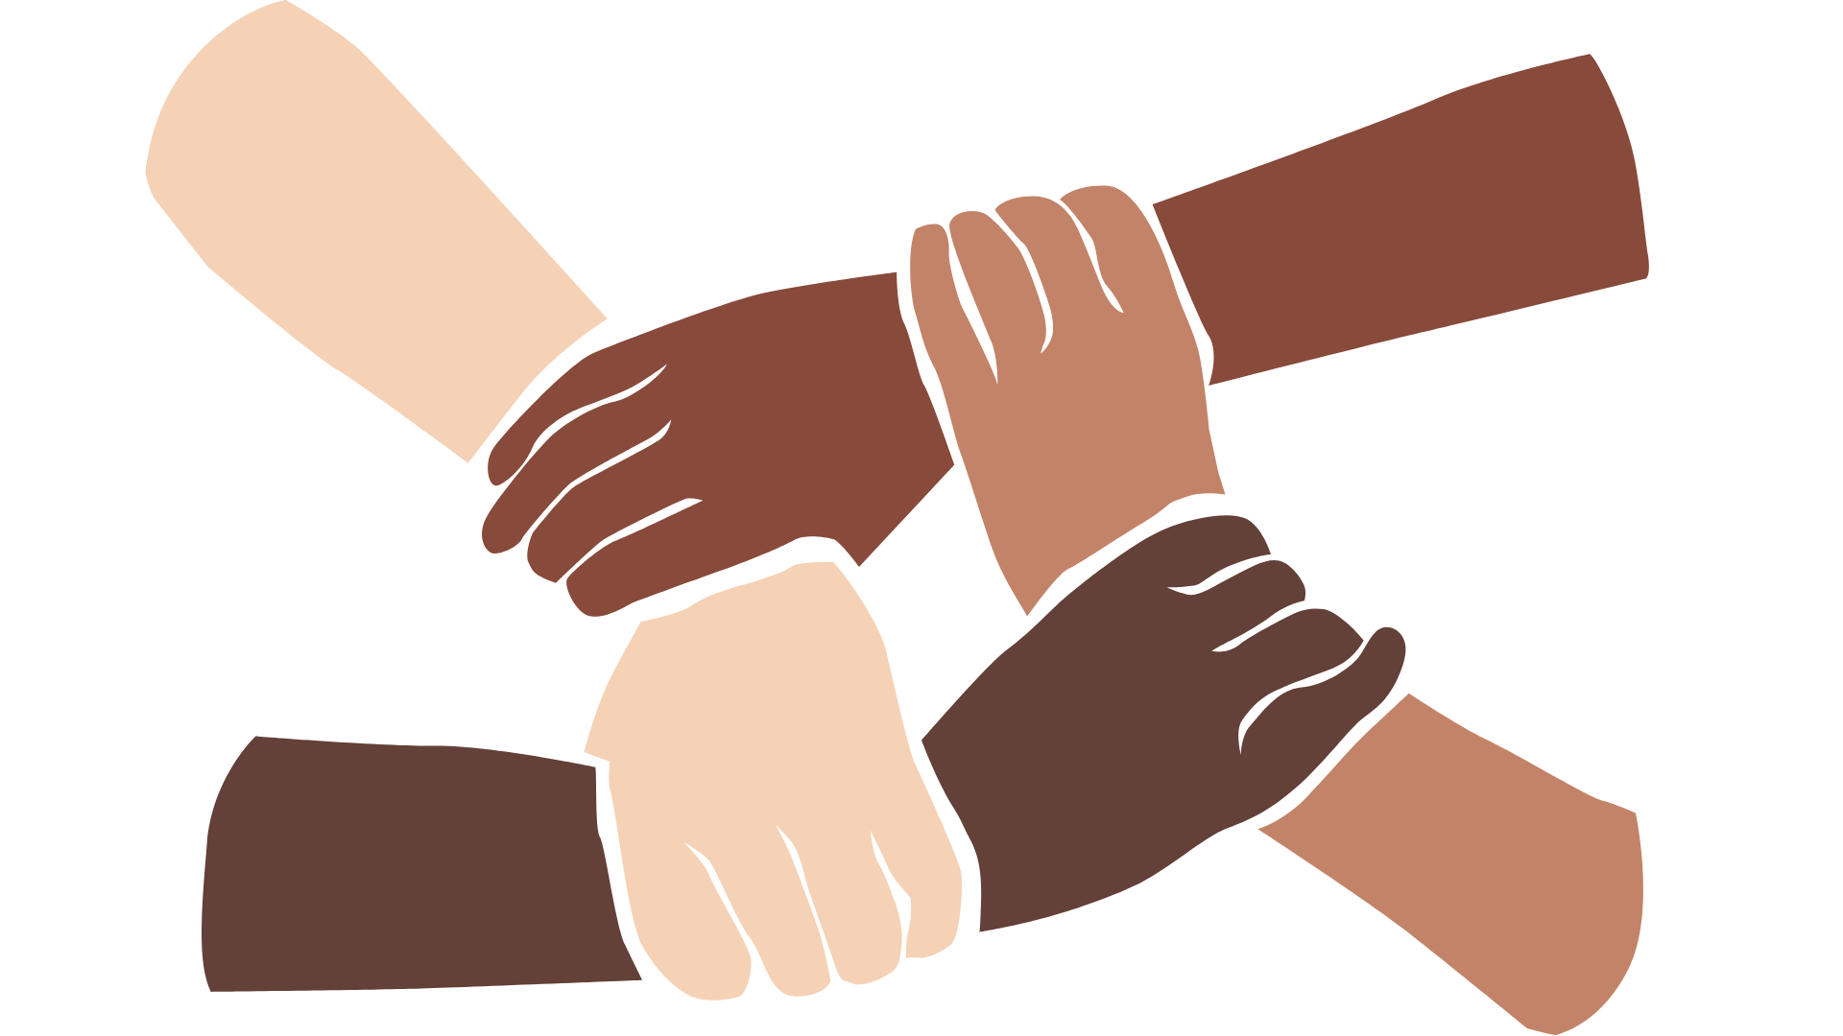
Cultural Safety
Open mindedness
Respect
Honest communication
Being mindful of privilege
Notes:
A culturally safe classroom environment relies on open-mindedness, respect and honest communication.
Make any changes needed for this discussion to be age-appropriate for your class
Image credit: Sketchify from Canva

Slide 8
Overview: this week’s activities
ACTIVITY 1: THE CROKER ISLAND EXODUS
The Croker Island Exodus is one of Australia’s greatest adventure stories. It highlights the tenacity, strength and resilience of spirit that aided the survival of 65 young Aboriginal children and the women who looked after them as they journeyed across the continent to safety in World War II.
ACTIVITY 2: THE DISRUPTION OF FAMILY
Students will discover the impacts that Australia’s government policies have had on Aboriginal and Torres Strait Islander peoples. The forced removal of First Nations children from their families has had catastrophic effects on families and their communities that are still being felt today.
ACTIVITY 3: THE SCARS ON OUR NATION
Students will explore many stories about the experiences, trauma and impacts Australian government policies have had on Aboriginal and Torres Strait Islander peoples. Students will be presented with perspectives that may challenge what they thought they knew about Australian history.
ACTIVITY 4: HOW WE HEAL TOGETHER
Strength, resilience and healing will be investigated in this activity. Students will be able to explore what it means to heal together and why healing is so important.
Notes:
OPTIONAL SLIDE
Update week to timeframe for these teaching activities in consideration of class schedule and activity time.

Slide 9
The Stolen Generations:
What do you know?
Notes:
Encourage students to share what they know about the Stolen Generations. Use the next slide to explain what happened in more detail.

Slide 10
The Stolen Generations
For about a century, thousands of First Nations children were systematically taken from their families, communities and culture, many never to be returned.
These children are known as the Stolen Generations
Notes:
More information:
First Nations children were removed by government authorities from the mid-1800s to the 1970s. In the 1860s, Victoria became the first state to pass laws authorising the removal of First Nations children from their families.
Similar policies were later adopted by other states and territories – and by the federal government when it was established in the 1900s.
For about a century, thousands of children were taken from their families, communities and culture, many never to be returned.
These children are known as Stolen Generations survivors, or Stolen Children. They were taken by the police, from their homes, and on their way to or from school, and placed in more than 480 institutions, adopted or fostered by non-Indigenous people and often subjected to abuse. The children were denied all access to their culture, they were not allowed to speak their language and they were punished if they did.
There are currently more than 33,000 Stolen Generations survivors in Australia. More than one third of all First Nations peoples are their descendants. In Western Australia, more than half of the population have Stolen Generation links.

Slide 11
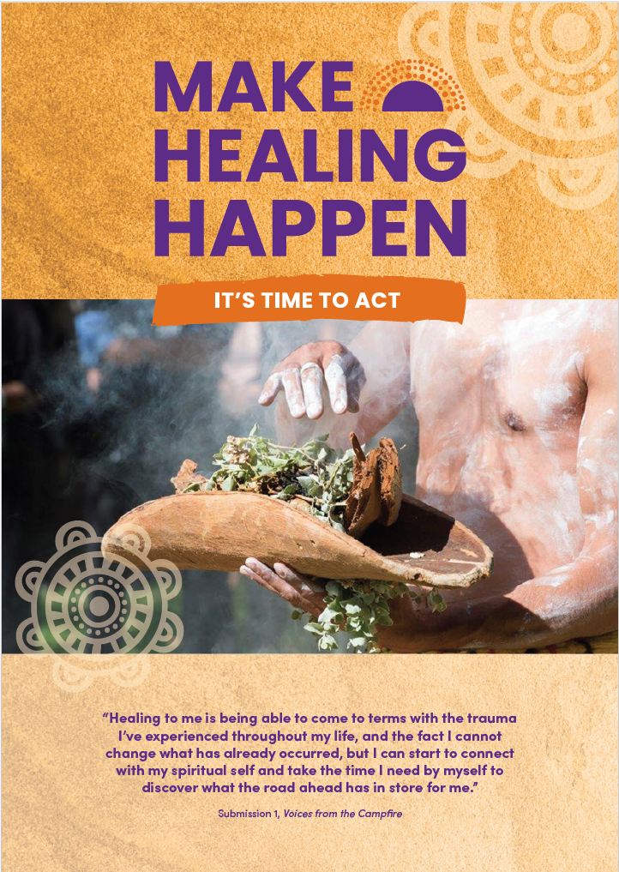
Make Healing Happen
In small groups, discuss the following questions:
Who are the Stolen Generations?
Where are they today?
What are the impacts of past policies?
What is meant by disproportionate disadvantage?
Notes:
Link to Make Healing Happen report: www.healingfoundation.org.au/make-healing-happen/
The overview (which is only 4 pages) can be found on the same page via the ‘Download the overview’ button. Give students a chance to read through this document in order to answer the questions on the slide.

Slide 12
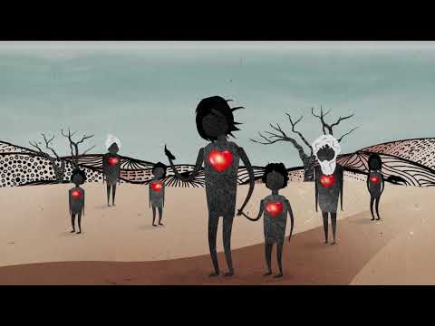
What is intergenerational trauma?
Notes:
Link to video: https://www.youtube.com/watch?v=vlqx8EYvRbQ

Slide 13
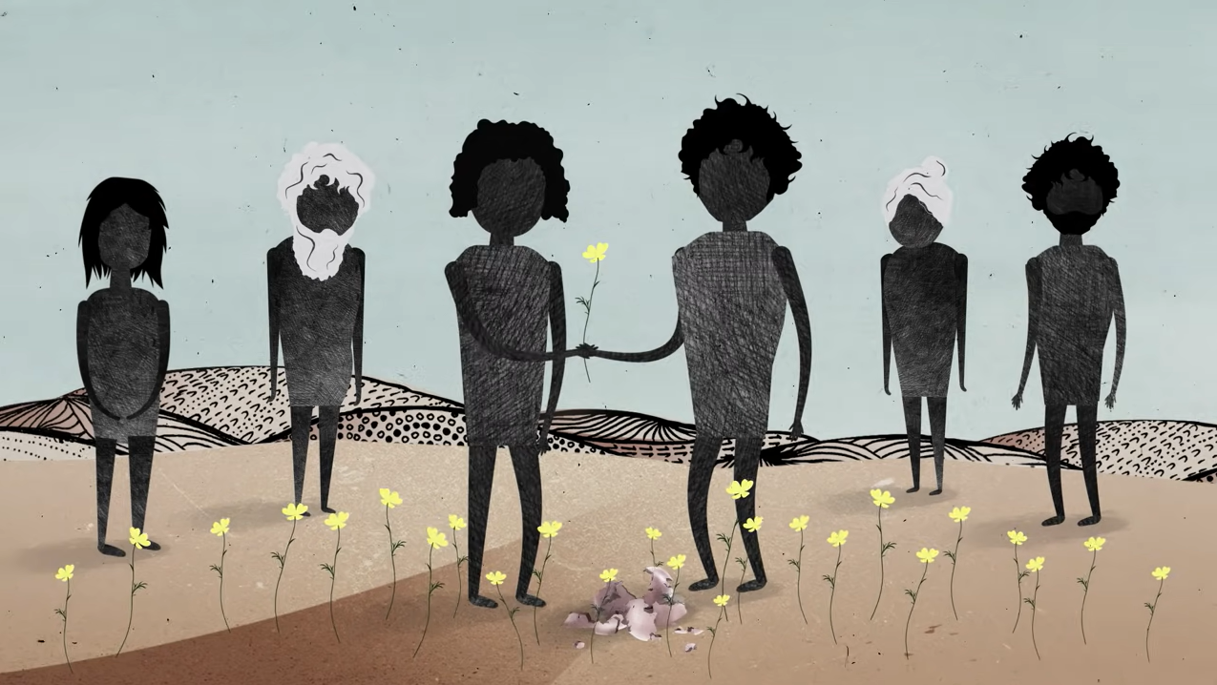
Intergenerational trauma
A report by the Australian Institute of Health and Welfare found that in comparison to other First Nations peoples, children living in households with Stolen Generations are:
2 times as likely to experience discrimination
2 times as likely to experience violence
1.5 times more likely to have been arrested
Notes:
Use this slide to discuss what intergenerational trauma means and how it impacts Stolen Generations descendants. Information from the lesson plan is provided below. Trauma in First Nations communities is not just experienced individually but between generations and across communities. The ripple effect is felt far and wide. If people don’t have the opportunity to heal from trauma, they may unknowingly pass it on to others through their behaviour. Their children may experience disconnection from their extended families and culture and have high levels of stress. This creates a cycle of trauma, where the impact is passed from one generation to the next. In Australia, intergenerational trauma predominantly affects the children, grandchildren and future generations of the Stolen Generations.
Report link: https://healingfoundation.org.au/aihwchildrensreport/
Ask students to:
Paraphrase this information into their own words, as a group or construct a zine.
Make a comment and post on a sticky note on the infographic.

Slide 14
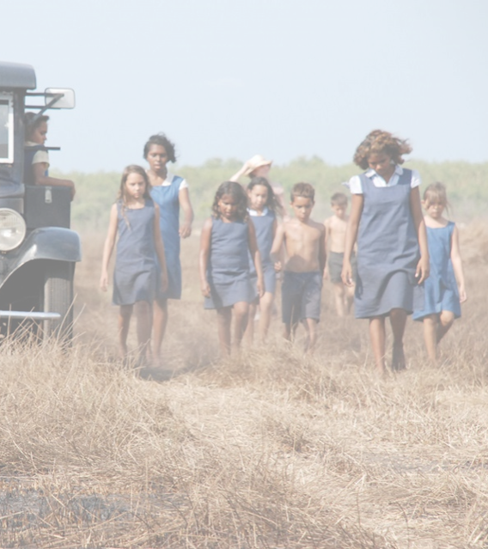
Activity 1:
The Croker Island Exodus
Notes:
The Croker Island Exodus is one of Australia’s greatest adventure stories. It highlights the tenacity, strength and resilience of spirit that aided the survival of 65 young Aboriginal children and the women who looked after them as they journeyed across the continent to safety in World War II.
Resources
Linda’s story.
Croker Island Exodus documentary. Possible ways to access the video include:
Fetch TV.
SBS website (It is usually made available each year).
ClickView.
Your local library.
Via Tamarind Tree Pictures, the company that produced the film.
KWL Chart (Appendix 1).
Footprint template (Appendix 2).
How to make a QR code (Appendix 3).
EXTRA RESOURCES/FURTHER READING
They Crossed a Continent by Margaret Somerville. Note: this book can be purchased from Somerville Community Service.
Find and Connect e.g. Croker Island Mission (1940 – 1968).
Image credit: https://statements.qld.gov.au/statements/93514

Slide 15
Cultural Safety
Open mindedness
Respect
Honest communication
Being mindful of privilege
Notes:
Remind students about their understanding of a culturally safe classroom.
Image credit: Sketchify from Canva

Slide 16
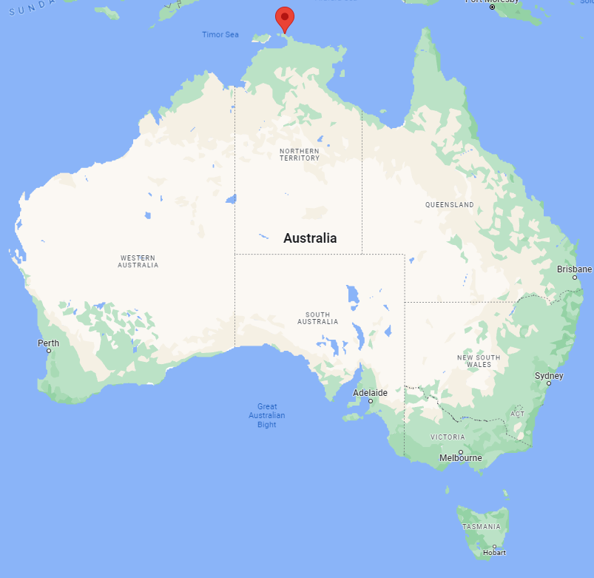
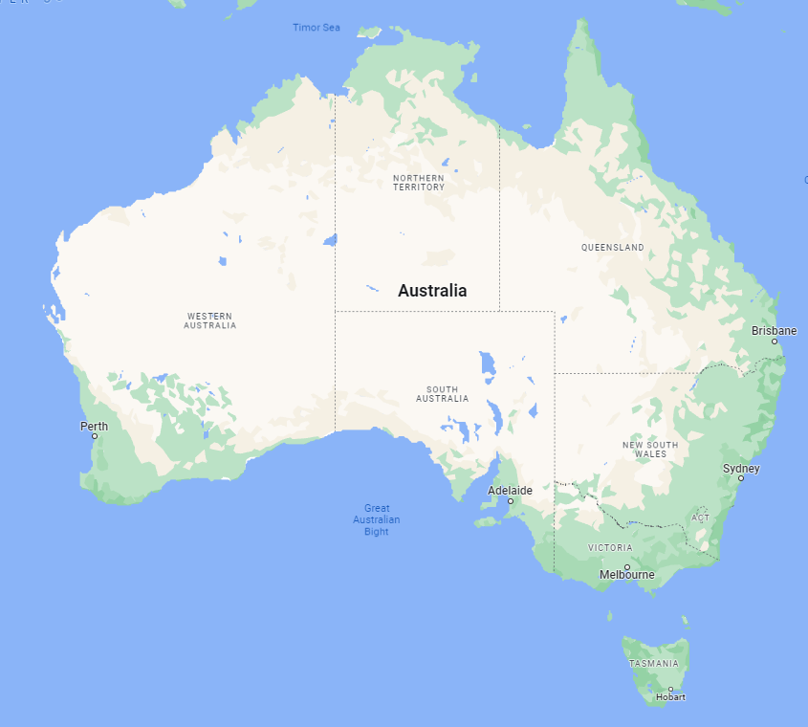
The Croker Island Exodus
  What do you know about Croker Island?
  Find Croker Island on the map, and research the Traditional Owners.
  The Croker Island Exodus is one of our country’s greatest adventure stories of tenacity, resilience and survival. Why isn’t this one of the things we think of when we talk about Australia’s history?
Notes:
Use Google Maps to find Croker Island before revealing the map

Slide 17
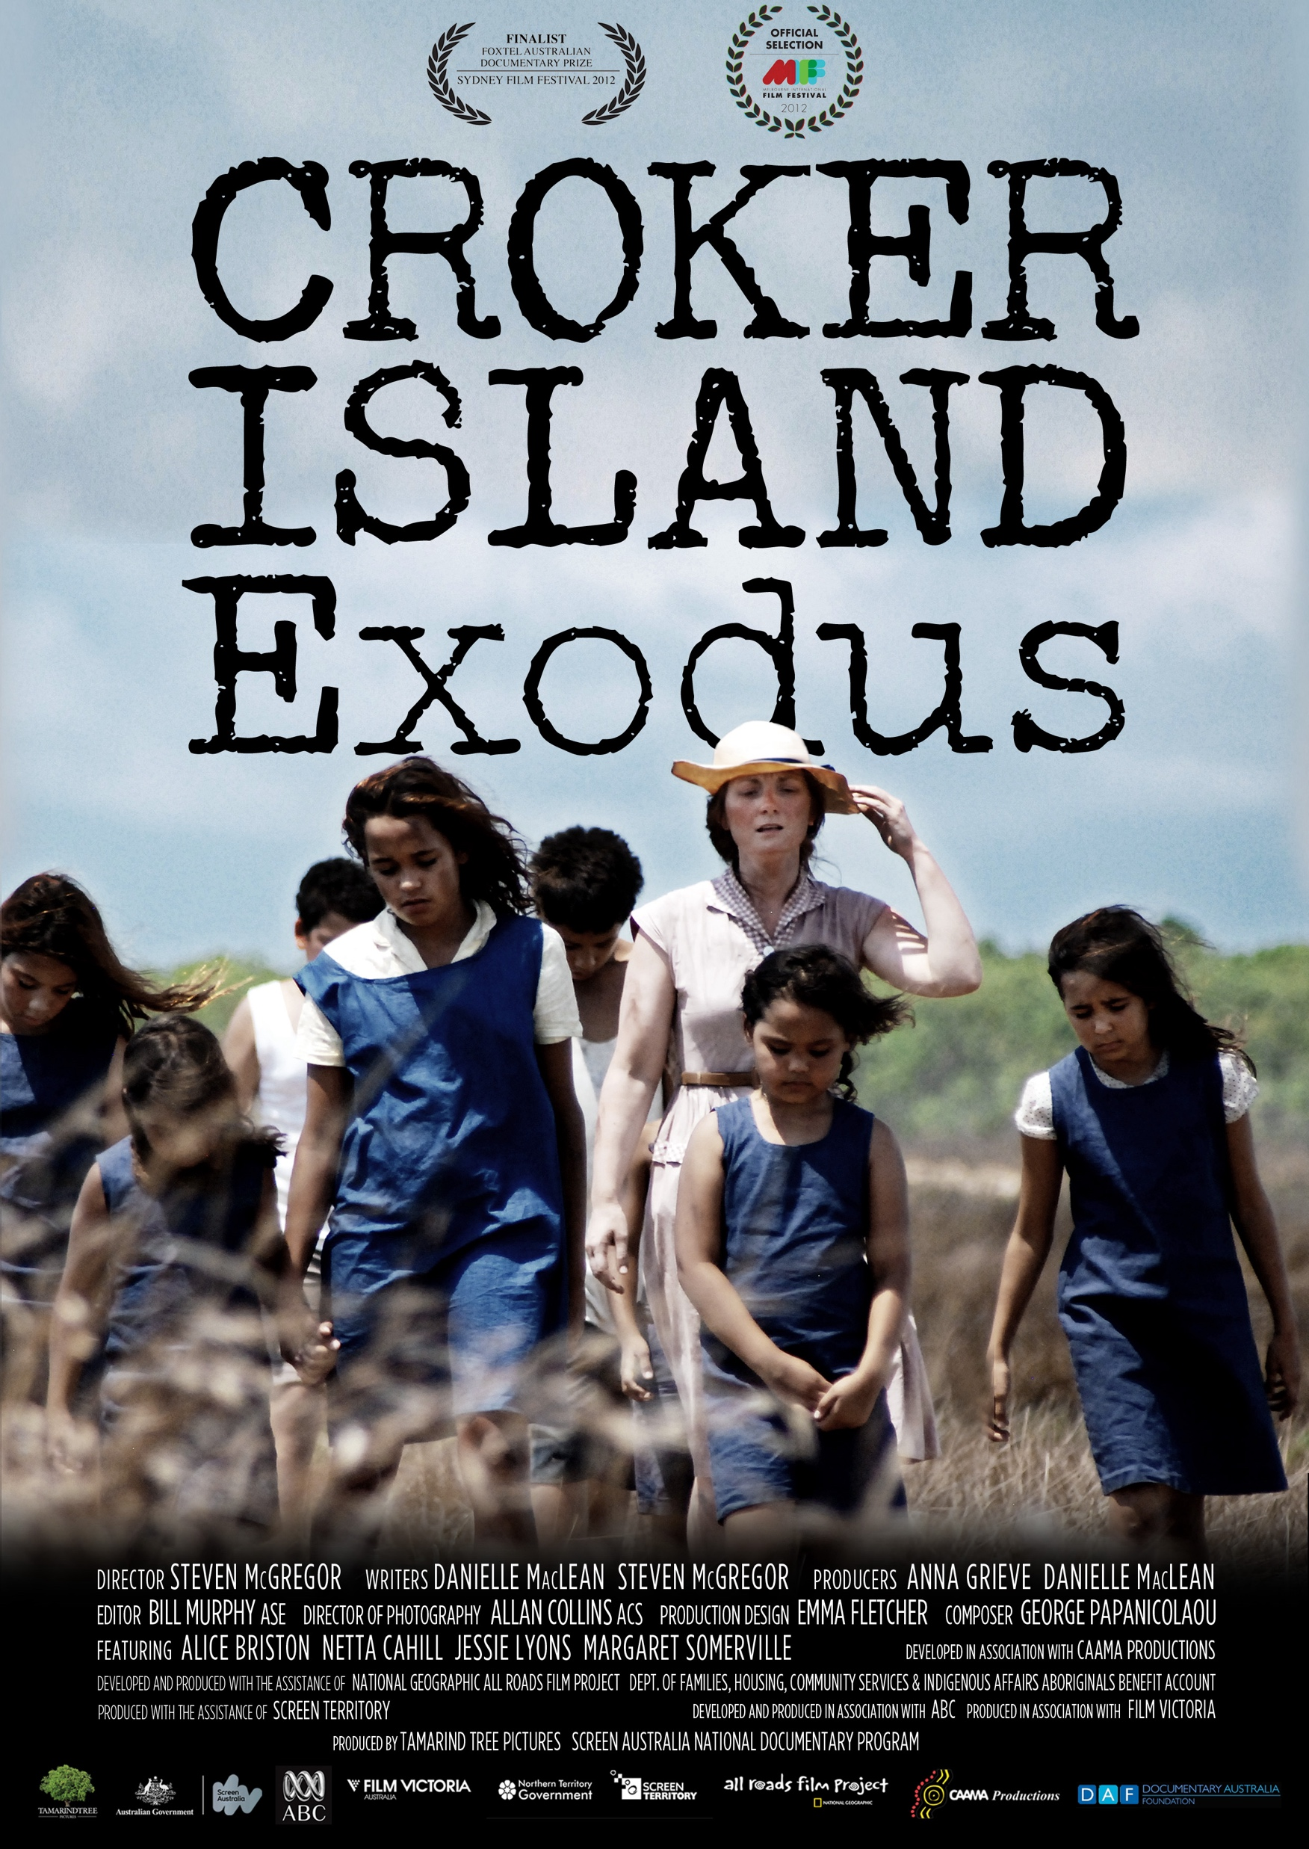
Watch The Croker Island Exodus
Notes:
Resources:
Fetch TV: https://www.fetchtv.com.au/movie/details/15643
iTunes: https://www.apple.com/au/itunes/
SBS Website: https://www.sbs.com.au/nitv/article/croker-island-exodus-a-documentary-telling-the-remarkable-adventure-story/se5agl8y9
ClickView: https://www.clickview.com.au/
Tamarind Tree Pictures: https://www.tamarindtreepictures.com/our-work/iduma-website-cyfc8

Slide 18
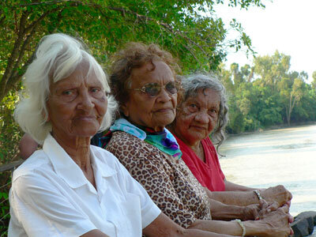
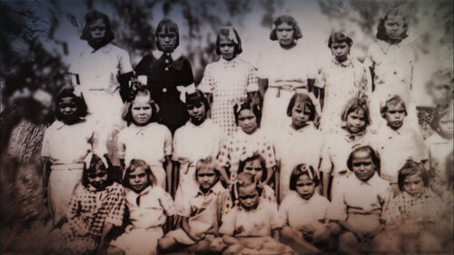
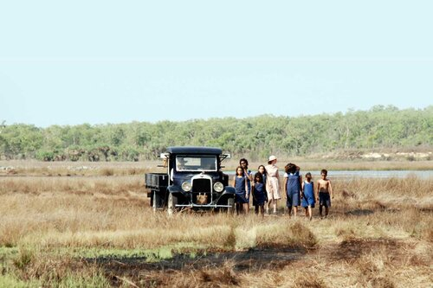
The Croker Island Exodus
  In small groups, discuss the documentary
  Use the discussion sheet, filling in the following:
      Impact:
        What elements had an impact on you?
          Use a KWL chart (What I Know, what I Want to know and what I Learned) to explain your responses
      Information:
        What is something new you learnt?
      Interest:
        What did you find interesting or creative about the film?
Notes:
Distribute Appendix 1: Discussion Sheet
Images from: https://www.tamarindtreepictures.com/our-work/iduma-website-cyfc8

Slide 19
The Croker Island Exodus
Option 1:
Draw the epic journey on a map of Australia:
Use the KWL worksheet provided to create your own map of Australia to draw the epic journey the children and staff took.
Use quotes from the documentary to enhance each step of the way.
This could be made as a digital or hardcopy resource to showcase this story in your school and local community.
Notes:
OPTIONAL, there are three options for this activity

Slide 20

The Croker Island Exodus
Option 2:
Recreate journey with footprints:
Reflect on your new learning in small groups and respond individually on the footprint handout.
Place these footprints around the room to recreate the journey from Crocker Island to Sydney.
Find images and information about each place the group stopped.
Notes:
OPTIONAL, there are three options for this activity
Distribute Appendix 2: Footprint Template

Slide 21
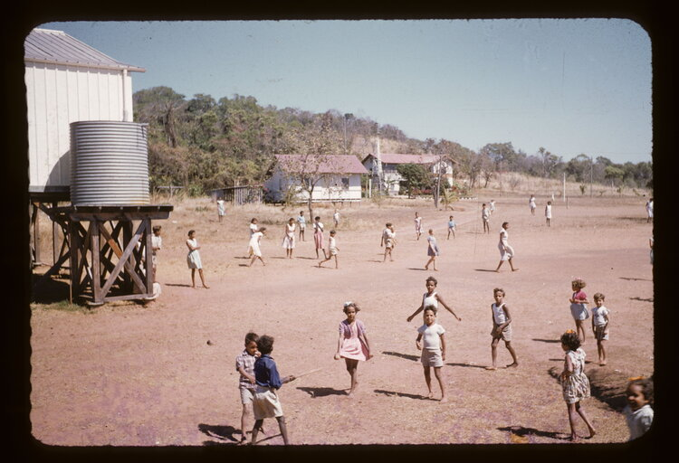
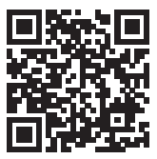
The Croker Island Exodus
Option 3:
Video stories of the journey:
Use old suitcases to represent the journey, record yourselves telling the story, displaying it using a QR code at locations around the room or school.
Notes:
OPTIONAL, there are three options for this activity
Image from: https://www.tamarindtreepictures.com/our-work/iduma-website-cyfc8

Slide 22
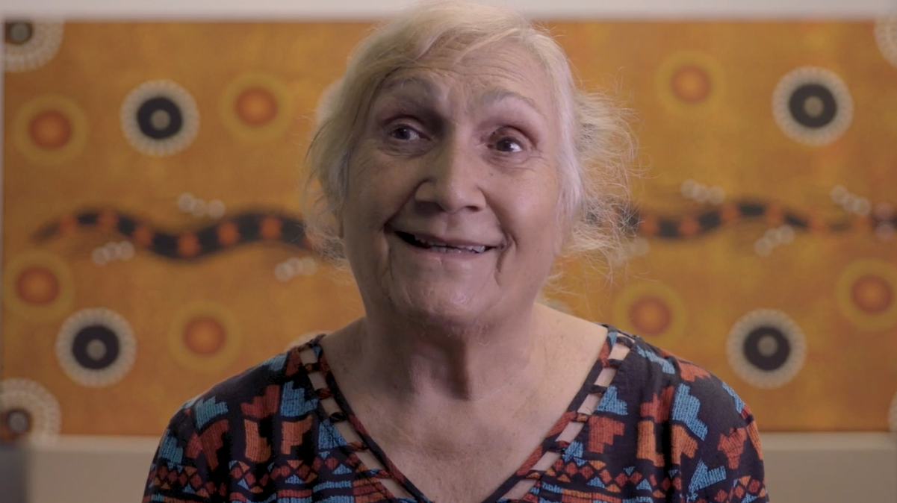
The Croker Island Exodus
  Write a letter to Linda, Netta, Alice or Jessie explaining the impact their story has had on you and thanking them for sharing their story with the world so that we can have a richer understanding of Australian history.
Notes:
This activity is an optional addition
Video Source: https://www.dropbox.com/sh/peagkn6vidov27l/AAB5oJHs7KAKSuaPP10gLqRFa?dl=0&preview=Linda+Croker+Island+After+Review+190416.mp4

Slide 23
The Croker Island Exodus
Key questions in response to the Croker Island Documentary:
  Explore the emotion in the documentary. Each person expresses their feelings differently but what is in common?
  Explain what Alice meant when she said, ‘it is not natural’.
  When Alice, Netta and Jessie talk about being forcibly removed from their families and sent away, they are visibly upset, and the pain of this experience is still with them.
  Why is it important to share these stories?
  Does sharing your story help?
Notes:
You may choose to run this activity in small groups or as a whole class, but ensure the whole class comes together to discuss the documentary before ending with reflections

Slide 24

Reflections
      ‘We had each other as support’.
      ‘Croker Island was our home. Even though it shouldn’t have been, it was. We wanted to return after the war’.
      ‘The children at Croker Island were my sisters and brothers’.
      ‘We never complained. We got on with our lives’.
  What can be learnt from these amazing women?
Notes:
Ask students to share reflections before sharing prompts. Each prompt should be discussed as a class, or give the students time to reflect individually.

Slide 25

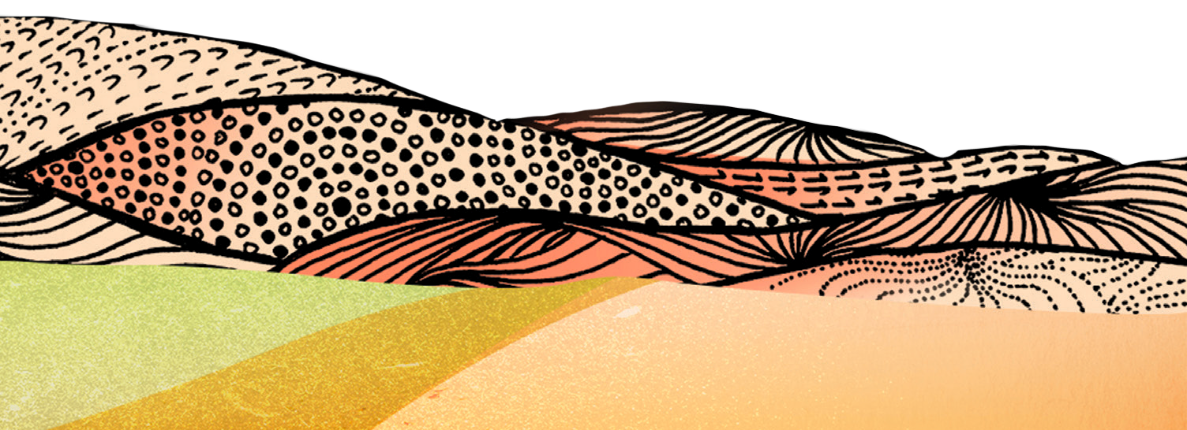

Activity 2:
Disruption of Family
Notes:
Students will discover the impacts that Australia’s government policies have had on Aboriginal and Torres Strait Islander peoples. The forced removal of First Nations children from their families has had catastrophic effects on families and their communities that are still being felt today.
Resources
Video: Aboriginal wellbeing and resilience by Western Australia Department of Health.
The Healing Foundation’s interactive map of Stolen Generations institutions.
Marlee’s Mob intergenerational trauma comic.
Documentary: Lousy Little Sixpence.
Video: Telling Our Stories – Tony Hansen.
Video: Telling Our Stories – Eileen Cummings.
Video: Telling Our Stories – Marjorie Winphil.
EXTRA RESOURCES
Island Stories: Listening to the people of the Torres Strait.

Slide 26
Cultural Safety
Open mindedness
Respect
Honest communication
Being mindful of privilege
Notes:
Remind students about their understanding of a culturally safe classroom.

Slide 27
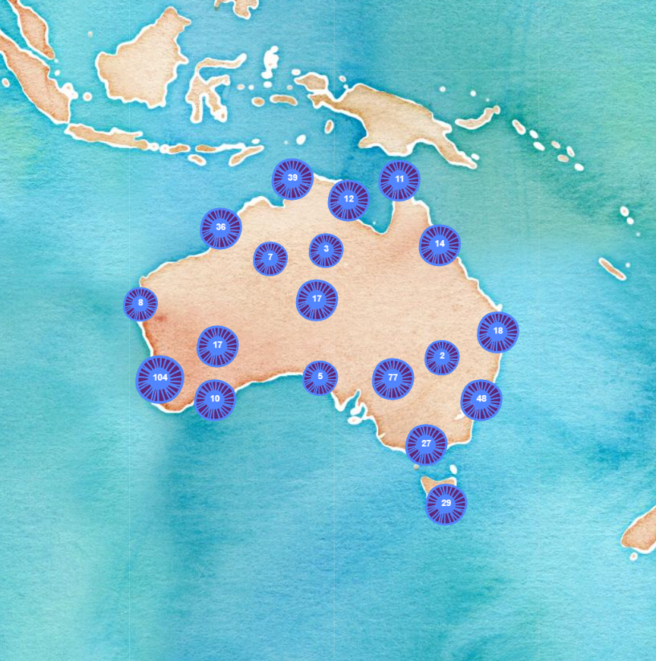
Disruption of family
  What do you already know about the Stolen Generations?
  Croker Islander was not the only place First Nations children were removed to. Does anyone know of anywhere else children were removed to?
  Why did the government decide to remove First Nations children from their families?
Notes:
Discuss the questions above and use the conversation to gauge the knowledge of your class.

Slide 28
Disruption of family
  In groups of 3-4, explore the Map of Stolen Generations institutions
  Groups will investigate one state on the map.
  Find out the different places where First Nations children were sent to.
  Choose a few institutions and research them to see what you can find
Notes:
You may choose to assign states to the groups or let them choose themselves
Link to map: https://healingfoundation.org.au/map-stolen-generations-institutions/

Slide 29
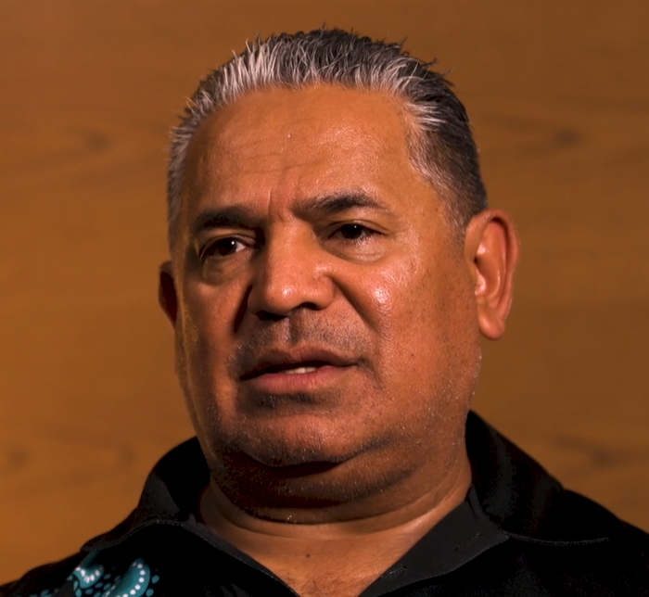
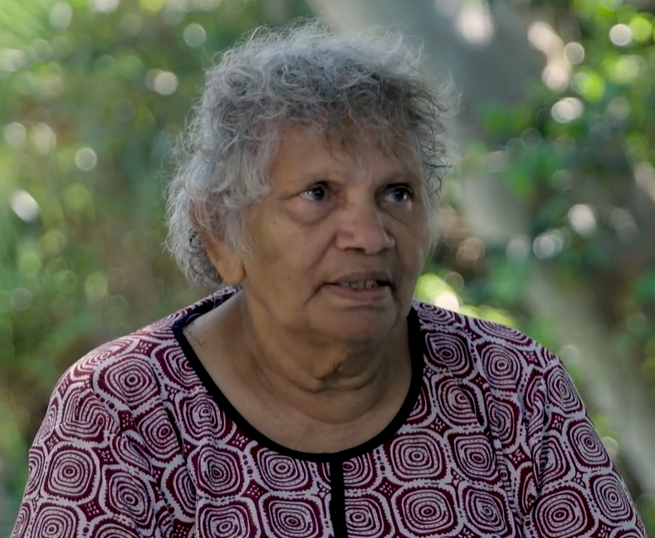
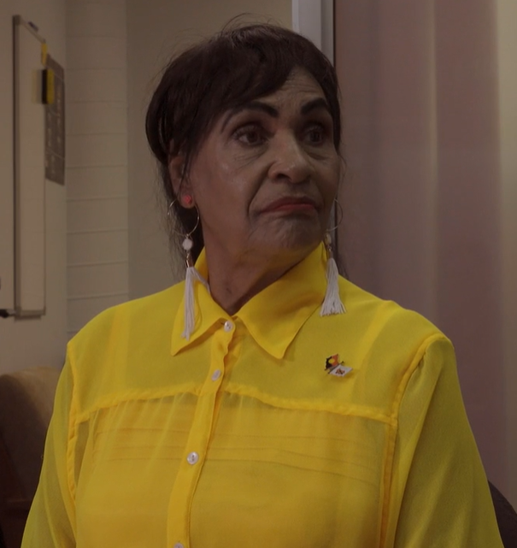
Disruption of family
Consider how the impacts of government policies are still being felt today.
Watch the videos for:
Tony Hansen, Eileen Cummings Marjorie Winphil
Notes:
After watching each video, complete a short think/pair/share activity for students to reflect on the video. Once all videos have been watched, have a longer discussion as a group.
The videos are on dropbox found at the links below:
Video: Telling Our Stories – Tony Hansen: https://www.dropbox.com/s/ajo6870z2mga4qw/Tony%20Hansen%20delivery%20file.mp4?dl=0
Video: Telling Our Stories – Eileen Cummings: https://www.dropbox.com/sh/peagkn6vidov27l/AAB5oJHs7KAKSuaPP10gLqRFa?dl=0&preview=Eileen+After+Review+190516.mp4
Video: Telling Our Stories – Marjorie Winphil: https://www.dropbox.com/sh/peagkn6vidov27l/AAB5oJHs7KAKSuaPP10gLqRFa?dl=0&preview=Marjorie+After+Review+190516.mp4

Slide 30
Reflection
Reflect on what you have learnt.
  Choose one word to sum up your new learning. Write it on a Post-it note and post it on an area in your classroom designated for debriefing.
  Take some time to read each other’s reflections.
Notes:
You may wish to alter this activity to suit your space and your students

Slide 31
Activity 3:
Scars on our Nation
Notes:
Students will explore many stories about the experiences, trauma and impacts Australian government policies have had on Aboriginal and Torres Strait Islander peoples. Students will be presented with perspectives that may challenge what they thought they knew about Australian history.
Resources
Video: The Story of The Healing Foundation.
Video: Telling Our Stories – Brian Gray.
Video: Telling Our Stories – TJ Mia.
Video: Telling Our Stories – Geoff Cooper.
How to structure student discussions with a walk and talk.
What about history?
Interactive documentary: K’gari by Fiona Foley and Larissa Behrendt.

Slide 32
Cultural Safety
Open mindedness
Respect
Honest communication
Being mindful of privilege
Notes:
Remind students about their understanding of a culturally safe classroom.
Image credit: Sketchify on Canva

Slide 33
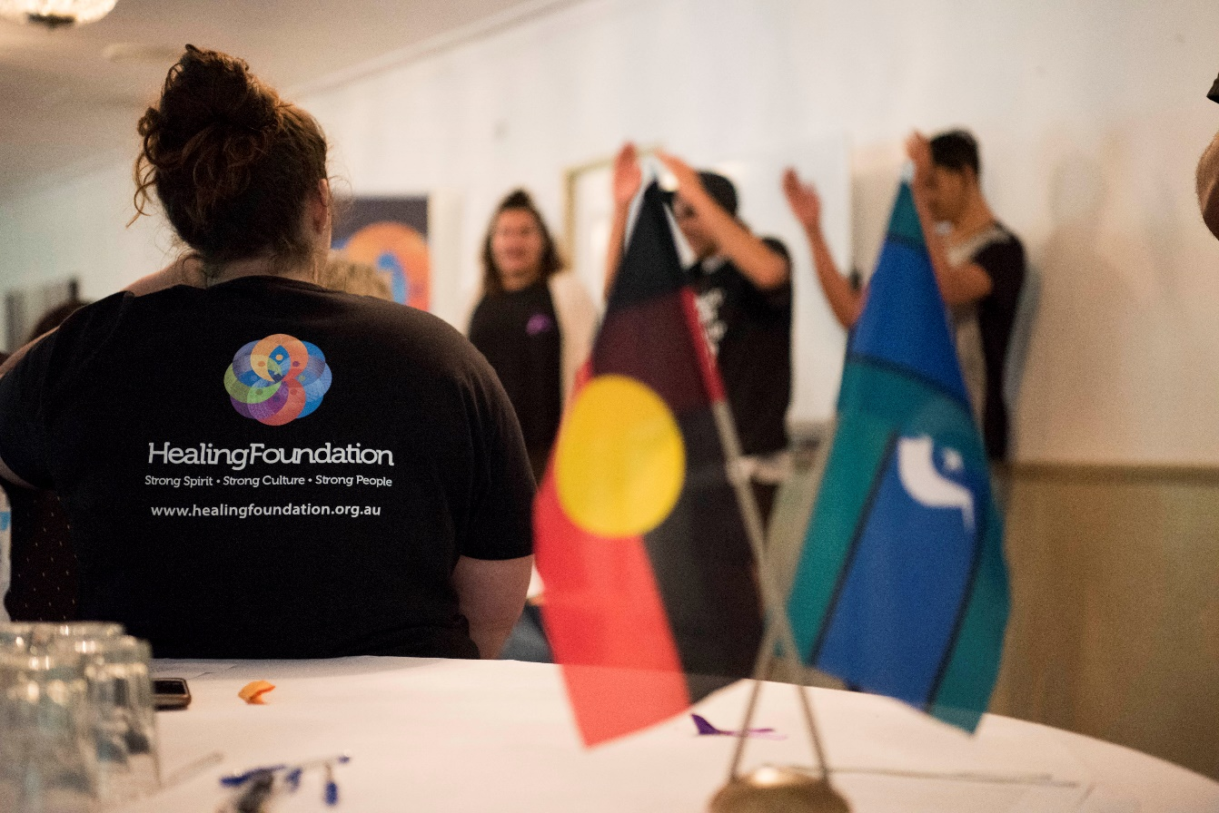
Scars on our nation
What do you know about The Healing Foundation?
What is the main role of The Healing Foundation?
Notes:
Gauge students understanding and knowledge

Slide 34
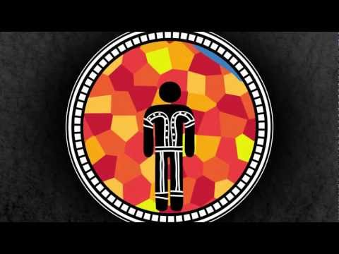
About The Healing Foundation
Notes:
Source: https://www.youtube.com/watch?v=zDN7R6qRpUg

Slide 35
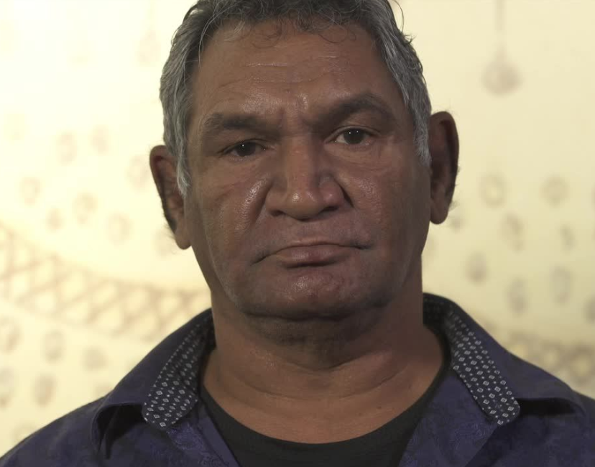
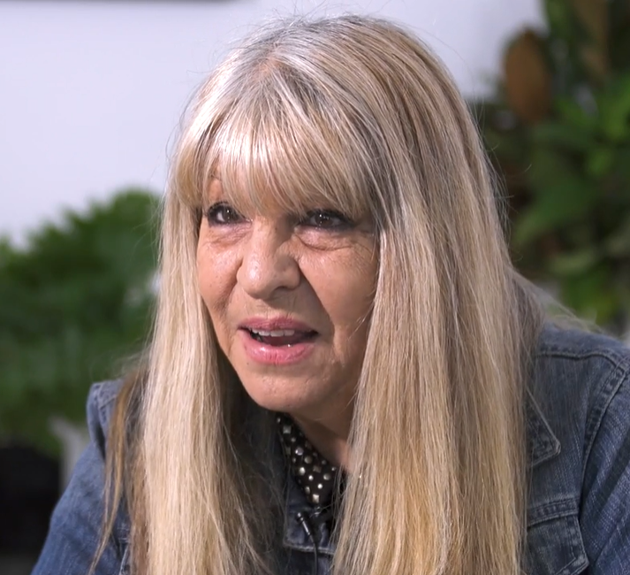
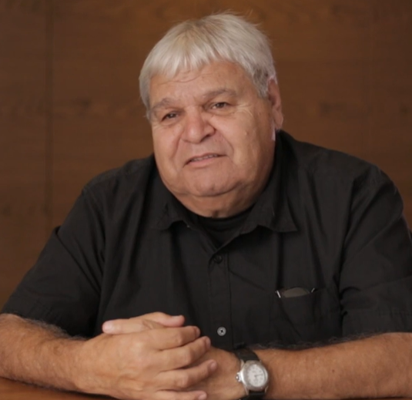
Scars on our nation
Watch the videos:
Brian TJ Geoff
Notes:
Use the links below to play each of the videos to students. You may wish to show students the questions on the next slide before viewing, or give them a quick brief on the focus of the discussion.
Resources:
Video: Telling Our Stories – Brian Gray: https://www.dropbox.com/s/2nwk0qiqkvqshdu/Brian%27s%20Story1st%20film.mp4?dl=0
Video: Telling Our Stories – TJ Mia: https://www.dropbox.com/sh/qd9yrpe481dw3vx/AAApU-HX0U-kAjQ8L-l1JxLja?dl=0
Video: Telling Our Stories – Geoff Cooper: https://www.dropbox.com/s/zmddg8gh8u038xb/Geoff%20Option%20B.mp4?dl=0

Slide 36
Scars on our nation
Thinking about the videos you just watched, in pairs, answer the following:
  Why is it important to tell your own story?
  Who makes the decisions about First Nations peoples and their needs, wants and hopes?
  Who has told us about our history?
  Who makes the decisions about what we learn?
  Discuss representation and having the power to choose how you want to be represented
Notes:
Have a whole class discussion for students to reflect on their discussions in pairs
Video: Telling Our Stories – Brian Gray: https://www.dropbox.com/s/2nwk0qiqkvqshdu/Brian%27s%20Story1st%20film.mp4?dl=0
Video: Telling Our Stories – TJ Mia: https://www.dropbox.com/sh/qd9yrpe481dw3vx/AAApU-HX0U-kAjQ8L-l1JxLja?dl=0
Video: Telling Our Stories – Geoff Cooper: https://www.dropbox.com/s/zmddg8gh8u038xb/Geoff%20Option%20B.mp4?dl=0

Slide 37
Scars on our nation
In your pairs, select one of the three videos to explore in more depth.
  Discuss and explain the social, moral and ethical issues addressed in the video.
    How does this impact on our comfort zone?
    How does this impact the Australian perspective of resilience and the little Aussie battler?
  Discuss the quote: ‘We don’t want to talk about it, it is too painful.’
  Explore how Brian, TJ and Geoff represent themselves in their own stories.
    If their story was written in a book would it be as powerful?
    How else could the power of these stories be shared?
Notes:
As students work in pairs, move around the room and take note of valuable reflections to bring to the class as a topic in the walk and talk.

Slide 38
Conclusion
  Walk and talk session to unpack what we have learned so far.
Notes:
Provide students with some topics from the class discussions to discuss on the walk and talk, move between groups and prompt reflections where needed.

Slide 39
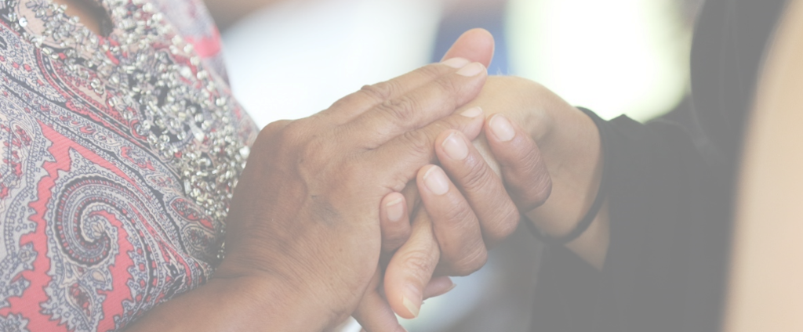
Activity 4:
Healing Together
Notes:
Strength, resilience and healing will be investigated in this activity. Students will be able to explore what it means to heal together and why healing is so important.
RESOURCES
Yarning Circles in the Literacy Classroom: https://eprints.qut.edu.au/219456/
Video: Florence Onus: https://www.youtube.com/watch?v=0z9iaZ7uhFg
Video: Gwen Schrieber: https://www.youtube.com/watch?v=BaFkJd6CTnA&t=7s
Video: ‘Heal Together’: https://healingfoundation.org.au/heal-together/
Video: Collective Healing: https://www.youtube.com/watch?v=dvsbw9hrYRs&t=8s
Collective healing resources: https://www.collectivehealing.net/resources/

Slide 40
Yarning Circle: Healing Together
Notes:
Take time to form a yarning circle. Explain the cultural significance of this protocol as a way to hear all voices, practise deep listening and reflect on what you have learnt

Slide 41
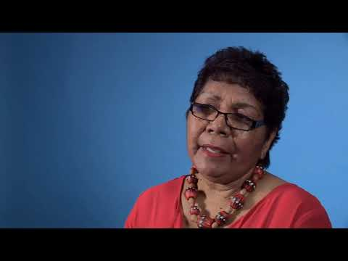
Video: Apology11 Florence Onus
Notes:
In the yarning circle, watch the videos from Florence and Gwen
RESOURCES
Video: Florence Onus: https://www.youtube.com/watch?v=0z9iaZ7uhFg
Video: Gwen Schrieber: https://www.youtube.com/watch?v=BaFkJd6CTnA&t=7s

Slide 42
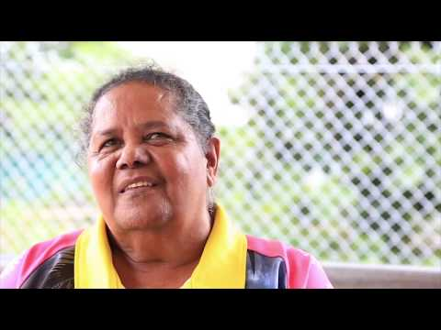
Video: Apology11 Gwen Schrieber
Notes:
In the yarning circle, watch the videos from Florence and Gwen
RESOURCES
Video: Florence Onus: https://www.youtube.com/watch?v=0z9iaZ7uhFg
Video: Gwen Schrieber: https://www.youtube.com/watch?v=BaFkJd6CTnA&t=7s

Slide 43
Healing together
What is similar in the videos?
What do both of these ladies speak about as a way of moving forward?
How do they see this happening?
Notes:
Work through questions as a group.
Discuss what students already know about the concept of moving forward and healing. What have they seen, experienced or read about resilience of the human spirit? Examples: Bethany Hamilton, Nelson Mandela, Aung San Suu Kyi.

Slide 44
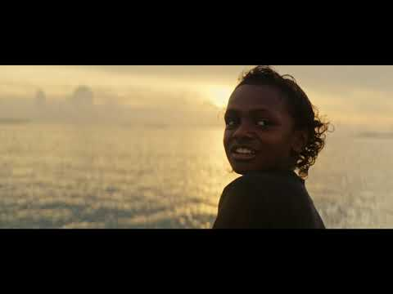
Video: Heal together with Christine Anu, Philly,
Mindy Kwanten and Radical Son
Notes:
Inform students that they are watching a video clip for a song
Video link: https://healingfoundation.org.au/heal-together/

Slide 45
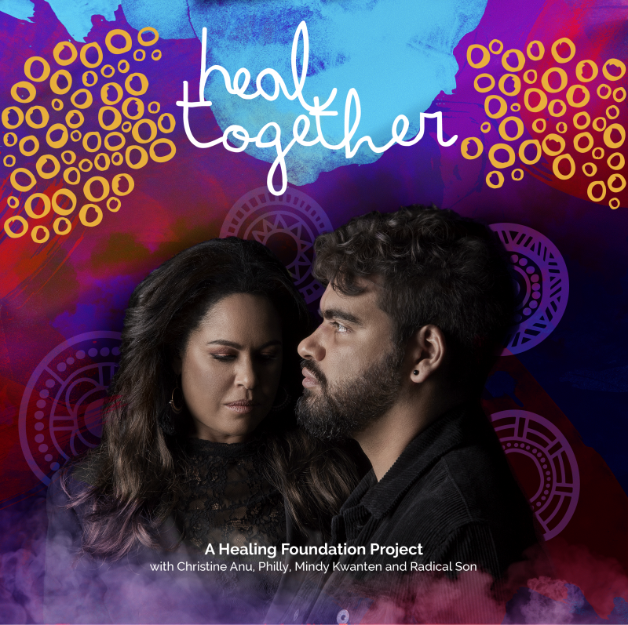
Healing together
What is the song about?
Why do you think it was made?
Notes:
Info about the song
The Healing Foundation launched Heal Together at the National NAIDOC Ball, a song and music video elevating the importance of healing in Aboriginal and Torres Strait Islander communities.
Composed by Christine Anu and Max Lambert, Heal Together provides a message of hope based on telling the truth about Australia’s history, a key message for NAIDOC 2019.
In Australia’s historical context, healing must involve Aboriginal and Torres Strait Islander individuals, families and communities healing from trauma. This involves the urgent restoring of language, dance, song and custom.

Slide 46
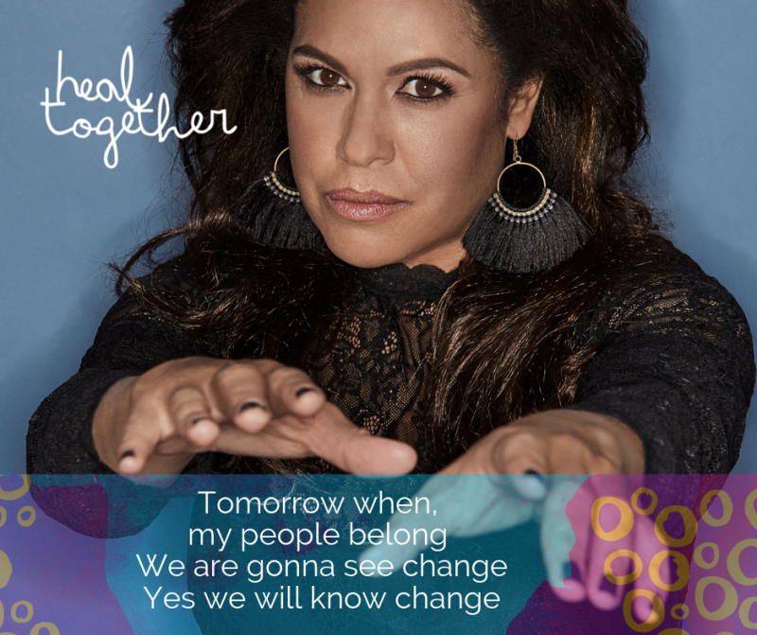
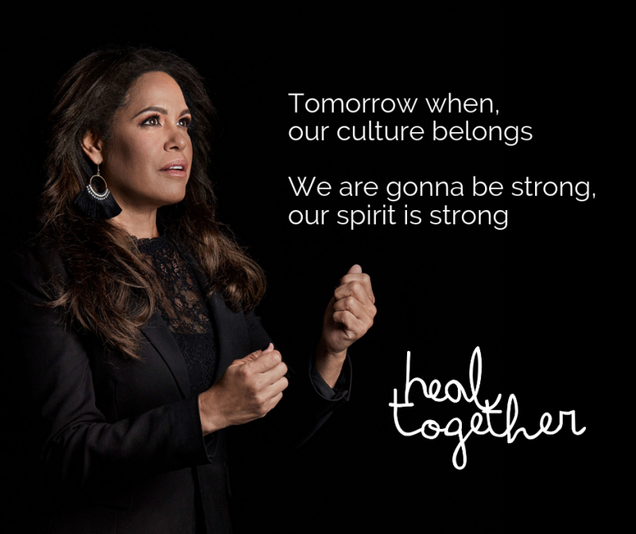
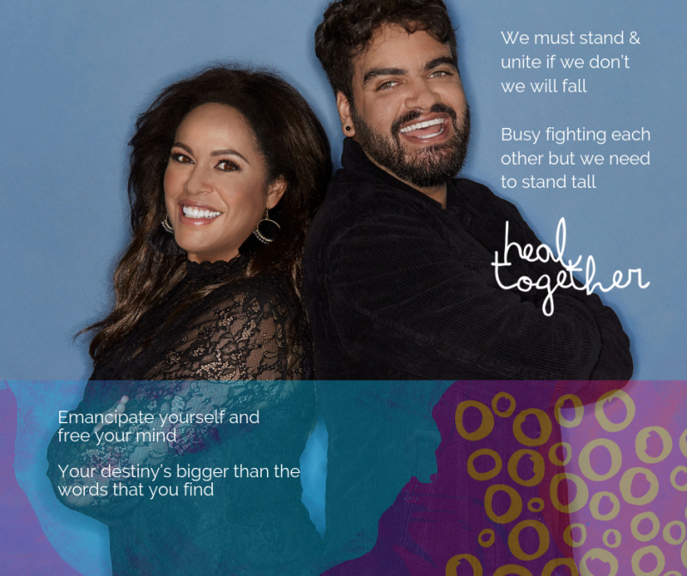
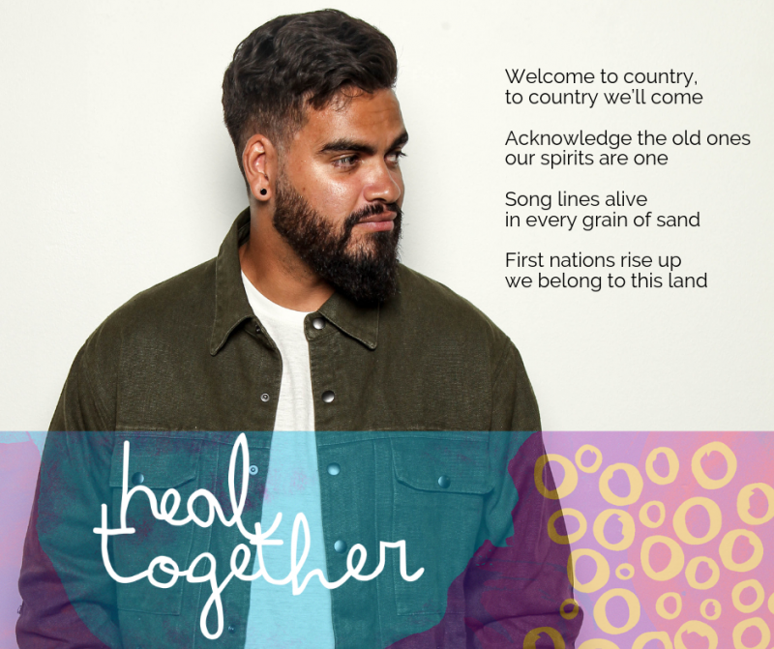
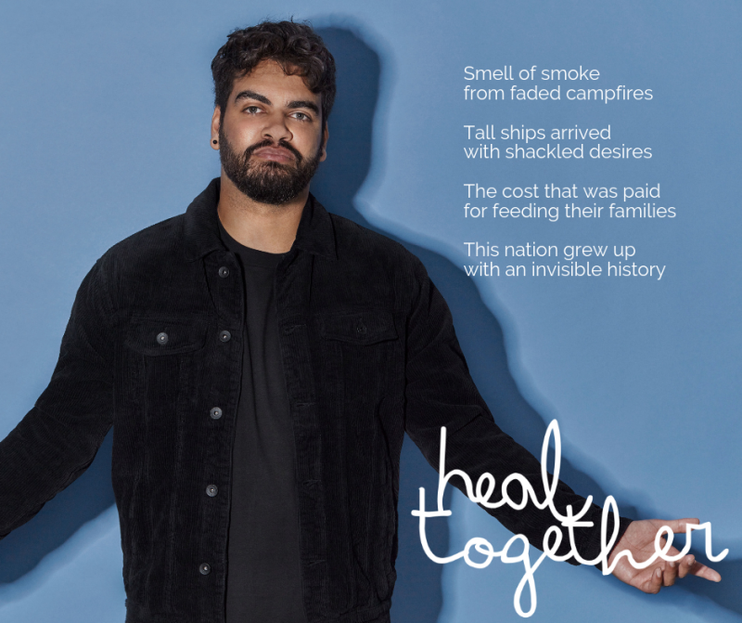
Notes:
Leaving the yarning circle, work with students to plan a text to inform and persuade the reader or viewer about the Stolen Generations. Choose a type of text that will suit your subject and students. These texts could include newspapers, film and digital texts, fiction, non-fiction, dramatic performances and multimodal texts

Slide 47
Healing together
In pairs conduct research to discuss the following:
What positive things are already happening to support Stolen Generations survivors?
What is collective healing?
Where else could collective healing be used in our society?
Investigate the positive work that is happening through The Healing Foundation.
Notes:
Guide students to sites for research if needed – particularly using The Healing Foundation's website.

Slide 48
Yarning Circle: Reflection
What have you learned?
What would you still like to know?

Slide 49
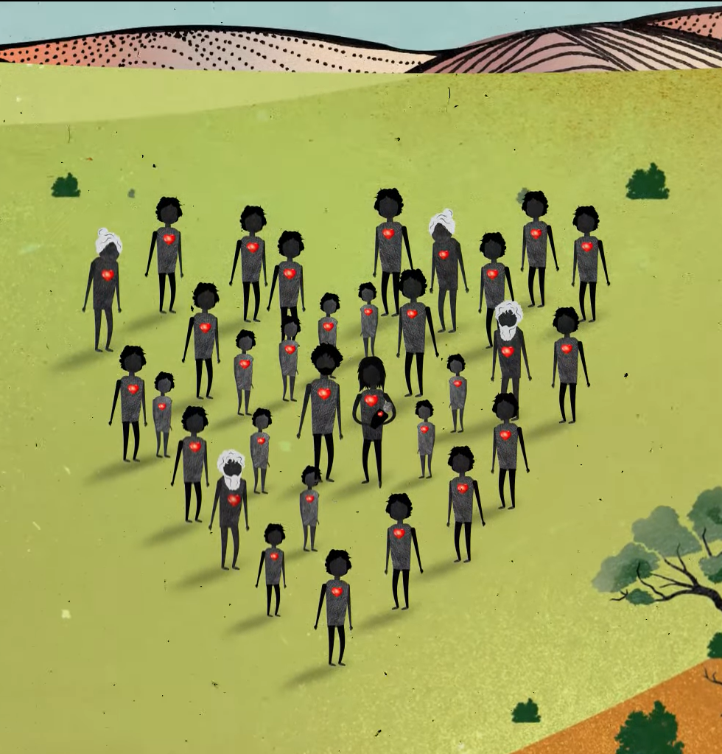
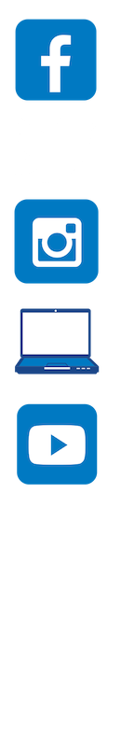
Contact The Healing Foundation
@HealingFoundation
@healingourway
@healingourway
www.healingfoundation.org.au
Healing Foundation
Notes:
Consider:
Sharing your outcomes and experience with The Healing Foundation at resources@healingfoundation.org.au
Sharing the resource and how you used it amongst your networks.
Sharing your students’ learning journey and tag The Healing Foundation on Instagram @healingourway and on Facebook as ‘Healing Foundation’.

