Slide 1
Year 3

Slide 2
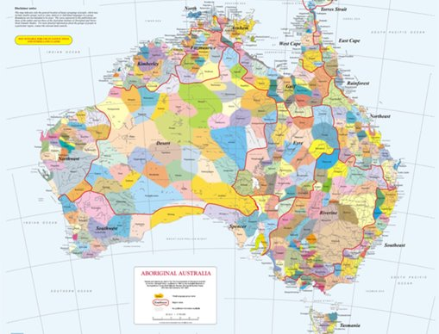
Acknowledgement
[Name of school/class] acknowledges Country, Custodians and Community of the lands on which we are on today [insert name of land/ peoples].
We also pay our respects to Elders and to Stolen Generations survivors, of the Dreaming and of the here and now.
We recognise the ongoing nature of trauma experiences for First Nations peoples and commit each day to survivor-led intergenerational healing.
Notes:
Update this slide with the name of your school/ class and the name of the land/s on which you're presenting the lesson on.
You may choose to make the wording of this acknowledgement more specific to your land/school/experiences. The acknowledgement isn't a script that we have to follow, you may even introduce the unit by working with students to write an acknowledgement for your class.
Image credit: https://ipaustralia.libguides.com/c.php?g=451400&p=3082380

Slide 3
Aboriginal and Torres Strait Islander students and teachers should be aware that these resources may contain the names, images, and voices of deceased persons.
Notes:
Important to remind students to speak up if they are feeling discomfort, and any safety and wellbeing measures your school has in place.

Slide 4



Care and safety
Notes:
Important to remind students to speak up if they are feeling discomfort, and any safety and wellbeing measures your school has in place.
This is also a good place to ask the cultural safety questions from the educator's guide so you can co-construct a culturally safe space with your students.

Slide 5

Healing together
Why is it important to learn about the Stolen Generations?
  to change the way we look at our collective history.
  to support reconciliation
  to become aware of how the government acted in ways that still affect many Aboriginal and Torres Strait Islander peoples and families today.

Slide 6
Overview: this week’s activities
ACTIVITY 1: LITERATURE INTRODUCTION AND ‘WHAT HAPPENS NEXT?’ WRITING ACTIVITY (40–60 MINUTES)
Teacher leads students in a guided reading session. Students write a ‘What happens next?’ narrative. Teacher also introduces the KWL chart that will be used throughout the unit.
ACTIVITY 2: VIDEO RESPONSE AND GROUP RESEARCH ROTATIONS (60 MINUTES)
Class creates four inquiry questions for further research. Students work in groups to use a variety of sources to begin to answer inquiry questions.
ACTIVITY 3: MUSICAL RESPONSE AND CREATION OF CLASS MOVEMENT PIECE (60–80 MINUTES)
Students ‘Think, Pair and Share’ to respond to a song. Class works in groups to create a symbolic movement piece to the song. Note: as Activity 3 is a more involved lesson, it can continue into Activity 4 if required.
ACTIVITY 4: PERSONAL STATEMENT OF LEARNING (30–40 MINUTES)
Students write and record a personal statement reflecting on what they have learnt and considering what else they wish to know.
Notes:
OPTIONAL SLIDE
Update week to timeframe for these teaching activities in consideration of class schedule and activity time.

Slide 7


Activity 1:
Literature Introduction and ‘What Happens Next?’ Writing Activity
Notes:
Teacher leads students in a guided reading session. Students write a ‘What happens next?’ narrative. Teacher also introduces the KWL chart that will be used throughout the unit.
Introduction:
Before you were born, the governments in Australia created laws that said that many Aboriginal children should be taken from their homes and families to live in other places. Taking these children away from their homes and families caused a lot of pain and sadness that still exists today. The children who were taken are called the Stolen Generations. In 2008, the then Prime Minister of Australia, Kevin Rudd, made an important speech in which he apologised on behalf of the Australian Government and said sorry for the pain that had been caused by removing children from their families. Today we are going to read a book about that day in Australian history.
Introduce today's activity. This is a good point to explain appropriate terms we will be using during this unit.

Slide 8
KWL Chart
KWL Chart
What I Know​ | What I Want to Know ​ | What I Learned​
​ | ​ | ​
Notes:
Introduce the KWL chart and tell students that we are going to start to fill out the K column with what they already know about Aboriginal and Torres Strait Islander history and the Stolen Generations. This activity can also allow teachers to gauge any misinformation students may have about Aboriginal cultures or histories.

Slide 9
Read book: Stolen Girl by Trina Saffioti and Norma McDonald
Notes:
Read the beginning of the book, stopping to explain or answer questions if necessary. Stop reading at a crucial or climactic point in the story.
Once you have finished, discuss any key points. You might ask:
What did you like about the story?
What did you learn from the story?
Are there any words in the story that are new to you?
Use a sentence to describe how the book made you feel.
How does the use of illustration help us feel something in the story?

Slide 10
‘What happens next?’ writing activity
What happens next...
Worksheet 1
Write what you think will happen next in the story
Draw illustrations for your story addition
Notes:
Introduce the activity
Students need to use their knowledge of what has happened so far in the book (character, setting, narrative style) to predict and write about what might happen next.
Model the lesson by asking for suggestions or making your own prediction for the next part of the story. Write a paragraph on the whiteboard that continues the story.
Students make their own predictions for what happens next in the story and complete Worksheet 1. Once they have finished writing they can illustrate their work.

Slide 11
Conclusion:
Share your work
Notes:
Students swap their work with a classmate for editing and reading appreciation.
Add extra words to your classroom ‘word wall’.

Slide 12



Activity 2:
Video response and
group research rotation
Notes:
Class creates four inquiry questions for further research. Students work in groups to use a variety of sources to begin to answer inquiry questions.
Resources
Suggested book for this session: continue reading Stolen Girl by Trina Saffioti and Norma MacDonald or select another book from the classroom library (e.g. Tell Me Why by Robyn Templeton and Sarah Jackson)
The Story of The Healing Foundation video
Suggested resources for research stations:
Station 1: Computers or iPads with link to:
The Little Red Yellow Black Website (if computers or iPads are not available, you could use copies of the The Little Red Yellow Black Book (Third Edition) by Bruce Pascoe with AIATSIS at this station instead)
Station 2: Computers or iPads with link to:
ABC’s Behind the News Archie Roach segment (if computers or iPads are not available, you could use transcript of Behind the News (BTN) story, also available on the BTN website)
Station 3: Fiction and non-fiction books. Some suggestions might be:
Sorry Day by Coral Vass and Dub Leffler
The Little Red Yellow Black Book (Third Edition) by Bruce Pascoe with AIATSIS
Tell Me Why by Robyn Templeton and Sarah Jackson
Station 4: Fact sheets:
Copies of Reconciliation Australia’s fact sheet on the Apology to the Stolen Generations
5 x A3 print outs of Research worksheet (Worksheet 2).
Note: as there is group work and research in this lesson, you might wish to ask teacher aides or even parent volunteers to be present to assist.

Slide 13
Read book: Stolen Girl by Trina Saffioti and Norma McDonald
Notes:
Continue reading the book, stopping to explain or answer questions if necessary.
Once you have finished, discuss any key points. You might ask:
How was the story different to what you imagined yesterday?
What did you like about the story?
What did you learn from the story?
Are there any words in the story that are new to you?
Use a sentence to describe how the book made you feel.
How does the use of illustration help us feel something in the story?

Slide 14
KWL Chart
What I Know​ | What I Want to Know ​ | What I Learned​
​ | ​ | ​
Notes:
Use the KWL chart again and this time concentrate on the W column. Ask students what they want to know about the Stolen Generations. Encourage them to pose questions for further research. If students need prompting, remind them of lead-in words for questions: ‘Who, what, when, where, why.’
Guide the class to create four meaningful questions for further research and write them in the W column. (While there will be many more questions, this number has been limited to allow for ease of creating groups and researching).

Slide 15

Video response: The Story of the Healing Foundation
Notes:
Link: https://www.youtube.com/watch?v=zDN7R6qRpUg
Introduce students to the activity:
We are going to watch a video that will give us some history of Aboriginal and Torres Strait Islander people and will be a source to help us begin to answer some of our questions.
Play the video The Story of The Healing Foundation. Be prepared to answer questions and engage in some discussion about the video.
To prompt discussion you might ask:
How did watching this video make you feel?
How does this video relate to the books we have been reading?
Why do you think this is important for us to know?
Were there any new words in the video that you did not understand?

Slide 16
KWL Chart
What I Know​ | What I Want to Know ​ | What I Learned​
​ | ​ | ​
Notes:
Ask students:
What is something new that you learned from the video?
Model the activity by filling out the L column as you discuss what information the class learned from the video.

Slide 17
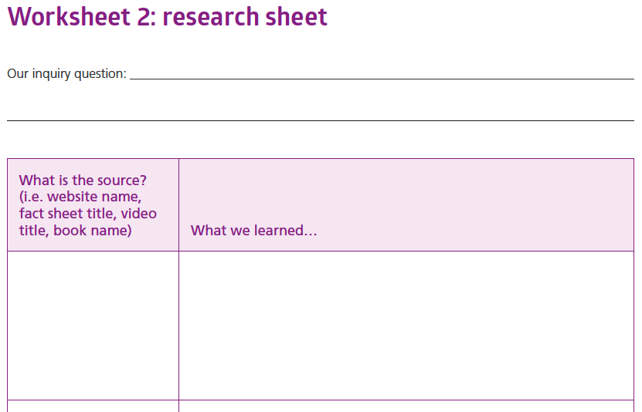
Group Research
Each group needs a:
Scribe (writes down information)
Leader (keeps the group on task as they research)
Presenter (presents findings at the end of the task)
And everyone will also be a researcher (looking for information in the sources).
What I Want to Know
​​
Notes:
Break the students into four groups.
Assign each group one inquiry question from the W column.
Distribute one Research sheet per group (see Worksheet 2).
Before students move to the first station, the group must decide who will take on the roles listed.
Send groups to their first research station.
Move around the room supporting groups as they find information in sources.
Once you feel that all groups have made good progress, move groups around to the next station.
Continue the rotations until groups have been to every station.

Slide 18
Conclusion:
Share your group's learning
Notes:
Bring the class back together and have presenters share the groups’ learning. Complete the L column on the class KWL sheet.
Display the group research worksheets and the class KWL chart on the classroom wall.
Add extra words to your classroom ‘word wall’.

Slide 19

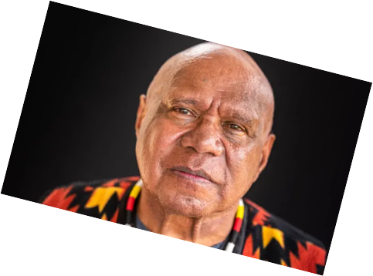
Activity 3:
Musical response and creation of class movement piece
Notes:
Students ‘Think, Pair and Share’ to respond to a song. Class works in groups to create a symbolic movement piece to the song. Note: as Activity 3 is a more involved lesson, it can continue into Activity 4 if required.
Resources
Suggested book for this session: continue reading Stolen Girl by Trina Saffioti and Norma MacDonald or select another book from the classroom library (e.g. ‘Took the Children Away’ by Archie Roach and Ruby Hunter).
Behind the News segment on Archie Roach.
Archie Roach ‘Took the Children Away’ song.
Archie Roach ‘Took the Children Away’ lyrics (Appendix 2).
For your own background knowledge listen to or read Archie Roach’s interview with Compass.
Three pieces of butcher’s paper with ‘Melody’, ‘Lyrics’ and ‘Message’ written at the top.
Post-It notes and pencils for students.
iPad or video camera.
Image source: https://www.theguardian.com/music/2022/jul

Slide 20
Read book: Stolen Girl by Trina Saffioti and Norma McDonald
Notes:
OPTIONAL: Or you can choose to read Took the Children Away by Archie Road and Ruby Hunter
Continue reading the book, stopping to explain or answer questions if necessary.
Once you have finished, discuss any key points. You might ask:
What did you like about the story?
What did you learn from the story?
Are there any words in the story that are new to you?
Use a sentence to describe how the book made you feel.
How does the use of illustration help us feel something in the story?

Slide 21

Read book: Took the Children Away by Archie Roach and Ruby Hunter
Notes:
OPTIONAL: If Stolen Girl book has been finished.
Read the book, stopping to explain or answer questions if necessary.
Once you have finished, discuss any key points. You might ask:
• What did you like about the story?
• What did you learn from the story?
• Are there any words in the story that are new to you?
• Use a sentence to describe how the book made you feel.
• How does the use of illustration help us feel something in the story?

Slide 22
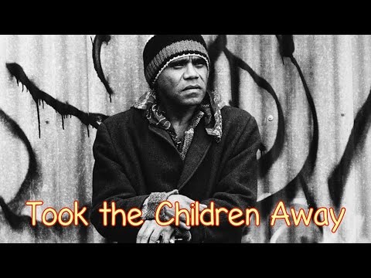
Song: Took the Children Away by Archie Roach
Notes:
Link: https://www.youtube.com/watch?v=R3FPc72ntY0
(Embedded video with lyrics, alternatively use Link: https://www.youtube.com/watch?v=IL_DBNkkcSE to original videoclip)
Introduce students to the activity:
Today we are going to listen to a song written by a member of the Stolen Generations.
Tell students they need to listen closely to the song’s melody (the music) and the lyrics (the words of the song) and consider the song’s message (what the song is trying to communicate).
Students listen to the song. Lyrics displayed on song.

Slide 23
‘Think, Pair, Share’
Think in your own mind about the melody of the song and write down your thoughts on post it notes. Use adjectives (feeling/describing words).
In a pair, talk about some of the words you thought of and see if your partner has the same or different ideas.
In pairs, share your thoughts with the class.
Melody
Notes:
Break students into pairs and distribute several post-it notes and pencils to each pair.
Students do a ‘Think, Pair, Share’ activity.
First, think in your own head about the melody of the song. Encourage students to think of adjectives (feeling/describing words) that describe the melody. Give them 30 seconds to do this.
Now, talk to your partner about some of the words you thought of and see if your partner agrees or has different ideas. Write your words down on post-it notes.
Share your thoughts with the class and stick your post-it notes on to the melody paper.
As a class, discuss some of the similarities and differences in the words.

Slide 24
‘Think, Pair, Share’
Think in your own mind about the lyrics of the song and write down your thoughts on post it notes. Use adjectives (feeling/describing words).
In a pair, talk about some of the words you thought of and see if your partner has the same or different ideas.
In pairs, share your thoughts with the class.
Lyrics
Notes:
Repeat the activity with the lyrics paper and the message papers.
Students do a ‘Think, Pair, Share’ activity.
First, think in your own head about the lyrics of the song. Encourage students to think of adjectives (feeling/describing words) that describe the lyrics. Give them 30 seconds to do this.
Now, talk to your partner about some of the words you thought of and see if your partner agrees or has different ideas. Write your words down on post-it notes.
Share your thoughts with the class and stick your post-it notes on to the lyrics paper.
As a class, discuss some of the similarities and differences in the words.

Slide 25
‘Think, Pair, Share’
Think in your own mind about the message of the song and write down your thoughts on post it notes. Use adjectives (feeling/describing words).
In a pair, talk about some of the words you thought of and see if your partner has the same or different ideas.
In pairs, share your thoughts with the class.
Message
Notes:
Repeat the activity with the message paper.
Students do a ‘Think, Pair, Share’ activity.
First, think in your own head about the message of the song. Encourage students to think of adjectives (feeling/describing words) that describe the message. Give them 30 seconds to do this.
Now, talk to your partner about some of the words you thought of and see if your partner agrees or has different ideas. Write your words down on post-it notes.
Share your thoughts with the class and stick your post-it notes on to the message paper.
As a class, discuss some of the similarities and differences in the words.

Slide 26
Creation of Class Movement Piece
In groups of 3-4:
Choose a verse from the song.
Decide on/ make up one simple movement that symbolises the feelings and mood of the verse.
Practise your movement
Show the rest of the class.
Notes:
Note: As Activity 3 is a more involved lesson, it can continue into Activity 4 if required.
Explain the task. Students are going to work in groups to create a movement/dance piece in response to the song. You can create the movement piece in any way you wish but a suggested format would be:
Break students into five groups and assign each group a verse of the song.
Have each group work together to decide on ONE simple movement they feel symbolises the feelings and mood of their verse. This movement could be as simple as performers giving themselves a hug and hanging their heads or wiping away a tear. These movements can be abstract or literal.
When each group has thought of and practised their movement, bring the groups back together and show their movements.

Slide 27
Performance
Notes:
Now the class will perform their movements in canon (one after another). Clear a performance space in the classroom and arrange all the groups around it. Play the song and have Group 1 perform their movement, with Groups 2,3,4 and 5 following them in canon. You may have to encourage the groups to slow their movements down so the canon takes the whole verse. Then do the same with the movements of Groups 2–5 as their respective verse of the song plays.
Reflect with students about how the song and story made them feel during the performance.

Slide 28
Activity 4:
Personal statement of learning
Notes:
Students write and record a personal statement reflecting on what they have learnt and considering what else they wish to know.
Resources
Suggested book for this session: finish reading Stolen Girl by Trina Saffioti and Norma MacDonald or select another book from the classroom library (e.g. Sorry Day by Coral Vass and Dub Leffler).
For reference:
Class KWL chart (Appendix 1).
Group research A3 sheets.
Previously completed sheets with melody, lyrics and message post-it note ideas.
Personal statement of learning (Worksheet 3).

Slide 29
Read book: Stolen Girl by Trina Saffioti and Norma McDonald
Notes:
Finish reading the book, stopping to explain or answer questions if necessary.
Once you have finished, discuss any key points. You might ask:
What did you like about the story?
What did you learn from the story?
Are there any words in the story that are new to you?
Use a sentence to describe how the book made you feel.
How does the use of illustration help us feel something in the story?

Slide 30

Read book: Sorry Day by Coral Vass and Dub Leffler
Notes:
OPTIONAL: If Stolen Girl book has been finished.
Read the book, stopping to explain or answer questions if necessary.
Once you have finished, discuss any key points. You might ask:
What did you like about the story?
What did you learn from the story?
Are there any words in the story that are new to you?
Use a sentence to describe how the book made you feel.
How does the use of illustration help us feel something in the story?

Slide 31
Personal Learning Statement
Draft your personal statement using the worksheet.
Use your draft to write a good copy.
What I Know​​ | What I Want to Know ​​ | What I Learned​​
Notes:
Introduce students to the task: they are going to reflect on what they have been learning by writing a Personal Learning Statement. They will be given some sentence starters and they need to write their own statement and then record it.
Distribute Personal Statement of Learning for students (Worksheet 3). Assist students with writing and editing their personal statements.
Students should write a good copy of their personal learning statements.
If you have the resources, students can work in pairs to record each other reading their personal statements or you can record them individually.
Teachers/classes will then create a video presentation that will include their class movement piece from the last activity. This video presentation will be distributed to their families via the school sharing platform and could also be shown during school assembly.

Slide 32
Conclusion:
Share your postcards
Notes:
Conclusion:
Organise a viewing of all the learning statements and the video of the movement piece for the class and other members of the school community.

Slide 33
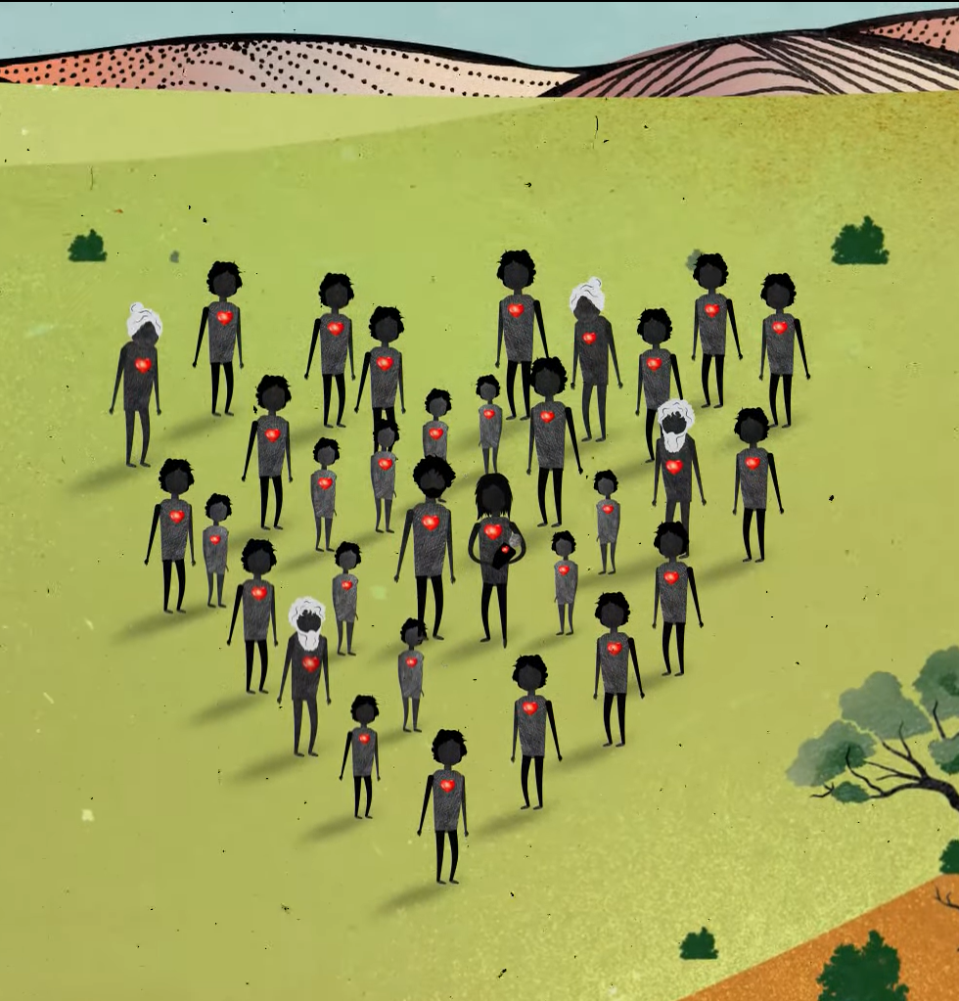

Contact The Healing Foundation
@HealingFoundation
@healingourway
@healingourway
www.healingfoundation.org.au
Healing Foundation
Notes:
Consider:
Sharing your outcomes and experience with The Healing Foundation at resources@healingfoundation.org.au
Sharing the resource and how you used it amongst your networks.
Sharing your students’ learning journey and tag The Healing Foundation on Instagram @healingourway and on Facebook as ‘Healing Foundation’.

