Slide 1
Year 2

Slide 2
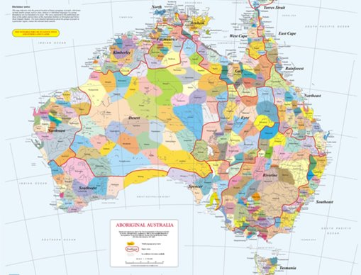
Acknowledgement
[Name of school/class] acknowledges Country, Custodians and Community of the lands on which we are on today [insert name of land/ peoples].
We also pay our respects to Elders and to Stolen Generations survivors, of the Dreaming and of the here and now.
We recognise the ongoing nature of trauma experiences for First Nations peoples and commit each day to survivor-led intergenerational healing.
Notes:
Update this slide with the name of your school/ class and the name of the land/s on which you're presenting the lesson on.
You may choose to make the wording of this acknowledgement more specific to your land/school/experiences. The acknowledgement isn't a script that we have to follow, you may even introduce the unit by working with students to write an acknowledgement for your class.
Image credit: https://ipaustralia.libguides.com/c.php?g=451400&p=3082380

Slide 3
Aboriginal and Torres Strait Islander students and teachers should be aware that these resources may contain the names, images, and voices of deceased persons.
Notes:
Important to remind students to speak up if they are feeling discomfort, and any safety and wellbeing measures your school has in place.

Slide 4

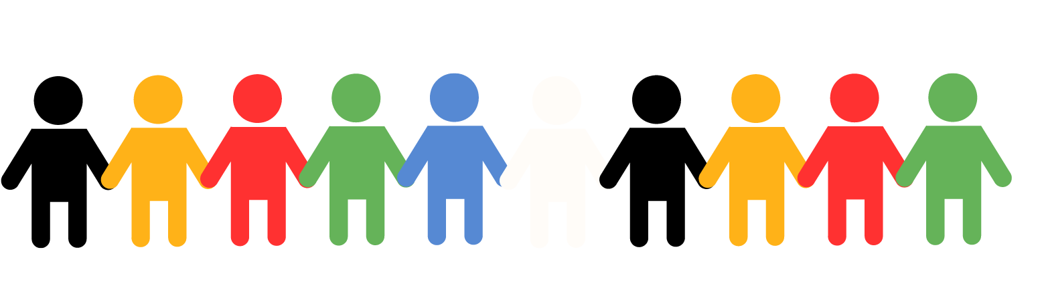

Care and safety
Notes:
Important to remind students to speak up if they are feeling discomfort, and any safety and wellbeing measures your school has in place.
This is also a good place to ask the cultural safety questions from the educator's guide so you can co-construct a culturally safe space with your students.

Slide 5
Overview: this week’s activities
ACTIVITY 1: LITERATURE INTRODUCTION AND COMPARE AND CONTRAST ACTIVITY (30–40 MINUTES)
Teacher leads students in a guided reading session. Students compare and contrast elements of the story and complete a Venn diagram.
ACTIVITY 2: VIDEO RESPONSE (30–40 MINUTES)
Students view and respond to an animation. Students reflect on what they have heard by drawing a picture of a part of the story that resonated with them and writing a letter to The Healing Foundation.
ACTIVITY 3: ARTWORK RESPONSE (30–40 MINUTES)
Students work in groups to view and respond closely to the artwork Healing Country by Riki Salam.
ACTIVITY 4: SHARE AND REFLECT ON LEARNING (30–40 MINUTES)
Students reflect on what they have learnt, share preferences for one of the books read during the week and consider future learning by writing a postcard they can send or take home.
Notes:
OPTIONAL SLIDE
Update week to timeframe for these teaching activities in consideration of class schedule and activity time.

Slide 6
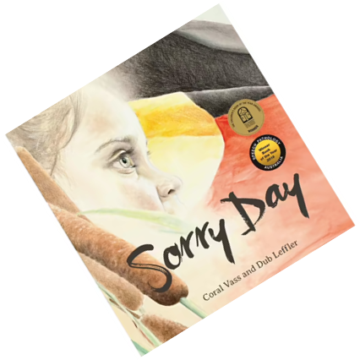

Activity 1:
Literature Introduction and Compare and Contrast Activity
Notes:
Students are led in a guided reading session. Students compare and contrast elements of the story and complete a Venn diagram.
Resources
Book for this session: Sorry Day by Coral Vass.
Venn diagram worksheet (Worksheet 1).
Butchers’ paper to model Venn diagram.

Slide 7


What do you know?
Notes:
Encourage students to share what they know about the Aboriginal and Torres Strait Islander Culture and History. You can ask if they've previously learned about:
Language
Aboriginal or Torres Strait Islander words
Bush food
Country
Music
This is also a good point to explain appropriate terms we will be using during this unit. Introduce the concept of Stolen Generations:
Before you were born, the governments in Australia created laws that said that many Aboriginal children should be taken from their homes and families to live in other places. Taking these children away from their homes and families caused a lot of pain and sadness that still exists today. The children who were taken are called the Stolen Generations. In 2008, the then Prime Minister of Australia, Kevin Rudd, made an important speech in which he apologised on behalf of the Australian Government and said sorry for the pain that had been caused by removing children from their families. Today we are going to read a book about that day in Australian history.

Slide 8

Read book: Sorry Day by Coral Vass and Dub Leffler
Notes:
Read the selected book, stopping to explain or answer questions if necessary.
Once you have finished the book, discuss any key points. You might ask:
What did you like about the story?
What did you learn from the story?
Are there any words in the story that are new to you?
Use a sentence to describe how the book made you feel.
How does the book use illustration to help us feel something in the story?
Explain that this book is set in two different times, the past and the present, to help emphasise the message of the story and to create a contrast.
Tell students that we are going to compare and contrast these two settings in the story using a Venn diagram.

Slide 9
Compare and Contrast
When you compare something, you are telling how they are similar or alike.
When you contrast something, you are telling how they are different.
Notes:
If required, define the terms compare and contrast.

Slide 10
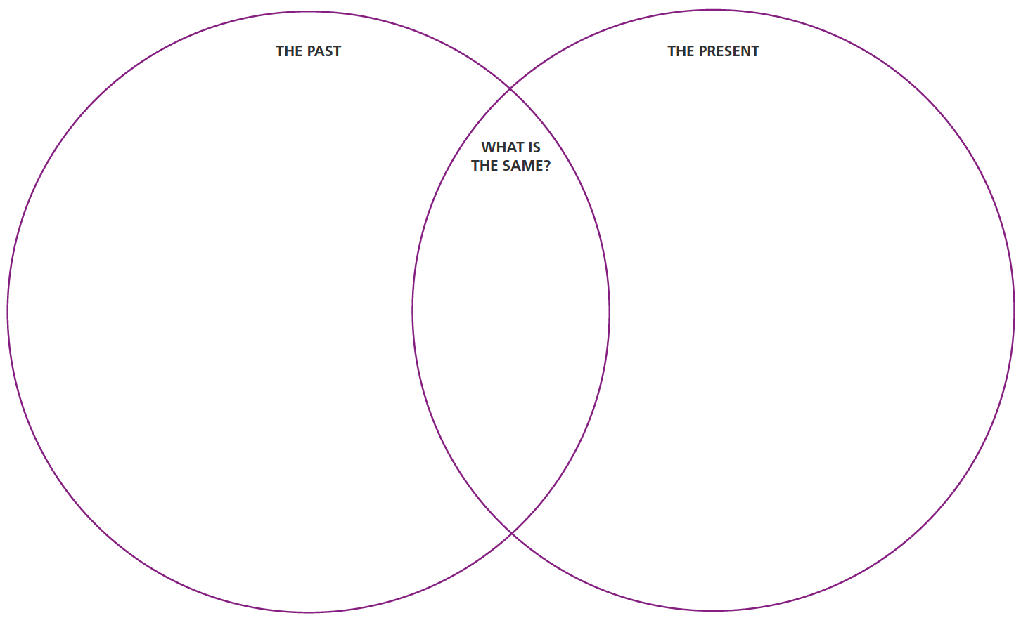
Compare and Contrast
Notes:
Draw a large Venn diagram on butchers’ paper and explain how the diagram works. Fill out one or two entries for each space to model the activity.
Students complete their own Venn diagram worksheets.
Bring students back for a class discussion about their own ideas.
Add to the large Venn diagram and display it on the classroom wall.

Slide 11

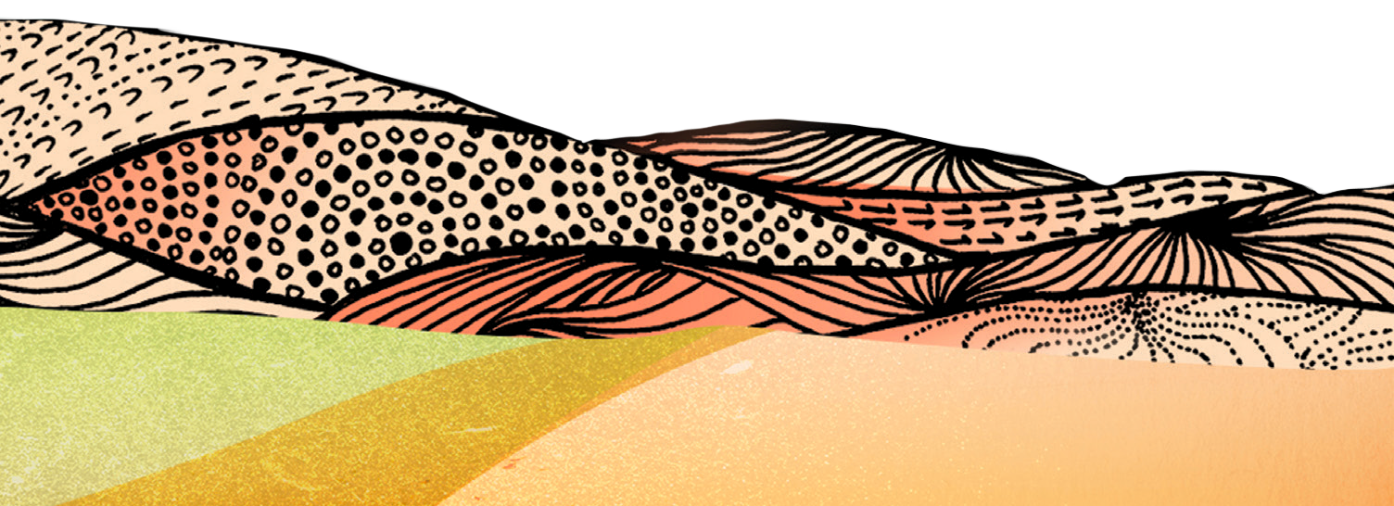

Activity 2:
Video Response
Notes:
Students view and respond to an animation. Students reflect on what they have heard by drawing a picture of a part of the story that resonated with them and writing a letter to The Healing Foundation.
Resources
Suggested book for this session: Sorry Sorry by Anne Kerr and Marda Pitt.
Butchers’ paper and pens for teacher to record any brainstorming ideas.
Worksheet 2: Letter to...’
Intergenerational Trauma animation.
Script for Intergenerational Trauma animation.

Slide 12
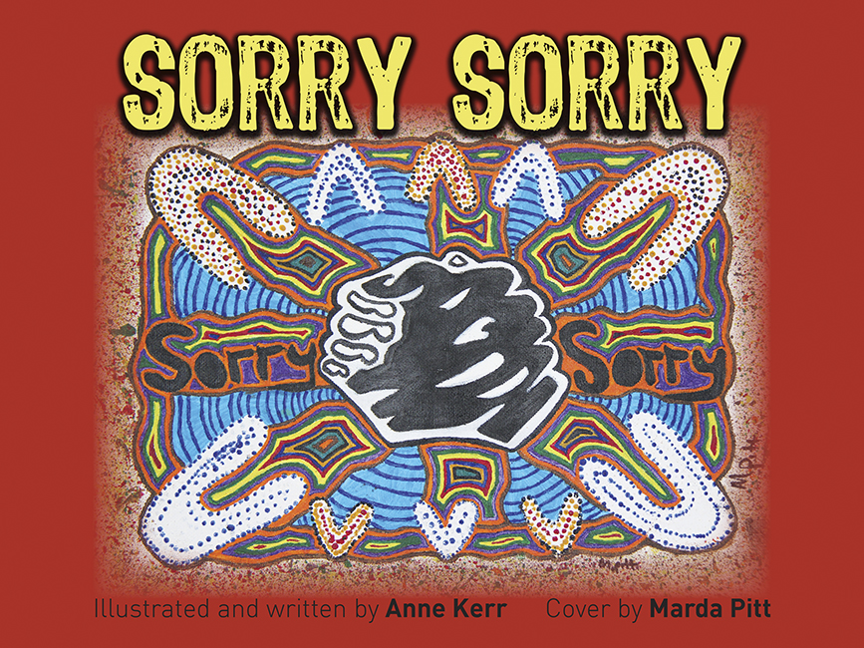
Read book: Sorry Sorry by Anne Kerr and Mardi Pitt
Notes:
Read the selected book, stopping to explain or answer questions if necessary.
Once you have finished the book, discuss any key points. Record students’ ideas on butchers paper/ on whiteboard. You might ask:
What did you like about the story?
What did you learn from the story?
Are there any words in the story that are new to you?
Use a sentence to describe how the book made you feel.
How does the author use illustration to help us feel something in the story?
You may also like to encourage students to consider the differences and similarities between this book and Sorry Day by Coral Vass that they have read in the previous session.

Slide 13

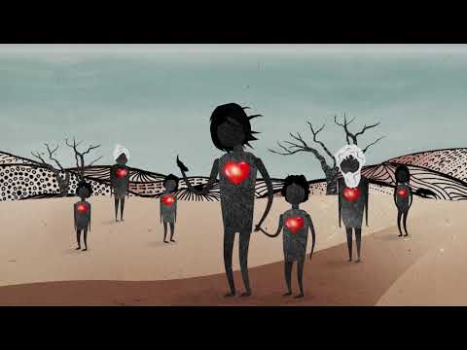
Video response: Animation
Notes:
Remind students of the unit topic and briefly discuss what they have already learnt about the Stolen Generations.
Introduce the animation: The children who were taken are called the Stolen Generations. These children have grown up now and have families of their own and lots of them are still healing from their sadness.
Play the video WITHOUT AUDIO. As the video plays, read the script. Be prepared to answer questions and engage in some discussion about the video.
Animation Link: https://www.youtube.com/watch?v=vlqx8EYvRbQ
Script Link: https://healingfoundation.org.au//app/uploads/2023/10/HF_SGRK_IGT_Animation_Script_Oct2023.pdf

Slide 14
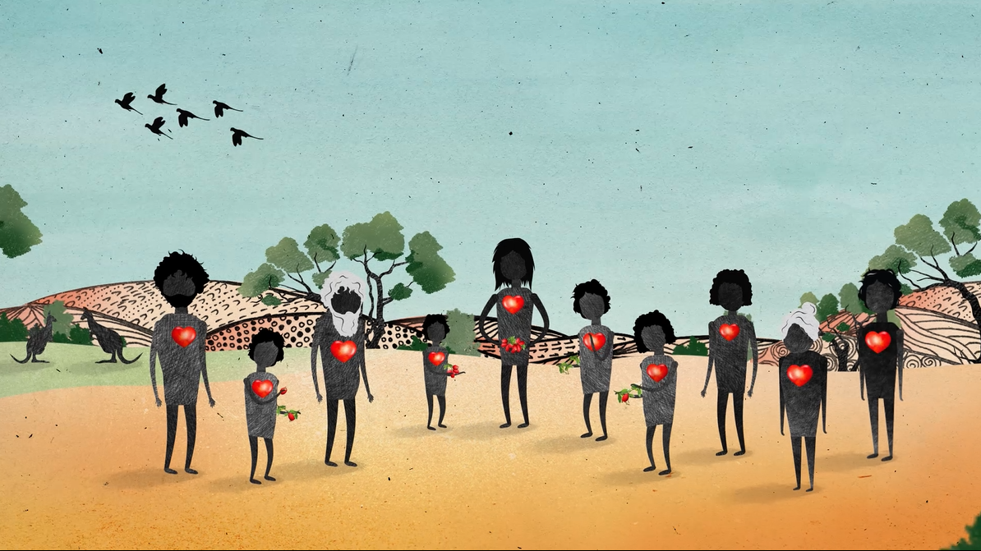




Notes:
To prompt discussion you might ask:
What is something new that you learned from listening to this story?
How does this story relate to some of the books we have been reading?
Why do you think this story might be important to listen to?
How did the story make you feel?

Slide 15
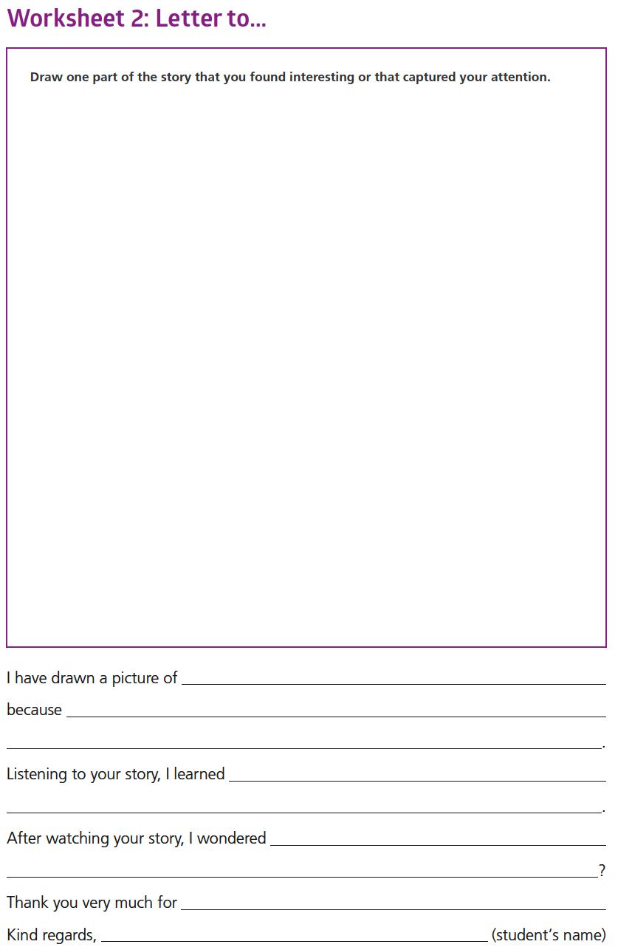
Notes:
Ask students to draw a picture of a part of the story that resonated with them and then write a letter to The Healing Foundation about their thoughts and feelings after watching the video.

Slide 16
Conclusion:
Share your response
Notes:
Students share their responses with a partner or with the class as a whole

Slide 17
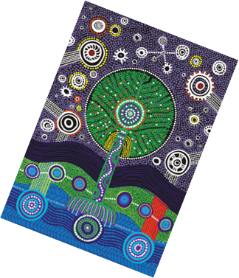
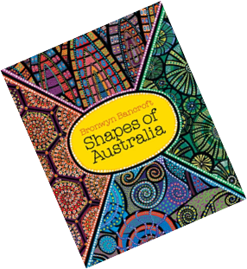
Activity 3:
Artwork Response
Notes:
Orient the students to today's lesson. Students will work in groups to view and respond closely to the artwork Healing Country by Riki Salam.
Resources
Suggested book for this session: Shapes of Australia by Bronwyn Bancroft.
Colour print out or projection of Riki Salam’s artwork Healing Country (Appendix 1).
For your own background information read the PDF of the Healing Country Artwork Creation Presentation (Appendix 2).
Colour copies of the ‘elements’ of the artwork included in the Healing Country Artwork Creation Presentation (Appendix 3):
Tree.
Tree branches.
Fire.
Three connected circles.
Southern Cross.
Five pieces of butchers’ paper. Before the lesson starts, glue one element to each piece of butchers’ paper, ready for group to brainstorm.
Pens/sharpies for students to write with.

Slide 18

Read book: Shapes of Australia by Bronwyn Bancroft
Notes:
Read the selected book, ask students to pay particular attention to the colours and shapes used in the illustrations in the book.
Once you have finished the book, discuss any key points. Record students’ ideas on butchers paper/ on whiteboard. You might ask:
What did you like about the story?
What did you learn from the story?
Are there any words in the story that are new to you?
Use a sentence to describe how the book made you feel.
How does the author use illustration to help us feel something in the story?
You may also like to encourage students to consider the differences and similarities between this book and those have read in the previous sessions.

Slide 19
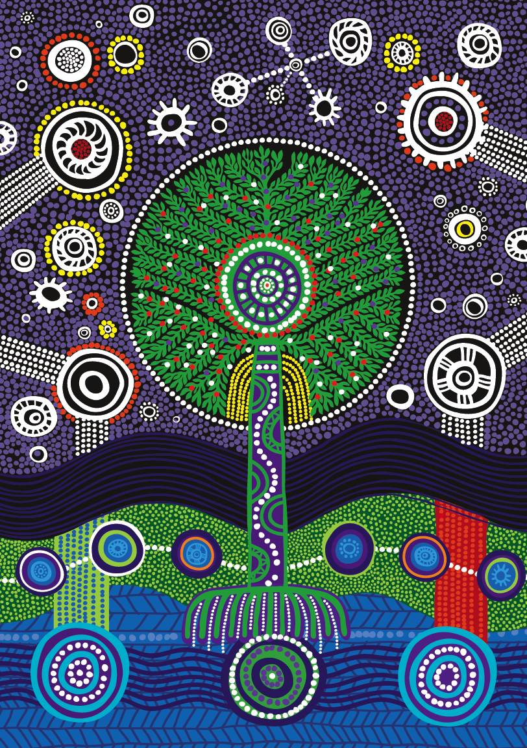
I see…
I think…
I feel…
Artwork:
Healing Country
by Riki Salam
Notes:
Explain to students some of the background and creation of this artwork:
This artwork was created by an artist called Riki Salam who worked with members of the Stolen Generations to listen to their stories and create an artwork that symbolised the journey of healing that lots of people are going through after they were taken from their families when they were children (Appendix 2).
Engage students in a verbal ‘I see…I think…I feel…’ to start a discussion. Activate some of their prior knowledge by connecting some of their ideas to books you have already read in class and the video viewed in Activity 2.

Slide 20
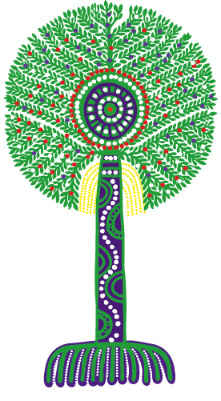
Group task: Artwork elements
Notes:
Introduce the group task. Tell students they are going to look at individual elements of the artwork and think about what they might symbolise.
Remind students of the meaning of ‘symbolise’ in art and stories. Sometimes artists use symbolism in their work. This means they are using something simple, like picture of a heart, to talk about a much bigger idea, like love.
Model the task using the butchers’ paper with the tree element glued on it. Ask students to suggest what the tree might symbolise for the artist and for members of the Stolen Generations. Write their thoughts on the butchers’ paper all around the tree.
Element meaning: The Spirit of the people remains steadfast like the tree Strong and Proud. Depicted central to the artwork the tree with it’s roots, draws deep water from within the land which replenishes and renourishes, in this still place healing takes place. The art of deep listening and contemplation - listening to self, listening to others, listening to country.

Slide 21
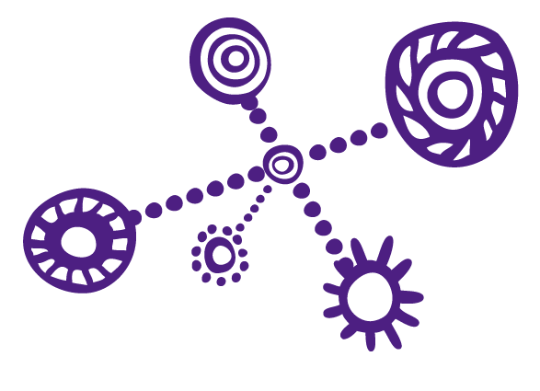
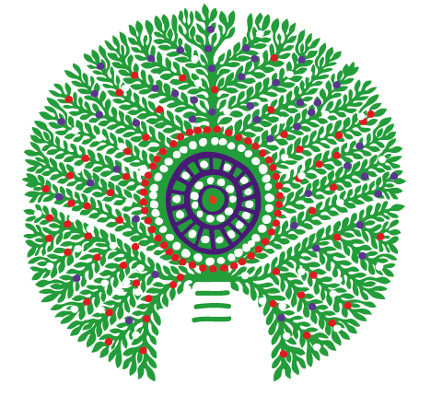
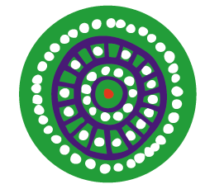
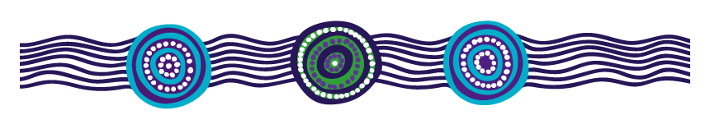
Group task: Artwork elements
Notes:
Groups brainstorm what they think their element might symbolise in the artwork and write on the paper. There are no right or wrong answers but rather a chance for students to consider the artwork and its reflection of the stories of the Stolen Generations more deeply. If required, support groups with some starting ideas based on your own knowledge after reading the background to the artwork.
Element meaning: Left to right, then down.
The tree’s many branches and leaves represents the Community that forms the Stolen Generations, they are strengthened together, the fruit represents the wisdom they hold.
The 4 predominant circles that are connected above in the night sky represents Country where the Spirit returns back to - Saltwater, Freshwater, Open Plains and Desert Country. The Southern Cross constellation guides their journey, and assists in navigation through life today and the journey of Healing. The stars in the night sky represent those that have passed on, their memories remain with us as our journey continues as individuals, as a community, as a people and as a Nation, guiding, informing, supporting, learning, listening and yarning on our journey to Healing Our People, Healing Our Country and Healing Our Nation.
The central circular motif within in the tree represents fire, the place where we gathered with Family, a place of warmth and comfort, a place of safety. Where childhood stories were shared in the flames of the campfire.
The 3 connected circles depicted at the bottom of the piece represents our connections to the Land, Sea (Water) and Sky. Connection to Deep Water.

Slide 22
I see…
I think…
I feel…
Artwork:
Healing Country
by Riki Salam
Notes:
As a class, take a final look at Healing Country as a whole and consider the message of the artwork and how it helps to tell the story of healing for people who are members of the Stolen Generations.
Display the brainstorms in the classroom for further reference.

Slide 23
Activity 4:
Share and reflect on learning
Notes:
Students reflect on what they have learnt, share preferences for one of the books read during the week and consider future learning by writing a postcard they can send or take home.
Resources
Suggested book for this session: Tell Me Why by Robyn Templeton and Sarah Jackson.
Class set of postcard size versions of Riki Salam’s artwork Healing Country. If required, glue colour copies of the artwork onto cardboard to replicate a postcard.
‘Worksheet 3’: Postcard sentence starters.

Slide 24
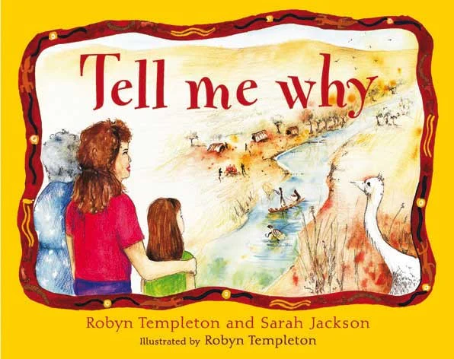
Read book: Tell Me Why by Robyn Templeton and Sarah Jackson
Notes:
Read the selected book, ask students to pay particular attention to the colours and shapes used in the illustrations in the book.
Once you have finished the book, discuss any key points. Record students’ ideas on butchers paper/ on whiteboard. You might ask:
What did you like about the story?
What did you learn from the story?
Are there any words in the story that are new to you?
Use a sentence to describe how the book made you feel.
How does the author use illustration to help us feel something in the story?
You may also like to encourage students to consider how this text builds on or adds to knowledge gained from other books you have been reading in class (e.g. Sorry Day by Coral Vass and Sorry Sorry by Anne Kerr).

Slide 25
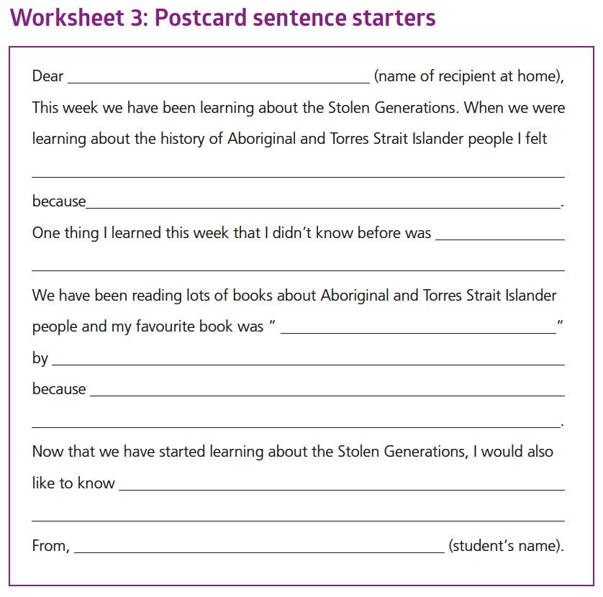
Postcard Writing
Notes:
Introduce students to the task. Today we are going to share what we have been learning with someone at home by writing and sending them a postcard.
Explain that the postcard format is exactly like a letter but is usually a lot shorter. This means students need to think carefully about what they are going to write.
Students can write their rough draft on Worksheet 3 using the sentence starters for support.
Once students have completed a first draft, they can write their good copy on the postcard.

Slide 26
Conclusion:
Share your postcards
Notes:
Students can share their postcards with a partner or a group.
You can legitimise the activity by actually posting the postcards home. Otherwise, students can take the postcards home to discuss with parents and carers.

Slide 27
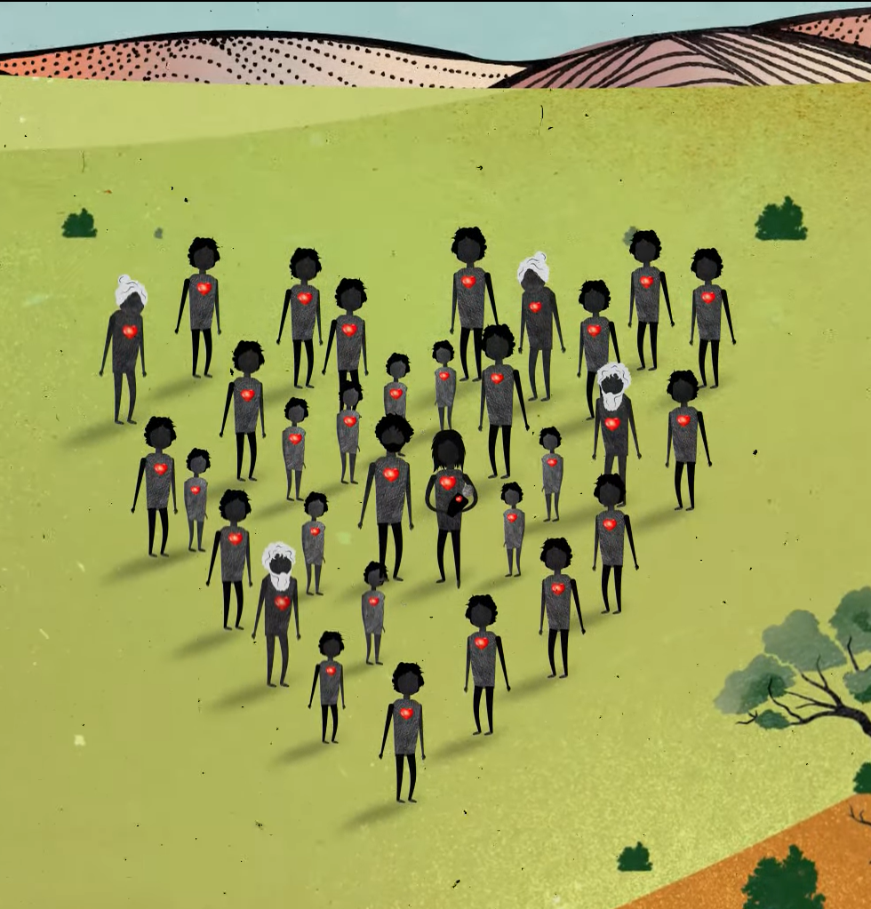
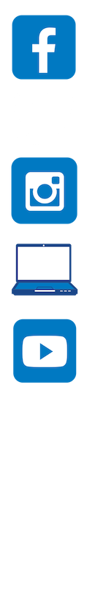
Contact The Healing Foundation
@HealingFoundation
@healingourway
@healingourway
www.healingfoundation.org.au
Healing Foundation
Notes:
Consider:
Sharing your outcomes and experience with The Healing Foundation at resources@healingfoundation.org.au
Sharing the resource and how you used it amongst your networks.
Sharing your students’ learning journey and tag The Healing Foundation on Instagram @healingourway and on Facebook as ‘Healing Foundation’.

