Slide 1
Year 6

Slide 2
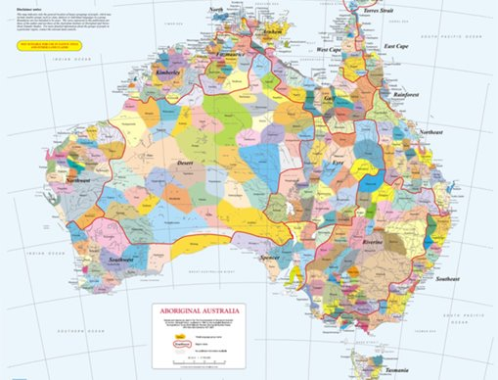
Acknowledgement
[Name of school/class] acknowledges Country, Custodians and Community of the lands on which we are on today [insert name of land/ peoples].
We also pay our respects to Elders and to Stolen Generations survivors, of the Dreaming and of the here and now.
We recognise the ongoing nature of trauma experiences for First Nations peoples and commit each day to survivor-led intergenerational healing.
Notes:
Update this slide with the name of your school/ class and the name of the land/s on which you're presenting the lesson on.
You may choose to make the wording of this acknowledgement more specific to your land/school/experiences. The acknowledgement isn't a script that we have to follow, you may even introduce the unit by working with students to write an acknowledgement for your class.
Image credit: https://ipaustralia.libguides.com/c.php?g=451400&p=3082380

Slide 3
Aboriginal and Torres Strait Islander students and teachers should be aware that these resources may contain the names, images, and voices of deceased persons.
Notes:
Important to remind students to speak up if they are feeling discomfort, and any safety and wellbeing measures your school has in place.

Slide 4
Care and safety
These lessons might include some content that is confronting or overwhelming
We all need to understand a full history of Australia, including the experiences of Stolen Generations survivors, their families and communities, and the impacts of past government policies that are still being felt today
It is important to speak to me or another adult if at any point you feel distressed – we are all here to learn together and keep each other safe.
Notes:
Important to remind students to speak up if they are feeling discomfort, and any safety and wellbeing measures your school has in place.
This is also a good place to ask the cultural safety questions from the educator's guide so you can co-construct a culturally safe space with your students.

Slide 5
Healing together
Why is learning about the Stolen Generations important?
to change the way we look at our collective history.
to support reconciliation and an honest understanding of our past – not just one perspective.
to become aware of past government policies that still affect many Aboriginal and Torres Strait Islander peoples and families today.
Notes:
Give students a chance to suggest why they think the learning is important before clicking through to the reasons.

Slide 6

Terminology
Sorry
Country
Aboriginal
Reconciliation
Colonisation
Culture
Torres Strait Islander
Notes:
Optional: Use to guide the creation of a word wall

Slide 7
Overview: this week’s activities
ACTIVITY 1: LITERATURE INTRODUCTION (40–60 MINUTES)
Teacher leads students in a guided reading session. Students read a case study from a member of the Stolen Generations and respond by creating a descriptive paragraph.
ACTIVITY 2: STATISTICAL ANALYSIS (60–80 MINUTES)
Students work in groups to analyse and discuss statistics related to the Stolen Generations and begin to understand Intergenerational Trauma.
ACTIVITY 3: RESEARCH AND CREATION OF POSTER AND PRESENTATION (60–80 MINUTES)
Students work individually to research the ongoing effects of the Stolen Generations and create a poster and presentation to share their learning.
ACTIVITY 4: PLANNING AN EVENT AND POSTER WALK (30–40 MINUTES)
Students plan and hold a poster presentation event for another class and members of the school community.
Notes:
OPTIONAL SLIDE
Update week to timeframe for these teaching activities in consideration of class schedule and activity time.

Slide 8
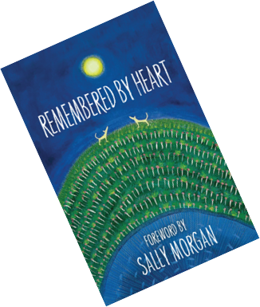

Activity 1: Literature Introduction
Notes:
In this activity, students will be led in a guided reading session. Students read a case study from a member of the Stolen Generations and respond by creating a descriptive paragraph.
Resources
Book: Tracks by Stephen Kinnane, in Remembered by Heart by Sally Morgan (Note: this is an excerpt from Stephen Kinnane’s book Shadow Lines. Sections from either book can be read at the beginning of each session as part of the lesson introduction).
Case study: Story of Stolen Generations survivor and advocate Aunty Isabel Reid.
ABC: Aunty Isabel Reid NSW Senior Australian of the Year.
NSW Senior Australian of the Year: Aunty Isabel Reid.
Writing paper and pencils.

Slide 9
Aboriginal and Torres Strait Islander Culture and history:
What do you know?
Notes:
Encourage students to share what they know about the Aboriginal and Torres Strait Islander culture and history.
If students bring up the Stolen Generations, this is a good time to move on to the next slide.

Slide 10
The Stolen Generations:
What do you know?
Notes:
Encourage students to share what they know about the Stolen Generations. Use the next slide to explain what happened in more detail.

Slide 11
The Stolen Generations
For about a century, thousands of First Nations children were systematically taken from their families, communities and culture, many never to be returned. These children are known as Stolen Generations survivors.
Notes:
More information:
First Nations children were removed by government authorities from the mid-1800s to the 1970s. In the 1860s, Victoria became the first state to pass laws authorising the removal of First Nations children from their families.
Similar policies were later adopted by other states and territories – and by the federal government when it was established in the 1900s.
For about a century, thousands of children were taken from their families, communities and culture, many never to be returned.
These children are known as Stolen Generations survivors, or Stolen Children. They were taken by the police, from their homes, and on their way to or from school, and placed in more than 480 institutions, adopted or fostered by non-Indigenous people and often subjected to abuse. The children were denied all access to their culture, they were not allowed to speak their language and they were punished if they did.
There are currently more than 33,000 Stolen Generations survivors in Australia. More than one third of all First Nations peoples are their descendants. In Western Australia, more than half of the population have Stolen Generation links.

Slide 12
Cultural Safety
How does a safe classroom look to you?
How does it feel?
How can we be culturally safe?
Notes:
You may have already established this as a class, if so, use this time to reiterate the class rules.
Begin a discussion about cultural safety with the class. Ask them to answer the questions in a 'think/pair/share' activity, or address them as a group.
Use the final question to lead in to the next slide.

Slide 13
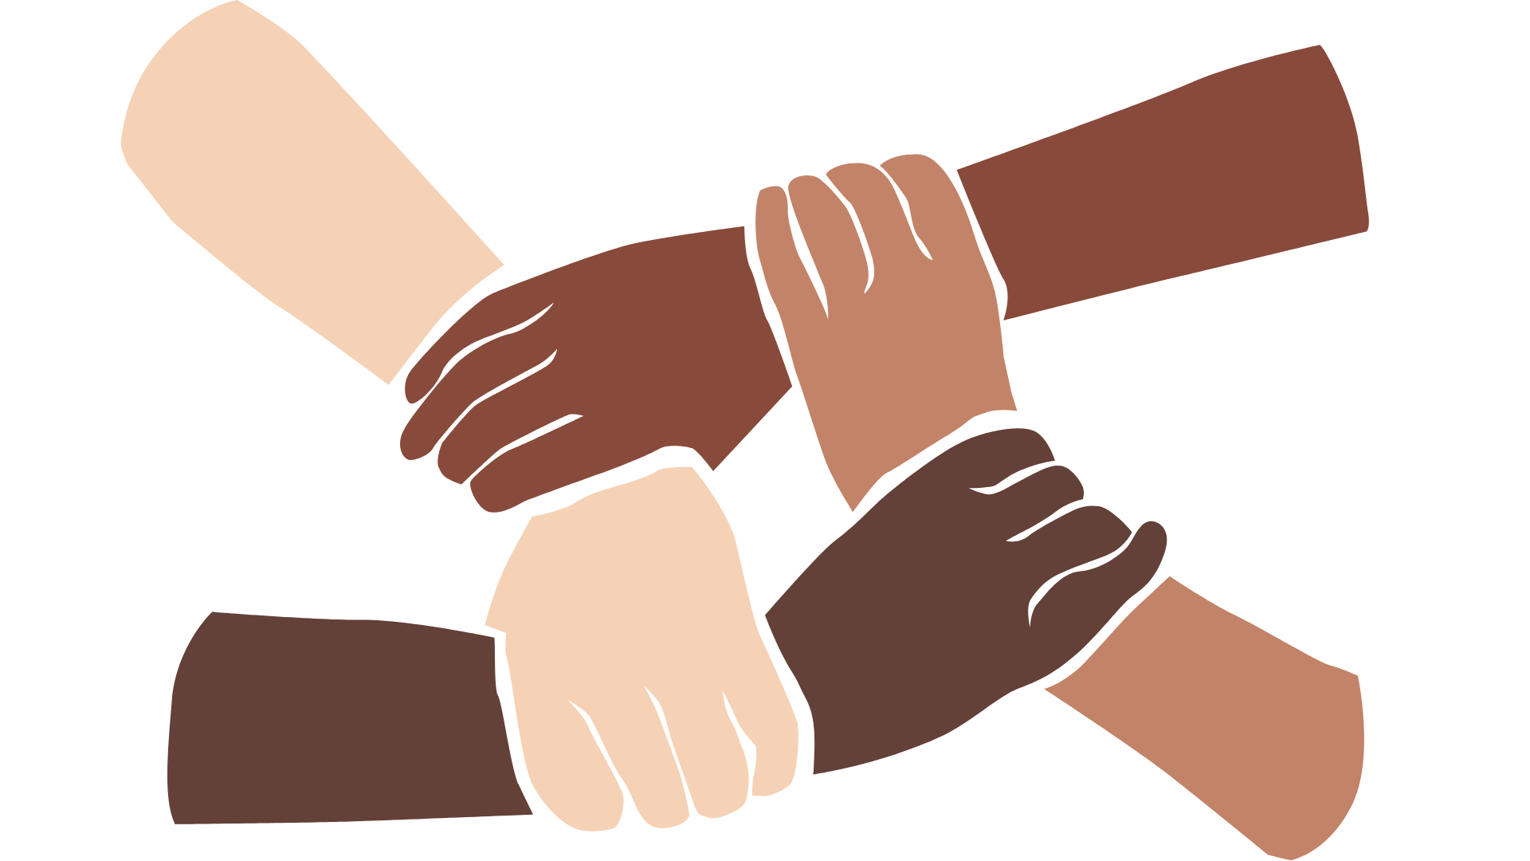
Cultural Safety
Open mindedness
Respect
Honest communication
Being mindful of privilege
Notes:
A culturally safe classroom environment relies on open-mindedness, respect and honest communication.
For a discussion to be culturally safe, participants should be mindful of their privilege, whether it be gender, race, sexuality, social class, education, physical ability or mental health etc.
Image credit: Sketchify from Canva

Slide 14
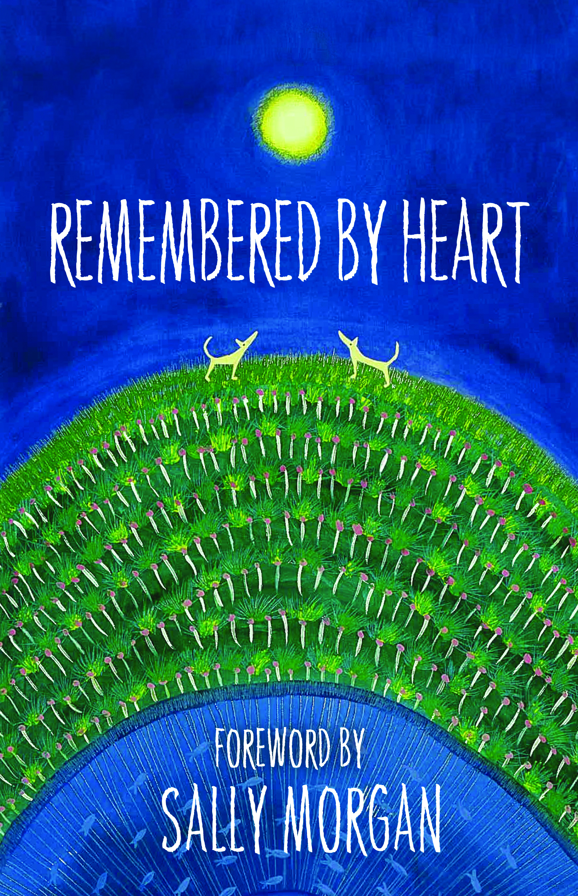
Read book: Remembered by Heart by Stephen Kinnane
Notes:
Introduce the text and read the first section from Tracks by Stephen Kinnane (from ‘My grandmother’s skin was concealed…’ to ‘Tracks can be followed.’) You may like to pass the book around so that students can also read aloud.
Discuss the text. To prompt discussion, you could ask:
What devices does the text use to convey meaning? (e.g. metaphor, simile, personification)
How did the European settlers view the land and subsequently the people who lived on it?
What do you know about Aboriginal and Torres Strait Islander peoples’ connection to country and place and how does the text reflect this?

Slide 15
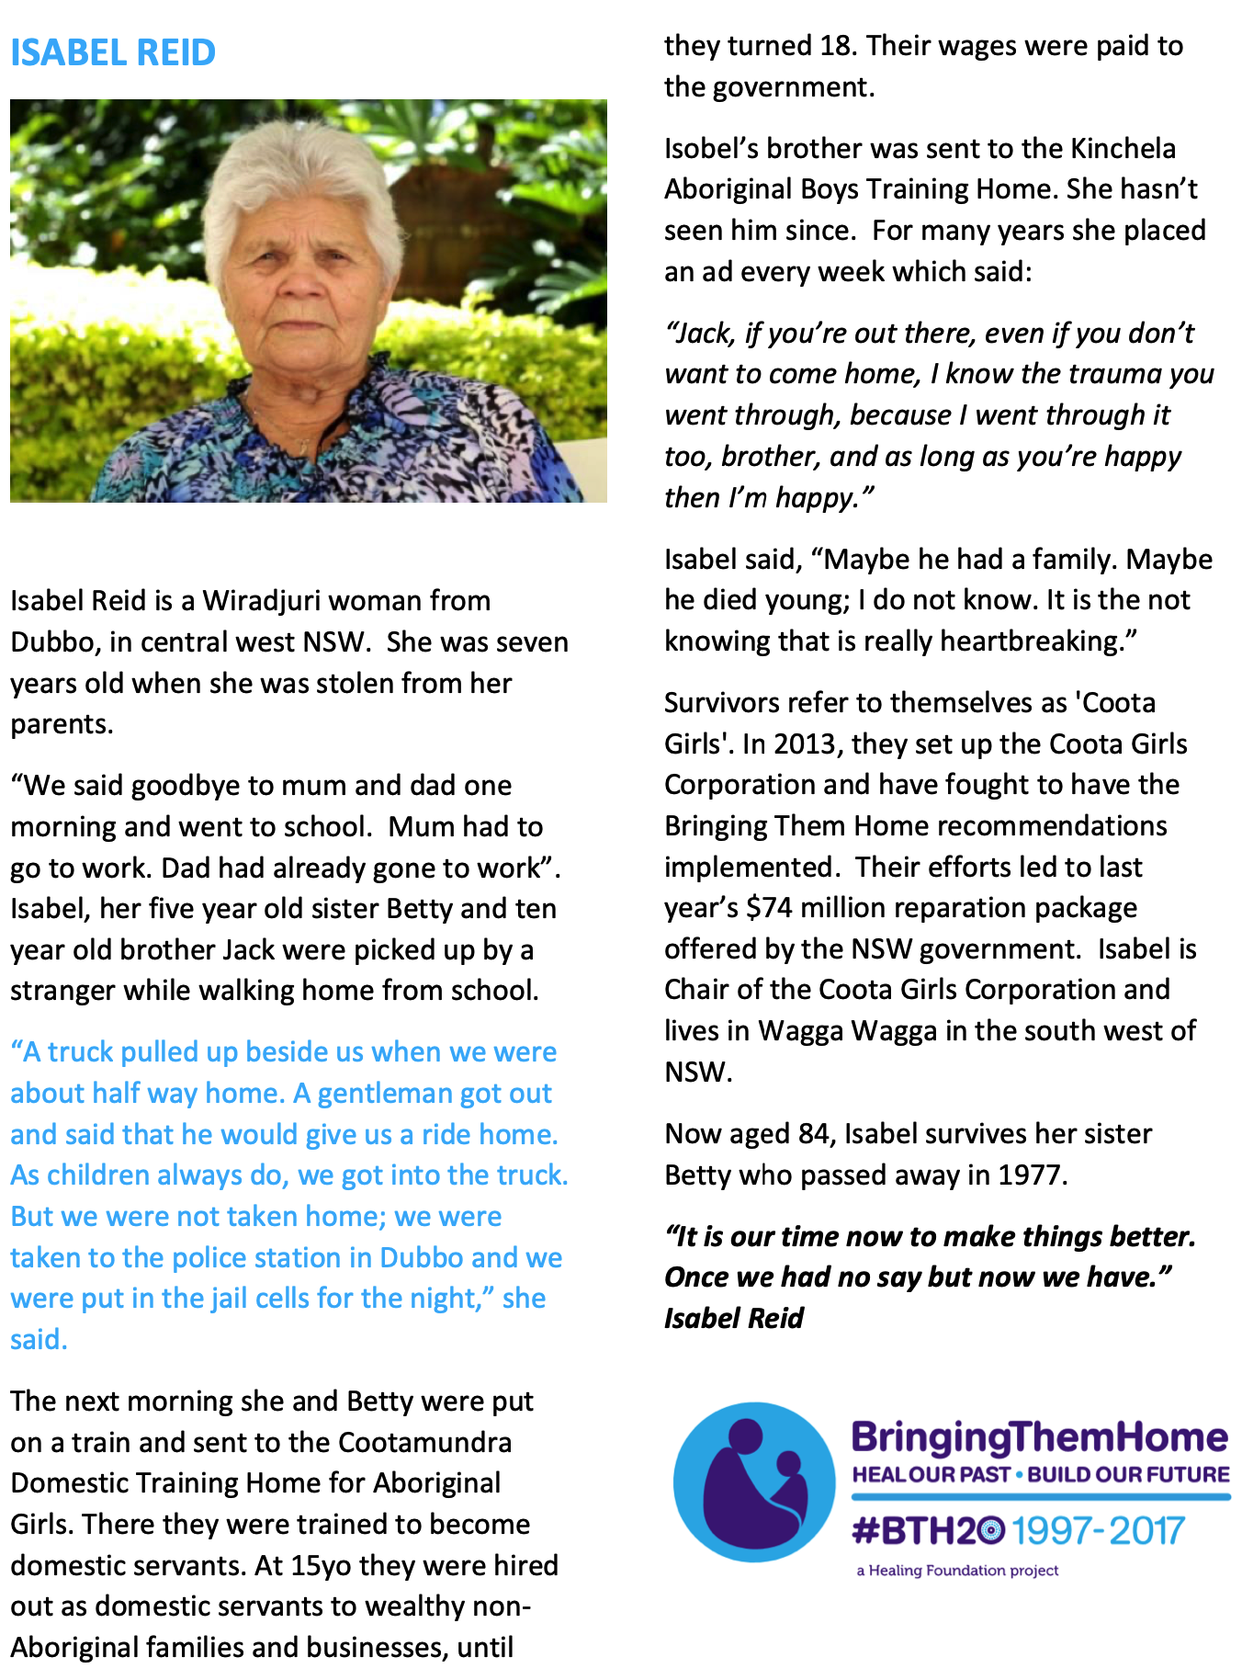
Notes:
As a class, read Isabel Reid’s case study and discuss.
Link: https://healingfoundation.org.au//app/uploads/2017/09/Isabel-Reid-BTH20-Case-Study.pdf

Slide 16
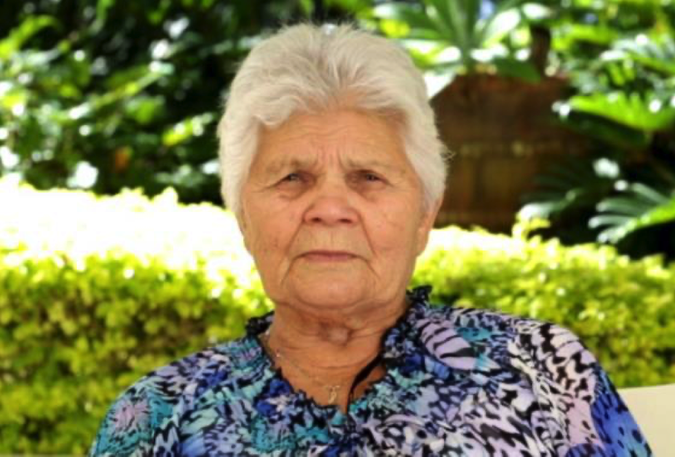
Case Study Narrative
Take one part of Isabel’s story and expand on it in a descriptive paragraph.
Paragraph must:
be written in third person
utilise information that is already in the case study
expand on this information and focus on imagery in descriptions of setting and character
use language devices such as metaphor, simile, personification to build on the setting and characters.
Notes:
Introduce the task. Students must take one part of Isabel Reid’s story (e.g. when she and her siblings said goodbye to their mother and father in the morning) and expand on it in a descriptive paragraph.
If required, model turning one part of the story into a descriptive paragraph.
Students can write and edit their own paragraph and share with a peer for editing and appreciation.
Link: https://healingfoundation.org.au//app/uploads/2017/09/Isabel-Reid-BTH20-Case-Study.pdf

Slide 17
Conclusion:
Optional share
Notes:
Select three or four students to read their paragraphs aloud.
Students can type their paragraphs and display on the classroom wall.
Add any new words to the classroom word wall.

Slide 18

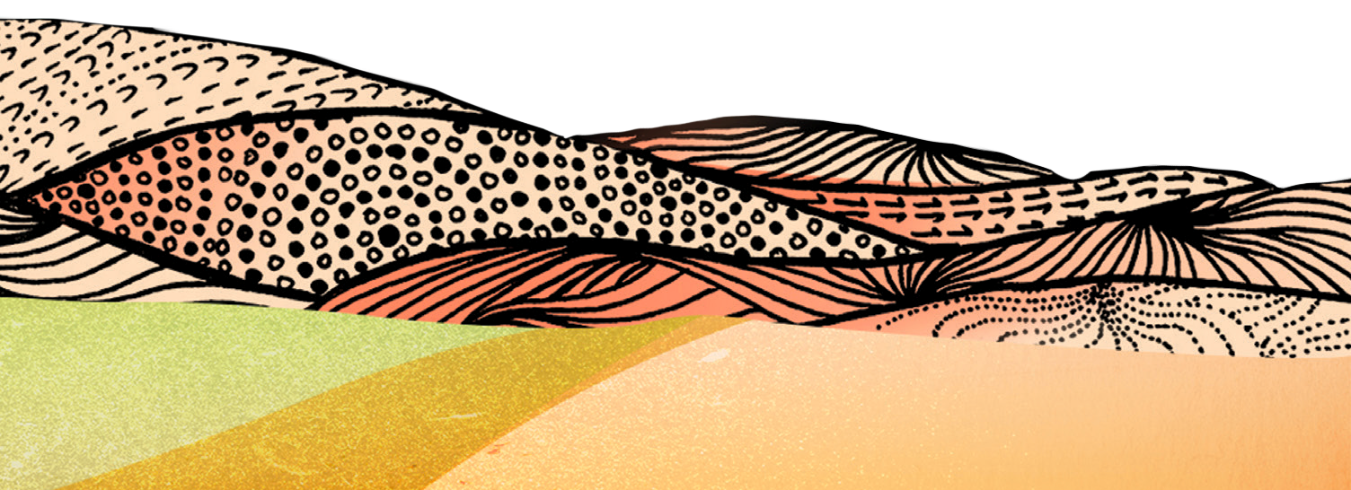

Activity 2:
Statistical Analysis
Notes:
Students work in groups to analyse and discuss statistics related to the Stolen Generations and begin to understand Intergenerational Trauma.
Resources
Book: Tracks by Stephen Kinnane, in Remembered by Heart by Sally Morgan (Note: this is an excerpt from Stephen Kinnane’s book Shadow Lines. Sections from either book can be read at the beginning of each session as part of the lesson introduction).
Stolen Generations infographics.
For your own background knowledge read Stolen Generations demographics.
Statistics for descendants of Stolen Generations (Appendix 1). Print and cut out into strips.
Statistics Analysis Worksheet (Worksheet 1). One sheet per group printed at A3.

Slide 19
Read book: Remembered by Heart by Stephen Kinnane
Notes:
Read section from Tracks in Remembered by Heart by Sally Morgan (Note: this is an excerpt from Stephen Kinnane’s book Shadow Lines. Sections from either book can be read at the beginning of each session as part of the lesson introduction).
Discuss the text. To prompt discussion, you could ask:
What devices does the text use to convey meaning? (e.g. metaphor, simile, personification)
How did the European settlers view the land and subsequently the people who lived on it?
What do you know about Aboriginal and Torres Strait Islander peoples’ connection to country and place and how does the text reflect this?

Slide 20
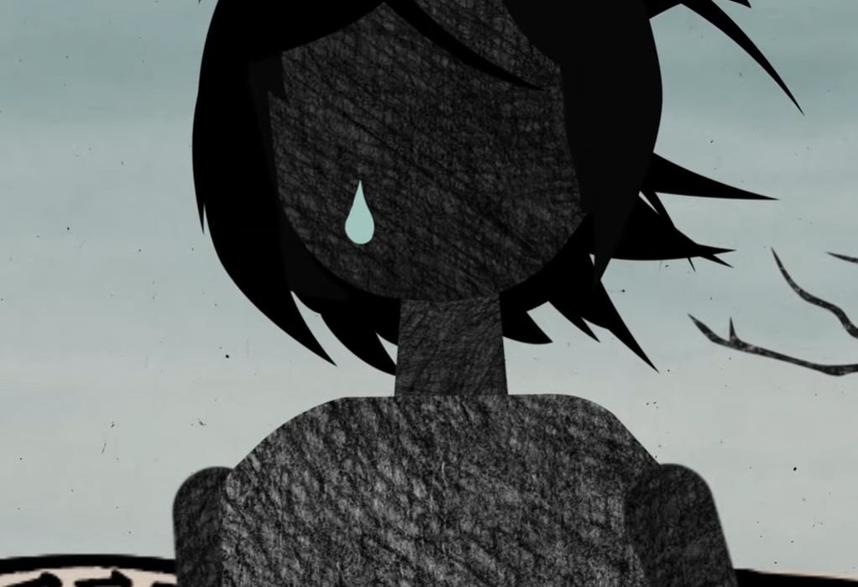
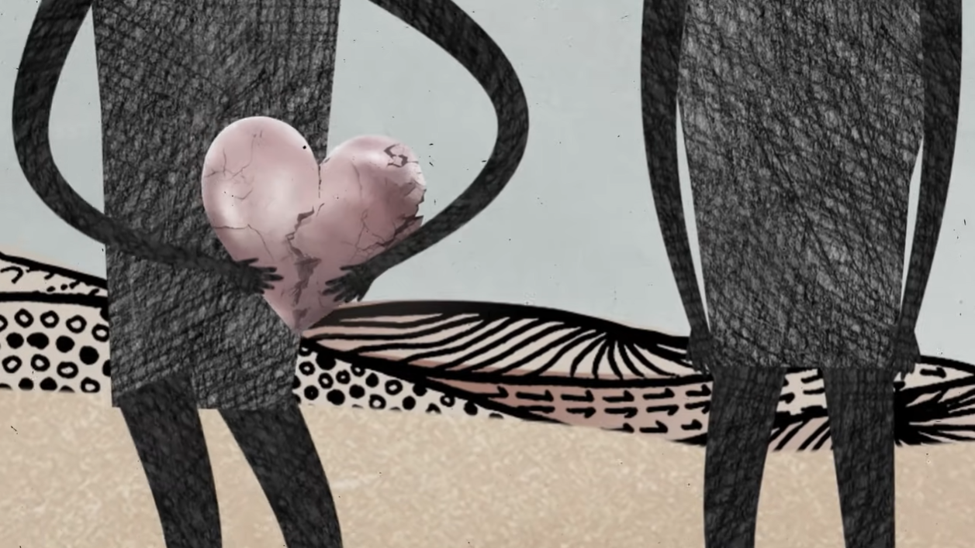
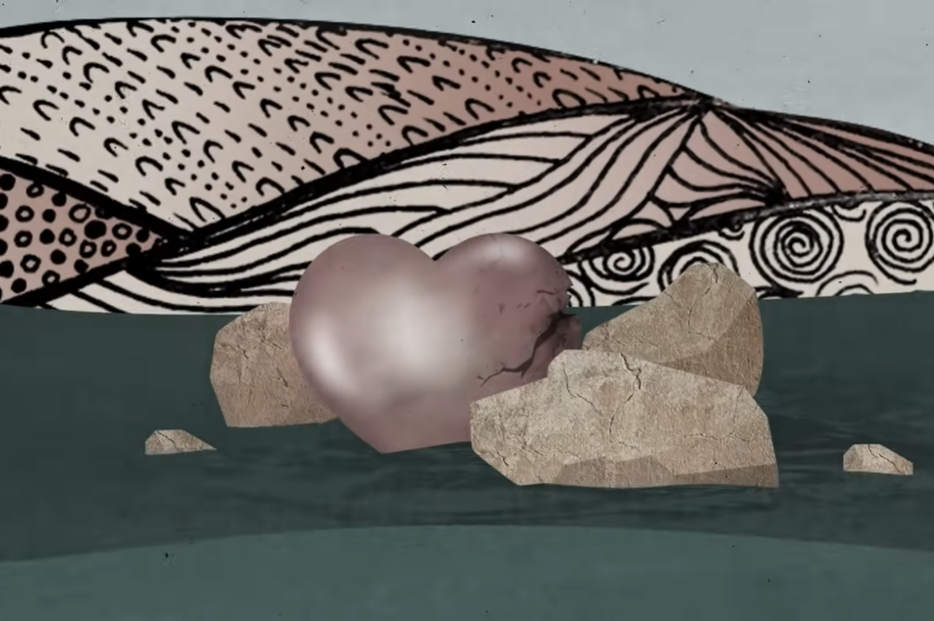
Intergenerational trauma
Notes:
Use this slide to discuss what intergenerational trauma means and how it impacts Stolen Generations descendants:
Trauma in First Nations communities is not just experienced individually but between generations and across communities.
The ripple effect is felt far and wide.
If people don’t have the opportunity to heal from trauma, they may unknowingly pass it on to others through their behaviour.
Their children may experience disconnection from their extended families and culture and have high levels of stress.
This creates a cycle of trauma, where the impact is passed from one generation to the next.
In Australia, intergenerational trauma predominantly affects the children, grandchildren and future generations of the Stolen Generations.

Slide 21
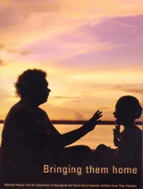
Bringing them Home: the report of the ‘National Inquiry into the Separation of Aboriginal and Torres Strait Islander Children from Their Families’
“Between one in three and one in 10 Indigenous children were forcibly removed from their families and communities in the period from approximately 1910 until 1970. In certain regions and in certain periods the figure was undoubtedly much greater than one in 10. In that time not one Indigenous family has escaped the effects of forcible removal ... Most families have been affected, in one or more generations, by the forcible removal of one or more children.”
Notes:
Explain to students that in the context of learning about the Stolen Generations, we will now be specifically focusing on the long-lasting effects of removal by looking at Intergenerational Trauma. Briefly discuss what students think ‘Intergenerational Trauma’ could mean, activating prior knowledge of word meanings.
Display and discuss this quote from Bringing them Home, the report of the National Inquiry into the Separation of Aboriginal and Torres Strait Islander Children from Their Families

Slide 22
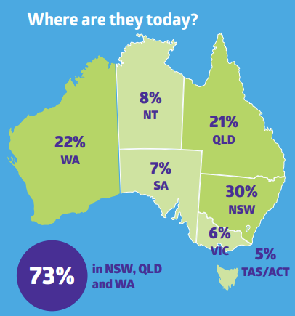
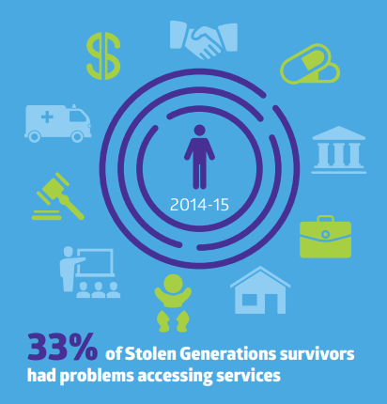
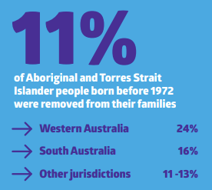
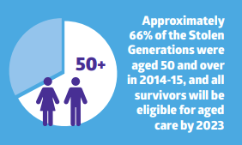
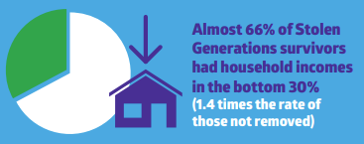
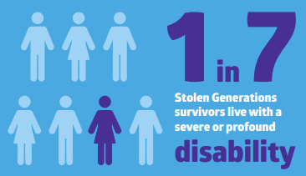
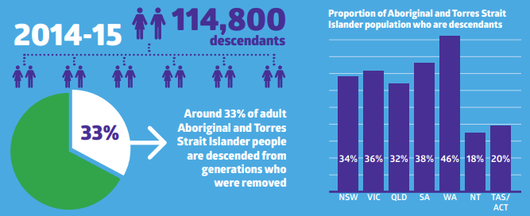
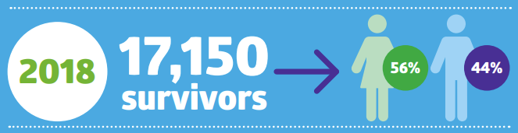
Who are the Stolen Generations?
Notes:
Use projector to display Stolen Generations infographics, examine and discuss as a class.
Link to infographics: https://healingfoundation.org.au//app/uploads/2018/08/HF_Stolen_Gererations_2Page_Infographics_Aug2018_V1.pdf

Slide 23
Analysis of infographics
Form small groups of 3-4
Every group needs to nominate one speaker
Discuss the statistic assigned to your group
Answer the questions on the worksheet
Notes:
Break students into groups.
Give each group one of the Descendants of Stolen Generations statistics (Appendix 1).
Ask groups to appoint a speaker who will share their ideas with the rest of the class.
Give groups Worksheet 2 and explain questions.
As a group, students discuss their statistic and complete Worksheet 2.

Slide 24
Conclusion:
Share group statistics and analysis
Notes:
Bring groups back together and ask speaker to share their group’s statistic and their reactions.
Display the discussion sheets on the classroom wall along with the statistics for reference in a later activity.
Add any new words to the classroom word wall.

Slide 25
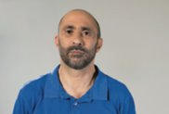
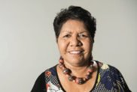
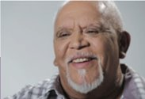
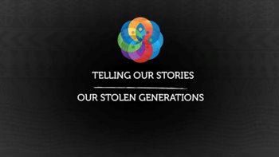
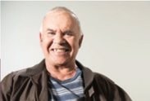
Activity 3: Research and Poster Presentation
Notes:
Students work individually to research the ongoing effects of the Stolen Generations and create a poster and presentation to share their learning.
Resources
Book: Tracks by Stephen Kinnane, in Remembered by Heart by Sally Morgan (Note: this is an excerpt from Stephen Kinnane’s book Shadow Lines. Sections from either book can be read at the beginning of each session as part of the lesson introduction).
Material for students to create posters (A3 cardboard, pens, images from case studies).
Sources for reference:
Demographics from Activity 2.
Non-fiction books.
News articles (to find more news articles, visit the NITV website and search for ‘Intergenerational Trauma’).
Videos from Stolen Generations survivors.
Telling Our Stories - Mark Bin Baker
Telling Our Stories - Florence Onus
Case studies printed (multiple copies of each) or on computer or iPad for students to easily access:
Michael Welsh
Ian Hamm
Florence Onus
Isabel Reid
Richard Campbell
Note: As Activity 3 is a more involved lesson, it can continue into Activity 4 if required.

Slide 26
Read book: Remembered by Heart by Stephen Kinnane
Notes:
Read section from Tracks in Remembered by Heart by Sally Morgan (Note: this is an excerpt from Stephen Kinnane’s book Shadow Lines. Sections from either book can be read at the beginning of each session as part of the lesson introduction).
Discuss the text. To prompt discussion, you could ask:
What devices does the text use to convey meaning? (e.g. metaphor, simile, personification)
How did the European settlers view the land and subsequently the people who lived on it?
What do you know about Aboriginal and Torres Strait Islander peoples’ connection to country and place and how does the text reflect this?

Slide 27
What have we learnt so far?
Notes:
Give students an opportunity to recall what they've learnt, particularly about intergenerational trauma

Slide 28
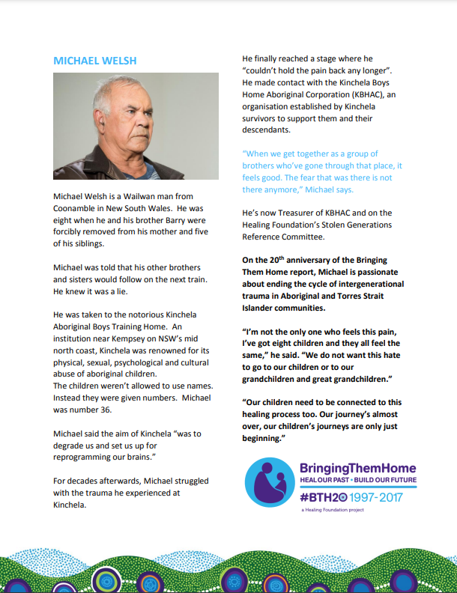
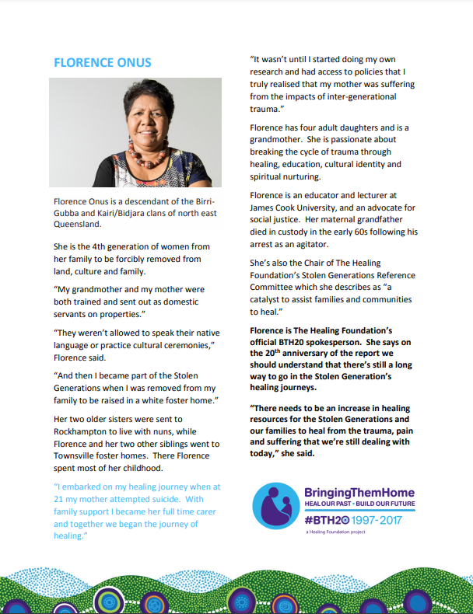
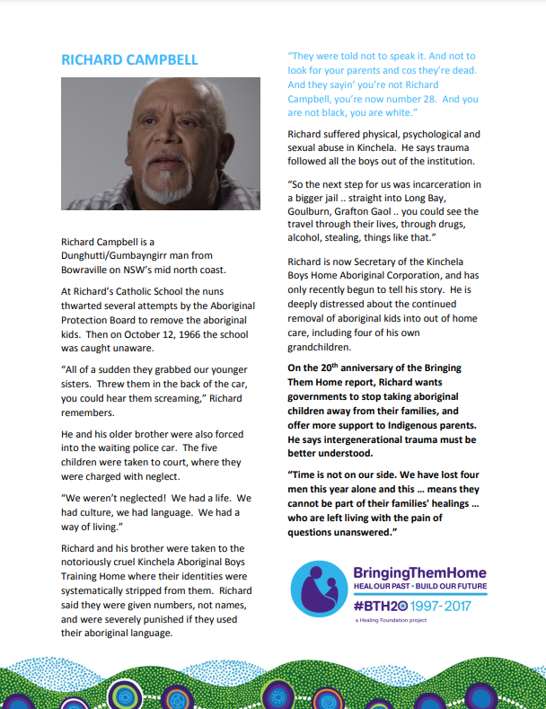
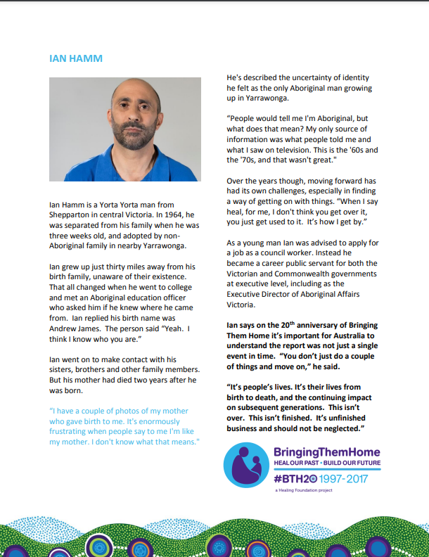
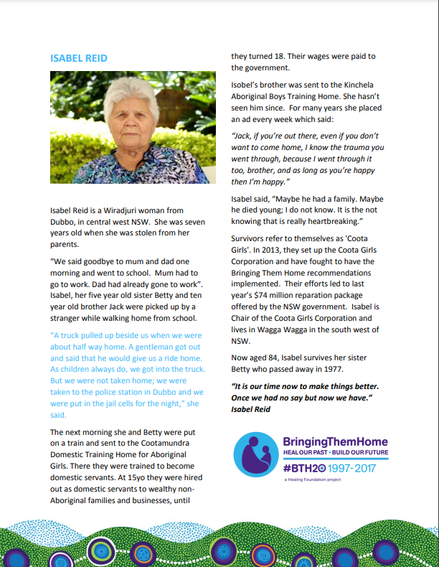
Notes:
Introduce the activity. Students will read stories from members of the Stolen Generations and understand the ongoing effects of their removal on them, their family and community. Print out copies so these can be read as a class.

Slide 29
Persuasive Poster
Choose one person's story to base your poster on
Your poster needs:
a title
demographics and statistics from The Healing Foundation
information from other sources
quotes from your selected story
Notes:
Students will then choose one person’s story to focus on and use the knowledge they have gained from Activity 1 and 2 and their own research to create:
a persuasive poster about the ongoing effects of the Stolen Generations
a two minute presentation to accompany the poster.

Slide 30
Write speech for poster
Use worksheet to draft speech.
Write a good copy of your speech on to index cards
Create a final copy of your poster on A3 cardboard.
Reminder: it is not appropriate to recreate Aboriginal and Torres Strait Islander art forms.
Notes:
• Students should plan their poster and a short presentation to accompany it. They can use Worksheet 2 to assist them in planning.

Slide 31
Conclusion:
Present posters and speeches
Notes:
Students can view each other’s posters and practise their speeches with a partner.
Posters and speeches should be kept safe for the next activity.
Add any new words to the classroom word wall.

Slide 32
Activity 4:
Planning event and poster walk
Notes:
Students plan and hold a poster presentation event for another class and members of the school community.
Resources
Book: Tracks by Stephen Kinnane, in Remembered by Heart by Sally Morgan (note: this is an excerpt from Stephen Kinnane’s book Shadow Lines. Sections from either book can be read at the beginning of each session as part of the lesson introduction).
A3 completed posters and presentations from Activity 3.

Slide 33
Read book: Remembered by Heart by Stephen Kinnane
Notes:
Read section from Tracks in Remembered by Heart by Sally Morgan (Note: this is an excerpt from Stephen Kinnane’s book Shadow Lines. Sections from either book can be read at the beginning of each session as part of the lesson introduction).
Discuss the text. To prompt discussion, you could ask:
What devices does the text use to convey meaning? (e.g. metaphor, simile, personification)
How did the European settlers view the land and subsequently the people who lived on it?
What do you know about Aboriginal and Torres Strait Islander peoples’ connection to country and place and how does the text reflect this?

Slide 34
Planning the Event
As a class, brainstorm what you will need for the event:
invitations (consider who it will be appropriate to invite. Does the school have a relationship with local Aboriginal and Torres Strait Islander community members?)
a dedicated space to display posters
food (could students make food with at least one ingredient that is Indigenous to Australia?)
music (what would be appropriate music to play at the event?).
Notes:
Introduce the activity. Students will now plan and hold a poster presentation event for another class and members of the school community. This event could align with National Sorry Day or Reconciliation Week.
You could also consider some other actions in your school community that could align with the event:
flying flags at half mast
working with a younger class to create Sorry Day flowers
inviting other classes to display their work at the event (e.g. Year 5 acrostic poem posters).

Slide 35
EVENT:
Poster Presentation
Notes:
HOLDING THE EVENT AND POSTER PRESENTATION
Once planning is complete, students will host the event.
During the event, students should stand near their posters and as attendees approach them they should give their presentation and answer any questions.
Conclusion:
Students should discuss and reflect on the event and their learning.

Slide 36
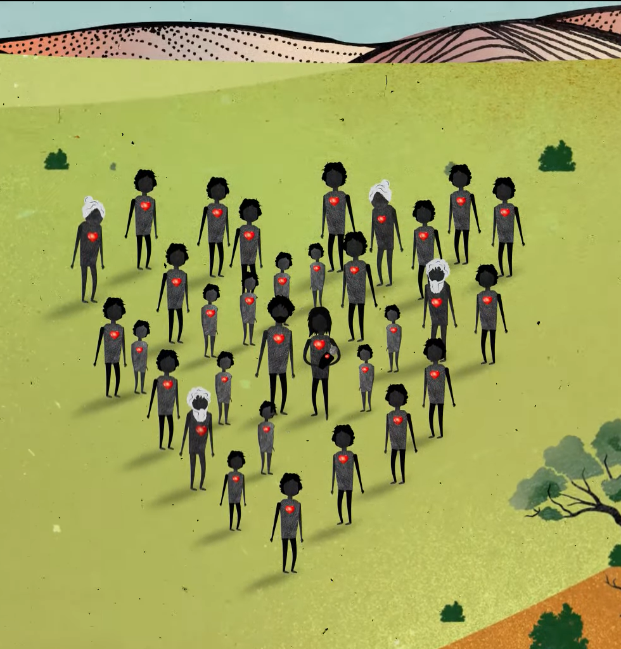
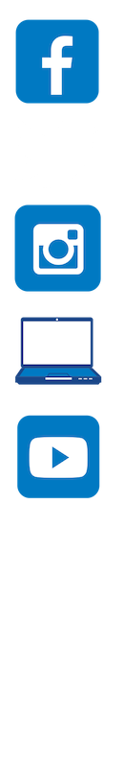
Contact The Healing Foundation
@HealingFoundation
@healingourway
@healingourway
www.healingfoundation.org.au
Healing Foundation
Notes:
Consider:
Sharing your outcomes and experience with The Healing Foundation at resources@healingfoundation.org.au
Sharing the resource and how you used it amongst your networks.
Sharing your students’ learning journey and tag The Healing Foundation on Instagram @healingourway and on Facebook as ‘Healing Foundation’.

