Slide 1
Foundation

Slide 2
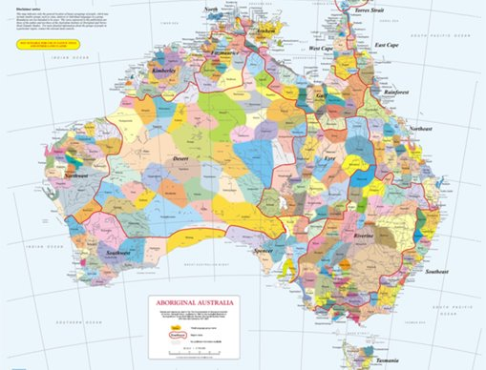
Acknowledgement
[Name of school/class] acknowledges Country, Custodians and Community of the lands on which we are on today [insert name of land/ peoples].
We also pay our respects to Elders and to Stolen Generations survivors, of the Dreaming and of the here and now.
We recognise the ongoing nature of trauma experiences for First Nations peoples and commit each day to survivor-led intergenerational healing.
Notes:
Update this slide with the name of your school/ class and the name of the land/s on which you're presenting the lesson on.
You may choose to make the wording of this acknowledgement more specific to your land/school/experiences. The acknowledgement isn't a script that we have to follow, you may even introduce the unit by working with students to write an acknowledgement for your class.
Image credit: https://ipaustralia.libguides.com/c.php?g=451400&p=3082380

Slide 3
Aboriginal and Torres Strait Islander students and teachers should be aware that these resources may contain the names, images, and voices of deceased persons.
Notes:
Important to remind students to speak up if they are feeling discomfort, and any safety and wellbeing measures your school has in place.

Slide 4

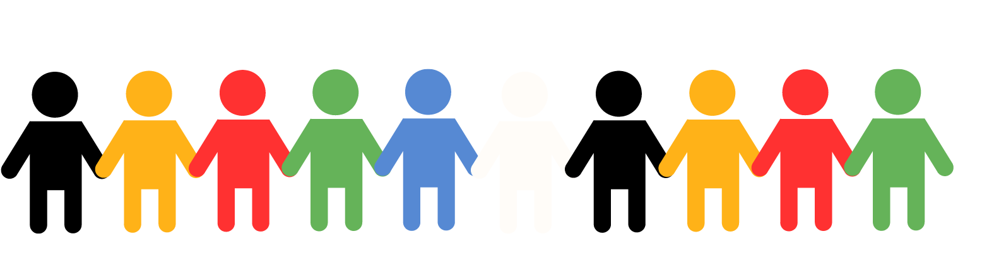

Care and safety
Notes:
Important to remind students to speak up if they are feeling discomfort, and any safety and wellbeing measures your school has in place.
This is also a good place to ask the cultural safety questions from the educator's guide so you can co-construct a culturally safe space with your students.

Slide 5
Overview: this week’s activities
ACTIVITY 1: LITERATURE INTRODUCTION (20–30 MINUTES)
Teacher leads children in a guided reading session and helps children create their own yarning circle.
ACTIVITY 2: ARTWORK RESPONSE (20–30 MINUTES)
Students view and respond to artwork.
ACTIVITY 3: MUSICAL RESPONSE (20–30 MINUTES)
Students listen to and respond to music and create a personal artwork response.
ACTIVITY 4: REFLECT AND SHARE LEARNING (20–30 MINUTES)
Students record a ‘digital postcard’ to reflect on their learning.
Notes:
OPTIONAL SLIDE
Update week to timeframe for these teaching activities in consideration of class schedule and activity time.

Slide 6
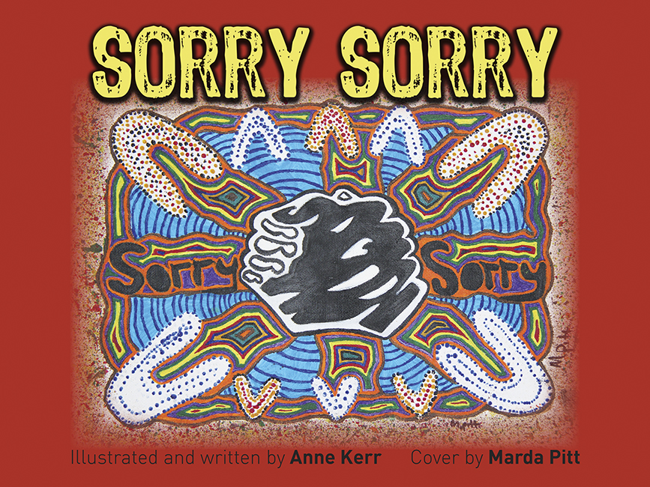

Activity 1: Literature Introduction
Notes:
Introduce students to the first activity in which they will be reading a book and forming a yarning circle.
Resources
Suggested book: Sorry Sorry by Anne Kerr and Marda Pitt. Equipment to help you create a yarning circle (e.g. logs arranged outside, cushions arranged inside, an object that will act as a ‘power instrument’ for speaker to hold).
For your own background knowledge, read information about yarning circles.

Slide 7


What do you know?
Notes:
Encourage students to share what they know about the Aboriginal and Torres Strait Islander Culture and History. You can ask if they've previously learned about:
Language
Aboriginal or Torres Strait Islander words
Bush food
Country
Music

Slide 8
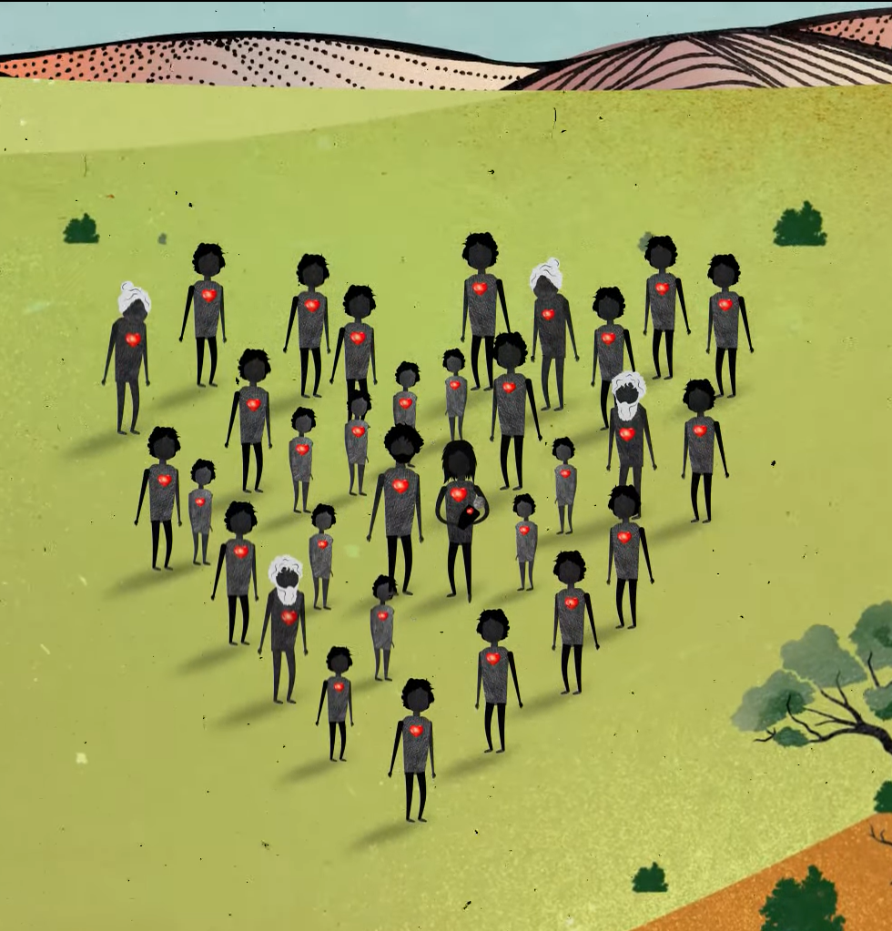
The Stolen Generations
Notes:
More information:
Before you were born, the governments in Australia created laws that said that many Aboriginal children should be taken from their homes and families to live in other places.
Taking these children away from their homes and families caused a lot of pain and sadness that still exists today. The children who were taken are called the Stolen Generations.
These children have grown up now and have families of their own and lots of them are trying to heal from their sadness

Slide 9
Read book: Sorry Sorry by Anne Kerr and Marda Pitt
Notes:
Read the selected book, stopping to explain or answer questions if necessary.
Once you have finished the book, discuss any key points. You might ask:
What did you like about the story?
What did you learn from the story?
Are there any words in the story that are new to you?
How does the book use illustration to help us feel something in the story?

Slide 10
Yarning Circles:
What do you know?
Notes:
Encourage students to share what they know about the Yarning Circles. Use the next slide to explain what happened in more detail.

Slide 11

Yarning Circles
group learning
respectful relationships
shared knowledge
Notes:
The use of Yarning Circles is an important process within Aboriginal and Torres Strait Islander cultures. This process has been used by Indigenous people from around the world for centuries to build respectful relationships, learn from a collective group and to preserve and pass on cultural knowledge.
Practice using the yarning circle in this session by having students talk about the book they just read. If students need prompting, they can give one word to describe their thoughts and reactions to the book.

Slide 12
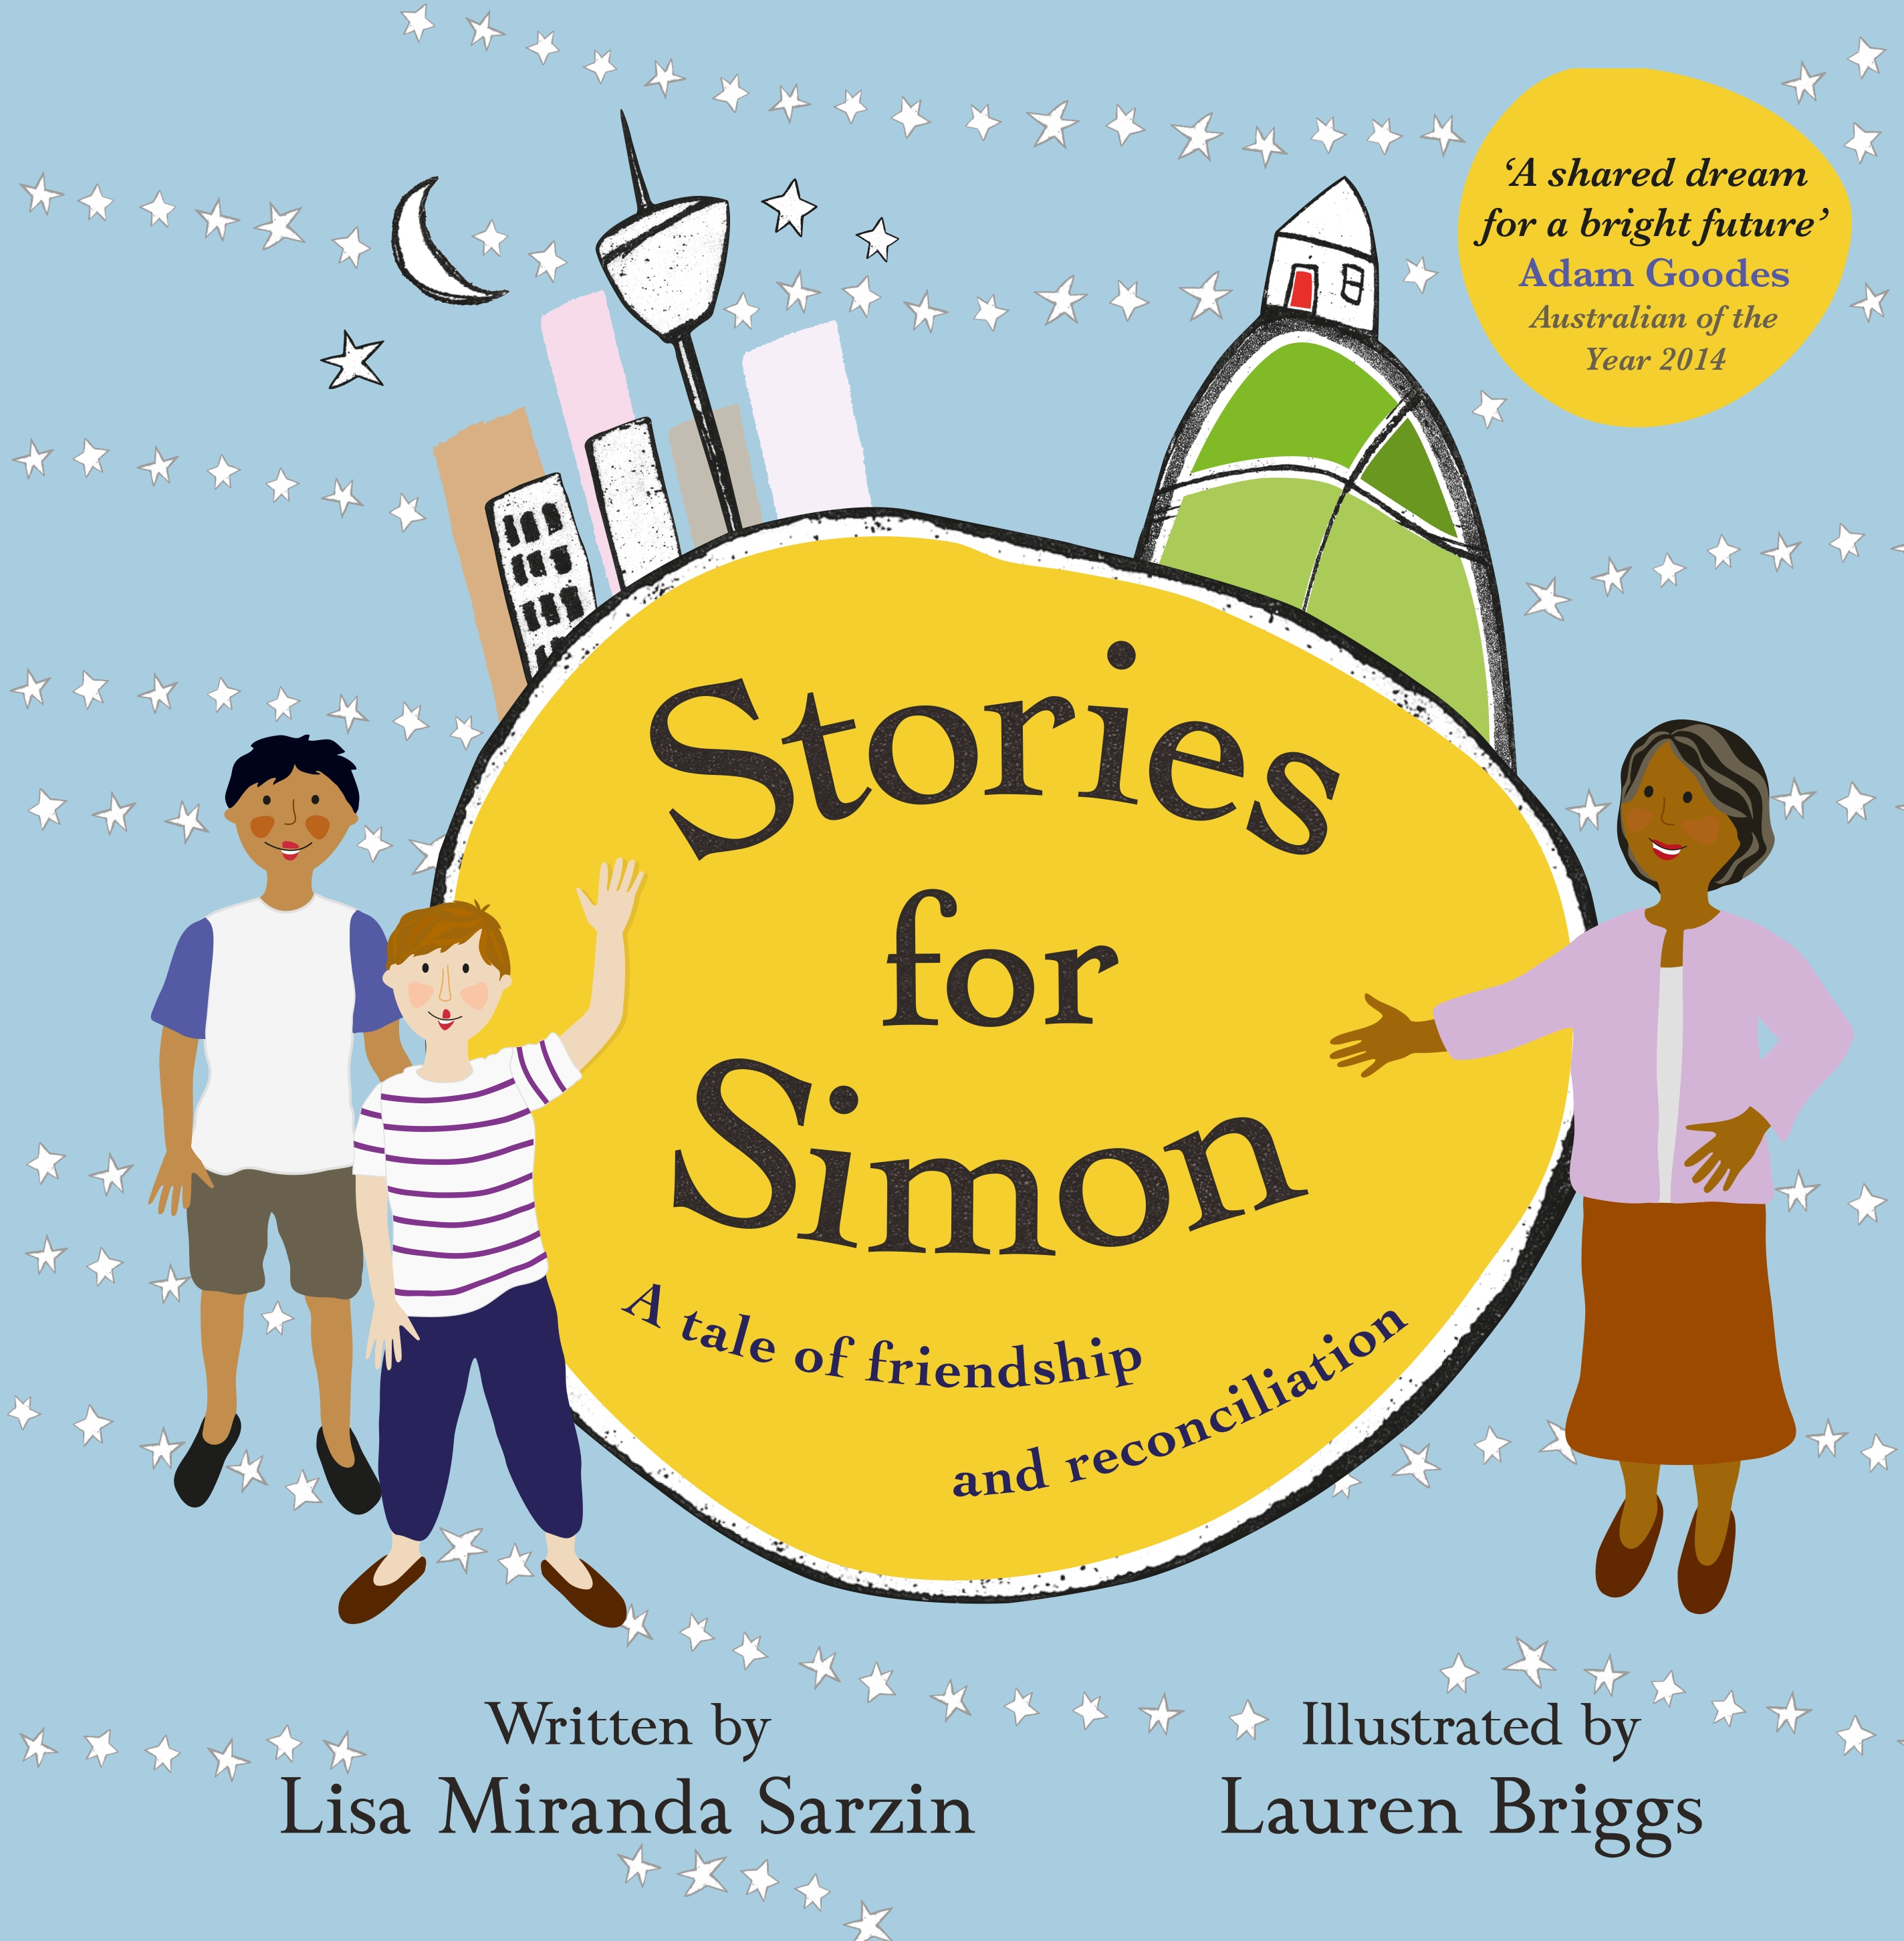
Activity 2: Artwork Response
Notes:
Introduce students to the second activity in which they will be reading a book before looking at some art.
Resources
Suggested book for this session: Stories for Simon by Lisa Sarzin and Lauren Briggs.
Healing Country by Riki Salam (Appendix 1).
For your own background information, read the artist statement for Healing Country.
‘I see…I think…I feel...’ worksheet (Worksheet 1).

Slide 13
The Stolen Generations
Notes:
Remind students of the unit topic and include a brief introduction to the Stolen Generations:
Before you were born, the governments in Australia created laws that said that many Aboriginal children should be taken from their homes and families to live in other places.
Taking these children away from their homes and families caused a lot of pain and sadness that still exists today. The children who were taken are called the Stolen Generations.
These children have grown up now and have families of their own and lots of them are trying to heal from their sadness

Slide 14
Read book: Stories for Simon by Lisa Sarzin and Lauren Briggs
Notes:
Read the selected book (or another from your library), stopping to explain or answer questions if necessary.
Once you have finished the book, discuss any key points. Record some thoughts on the whiteboard/ butchers paper.
You might ask:
What did you like about the story?
What did you learn from the story?
Are there any words in the story that are new to you?
Use one word to describe how the book made you feel.
How does the book use illustration to help us feel something in the story?

Slide 15
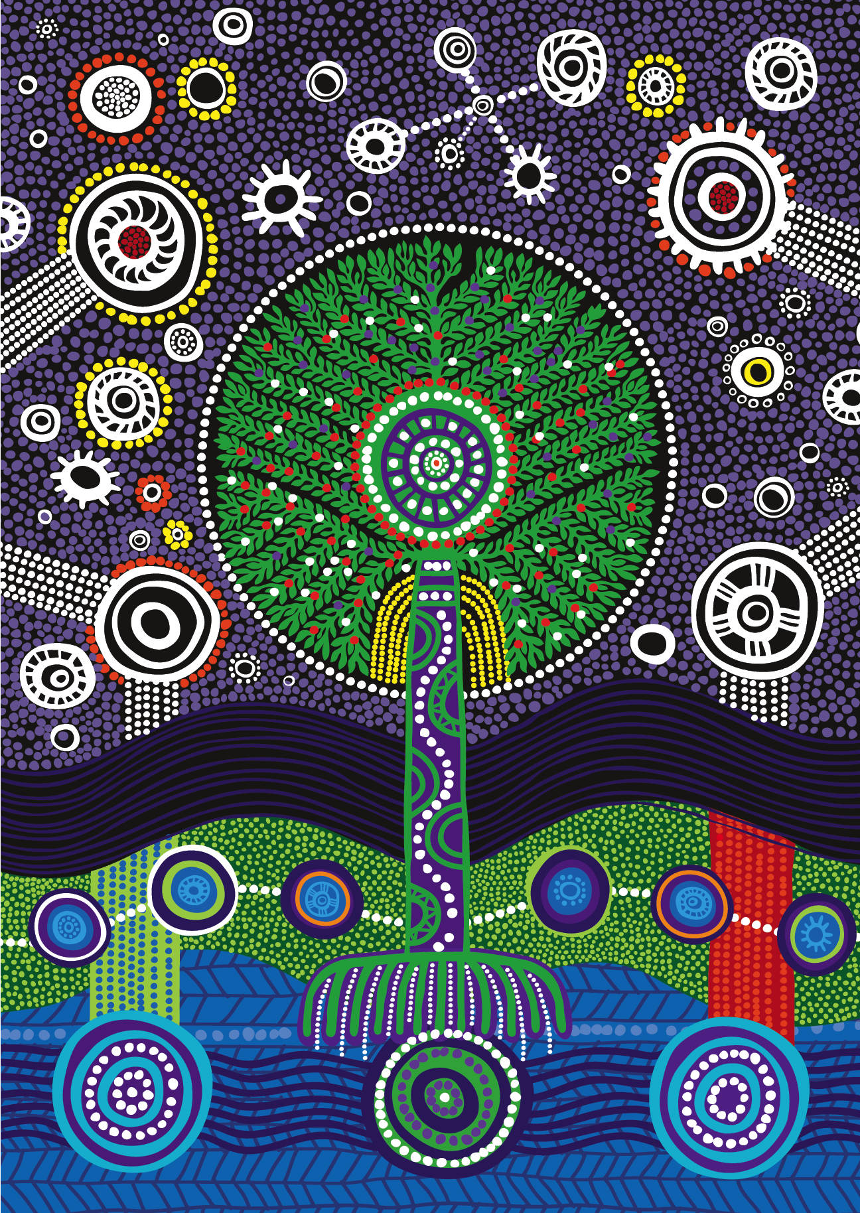
Artwork Response
Healing Country by Riki Salam
Notes:
Introduce the activity: Today we are going to study some art that represents the healing journey of lots of Aboriginal people who are members of the Stolen Generations.
Provide time for students to look, and encourage them to talk to a partner or a small group about what they can see in the artwork.
Prompting questions:
What do you like about the painting?
What do you feel when you look at the painting?
Talk to students about the history of the artwork: This artwork was made by an artist called Riki Salam. To create this artwork he listened to the stories of lots of members of the Stolen Generations and used their stories to think about how the artwork would look.
Continue discussing ideas about the artwork, when students are ready, move on to the worksheet on the next slide

Slide 16
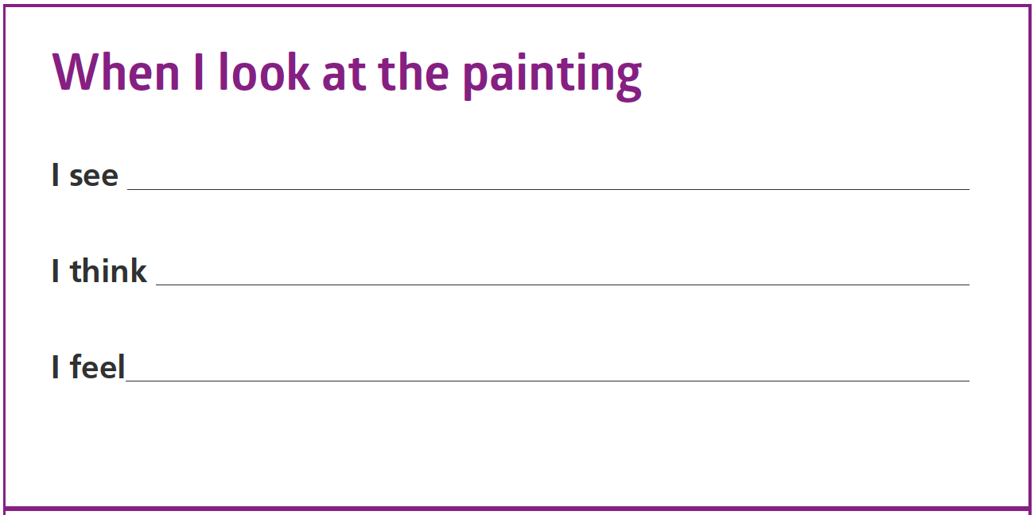



Worksheet 1: I see… I think… I feel…
Notes:
Have students respond to the artwork using the ‘I see…I think…I feel…’ worksheet (Worksheet 1). If they are capable they can write one or two words to respond to each section or you can scribe for them.

Slide 17
Yarning Circle
Notes:
Use the yarning circle to allow students to share their writing.
Display their work on the classroom wall along with a colour print-out of the artwork.

Slide 18
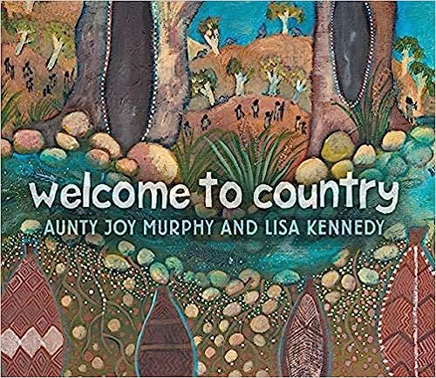
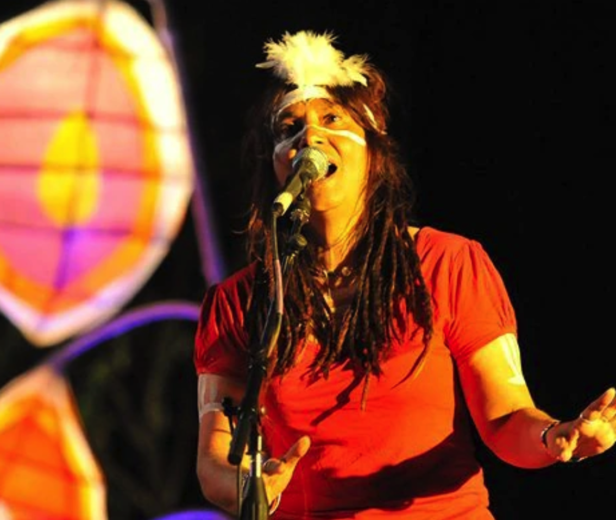
Activity 3: Musical response
Notes:
Remind students that in Activity 2 we started talking about healing journeys and the ways that members of the Stolen Generations help themselves to heal some of their sadness.
One way that some members of the Stolen Generations help themselves is with creating music and today we are going to listen to a song by Shellie Morris, who was a member of the Stolen Generations.
Resources
Suggested book for this session: Welcome to Country by Aunty Joy Murphy and Lisa Kennedy.
Video and audio of Shellie Morris’ performance at the Deadly Awards (Waliwaliyangu li-Anthawirriyarra a-Kurija by Shellie Morris and the Borroloola Songwomen).
For your own background information, read more about the creation of these songs and Shellie Morris’ story.
‘I hear…I think…I feel...’ worksheet (Worksheet 2).
Drawing paper, pencils, crayons.
Image Source: https://www.abc.net.au/radio/programs/conversations/singer-shellie-morris-on-the-beauty-of-indigenous-language/7756646

Slide 19
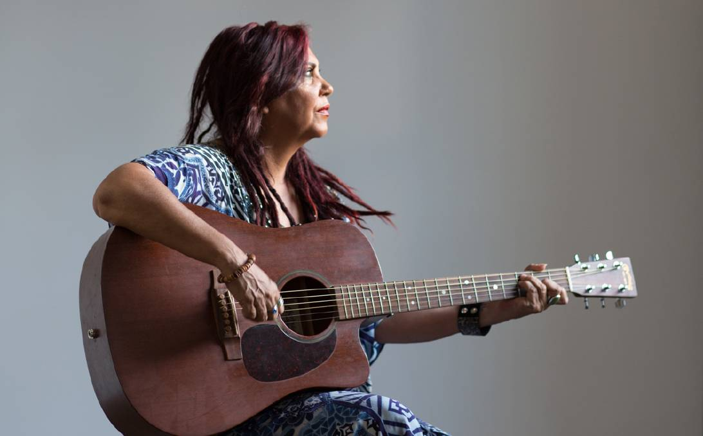
Shellie Morris
Notes:
Shellie Morris is a First Nations singer / songwriter who plays a mix of contemporary folk music and contemporary acoustic ballads. Let students know that on the next slide they will be watching Shellie perform a song.
Image source: https://www.illawarramercury.com.au/story/4771678/duo-celebrates-indigenous-culture-at-illawarra-folk-club/
Extend on Shelly Morris background: https://www.sbs.com.au/news/podcast-episode/indigenous-singer-songwriter-shellie-morris-is-appointed-an-officer-of-the-order-of-australia/18q5xza6q

Slide 20
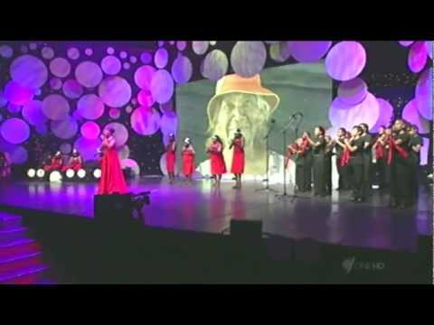
Video: Waliwaliyangu li-Anthawirriyarra a-Kurija - Shellie Morris & the Borroloola Songwomen
Notes:
Link: https://www.youtube.com/watch?v=pdEvTMMFOvU
Give students time to listen and then encourage them to talk to a partner or small group about the song. Some questions that could prompt discussion are:
What do you like about the song?
What do you picture in your head when you listen to the song?
Provide students with worksheet 2 to fill out after the discussion. If they are capable they can write one or two words to respond to each section or you can scribe for them.

Slide 21
Draw the Music
Listen to audio: Waliwaliyangu li-Anthawirriyarra a-Kurija - Shellie Morris & the Borroloola Songwomen
Notes:
Explain that now we are going to ‘draw the music’.
We are going to listen to the song again and use colours and shapes to show how the music is making us feel.
Model the lesson by playing the beginning of the song again and using butchers’ paper and coloured pens to show how you would respond. As you draw, explain your thinking. For example:
This piece of music makes me feel a bit sad and slow, so I am going to use this dark blue pen and draw big, slow waves to show how I am feeling.
Spread students out with their drawing materials and freeze the screen before you play the video, so students can only hear the audio.
Link: https://www.youtube.com/watch?v=pdEvTMMFOvU

Slide 22
Yarning Circle:
Notes:
Give children time to view each other’s work in the yarning circle. You could also facilitate a discussion about how we each have our own responses to the same piece of music.
Display the artwork on the classroom wall.

Slide 23

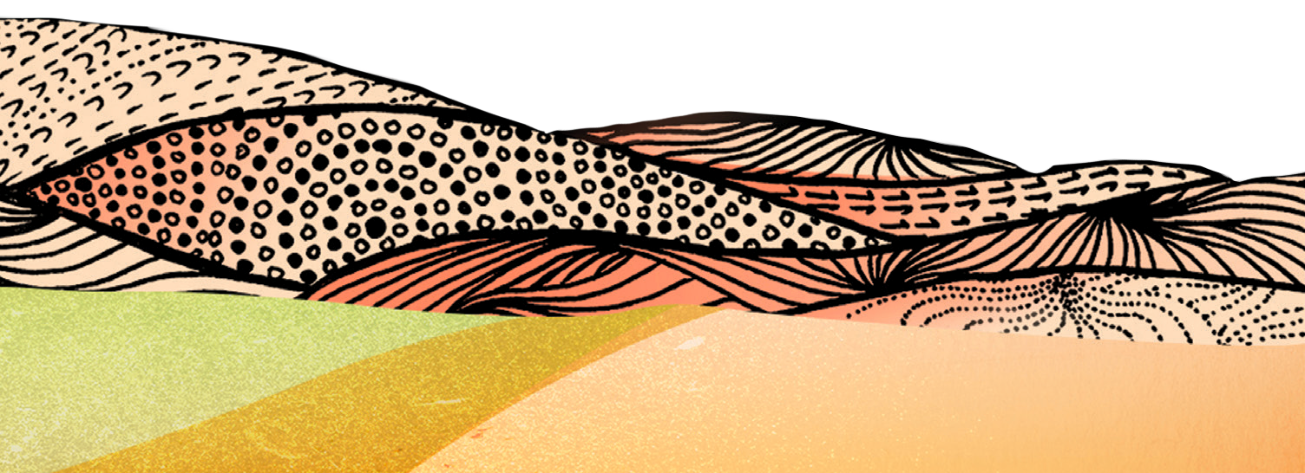

Activity 4:
Reflect and Share Learning
Notes:
Orient the students to today's lesson in which they will be reading a book before recording a 'digital postcard' to share their learning.
Resources
Suggested book for this session: The Lost Girl by Ambelin Kwaymullina and Leanne Tobin.
‘What I think and feel’ worksheet (Worksheet 3).
Coloured print out of Healing Country artwork by Riki Salam.
iPads with Book Creator or other recording app OR video camera set up in a quiet area to record students.
If you wish, create your own ‘model’ version of the task to show students. Take a photo of the Healing Country artwork using the iPad or position it in front of the video camera so it fills the screen. Then, make an audio recording of yourself talking about your thoughts and feelings about the unit. Include this on the next slide.

Slide 24
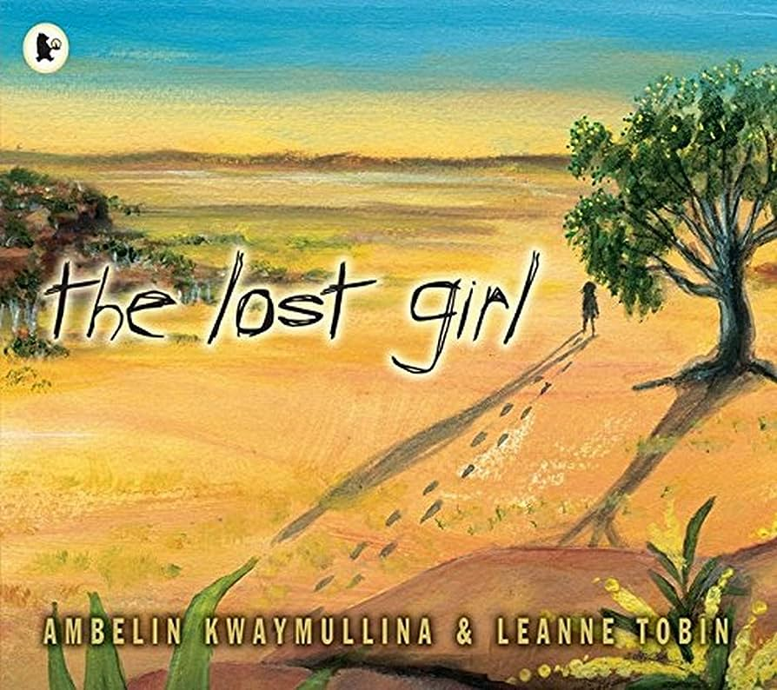
Read book: the lost girl by Amberlin Kwaymullina & Leanne Tobin
Notes:
Read the selected book, stopping to explain or answer questions if necessary.
Once you have finished the book, discuss any key points. Record some thoughts on the whiteboard/ butchers paper.
You might ask:
What did you like about the story?
What did you learn from the story?
Are there any words in the story that are new to you?
Use one word to describe how the book made you feel.
How does the book use illustration to help us feel something in the story?

Slide 25
Creating Digital Postcards
Notes:
Explain the task to your students. Attach your digital postcard to this slide. If you wish, create your own ‘model’ version of the task to show students. Take a photo of the Healing Country artwork using the iPad or position it in front of the video camera so it fills the screen. Then, make an audio recording of yourself talking about your thoughts and feelings about the unit. Include this on the next slide.

Slide 26
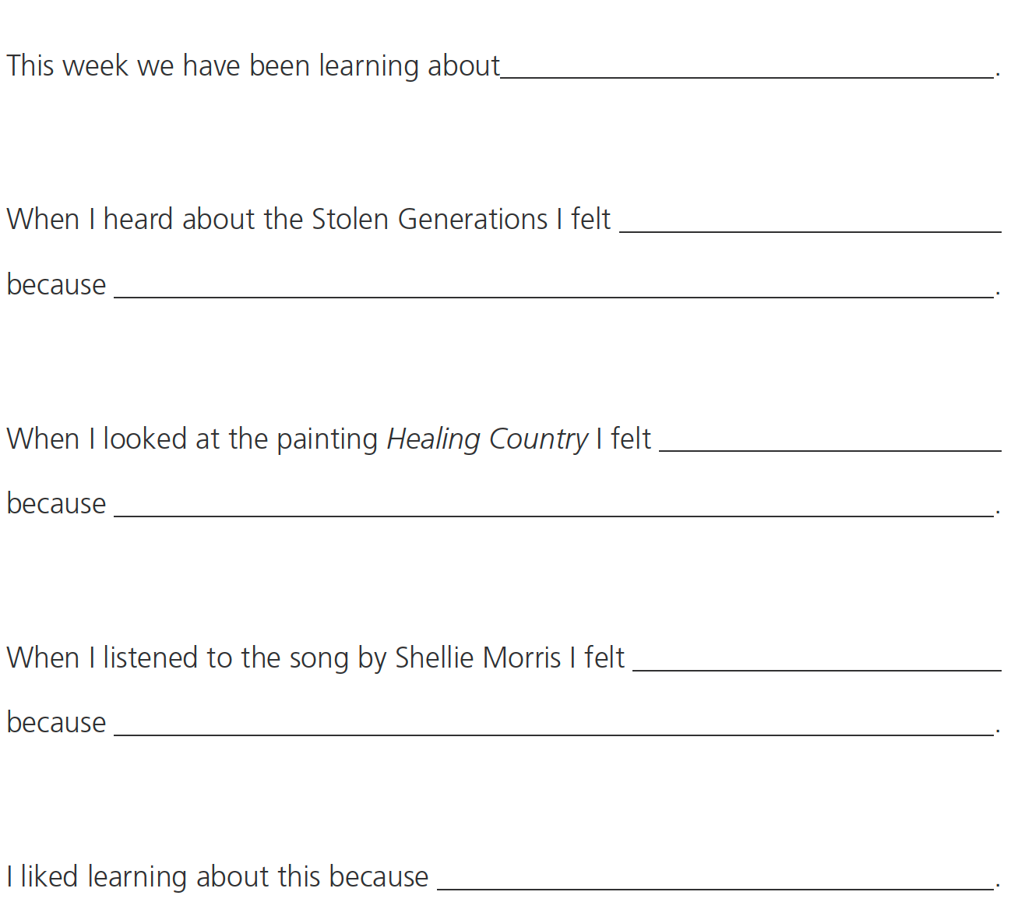
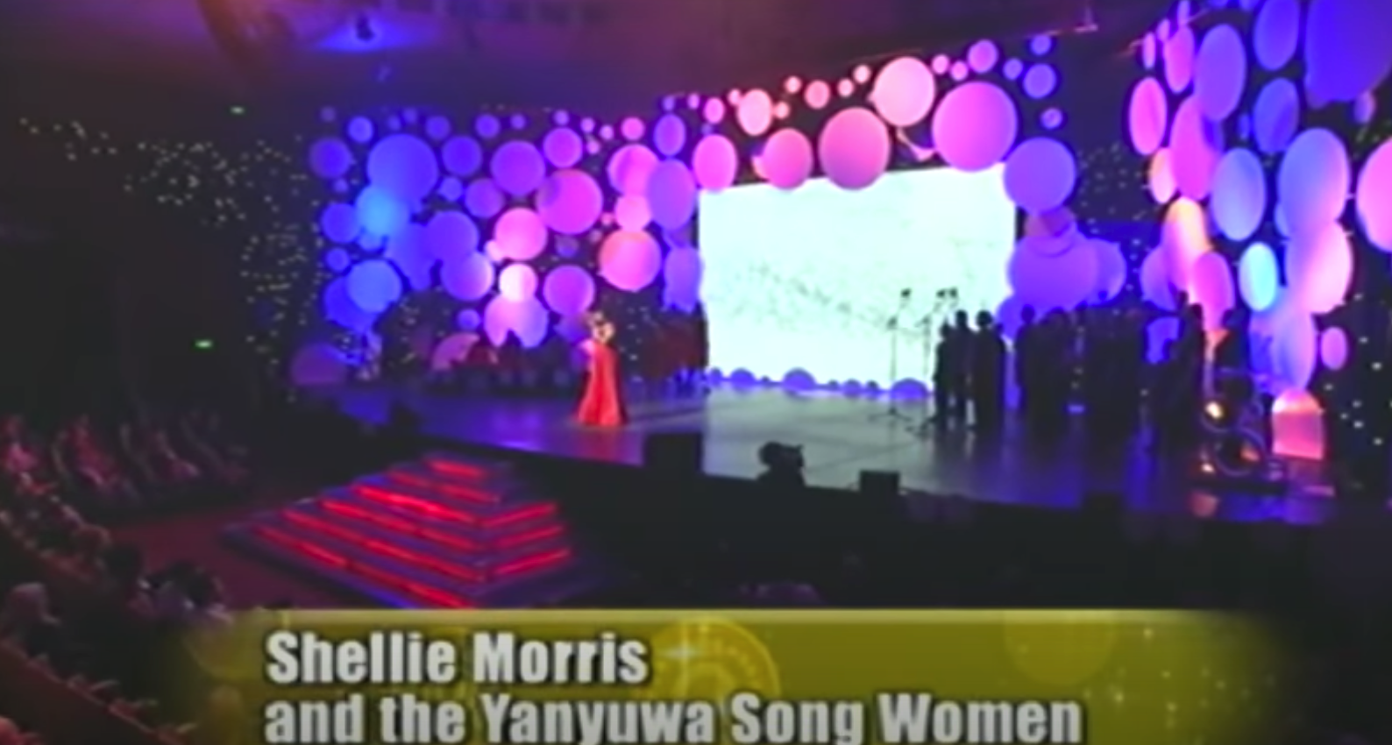
Creating Digital Postcards
Notes:
Distribute the ‘What I think and feel’ worksheet (Worksheet 3) and assist students in completing it. They can refer to their ‘I see…I hear…I feel…’ worksheets if they need to and you could also replay the song or show them the artwork again if required.
Set class up in small groups with puzzles, games or books so you can work individually with students.
One by one, bring students over and ask them to take a photo of the artwork using the iPad or hold it up to the camera. Use the iPads recording capabilities to help students record themselves reading their ‘What I think and feel’ worksheet. Depending on capability, you can read the sentence starters for them.
Link for Waliwaliyangu li-Anthawirriyarra a-Kurija - Shellie Morris & the Borroloola Songwomen: https://www.youtube.com/watch?v=pdEvTMMFOvU

Slide 27
Yarning Circle
Notes:
End the lesson with a yarning circle to share the videos, or play the completed videos for a ‘buddy class’ and then email the videos home for parents and carers or show the videos on parade.

Slide 28
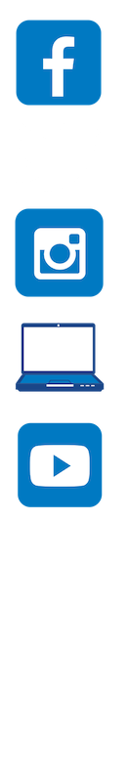
Contact The Healing Foundation
@HealingFoundation
@healingourway
@healingourway
www.healingfoundation.org.au
Healing Foundation
Notes:
Consider:
Sharing your outcomes and experience with The Healing Foundation at resources@healingfoundation.org.au
Sharing the resource and how you used it amongst your networks.
Sharing your students’ learning journey and tag The Healing Foundation on Instagram @healingourway and on Facebook as ‘Healing Foundation’.

