Slide 1
Year 11

Slide 2
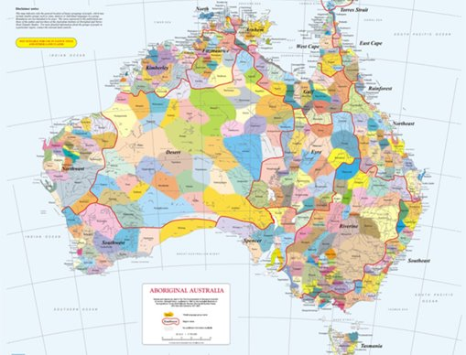
Acknowledgement
[Name of school/class] acknowledges Country, Custodians and Community of the lands on which we are on today [insert name of land/ peoples].
We also pay our respects to Elders and to Stolen Generations survivors, of the Dreaming and of the here and now.
We recognise the ongoing nature of trauma experiences for First Nations peoples and commit each day to survivor-led intergenerational healing.
Notes:
Update this slide with the name of your school/ class and the name of the land/s on which you're presenting the lesson on.
You may choose to make the wording of this acknowledgement more specific to your land/school/experiences. The acknowledgement isn't a script that we have to follow, you may even introduce the unit by working with students to write an acknowledgement for your class.
Image credit: https://ipaustralia.libguides.com/c.php?g=451400&p=3082380

Slide 3
Aboriginal and Torres Strait Islander students and teachers should be aware that these resources may contain the names, images, and voices of deceased persons.
Notes:
Important to remind students to speak up if they are feeling discomfort, and any safety and wellbeing measures your school has in place.

Slide 4
Care and safety
These lessons might include some content that is confronting or overwhelming
We all need to understand a full history of Australia, including the experiences of Stolen Generations survivors, their families and communities, and the impacts of past government policies that are still being felt today
It is important to speak to me or another adult if at any point you feel distressed – we are all here to learn together and keep each other safe.
Notes:
Important to remind students to speak up if they are feeling discomfort, and any safety and wellbeing measures your school has in place.
This is also a good place to ask the cultural safety questions from the educator's guide so you can co-construct a culturally safe space with your students.

Slide 5
Healing together
Why is learning about the Stolen Generations important?
to change the way we look at our collective history.
to support reconciliation and an honest understanding of our past – not just one perspective.
to become aware of past government policies that still affect many Aboriginal and Torres Strait Islander peoples and families today.
Notes:
Give students a chance to suggest why they think the learning is important before clicking through to the reasons.

Slide 6
Cultural Safety
How does a safe classroom look to you?
How does it feel?
How can we be culturally safe?
Notes:
You may have already established this as a class, if so, use this time to reiterate the class rules.
Begin a discussion about cultural safety with the class. Ask them to answer the questions in a 'think/pair/share' activity, or address them as a group.
Use the final question to lead in to the next slide.

Slide 7
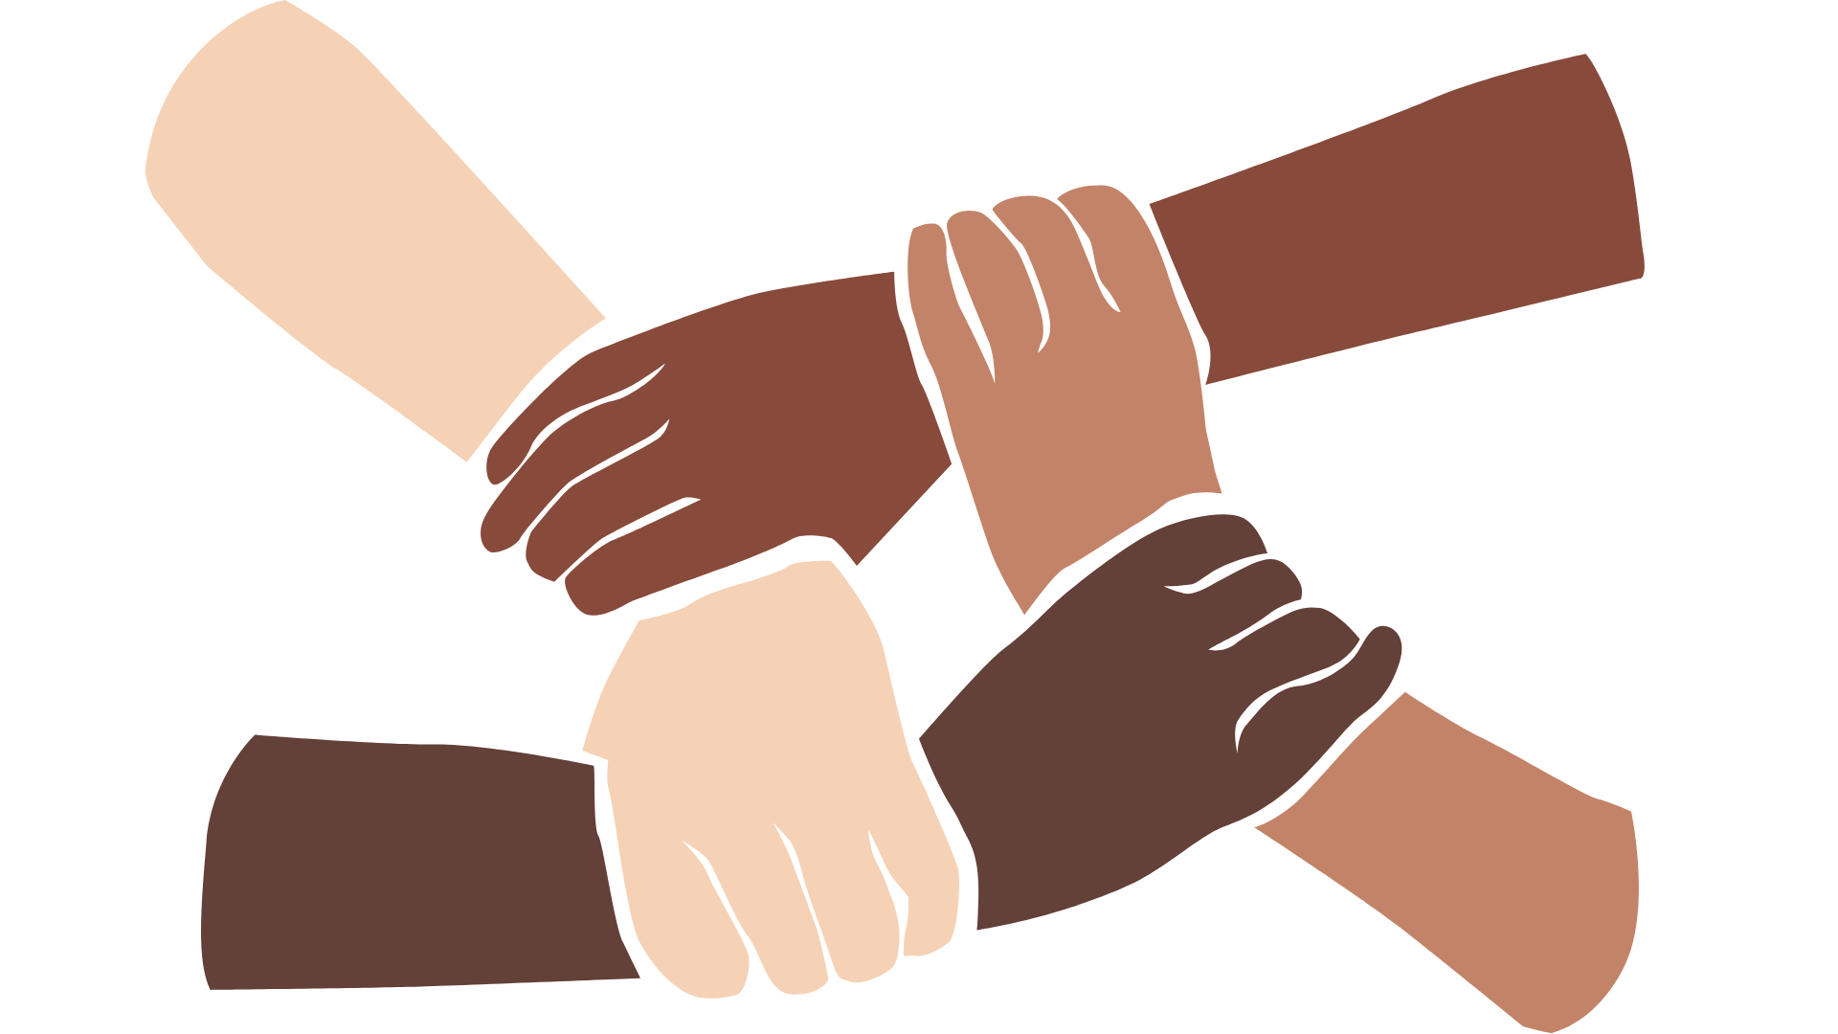
Cultural Safety
Open mindedness
Respect
Honest communication
Being mindful of privilege
Notes:
A culturally safe classroom environment relies on open-mindedness, respect and honest communication.
Make any changes needed for this discussion to be age-appropriate for your class
Image credit: Sketchify from Canva

Slide 8
Overview: this week’s activities
ACTIVITY 1: MOTHER
Through the work of artist Michael Cook, students can explore the visual representation of emotions that are depicted in the journey of a woman in a deserted Australian landscape. The ‘mother’ is always alone, her baby absent.
ACTIVITY 2: THE CHILDREN
In this activity, Archie Roach’s song ‘Took the Children Away’ will lead students through an emotional journey while learning about the power of sharing your story.
ACTIVITY 3: SHARING PERSONAL STORIES
Sharing stories has been part of how we inspire, heal and learn as humans. Students are given time in this activity to listen deeply, understand, reflect and learn from the stories shared by survivors of the Stolen Generations.
ACTIVITY 4: THE CHILDREN CAME BACK
In this activity, students will have the opportunity to explore the resilience of spirit through song and story.
Notes:
OPTIONAL SLIDE
Update week to timeframe for these teaching activities in consideration of class schedule and activity time.

Slide 9
The Stolen Generations:
What do you know?
Notes:
Encourage students to share what they know about the Stolen Generations. Use the next slide to explain what happened in more detail.

Slide 10
The Stolen Generations
For about a century, thousands of First Nations children were systematically taken from their families, communities and culture, many never to be returned.
These children are known as Stolen Generations survivors.
Notes:
More information:
First Nations children were removed by government authorities from the mid-1800s to the 1970s. In the 1860s, Victoria became the first state to pass laws authorising the removal of First Nations children from their families.
Similar policies were later adopted by other states and territories – and by the federal government when it was established in the 1900s.
For about a century, thousands of children were taken from their families, communities and culture, many never to be returned.
These children are known as Stolen Generations survivors, or Stolen Children. They were taken by the police, from their homes, and on their way to or from school, and placed in more than 480 institutions, adopted or fostered by non-Indigenous people and often subjected to abuse. The children were denied all access to their culture, they were not allowed to speak their language and they were punished if they did.
There are currently more than 33,000 Stolen Generations survivors in Australia. More than one third of all First Nations peoples are their descendants. In Western Australia, more than half of the population have Stolen Generation links.

Slide 11
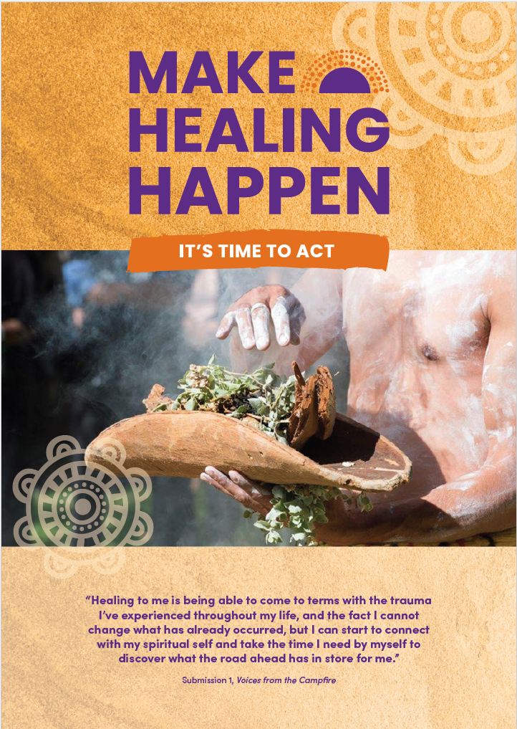
Make Healing Happen
In groups of four read and discuss the information in the Make Healing Happen: it’s time to act report overview.
Present your thoughts and feelings about it back to the class.
Notes:
Link to Make Healing Happen report: www.healingfoundation.org.au/make-healing-happen/
The overview (which is only 4 pages) can be found on the same page via the ‘Download the overview’ button

Slide 12
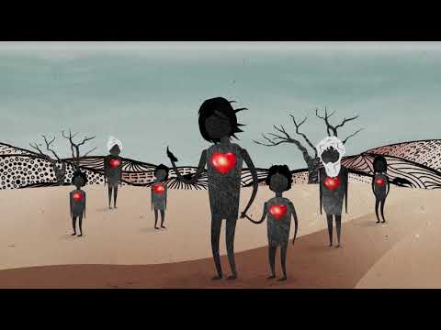
What is intergenerational trauma?
Notes:
Link to video: https://www.youtube.com/watch?v=vlqx8EYvRbQ

Slide 13
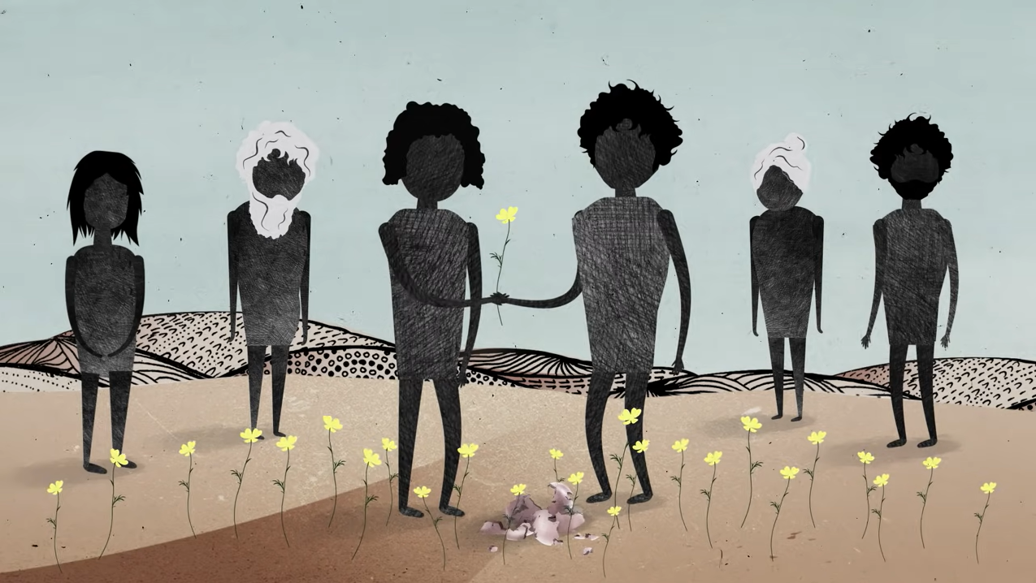
Intergenerational trauma
A report by the Australian Institute of Health and Welfare found that in comparison to other First Nations peoples, children living in households with Stolen Generations are:
2 times as likely to experience discrimination
2 times as likely to experience violence
1.5 times more likely to have been arrested
Notes:
Use this slide to discuss what intergenerational trauma means and how it impacts Stolen Generations descendants. Information from the lesson plan is provided below.
Trauma in First Nations communities is not just experienced individually but between generations and across communities. The ripple effect is felt far and wide.
If people don’t have the opportunity to heal from trauma, they may unknowingly pass it on to others through their behaviour. Their children may experience disconnection from their extended families and culture and have high levels of stress. This creates a cycle of trauma, where the impact is passed from one generation to the next. In Australia, intergenerational trauma predominantly affects the children, grandchildren and future generations of the Stolen Generations.
Report link: https://healingfoundation.org.au/aihwchildrensreport/

Slide 14
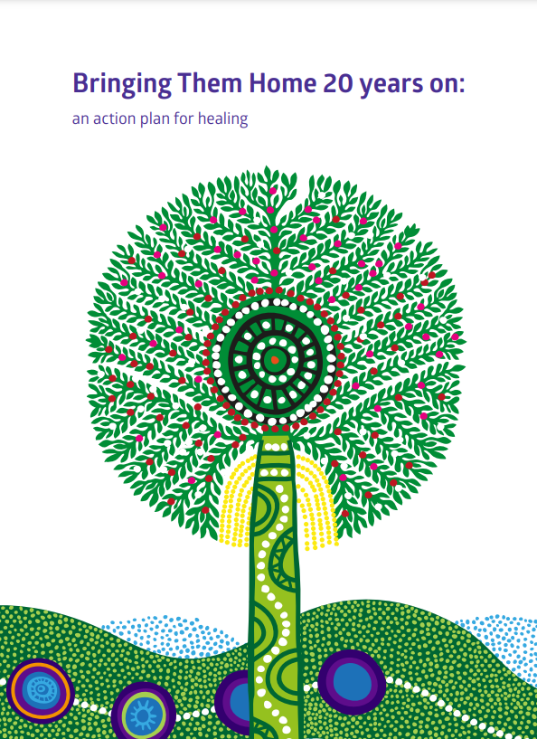
Activity: Bringing Them Home 20 Years On
What has been done about this gross violation of human rights...
Discuss the following questions:
Who are the Stolen Generations?
Where are they today?
What are the ongoing impacts of past policies?
What is meant by disproportionate disadvantage?
What has been done to put things right?
Explore The Healing Foundations’ projects.
Notes:
Link to Bringing Them Home 20 Years on report: https://healingfoundation.org.au/bringing-them-home/
There are a range of fact sheets and releases about the report that you may guide your students to use at the link above

Slide 15
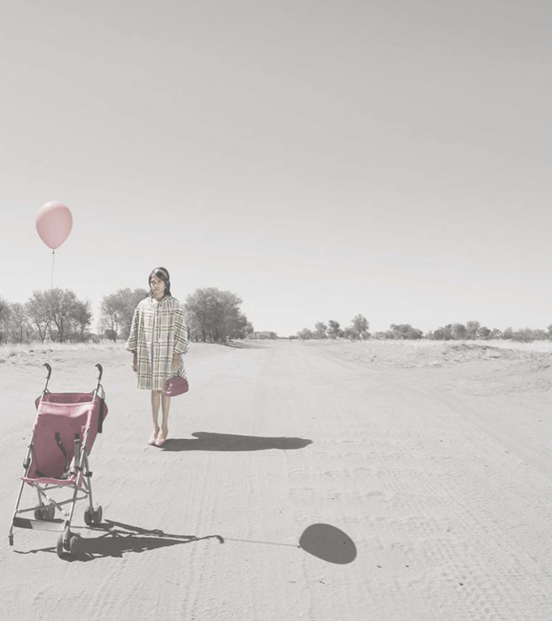
Activity 1: Mother
Notes:
Through the work of artist Michael Cook, students can explore the visual representation of emotions that are depicted in the journey of a woman in a deserted Australian landscape. The ‘mother’ is always alone, her baby absent.
Link to image: https://www.michaelcook.net.au/projects/mother

Slide 16
Cultural Safety
Open mindedness
Respect
Honest communication
Being mindful of privilege
Notes:
Remind students about their understanding of a culturally safe classroom.
Image credit: Sketchify from Canva

Slide 17
Mother by Michael Cook
Yarning circle
Look at the images from Micheal Cook's artwork series 'Mother'
Choose an image that resonates with you and remember the number on the image
By yourself, reflect on why you chose that image
Break out into smaller yarning circles with other students who chose the same image as you. Share why you chose that image.
Notes:
Create the yarning circle and discuss the cultural significance and protocol of starting and ending the class this way
Place copies of Michael Cook’s artwork series Mother on the floor inside the circle so students can see all pieces in the series. Place a Post-it note with a number from 1-7 on top of each artwork.

Slide 18
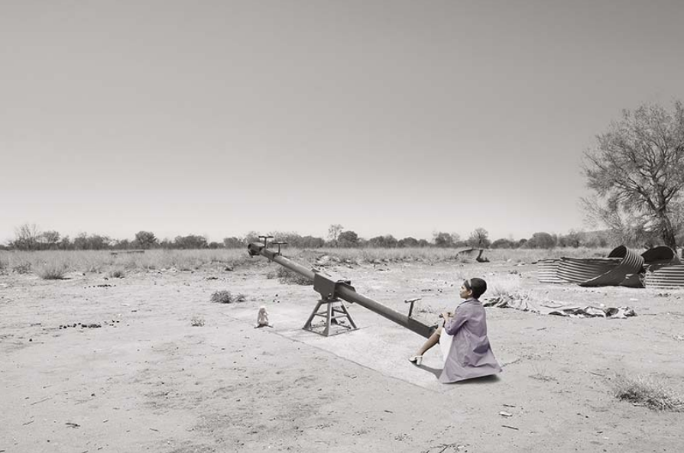
Mother by Michael Cook
In pairs, research more about Michael Cook and his artwork series: Mother.
Share your notes and findings with another pair.
Notes:
As students complete this activity, move around the room and make note of interesting and thoughtful responses from students – record these on the board as students continue discussing
Provide students with timeframes for each part of activity – e.g. 10 minutes to research in pairs, 5 minutes to discuss in groups

Slide 19
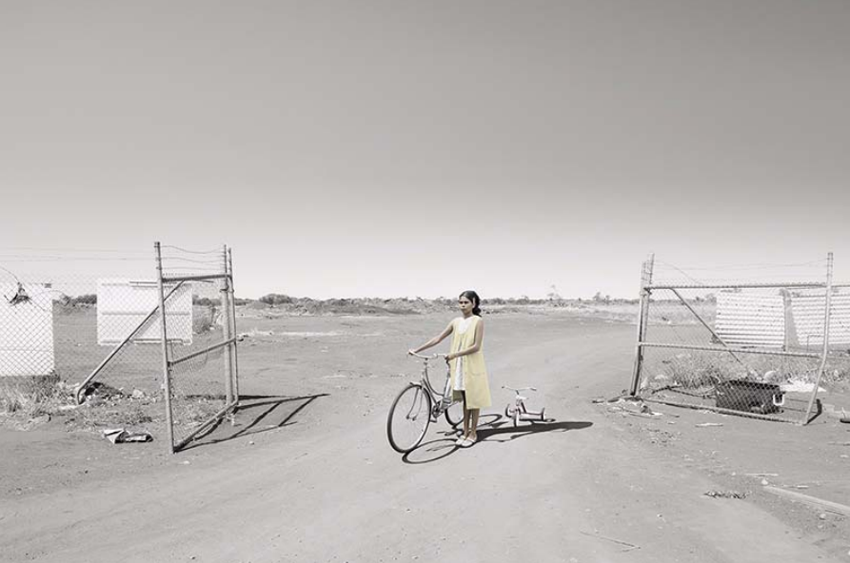
Mother by Michael Cook
Stay in your groups of 4.
Using Cook’s artwork series ‘Mother’ as stimulus respond to this quote:
‘A picture speaks a thousand words’

Slide 20
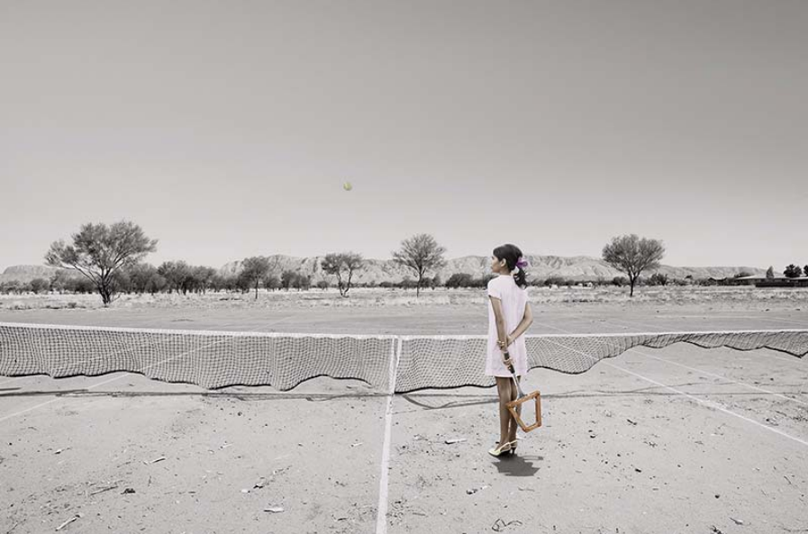
Mother by Michael Cook
Write, draw, paint or perform a response to Cook’s work and share with the class.

Slide 21
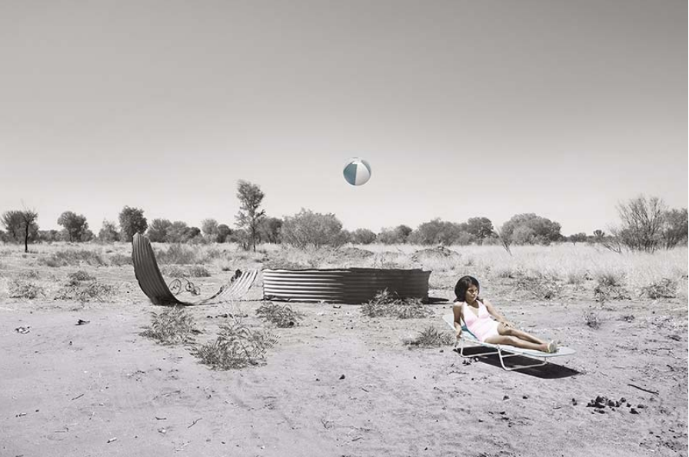
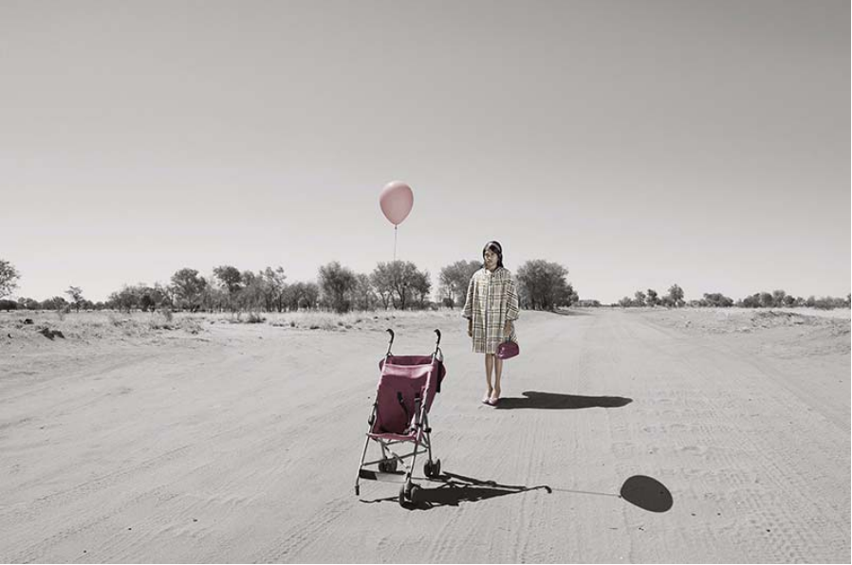
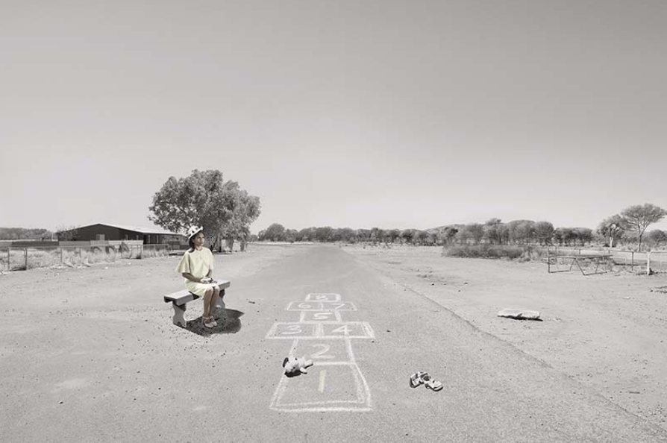
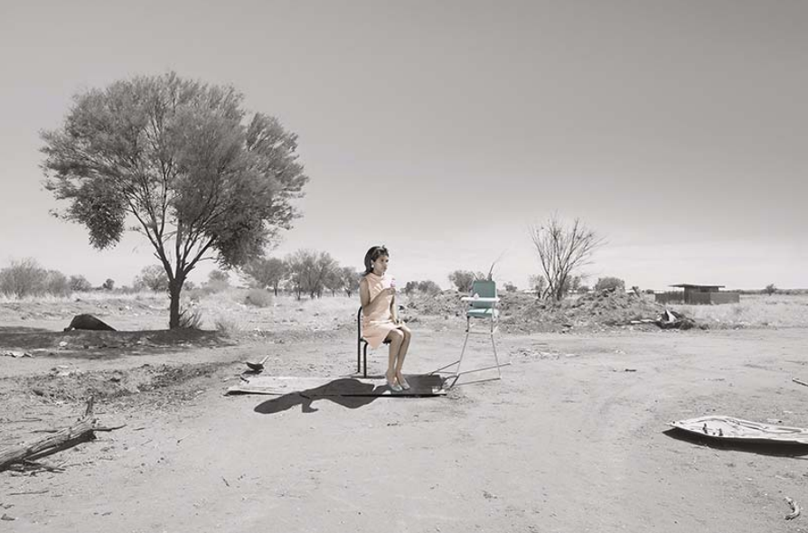
Mother by Michael Cook
Notes:
Use this slide to give students space to reflect on their learning and present what they have created.
End the session with a yarning circle, with Cook’s artwork in the middle, and share ideas, thoughts and feelings.

Slide 22

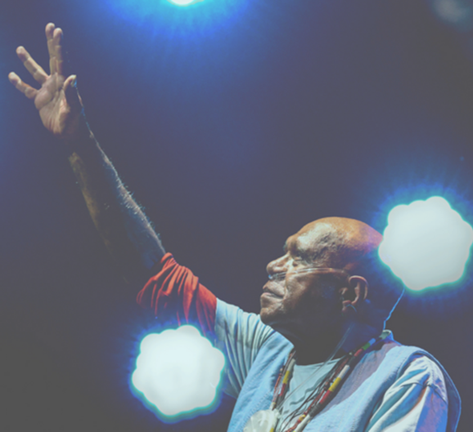

Activity 2:
The Children
Notes:
In this activity, Archie Roach’s song ‘Took the Children Away’ will lead students through an emotional journey while learning about the power of sharing your story.
Image credit: Vivid Sydney/Lisa Businovski, https://www.timeout.com/sydney/music/a-bend-in-the-river-a-tribute-to-archie-roach
Resources:
Video: Aboriginal wellbeing and resilience by Western Australia Department of Health: https://www.youtube.com/watch?v=cDYGjkcjUdg
The Healing Foundation’s interactive map of Stolen Generations institutions: https://healingfoundation.org.au/map-stolen-generations-institutions/
Marlee’s Mob intergenerational trauma comic: https://healingfoundation.org.au/resources/marlees-mob/
Video: Telling Our Stories – Tony Hansen: https://www.dropbox.com/s/ajo6870z2mga4qw/Tony%20Hansen%20delivery%20file.mp4?dl=0
Video: Telling Our Stories – Eileen Cummings: https://www.dropbox.com/sh/peagkn6vidov27l/AAB5oJHs7KAKSuaPP10gLqRFa?dl=0&preview=Eileen+After+Review+190516.mp4
Video: Telling Our Stories – Marjorie Winphil: https://www.dropbox.com/sh/peagkn6vidov27l/AAB5oJHs7KAKSuaPP10gLqRFa?dl=0&preview=Marjorie+After+Review+190516.mp4
Video: Telling Our Stories – Michael Welsh: https://www.youtube.com/watch?v=TxtJGyZhq0k&t=2s
Extra resources
Island Stories: Listening to the people of the Torres Strait: https://m.facebook.com/healingfoundation/videos/643371426523431/?refsrc=https%3A%2F%2Fm.facebook.com%2Fstory.php&_rdr

Slide 23
Cultural Safety
Open mindedness
Respect
Honest communication
Being mindful of privilege
Notes:
Remind students about their understanding of a culturally safe classroom.
Image credit: Sketchify from Canva

Slide 24
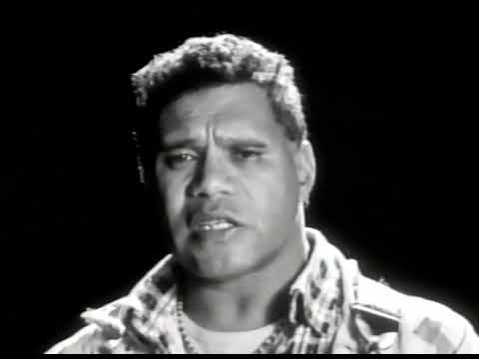
Took the Children Away – Archie Roach (1990)
Notes:
Video link: https://www.youtube.com/watch?v=IL_DBNkkcSE

Slide 25
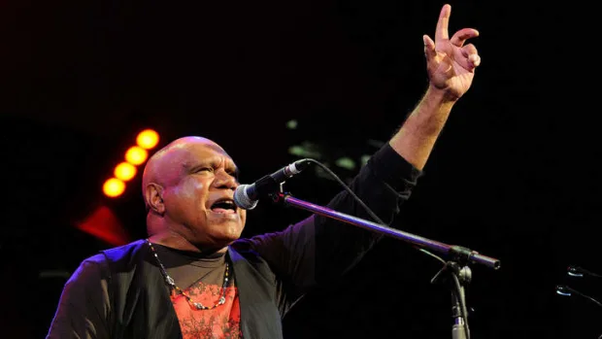
Took the Children Away – Archie Roach (1990)
Who is Archie Roach?
Why might he have written this song?
What are the main ideas of the song?
Notes:
Image credit: https://www.smh.com.au/entertainment/music/port-fairy-folk-festival-archie-roachs-emotional-homecoming-20140308-34efj.html
Assess students knowledge and then either give them 30 seconds to reflect/research before coming back to the group, or get them to answer these questions in small groups

Slide 26
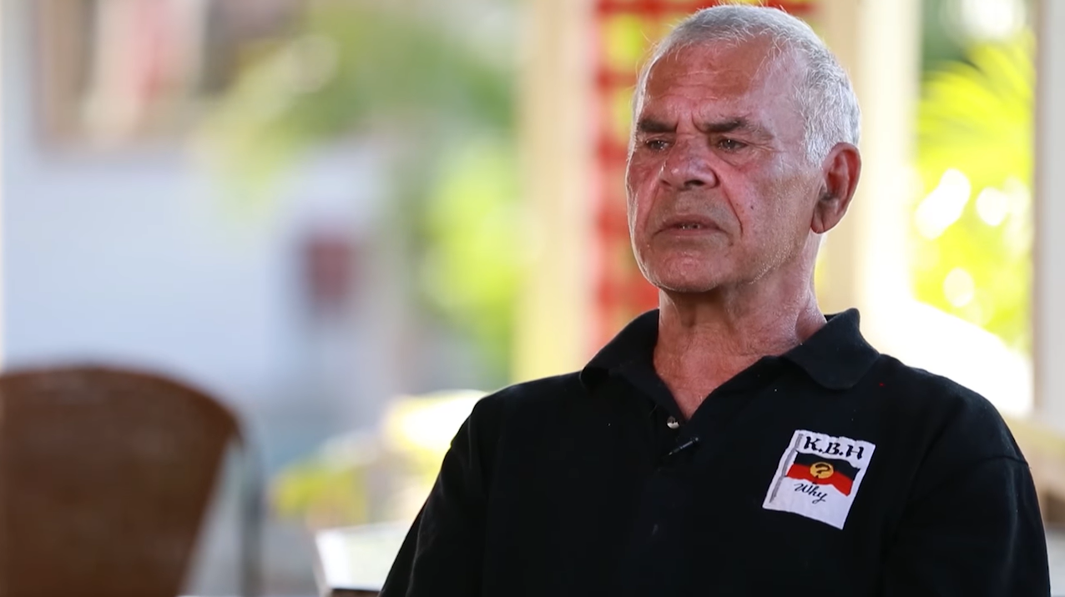
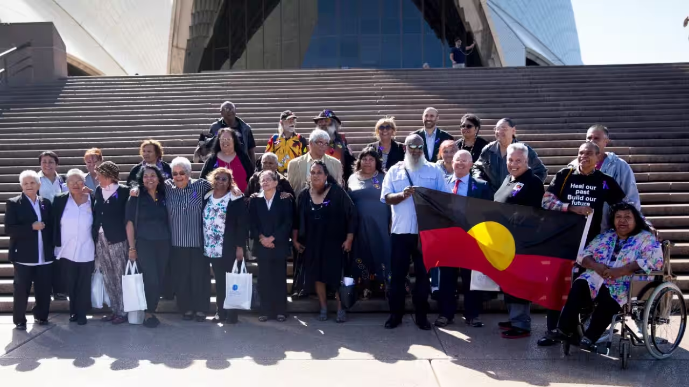
Took the Children Away
Split into two groups
Group One will watch Michael Welsh's video
Group Two will read the NITV news article, Survivors of the Stolen Generation, Still sufferers of lost Aboriginality
Notes:
Article link: https://www.sbs.com.au/nitv/the-point/article/survivors-of-the-stolen-generation-still-sufferers-of-lost-aboriginality/69u5wpi3r
Video link: https://www.youtube.com/watch?v=TxtJGyZhq0k

Slide 27
Took the Children Away
Pair up with someone from the same group as you.
Investigate the following parts of the text:
language features
text structures
stylistic choices
Find examples of emotive language and imagery in the construction of the text.
What is the impact of the text features you identified? How does that shape the reader/viewer's perspective?
Pair up with someone from another group to reflect on your answers
Notes:
Article link: https://www.sbs.com.au/nitv/the-point/article/survivors-of-the-stolen-generation-still-sufferers-of-lost-aboriginality/69u5wpi3r
Video link: https://www.youtube.com/watch?v=TxtJGyZhq0k
Provide students with a time limit for their analysis and once this time is complete, each pair should match with a pair from the other group to share their analyses

Slide 28

Reflection
Share some new knowledge you gained in this lesson.
How could this information be shared within your school and wider community?
Make an action plan.
Notes:
https://healingfoundation.org.au/stolen-generations/stolen-%20generation-projects/

Slide 29
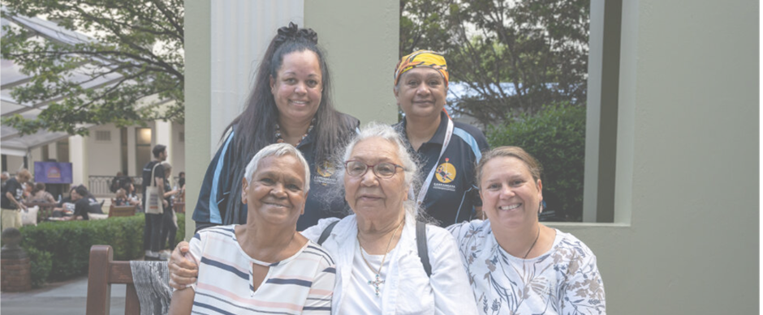
Activity 3:
Sharing story
Notes:
Sharing stories has been part of how we inspire, heal and learn as humans. Students are given time in this activity to listen deeply, understand, reflect and learn from the stories shared by survivors of the Stolen Generations.
Resources
Video: Telling Our Stories – Geoff Cooper: https://www.dropbox.com/s/zmddg8gh8u038xb/Geoff%20Option%20B.mp4?dl=0
Video: Telling Our Stories – Ian Hamm: https://www.dropbox.com/s/0cctg73scsr3eem/11%20Ian%20Hamm_Big_Assembly_07_190905%20Sound%20and%20Colour%20DB.mp4?dl=0
Video: Telling Our Stories – TJ Mia: https://www.dropbox.com/sh/qd9yrpe481dw3vx/AAApU-HX0U-kAjQ8L-l1JxLja?dl=0
Video: Telling Our Stories – Eileen Cummings: https://www.dropbox.com/sh/peagkn6vidov27l/AAB5oJHs7KAKSuaPP10gLqRFa?dl=0&preview=Eileen+After+Review+190516.mp4
Artwork: Mother by Michael Cook: https://www.michaelcook.net.au/projects/mother
Documentary: Lousy Little Sixpence: https://www.sbs.com.au/ondemand/tv-program/lousy-little-sixpence/939052099778
Marlee’s Mob intergenerational trauma comic: https://healingfoundation.org.au/resources/marlees-mob/
The Healing Foundation videos: https://healingfoundation.org.au/videos/
How to structure student discussions with a walk and talk: https://kidsdiscover.com/teacherresources/how-to-structure-student-discussions-with-a-walk-and-talk/
Extra Resources/ Further Reading
Video: The Secrets of Pecan Summer: https://www.sbs.com.au/ondemand/tv-program/the-secrets-of-pecan-summer/860269123625

Slide 30
Cultural Safety
Open mindedness
Respect
Honest communication
Being mindful of privilege
Notes:
Remind students about their understanding of a culturally safe classroom.
Image credit: Sketchify from Canva

Slide 31
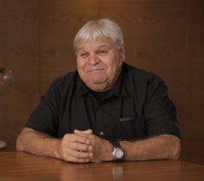
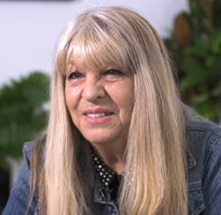
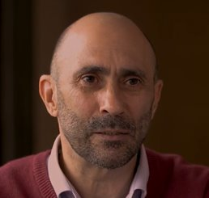
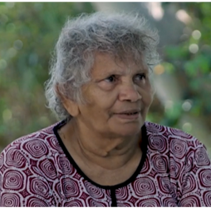
Sharing stories
In pairs, choose one of the four videos of Stolen Generations survivors.
Geoff Cooper TJ Mia Ian Hamm Eileen Cummings
Notes:
Acknowledge that everyone’s story is unique and can be expressed in many ways.
Each pair chooses one of the four videos of Stolen Generations survivors – Geoff Cooper, Ian Hamm, TJ Mia and Eileen Cummings.
Ask students to watch and discuss with their partner, recording the main ideas that were discussed in the video.
Video: Telling Our Stories – Geoff Cooper: https://www.dropbox.com/s/zmddg8gh8u038xb/Geoff%20Option%20B.mp4?dl=0
Video: Telling Our Stories – Ian Hamm: https://www.dropbox.com/s/0cctg73scsr3eem/11%20Ian%20Hamm_Big_Assembly_07_190905%20Sound%20and%20Colour%20DB.mp4?dl=0
Video: Telling Our Stories – TJ Mia: https://www.dropbox.com/sh/qd9yrpe481dw3vx/AAApU-HX0U-kAjQ8L-l1JxLja?dl=0
Video: Telling Our Stories – Eileen Cummings: https://www.dropbox.com/sh/peagkn6vidov27l/AAB5oJHs7KAKSuaPP10gLqRFa?dl=0&preview=Eileen+After+Review+190516.mp4

Slide 32
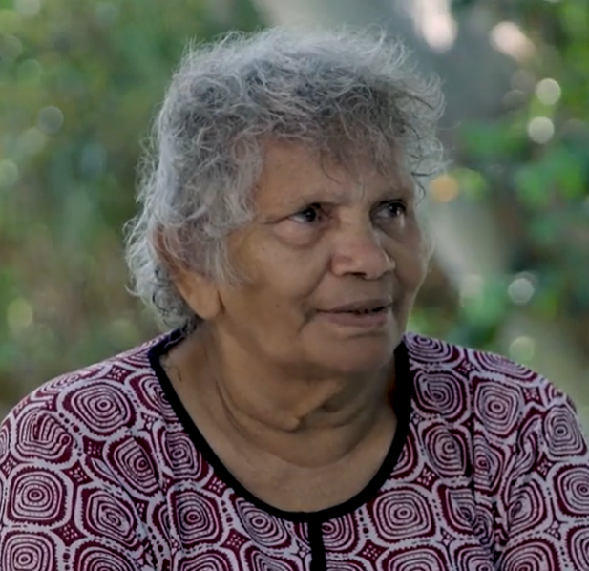


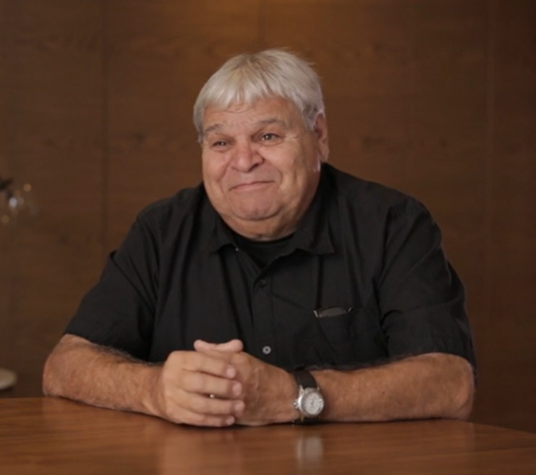
Sharing stories
Discuss with your partner any
thoughts, feelings, questions
that you have after watching the video
Notes:
After discussing in pairs, ask students to discuss with another pair who watched a different video.
Video: Telling Our Stories – Geoff Cooper: https://www.dropbox.com/s/zmddg8gh8u038xb/Geoff%20Option%20B.mp4?dl=0
Video: Telling Our Stories – Ian Hamm: https://www.dropbox.com/s/0cctg73scsr3eem/11%20Ian%20Hamm_Big_Assembly_07_190905%20Sound%20and%20Colour%20DB.mp4?dl=0
Video: Telling Our Stories – TJ Mia: https://www.dropbox.com/sh/qd9yrpe481dw3vx/AAApU-HX0U-kAjQ8L-l1JxLja?dl=0
Video: Telling Our Stories – Eileen Cummings: https://www.dropbox.com/sh/peagkn6vidov27l/AAB5oJHs7KAKSuaPP10gLqRFa?dl=0&preview=Eileen+After+Review+190516.mp4

Slide 33
Recap: Mother by Michael Cook
Notes:
Remind students of Michael Cook's Mother series and recap some of the main discussion points they had to prepare for this lesson

Slide 34
Sharing stories
Take the main ideas from the video you chose to create still and moving images in digital and multimodal texts.
Plan your text by thinking about how you will convey your own feelings and thoughts within the text you create
Think back to our discussions of Michael Cook's Mother series, comics like Marlee's Mob and documentaries such as Lousy Little Sixpence
Decide what you will create. A comic, an animation, a multimodal presentation, an art installation...
Form small groups and share your ideas, giving each other feedback and developing your creations further
Notes:
Michael Cook's Mother: https://www.michaelcook.net.au/projects/mother
Marlee's mob: https://healingfoundation.org.au/resources/marlees-mob/
Lousy Little Sixpence: https://www.sbs.com.au/ondemand/tv-program/lousy-little-sixpence/939052099778
The final creation can be tailored to the skills/assessment criteria of your class

Slide 35
Sharing stories
Why is it important that we share our own stories of happiness, grief and triumph with others? What can we all learn by doing this?
Social media is a way many people share their own stories. How do we make sure we respect each other's stories?
Why is it important not to retell other peoples' stories (unless you have permission)?
Notes:
Use these questions to deepen the thoughts and discussions of your class
Investigate some examples (e.g. any of the Stolen Generations videos, or stories from individuals from your
community)

Slide 36
Conclusion
Reflect on today's learning
Notes:
To end the lesson run a walk and talk session to unpack and debrief what students have discussed today. You may also run this as a yarning circle.
Conclude by highlighting how students can continue this learning

Slide 37
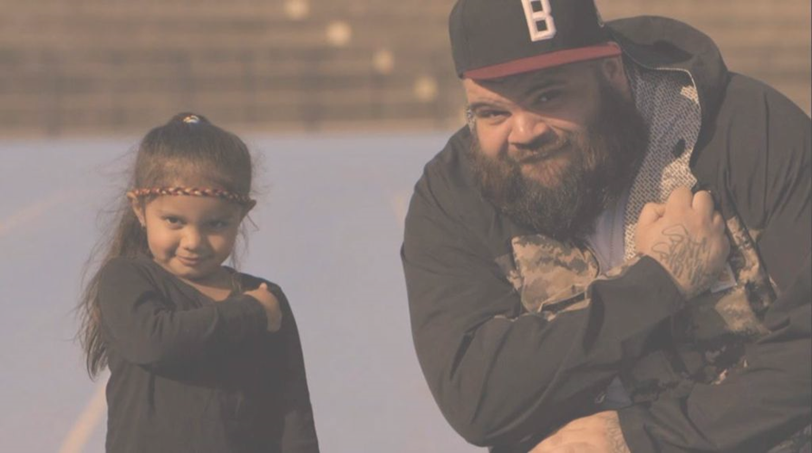
Activity 4:
The Children Came Back
Notes:
In this activity, students will have the opportunity to explore the resilience of spirit through song and story.
Image credit: https://musicfeeds.com.au/news/briggs-shares-powerful-music-video-for-the-children-came-back/
Resources
Yarning Circles in the Literacy Classroom: https://eprints.qut.edu.au/219456/1/61361.pdf
Lyrics to ‘Took the Children Away’ by Archie Roach: https://www.lyrics.com/lyric/4503696/Archie+Roach/Took+the+Children+Away
Video: Telling Our Stories – Brian Gray: https://www.dropbox.com/s/2nwk0qiqkvqshdu/Brian%27s%20Story1st%20film.mp4?dl=0
Video: Joyce Napurrula Schroeder: https://www.dropbox.com/sh/peagkn6vidov27l/AAB5oJHs7KAKSuaPP10gLqRFa?dl=0&preview=Joyce+After+Review+190516.mp4
Video: Briggs – ‘The Children Came Back’ (featuring Gurrumul and Dewayne Everettsmith): https://www.youtube.com/watch?v=3-wMbFntrTo
Extra Resources/Further Reading
Singing Trauma Trails: Songs of the Stolen Generations in Indigenous Australia: https://quod.lib.umich.edu/m/mp/9460447.0004.202/--singing-trauma-trails-songs-of-the-stolen-generations?rgn=main;view=fulltext
Murundak – Songs of Freedom. The full film can be accessed via Kanopy using your school or local library to log in: https://www.kanopy.com/en/product/murundak-songs-freedom-0

Slide 38
Cultural Safety
Open mindedness
Respect
Honest communication
Being mindful of privilege
Notes:
Remind students about their understanding of a culturally safe classroom.
Image credit: Sketchify from Canva

Slide 39
Yarning Circle
Notes:
Begin by forming a yarning circle and discussing the cultural significance of this protocol.
Refer back to the lesson where we discussed Archie Roach’s song ‘Took the Children Away’ before playing the video

Slide 40
Took the Children Away – Archie Roach (1990)
Notes:
Video link: https://www.youtube.com/watch?v=IL_DBNkkcSE

Slide 41
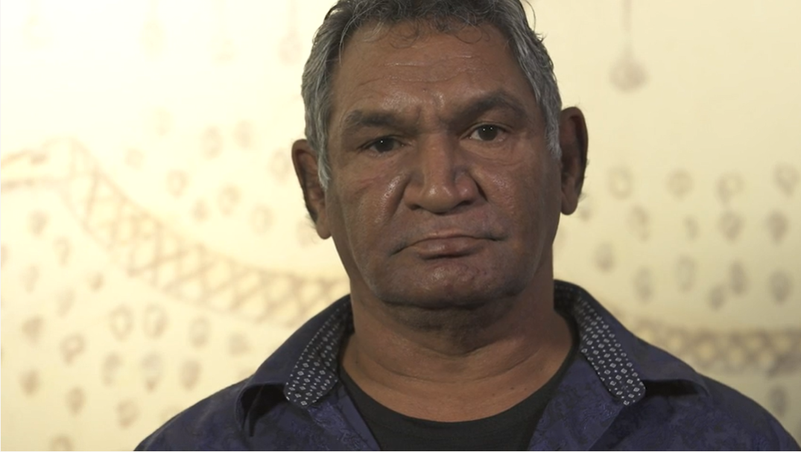
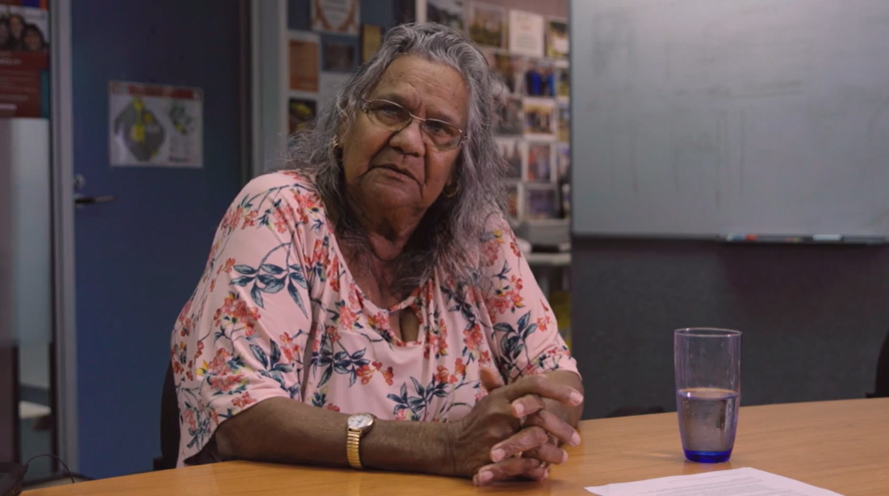
The Children Came Back
In pairs, choose one of the video from either:
Brian or Joyce
Discuss your feelings and thoughts after watching the video.
Write down the main ideas addressed in Brian’s or Joyce’s video.
Notes:
Brian's video: https://www.dropbox.com/s/2nwk0qiqkvqshdu/Brian%27s%20Story1st%20film.mp4?dl=0
Joyce's video: https://www.dropbox.com/sh/peagkn6vidov27l/AAB5oJHs7KAKSuaPP10gLqRFa?dl=0&preview=Joyce+After+Review+190516.mp4

Slide 42
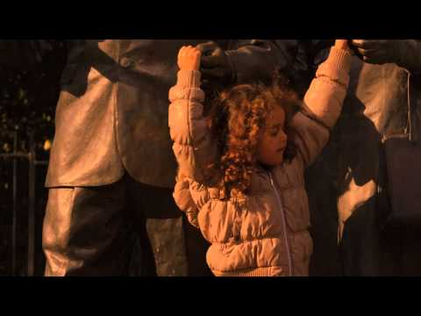
The Children Came Back by Briggs feat. Gurrumul and Dewayne Everettsmith
Notes:
Video: https://www.youtube.com/watch?v=3-wMbFntrTo
Keep students in existing pairs to watch The Children Came Back as a class

Slide 43
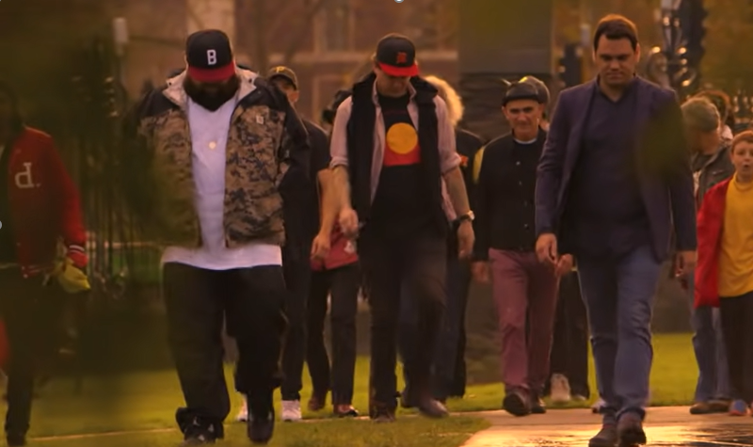
The Children Came Back
In your pairs, write down the main ideas and your thoughts and feelings about The Children Came Back
Find another pair and discuss your notes with each other, picking one or two key ideas to share with the class
Notes:
Use the class discussion to highlight similar themes, as well as differences, across the groups of students.
Encourage links back to Archie Roach's Took the Children Away
Image credit: https://www.youtube.com/watch?v=3-wMbFntrTo

Slide 44
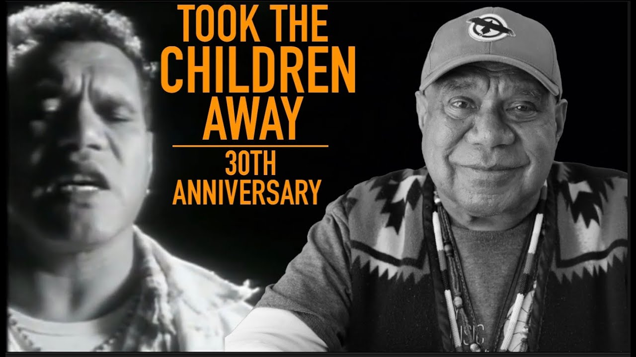
The Children Came Back
What are the main messages coming through from each text?
What similarities did you find?
What differences did you find?
How do these stories link to the concept of 'resilience'?
Why is it important to share these stories and songs?
Notes:
Discuss the questions as a class. Give students time to chat in pairs first if needed.
Image credit top: https://www.youtube.com/watch?v=3-wMbFntrTo
Image credit bottom: https://www.youtube.com/watch?v=UhSBHSuFNtU

Slide 45
Yarning Circle
Reflection:
What have you learnt?
What would you still like to know?
Is it important for all Australians to understand the significance of the Stolen Generations to the history of Australia?
Why?
Why is it important to highlight the resilience of Stolen Generations survivors?
Notes:
Restate the cultural significance of yarning circle as a way to debrief and remind students about cultural safety if needed

Slide 46
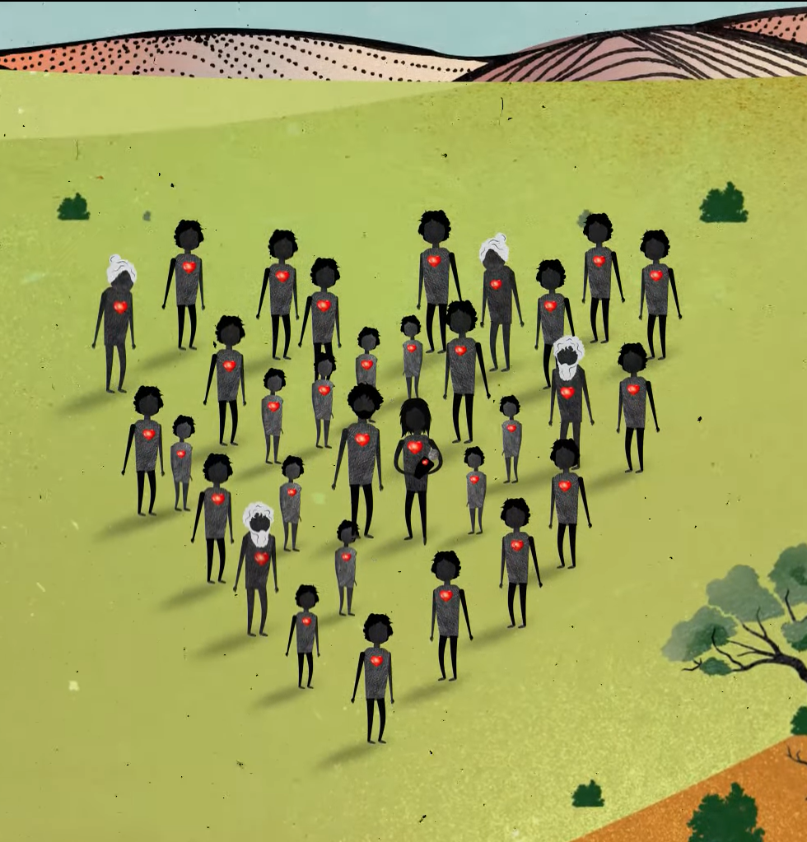
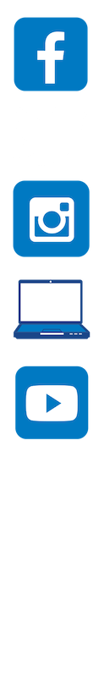
Contact The Healing Foundation
@HealingFoundation
@healingourway
@healingourway
www.healingfoundation.org.au
Healing Foundation
Notes:
Consider:
Sharing your outcomes and experience with The Healing Foundation at resources@healingfoundation.org.au
Sharing the resource and how you used it amongst your networks.
Sharing your students’ learning journey and tag The Healing Foundation on Instagram @healingourway and on Facebook as ‘Healing Foundation’.

