Slide 1
Year 5

Slide 2
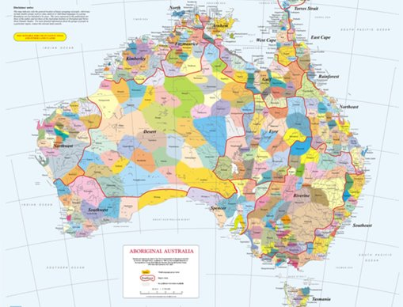
Acknowledgement
[Name of school/class] acknowledges Country, Custodians and Community of the lands on which we are on today [insert name of land/ peoples].
We also pay our respects to Elders and to Stolen Generations survivors, of the Dreaming and of the here and now.
We recognise the ongoing nature of trauma experiences for First Nations peoples and commit each day to survivor-led intergenerational healing.
Notes:
Update this slide with the name of your school/ class and the name of the land/s on which you're presenting the lesson on.
You may choose to make the wording of this acknowledgement more specific to your land/school/experiences. The acknowledgement isn't a script that we have to follow, you may even introduce the unit by working with students to write an acknowledgement for your class.
Image credit: https://ipaustralia.libguides.com/c.php?g=451400&p=3082380

Slide 3
Aboriginal and Torres Strait Islander students and teachers should be aware that these resources may contain the names, images, and voices of deceased persons.
Notes:
Important to remind students to speak up if they are feeling discomfort, and any safety and wellbeing measures your school has in place.

Slide 4
Care and safety
These lessons might include some content that is confronting or overwhelming
We all need to understand a full history of Australia, including the experiences of Stolen Generations survivors, their families and communities, and the impacts of past government policies that are still being felt today
It is important to speak to me or another adult if at any point you feel distressed – we are all here to learn together and keep each other safe.
Notes:
Important to remind students to speak up if they are feeling discomfort, and any safety and wellbeing measures your school has in place.
This is also a good place to ask the cultural safety questions from the educator's guide so you can co-construct a culturally safe space with your students.

Slide 5
Healing together
Why is learning about the Stolen Generations important?
to change the way we look at our collective history.
to support reconciliation and an honest understanding of our past – not just one perspective.
to become aware of past government policies that still affect many Aboriginal and Torres Strait Islander peoples and families today.
Notes:
Give students a chance to suggest why they think the learning is important before clicking through to the reasons.

Slide 6
Overview: this week’s activities
ACTIVITY 1: LITERATURE INTRODUCTION (40–60 MINUTES)
Teacher leads students in a guided reading session. Students respond to questions about the text and create one-word responses as a group.
ACTIVITY 2: POETRY RESPONSE (40–60 MINUTES)
Students read and analyse contemporary poems by Indigenous poets and participate in group discussions to compare and contrast the poems.
ACTIVITY 3: RESEARCH TASK (60–80 MINUTES)
Students work in groups to draw information from a variety of sources.
ACTIVITY 4: POETRY RESPONSE TO LEARNING (40–60 MINUTES)
Students reflect on and share their learning by writing a poem and creating a poster for display.
Notes:
OPTIONAL SLIDE
Update week to timeframe for these teaching activities in consideration of class schedule and activity time.

Slide 7
Cultural Safety
How does a safe classroom look to you?
How does it feel?
How can we be culturally safe?
Notes:
You may have already established this as a class, if so, use this time to reiterate the class rules.
Begin a discussion about cultural safety with the class. Ask them to answer the questions in a 'think/pair/share' activity, or address them as a group.
Use the final question to lead in to the next slide.

Slide 8

Cultural Safety
Open mindedness
Respect
Honest communication
Being mindful of privilege
Notes:
A culturally safe classroom environment relies on open-mindedness, respect and honest communication.
Make any changes needed for this discussion to be age-appropriate for your class
Image credit: Sketchify from Canva

Slide 9

Terminology
Sorry
Country
Aboriginal
Reconciliation
Colonisation
Culture
Torres Strait Islander
Notes:
Optional: Use to guide the creation of a word wall

Slide 10
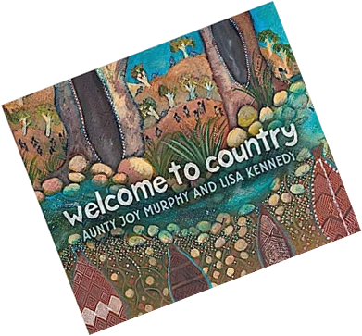

Activity 1: Literature Introduction
Notes:
Teacher leads students in a guided reading session. Students respond to questions about the text and create one-word responses as a group.
Resources
Suggested books:
Welcome to Country by Aunty Joy Murphy and Lisa Kennedy.
My Country by Ezekiel Kwaymullina and Sally Morgan.
Video of Aunty Joy Murphy Welcome to Country.
Pens/sharpies.
Three large pieces of card with one question per card:
What is country/place to Aboriginal and Torres Strait Islander peoples?
Why is country important to Aboriginal and Torres Strait Islander people?
How do Aboriginal and Torres Strait Islander peoples care for Country/place?
A5 cardboard (enough for each group to have three pieces).
Butchers’ paper for group recording.
Digital version of AIATSIS map of Indigenous Australia.

Slide 11
Aboriginal and Torres Strait Islander Culture and history:
What do you know?
Notes:
Encourage students to share what they know about the Aboriginal and Torres Strait Islander culture and history.
This is also a good point to explain appropriate terms we will be using during this unit.
If students bring up the Stolen Generations, this is a good time to move on to the next slide.

Slide 12
The Stolen Generations:
What do you know?
Notes:
Encourage students to share what they know about the Stolen Generations. Use the next slide to explain what happened in more detail.

Slide 13
The Stolen Generations
For about a century, thousands of First Nations children were systematically taken from their families, communities and culture, many never to be returned. These children are known as Stolen Generations survivors.
Notes:
More information:
First Nations children were removed by government authorities from the mid-1800s to the 1970s. In the 1860s, Victoria became the first state to pass laws authorising the removal of First Nations children from their families.
Similar policies were later adopted by other states and territories – and by the federal government when it was established in the 1900s.
For about a century, thousands of children were taken from their families, communities and culture, many never to be returned.
These children are known as Stolen Generations survivors, or Stolen Children. They were taken by the police, from their homes, and on their way to or from school, and placed in more than 480 institutions, adopted or fostered by non-Indigenous people and often subjected to abuse. The children were denied all access to their culture, they were not allowed to speak their language and they were punished if they did.
There are currently more than 33,000 Stolen Generations survivors in Australia. More than one third of all First Nations peoples are their descendants. In Western Australia, more than half of the population have Stolen Generation links.

Slide 14
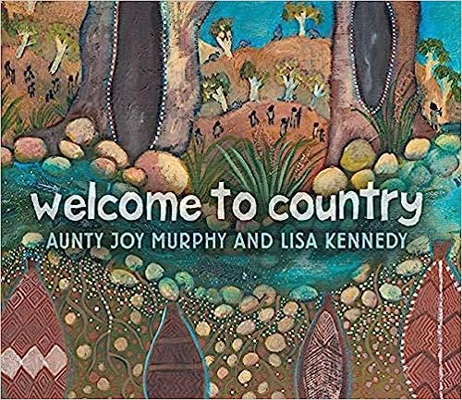
Read book: Welcome to Country by Aunty Joy and Lisa Kennedy
Notes:
OPTIONAL: May choose other book to read
Read Welcome to Country by Aunty Joy Murphy and Lisa Kennedy
Facilitate a class discussion. You might ask:
What did you like about the story?
What did you learn from the story?
Are there any words in the story that are new to you?
Use a sentence to describe how the book made you feel.
How does the book use illustration to help us feel something? Is there a particular illustration that made you feel something?
Do you recognise any parts of the book as a part of Australian history?

Slide 15
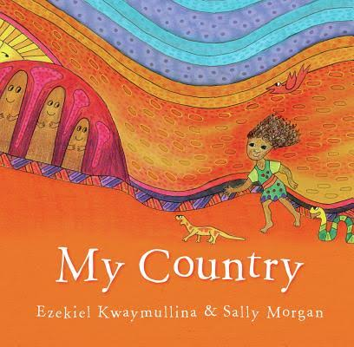
Read book: My Country by Ezekiel Kwaymullina and Sally Morgan
Notes:
OPTIONAL: May choose other book to read
Read My Country by Ezekiel Kwaymullina and Sally Morgan
Facilitate a class discussion. You might ask:
What did you like about the story?
What did you learn from the story?
Are there any words in the story that are new to you?
Use a sentence to describe how the book made you feel.
How does the book use illustration to help us feel something? Is there a particular illustration that made you feel something?
Do you recognise any parts of the book as a part of Australian history?

Slide 16
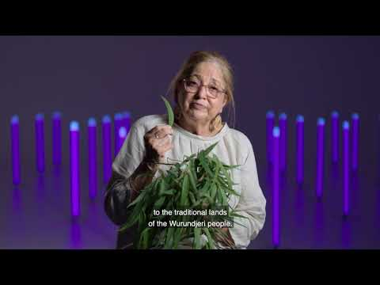
Video: Welcome to Country by Aunty Joy
Notes:
Link: https://www.youtube.com/watch?v=i9ta1EQJYqE
Watch Video: Welcome to Country by Aunty Joy Murphy

Slide 17
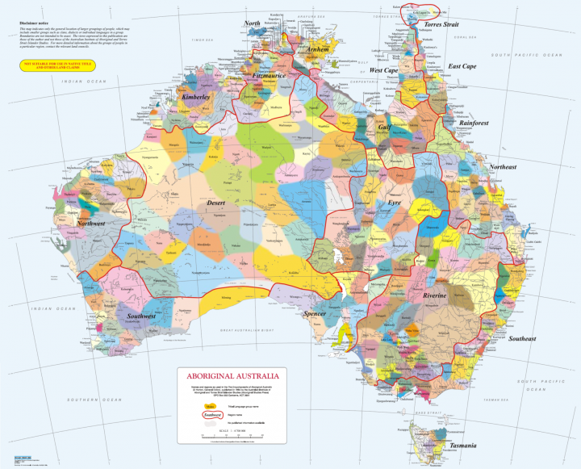
Notes:
Show students the Digital version of AIATSIS map of Indigenous Australia and explain:
There are more than 250 traditional and distinct Aboriginal and Torres Strait Islander languages across Australia. Each colour on this map represents a distinct linguistic-cultural community. Each community has their own cultural protocols and practices and a distinct connection to country. Be prepared to answer questions and discuss
this topic.
Click on the image of the map to follow the link to the AIATSIS map that can be zoomed in on.
Find Wurundjeri (Aunty Joy Murphy’s country) on the digital map of Indigenous Australia (Victoria area)
Find your own area and determine the country.
Link for map: https://aiatsis.gov.au/aboriginal-studies-press/products/aiatsis-map-indigenous-Australia
Image source: https://reconciliationsa.org.au/aiatsis-map-of-indigenous-australia/

Slide 18
One word group response
In groups, answer:
What does country/place mean to Aboriginal and Torres Strait Islander people?
Why is it important to Aboriginal and Torres Strait Islander people?
How do Aboriginal and Torres Strait Islander people care for country/place?
Notes:
Break students into small groups and distribute three pieces of card and a sharpie or pen to each group.
Group must discuss and come to a consensus on a one word answer to each question.
Groups write their one word response to each question on a piece of card.

Slide 19
One word group response
What does country/place mean to Aboriginal and Torres Strait Islander people?
Why is it important to Aboriginal and Torres Strait Islander people?
How do Aboriginal and Torres Strait Islander people care for country/place?
Notes:
Bring the class back together and read out each question, having groups respond with their word and adding it to the wall under the original question card.

Slide 20
Book quote: Nourishing Terrains by Deborah Bird Rose:
“Country in Aboriginal English is not only a common noun but also a proper noun. People talk about country in the same way that they would talk about a person: they speak to country, sing to country, visit country, worry about country, feel sorry for country, and long for country. People say that country knows, hears, smells, takes notice, takes care, is sorry or happy. Country is not a generalised or undifferentiated type of place, such as one might indicate with terms like ‘spending a day in the country’ or ‘going up the country’. Rather, country is a living entity with a yesterday, today and tomorrow, with a consciousness, and a will toward life.”
Notes:
Display and read the quote above
Facilitate a discussion about the quote, including clarifying any new or unfamiliar words. Discuss the students’ word choices again in the context of the quote.
Now that students have a beginning understanding of the importance of country/place to Aboriginal and Torres Strait Islander people, they need to consider this question:
What do you think the impact would be for Aboriginal and Torres Strait Islander people when they are removed from their country/place?
Write this question on card and display it on the classroom wall.
Add any new words to the classroom word wall.

Slide 21

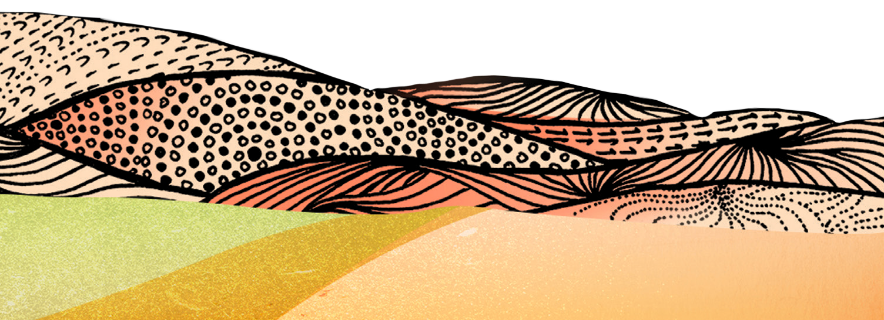

Activity 2:
Poetry Response
Notes:
Students read and analyse contemporary poems by Indigenous poets and participate in group discussions to compare and contrast the poems.
Resources
Suggested book: Sister Heart by Sally Morgan. This is a chapter book written in prose so it is suggested that you read this book in sections over the next three activities.
Response to Poetry Worksheet (Worksheet 1).
For your own background knowledge read Poetry in First Languages.
Poems from three contemporary Aboriginal and Torres Strait Islander writers (you will need to print out sets of each poem so there are enough for each student in a group).
Words and Audio of Adrian Webster reading Baladjarang.
Words of Ngurrparringu (Forgotten) by Matthew Heffernan (with assistance from Lavinia Heffernan).
Words of Ban Maganindadjyang (My Old People Done) by Jacob Morris.

Slide 22

Read book: Sister Heart by Sally Morgan
Notes:
Continue reading Sister Heart by Sally Morgan. This is a chapter book written in prose so it is suggested that you read this book in sections.
Facilitate a class discussion. You might ask:
What did you like about the story?
What did you learn from the story?
Are there any words in the story that are new to you?
Use a sentence to describe how the book made you feel.

Slide 23
Inquiry questions
What is the significance of country/place to Aboriginal and Torres Strait Islander people?
What was and is the impact for Aboriginal and Torres Strait Islander people when they experience loss of country through removal?
Notes:
Introduce topic to students:
Today you will be looking at three contemporary poems by Aboriginal authors and comparing and contrasting them in discussion groups to consider our inquiry Questions.
Introduce the three poems on next slides.

Slide 24
Poem 1: Baladjarang by Adrian Webster
Poem 2: Ban Maganindadjyang (My Old People Done) by Jacob Morris
Poem 3: Ngurrparringu (Forgotten)
by Matthew Heffernan
Notes:
Split class into three groups and give each one of the poems.
Distribute Response to Poetry (Worksheet 1) and discuss any unfamiliar terms on the worksheet.
Separate students into three groups and explain the activity.
Each group will read and analyse one poem
Each student in the group will need a copy of the poem and their own worksheet.
Link to poem: https://redroompoetry.org/poets/adrian-webster/baladjarang/
Link to poem: https://redroompoetry.org/poets/matthew-heffernan/ngurrparringu-forgotten/
Link to poem: https://redroompoetry.org/poets/jacob-morris/ban-maganindadjyang-my-old-people-done/

Slide 25
Poetry Analysis
Read through your poem
Discuss the poem with 1-2 other people in your group
Answer the questions on the worksheet
Poem 1: Baladjarang by Adrian Webster
Poem 2: Ban Maganindadjyang (My Old People Done) by Jacob Morris
Poem 3: Ngurrparringu (Forgotten)
by Matthew Heffernan
Notes:
Give each group time to read and discuss their poem and complete their worksheet individually.
Students can work in small groups within their larger group if this is more manageable.

Slide 26
Poetry Analysis – New Groups
In new discussion groups:
Each person in the group will introduce and read their poem to the group
Discuss how the poem relates to and reflects the inquiry questions.
Inquiry questions:
What is the significance of Country/place to Aboriginal and Torres Strait Islander people?
What was and is the impact for Aboriginal and Torres Strait Islander people when they experience loss of Country through removal?
Notes:
Once groups have had sufficient time, create new groups for discussion. Each new group will have three members, a representative from the original three poetry groups. If you have uneven numbers you can also have a group of two or a group of four and students from the same poetry group can share together.
To prompt discussion, you could ask groups to consider:
Which poem did you like best and why?
What do the poems all have in common?
How are they different?
Do you think it is important that these poems are in first languages? Why?

Slide 27
Conclusion:
Share thoughts and feelings
Notes:
Bring class back together and facilitate a discussion. The group can compare and contrast their poems and share thoughts and feelings on reading the poems.
You may also like to play the audio of the authors reading their poetry available at each of the links below:
Link to poem: https://redroompoetry.org/poets/adrian-webster/baladjarang/
Link to poem: https://redroompoetry.org/poets/matthew-heffernan/ngurrparringu-forgotten/
Link to poem: https://redroompoetry.org/poets/jacob-morris/ban-maganindadjyang-my-old-people-done/

Slide 28
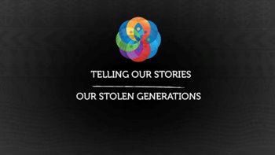
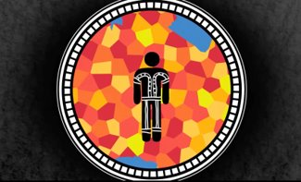
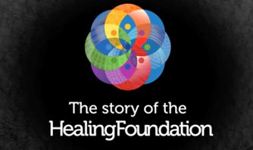
Activity 3: Research Task
Notes:
Students work in groups to draw information from a variety of sources.
Resources
Suggested book: continue reading Sister Heart by Sally Morgan (or Down the Hole by Edna Tantjingu Williams, Eileen Wani Wingfield and Kunyi June-Anne McInerney).
Significance of Country worksheet (Worksheet 2).
Suggested resources for research stations:
Station 1: Video (iPad or computer).
The Story of The Healing Foundation video.
Telling our Stories: Gwen Schreiber.
Station 2: Artwork and artist’s statement (print multiple copies for ease of use or display on iPads or computer).
Healing Country by Riki Salam (artwork and information about the artwork) Appendix 1 and 2.
Station 3: Excerpt from book (print multiple copies).
Boorn − Taproot by Tjalaminu Mia from Remembered by Heart edited by Sally Morgan.
Station 4: News articles related to Country (to find more news articles, visit the NITV website and search for Country/place) e.g. Gubbi Gubbi ‘Welcome Baby to Country’ ceremony revived.
Note: As Activity 3 is a more involved lesson, it can continue into Activity 4 if required.

Slide 29
Read book: Sister Heart by Sally Morgan
Notes:
Continue reading Sister Heart by Sally Morgan. This is a chapter book written in prose so it is suggested that you read this book in sections.
Facilitate a class discussion. You might ask:
What did you like about the story?
What did you learn from the story?
Are there any words in the story that are new to you?
Use a sentence to describe how the book made you feel.

Slide 30
Inquiry questions
What is the significance of country/place to Aboriginal and Torres Strait Islander people?
What was and is the impact for Aboriginal and Torres Strait Islander people when they experience loss of country through removal?
Notes:
Remind students of the topic and the previous activity.
Introduce the activity. Students will move in groups around the four stations, looking at both primary and secondary sources and individually completing the worksheet.

Slide 31
Research Task
Primary Resource:
Secondary Resource:
A description of an event from someone who was there to experience it.
A description of an event based on research or told by someone who was NOT there to see it.
Notes:
Check for understanding of primary and secondary sources.

Slide 32
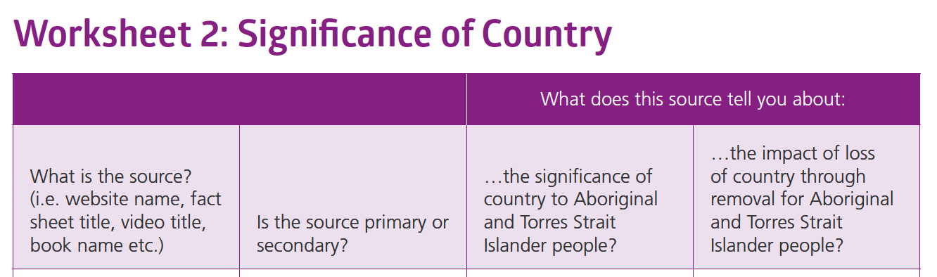
Research Task
Station 1:
Videos: The Story of The Healing Foundation and Telling our Stories: Gwen Schrieber
Station 2:
Artwork: Healing Country by Riki Salam
Station 3:
Book: Boorn − Taproot by Tjalaminu Mia from Remembered by Heart edited by Sally Morgan
Station 4:
News Articles related to country
Notes:
Break the students into four groups. Distribute worksheet.
Send groups to their first research station. Move around the room supporting groups as they find information in sources.
Students may need up to 20 minutes at each station to read or view the source and analyse the information.
Once you feel that all groups have made good progress, move them around to the next station.
Continue the rotations until groups have been to every station.
Note: As Activity 3 is a more involved lesson, it can continue into Activity 4 if required.

Slide 33
Conclusion:
Discuss sources and information
Notes:
Bring class back together to discuss sources and information.
Students should keep their research sheets for reference in a later activity.

Slide 34
Activity 4:
Poetry response to learning
Notes:
Orient the students to today's lesson. Students reflect on and share their learning by writing a poem and creating a poster for display.
Resources
Suggested book: finish reading Sister Heart by Sally Morgan (or Why I love Australia by Bronwyn Bancroft).
Completed Significance of Country worksheet for reference.
One word responses from Activity 1 for reference.
Writing paper for drafts of poetry.
A3 cardboard, coloured paper, markers, pencils, scissors, glue.

Slide 35
Read book: Sister Heart by Sally Morgan
Notes:
Finish reading Sister Heart by Sally Morgan.
Facilitate a class discussion. You might ask:
What did you like about the story?
What did you learn from the story?
Are there any words in the story that are new to you?
Use a sentence to describe how the book made you feel.

Slide 36
Acrostic Poem
Choose one word related to your learning on this topic.
Some suggested words:
COUNTRY
PLACE
STOLEN
What others are there?
Create a draft
Edit your draft
Swap with someone else to give feedback to each other
Create a good copy on a poster
Decorate with artwork and illustrations
Remember not to recreate Aboriginal and Torres Strait Islander art forms.
Notes:
Introduce students to the task. They are going to reflect on what they have been learning by writing an acrostic poem using a word of their choice related to our learning.
Show students some examples of acrostic poems or model writing an acrostic poem using a simple word.
Note: you are welcome to allow students to write poetry in any genre if they are familiar with it (e.g. free verse, haiku, rhyming). Acrostic poetry has been chosen for this activity as it is an easier form to explain to students.
Students need to choose a word that is related to their learning on this topic and use the word to write an acrostic poem.
Clarify for students that the poem must be a reflection of what they have learnt about this week, rather than an attempt to write from the point of view of an Aboriginal and Torres Strait Islander person.
Students create a draft of their poem and edit their work.
Students can consult with you and their peers to check their draft.
Students create a good copy poster of their poem on A3 cardboard and include artwork or illustrations.
Remind students that it is not appropriate to recreate Aboriginal and Torres Strait Islander art forms.

Slide 37
Conclusion:
Share your poem posters
Notes:
Students share their poem posters with a class.
To legitimise the activity, students can display their poem posters during parade or in the school library.

Slide 38
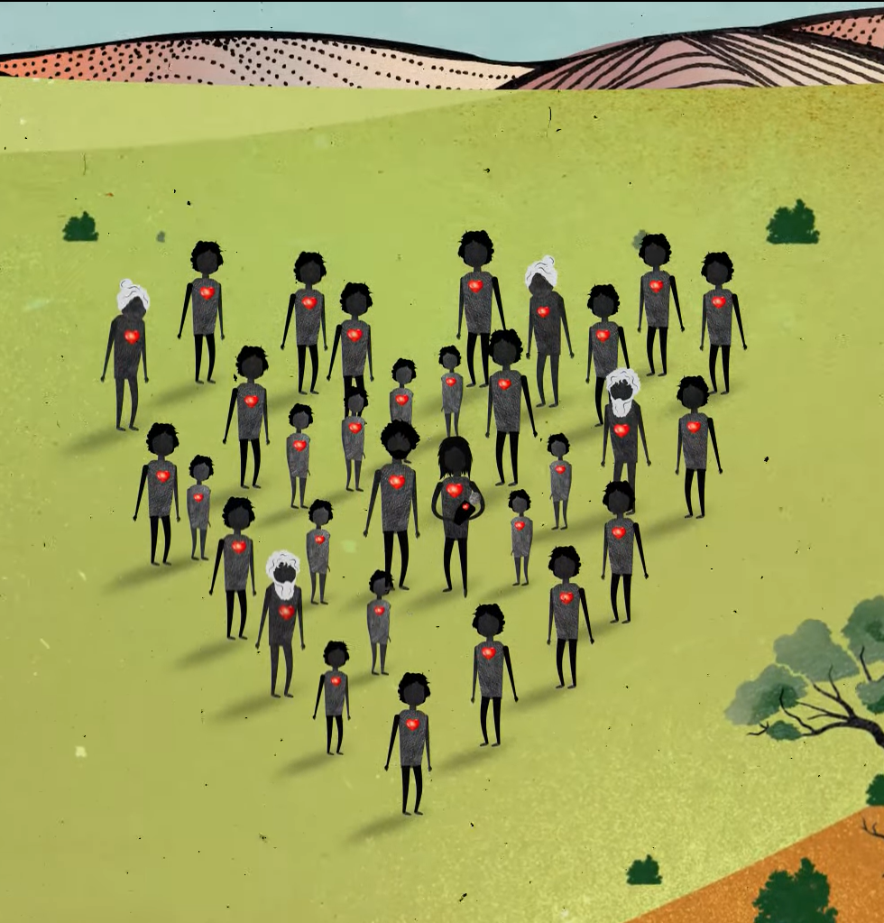

Contact The Healing Foundation
@HealingFoundation
@healingourway
@healingourway
www.healingfoundation.org.au
Healing Foundation
Notes:
Consider:
Sharing your outcomes and experience with The Healing Foundation at resources@healingfoundation.org.au
Sharing the resource and how you used it amongst your networks.
Sharing your students’ learning journey and tag The Healing Foundation on Instagram @healingourway and on Facebook as ‘Healing Foundation’.

